Slide 1
Edge Detection
6.344 Final Project
Michael Mekonnen

Slide 2
Outline
Gradient-based method
Description
Examples
Laplacian-based method
Description
Examples
Comparison

Slide 3
Gradient-based method

Slide 4
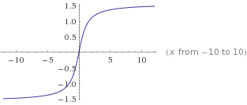
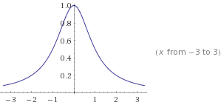
Gradient-based method Motivation
f(x)
df(x)/dx

Slide 5
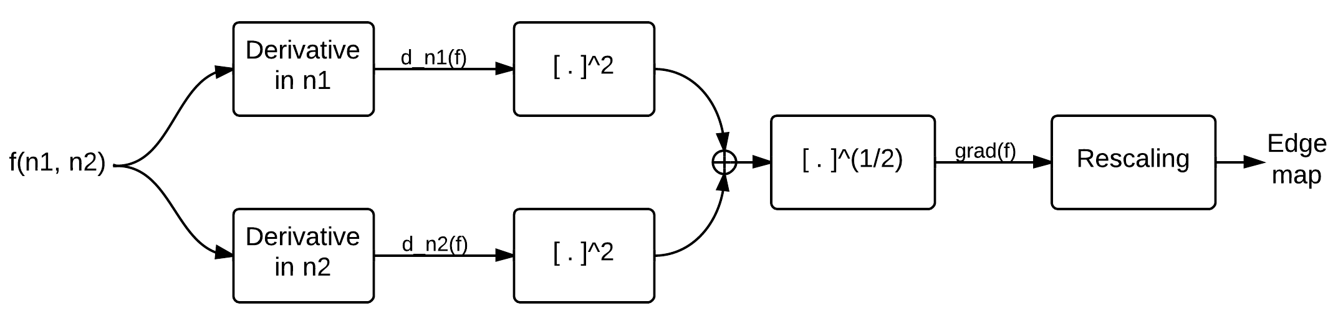
Gradient-based method Steps

Slide 6
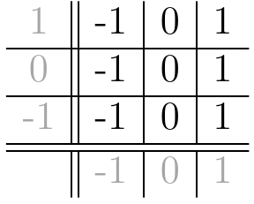
Gradient-based method Computing Derivatives

Slide 7
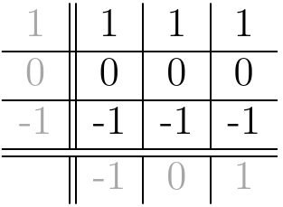
Gradient-based method Computing Derivatives

Slide 8

Gradient-based method Computing Derivatives

Slide 9
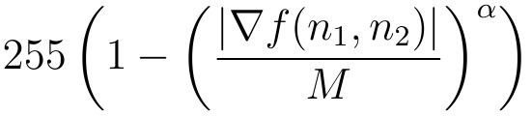

Gradient-based method Computing Derivatives

Slide 10

Gradient-based method Example 1

Slide 11

Gradient-based method Example 1

Slide 12
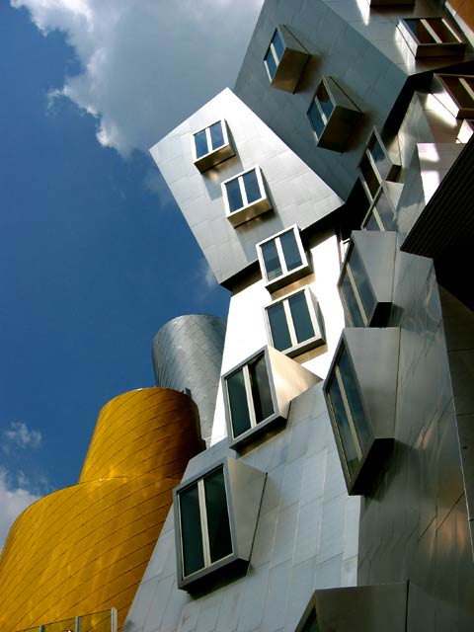
Gradient-based method Example 2

Slide 13
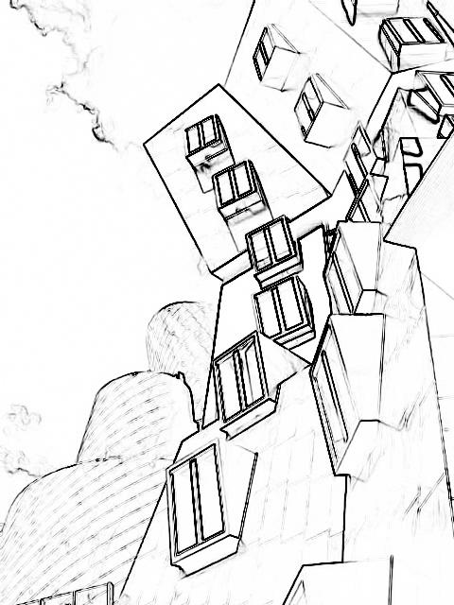
Gradient-based method Example 2

Slide 14
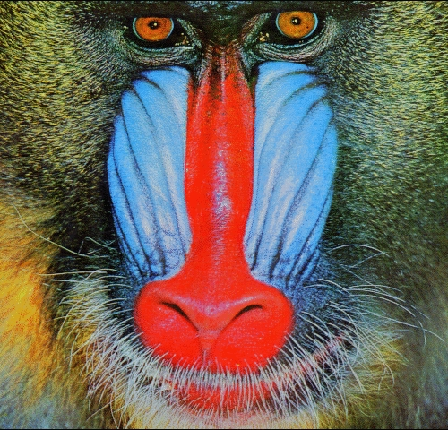
Gradient-based method Example 3

Slide 15
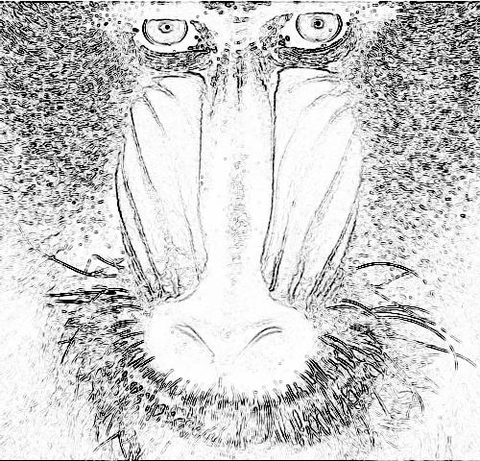
Gradient-based method Example 3

Slide 16
Laplacian-based method

Slide 17
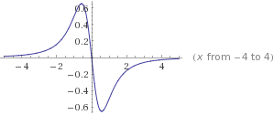
Laplacian-based method Motivation
f(x)
d²f(x)/dx²

Slide 18
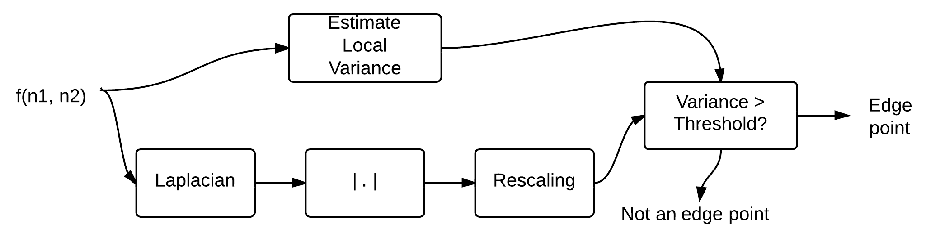
Laplacian-based method Steps

Slide 19
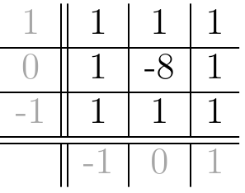
Laplacian-based method Steps

Slide 20


Laplacian-based method Steps

Slide 21
Laplacian-based method Example 1

Slide 22
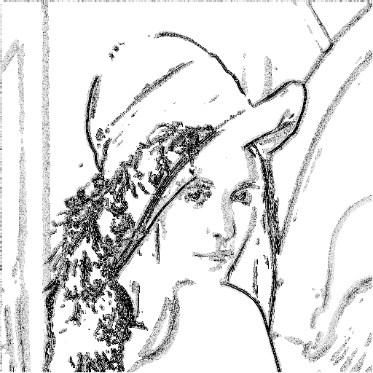
Laplacian-based method Example 1

Slide 23
Laplacian-based method Example 2

Slide 24
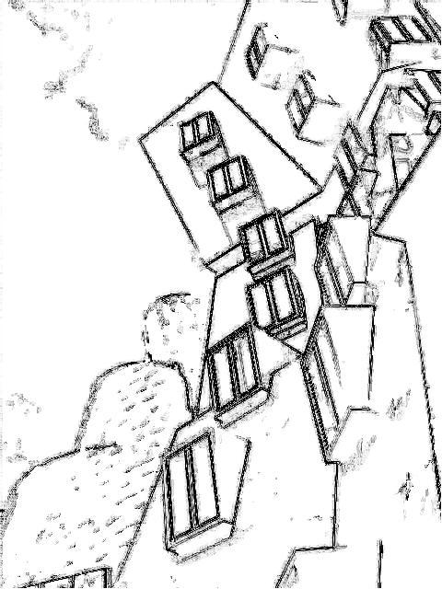
Laplacian-based method Example 2

Slide 25
Laplacian-based method Example 3

Slide 26
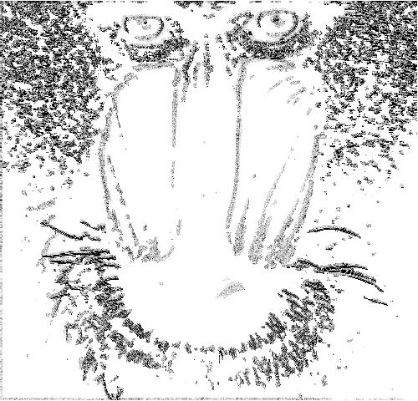
Laplacian-based method Example 3

Slide 27
Comparison

Slide 28
Comparison Original

Slide 29
Comparison Gradient-based

Slide 30
Comparison Laplacian-based

Slide 31
Comparison Original

Slide 32
Comparison Gradient-based

Slide 33
Comparison Laplacian-based

Slide 34
Comparison Original

Slide 35
Comparison Gradient-based

Slide 36
Comparison Laplacian-based

Slide 37
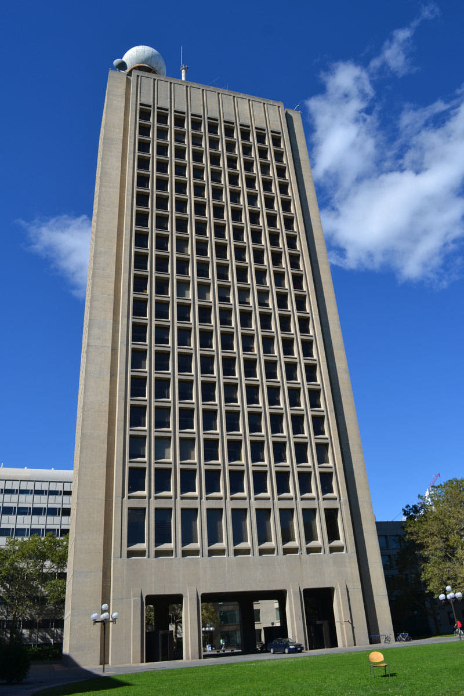
Comparison Original

Slide 38
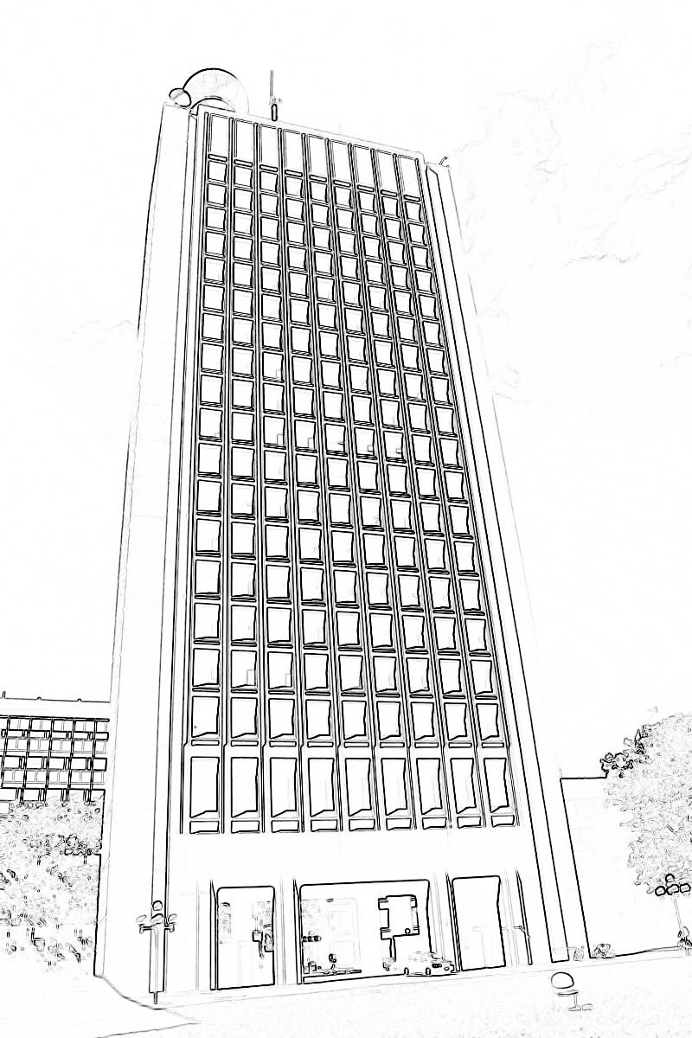
Comparison Gradient-based

Slide 39
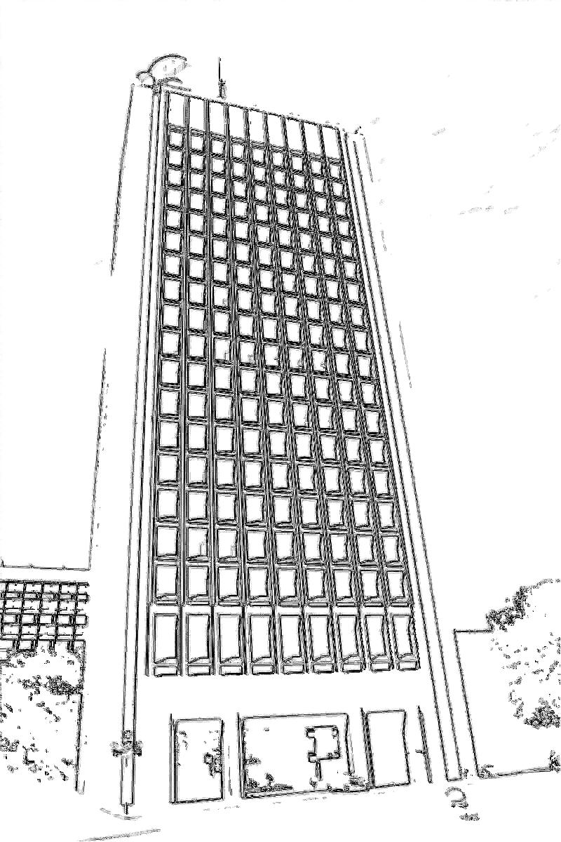
Comparison Laplacian-based

Slide 40
Source
https://github.com/mikemeko/6.344-Project

