Slide 1


BUILDING HYBRID MICROSERVICES ON EKS
Leon Jalfon
DevOps & Cloud Architect

Slide 2
About Sela Group & More
SELA Group is a global company with over two decades of track record in development, training, and consulting.
10 Years in the cloud business – from reselling, onboarding, developing, training, optimizing, and mostly delivering complete cloud solutions
MORE by Sela Group was built with one vision in mind: Delivering an holistic Multi Cloud service, from development to production.

Slide 3
Agenda
Introduction
Case of Study Overview
Implementation and Demos
Summary
Q&A

Slide 4

Introduction
Notes:
RM – DSC, Configuration as a Code

Slide 5
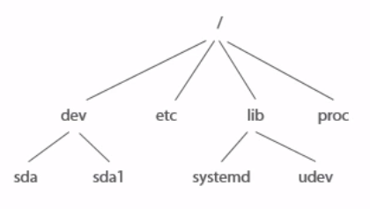
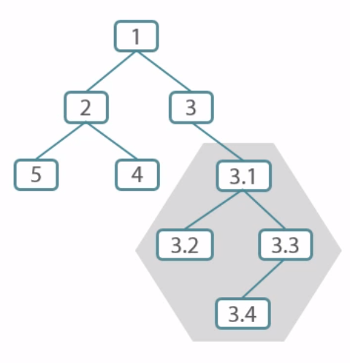
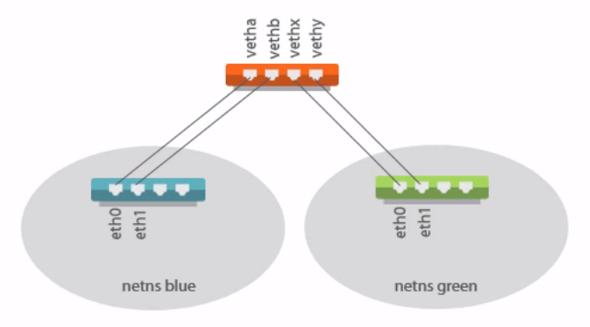
Linux Containers (LXC)
Is an operating-system-level virtualization method
Run multiple isolated Linux systems (containers) on a control host using a single Linux kernel.
File System
Process Tree
Networking Stacks
Notes:
namespaces 🡪 Isolation
cgroups 🡪 Apply limits
capabilities 🡪 Manage privileges

Slide 6
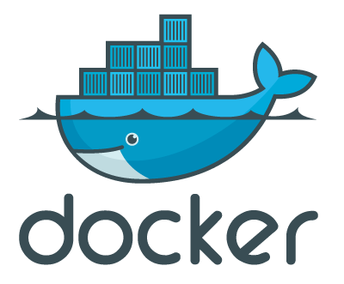
Docker Containers
Is an actual implementation of a container technology
LINUX SERVER
LINUX SERVER
Container
Container
file system
file system
network
Kernel
network
process tree
process tree

Slide 7
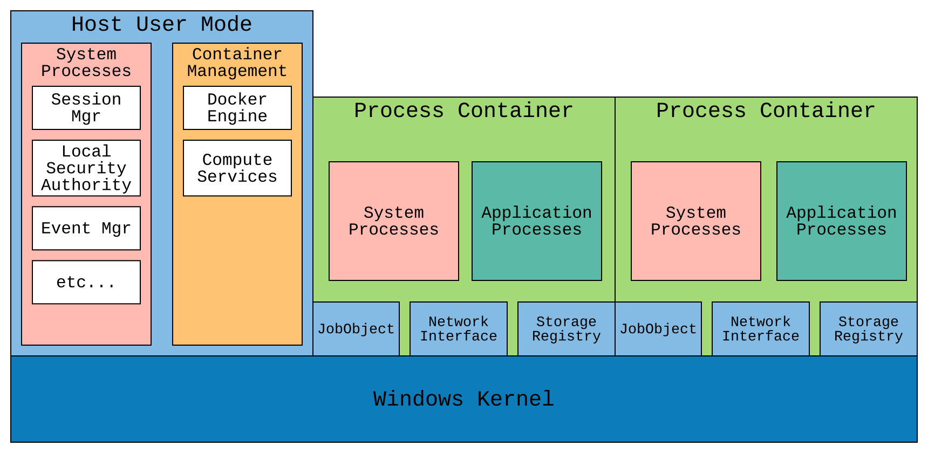
Windows Containers
Use “Windows Container Support” instead of LXC

Slide 8
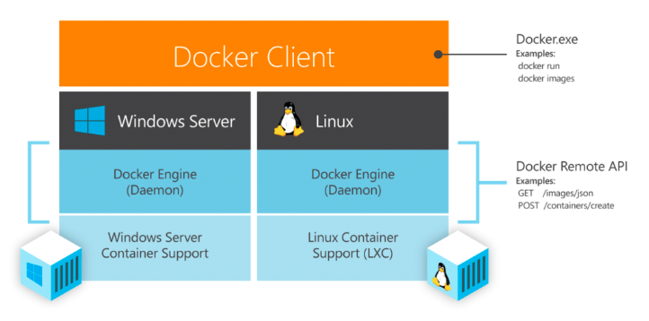
Linux Containers Vs Windows Containers

Slide 9
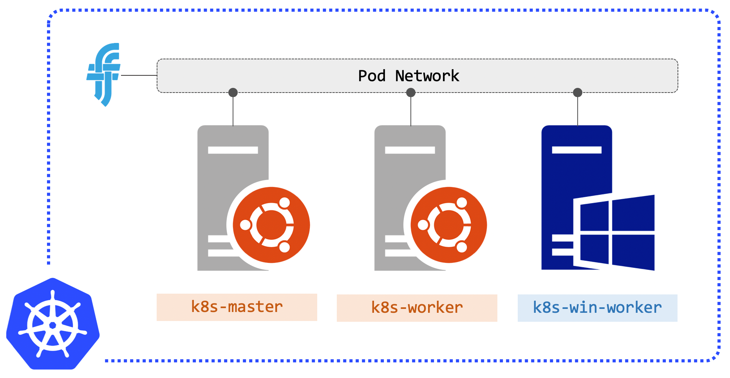
Windows Containers on Kubernetes
Pod networking is a separate component in K8s
Notes:
EKS uses calico
Calico and Flannel are most popular for windows container support

Slide 10
Windows Containers on EKS (notes)
Supported from Kubernetes version 1.14 or later
EKS clusters must contain one or more Linux worker nodes to run core system pods that only run on Linux
The kubelet and kube-proxy event logs are redirected to the EKS Windows Event Log and are set to a 200 MB limit
Calico network policy enforcement has not been tested with Amazon EKS Windows nodes
Notes:
only run on Linux, such as coredns and the VPC resource controller

Slide 11
Windows Containers on EKS (Limitations)
Instance types not supported: C3, C4, D2, I2, R3 and M4 (excluding m4.16xlarge)
Host networking mode is not supported for Windows workloads
Windows worker nodes support one elastic network interface per node
Group Managed Service Accounts for Windows pods and containers is a Kubernetes 1.14 alpha feature that is not supported by Amazon EKS
Notes:
The number of pods that you can run per Windows worker node is equal to the number of IP addresses available per elastic network interface for the node's instance type, minus one.
Group Managed Service Account (gMSA) is a special type of service account; its identity can be shared across multiple computers without needing to know the password. Computers should be part of an Active Directory domain, which manages these service accounts to make use of them

Slide 12
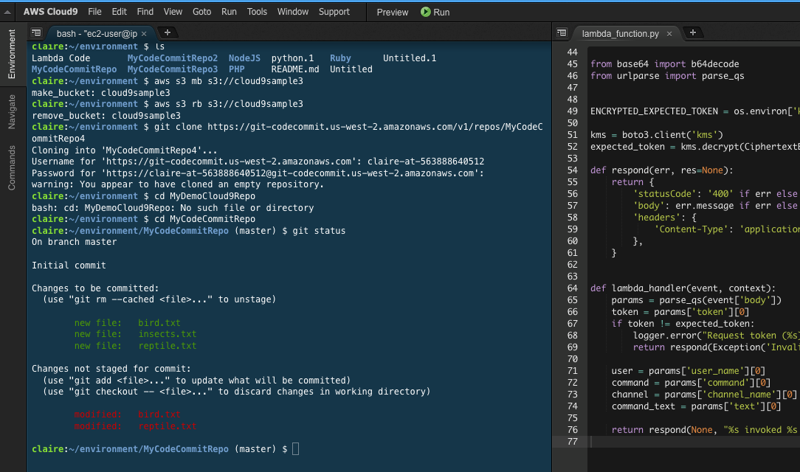
AWS Cloud9
AWS Cloud9 is a cloud-based IDE that lets you write, run, and debug your code with just a browser

Slide 13
Case of Study
Notes:
RM – DSC, Configuration as a Code

Slide 14
Case of Study
Convert a windows monolith into a linux microservices
(running on kubernetes from day 1)
Cluster Provisioning
Windows Monolith
Hybrid Microservices
Linux Microservices
Update Cluster

Slide 15
Learning Curve
Docker Containers
Kubernetes Infrastructure
Microservices
Architecture

Slide 16
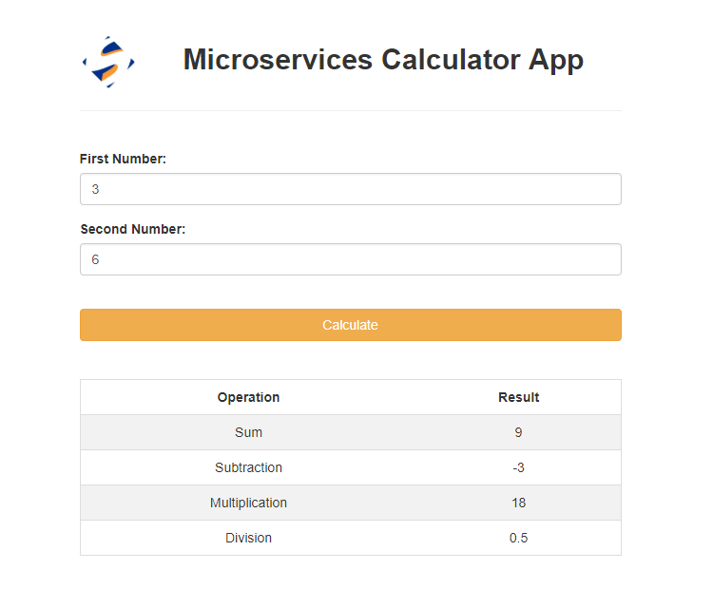
Demo Application
Calculator Application
Sum Service
Subtraction Service
Multiplication Service
Division Service
UI Service

Slide 17
Demo Application
Sum Service (port 30001)
Subtraction Service (port 30002)
(port 30005) UI Service
Multiplication Service (port 30003)
Division Service (port 30004)
(All services are exposed in port 3000 internally)

Slide 18
Let’s get to work!

Slide 19
Implementation
Notes:
RM – DSC, Configuration as a Code

Slide 20
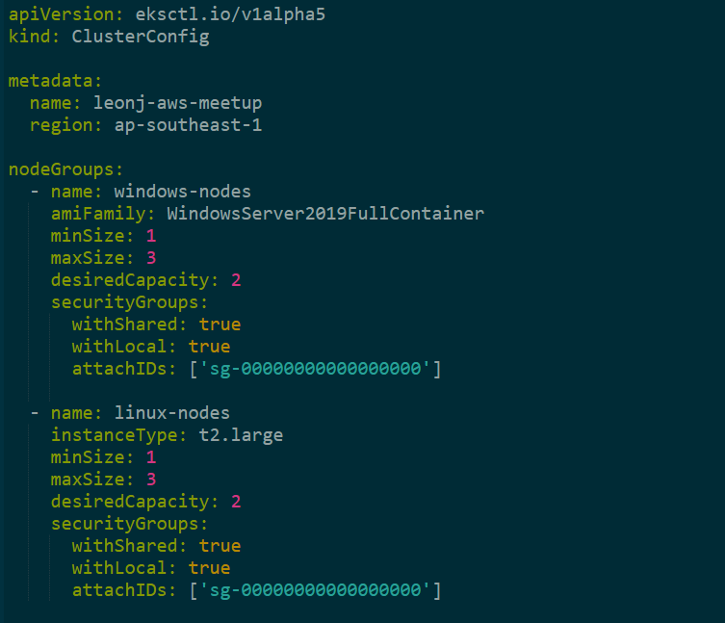

Cluster Provisioning
Windows Monolith
Hybrid Microservices
Linux Microservices
Update Cluster
Notes:
eksctl to use infrastructure as code
Demo process:
1) create control plane (--without-nodegroup)
2) create security group
3) create nodes
4) install vpc-controllers (eksctl utils install-vpc-controllers)

Slide 21
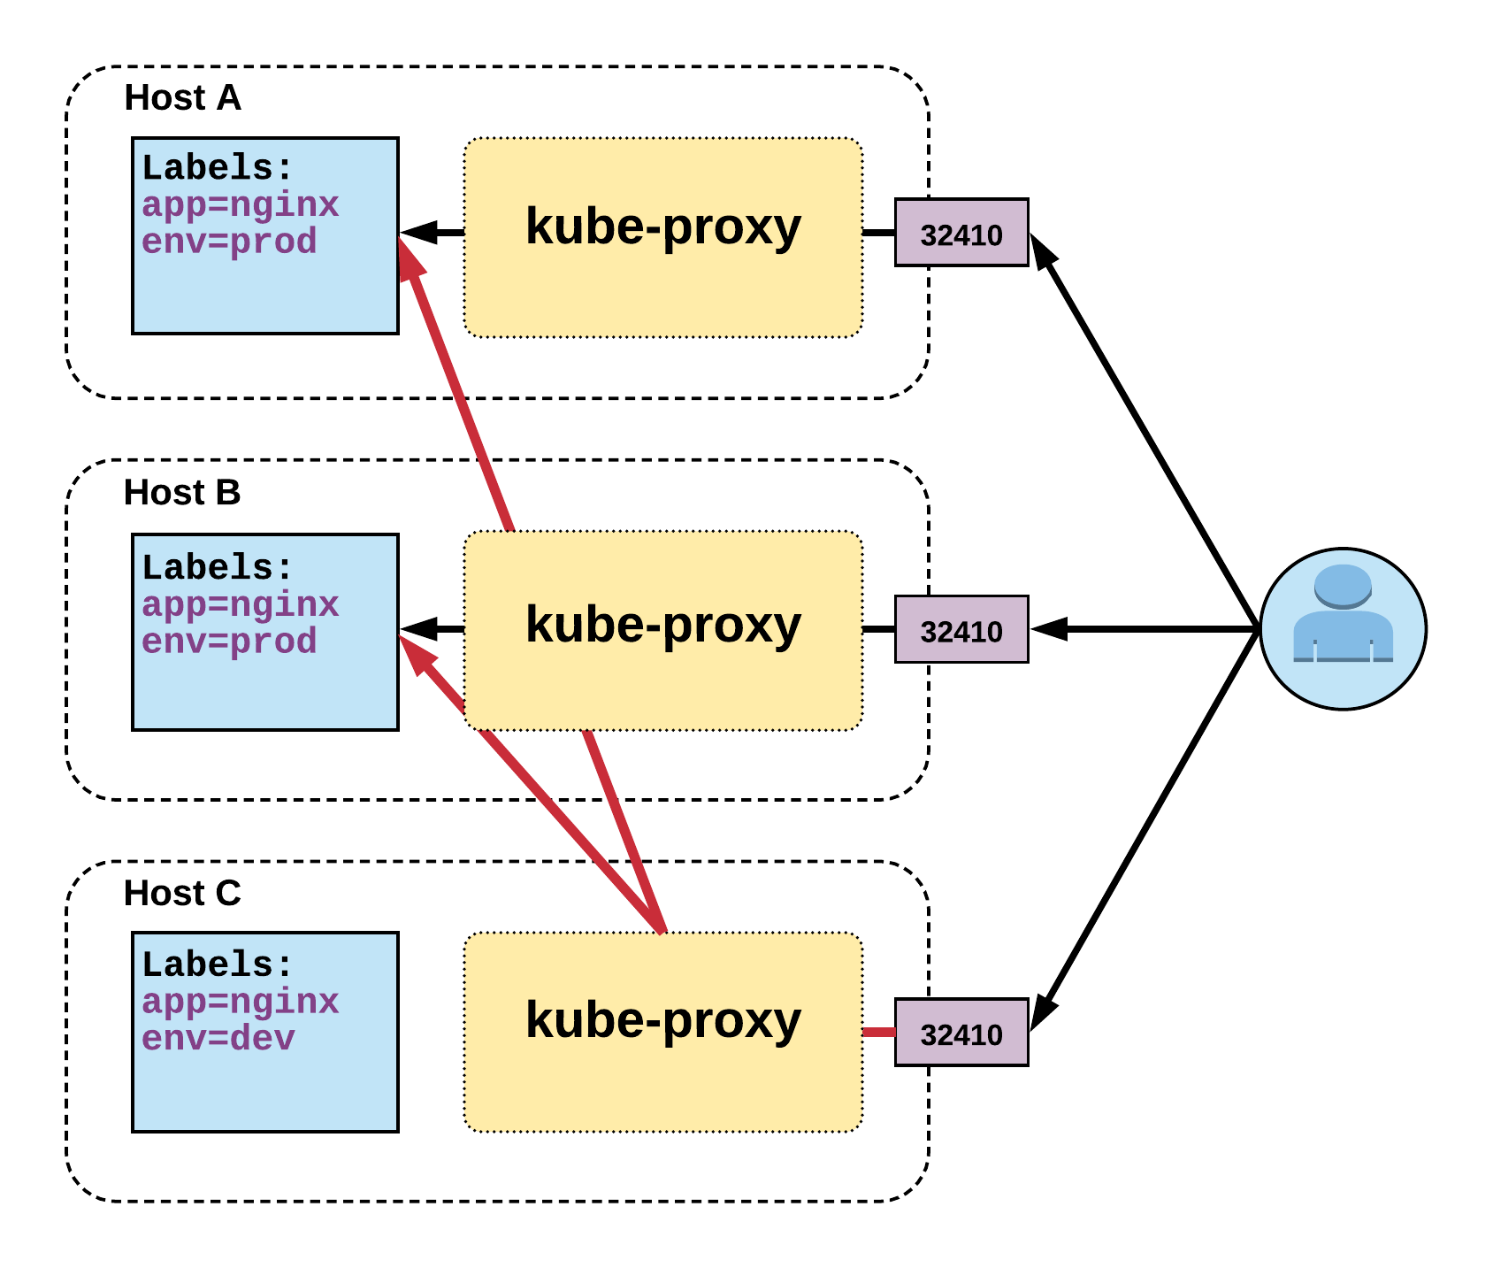
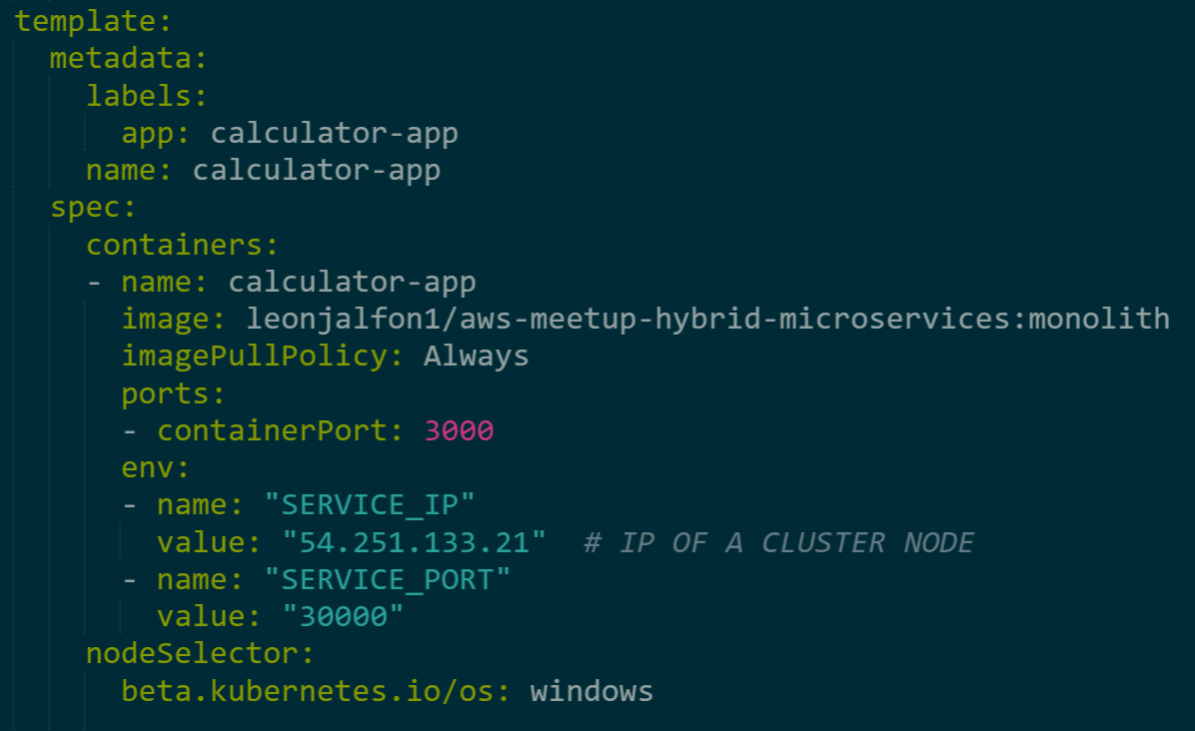

Cluster Provisioning
Windows Monolith
Hybrid Microservices
Linux Microservices
Update Cluster
calculator-app
30000
calculator-app
30000
NodePort
other app
30000

Slide 22

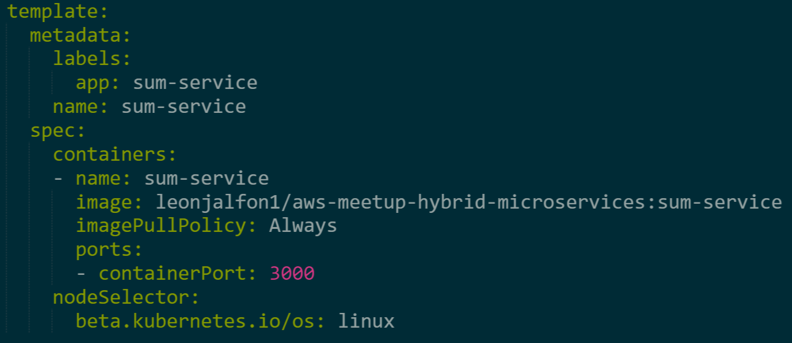


Cluster Provisioning
Windows Monolith
Hybrid Microservices
Linux Microservices
Update Cluster
Monolith
[ * ] [ ui ] [ / ]
sum
service
[ + ]
subtraction
service
[ - ]

Slide 23
Cluster Provisioning
Windows Monolith
Hybrid Microservices
Linux Microservices
Update Cluster
division
service
[ + ]
sum
service
[ - ]
ui
service
[ ui ]
Port
30005
Monolith
[ * ] [ ui ] [ / ]
Port
30000
multiplication
service
[ / ]
subtraction
service
[ * ]

Slide 24
Cluster Provisioning
Windows Monolith
Hybrid Microservices
Linux Microservices
Update Cluster
Master
Pod
Pod
Pod
Pod
Pod
Linux
Node
Linux
Node
Windows
Node
Windows
Node

Slide 25
Summary
Notes:
RM – DSC, Configuration as a Code

Slide 26
Summary
Differences between windows and linux containers
EKS windows container support considerations
Create and manage an hybrid EKS cluster using eksctl
Monolith to Microservices transformation
Manage windows and linux workloads in kubernetes

Slide 27
Questions
Notes:
RM – DSC, Configuration as a Code

Slide 28
Thank you!
Leon Jalfon
https://github.com/leonjalfon1/aws-meetup-hybrid-eks

