Slide 1
What are Large Language Models
Chun-Chieh Lin

Slide 2
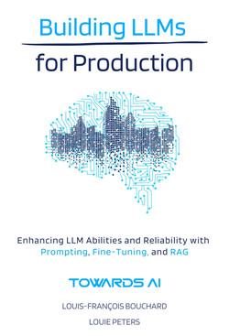
Book reading
Building LLMs for Production
  by Louis-Francois Bouchard, Louie Peters
Released May 2024
Publisher(s): Towards AI
ISBN: 9798324731472

Slide 3
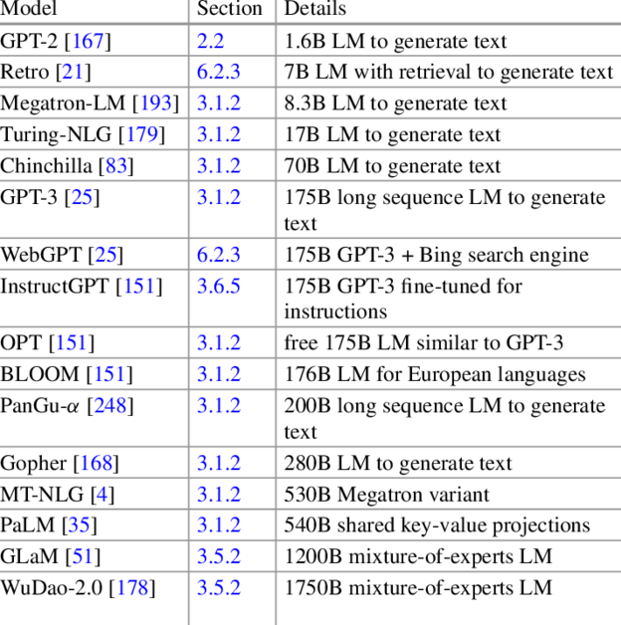
What are Large Language Models
(LLMs)
You might heard these below:
  large number of parameters, billions!! (e.g. GLM-130B)
  great at processing or generating text.
  trained on extensive textual data
    various language patterns and structures
  interpret and create human-like text

Slide 4
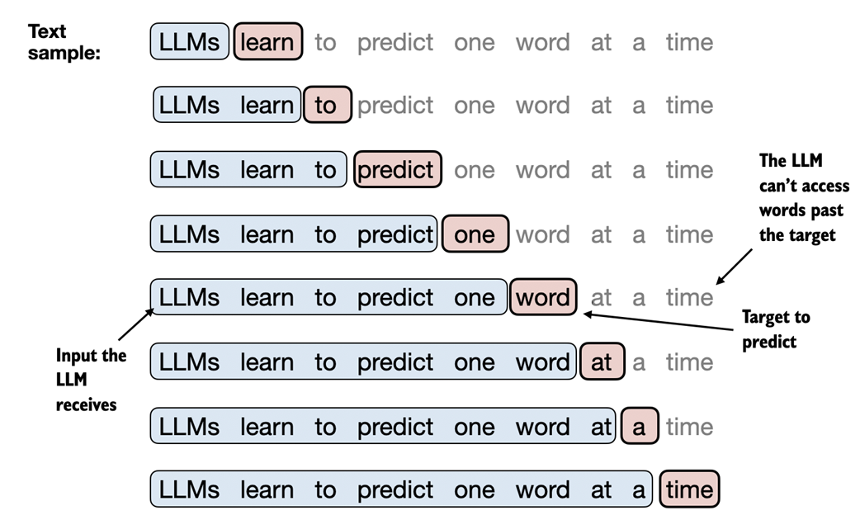
What are Large Language Models
(LLMs)
The core training objective of LLMs focuses on predicting the next word in a sentence.
  including machine translation, natural language generation, part-of-speech tagging, parsing, information retrieval, and others.
Text generation process is
autoregressive.
  Models generate the next
  tokens based on the
  sequence of tokens
  already generated.

Slide 5
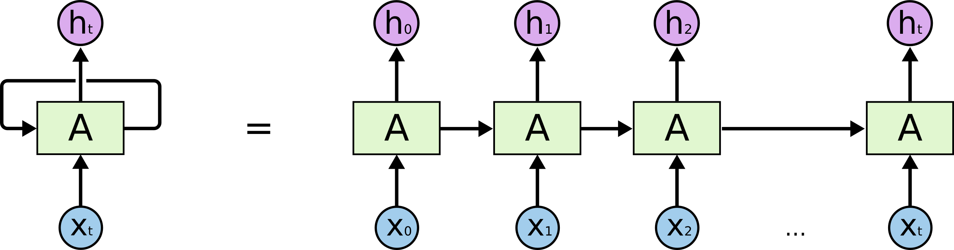
What are Large Language Models
Traditionally, we used Recurrent Neural Networks (RNNs) to handle text problem.
  Because RNNs can deal with ‘sequential data’
  However, RNNs encounter challenges with long sequences where they forget older information in favor of recently processed input.
we used Recurrent …. .

Slide 6
What are Large Language Models
vanishing gradient problem
  during training, the change, gradient, of network’s weights might become increasingly smaller as they are propagated back through each timestep of the sequence.
  That reduce the network’s ability to learn from and remember long-term dependencies within the data.

Slide 7
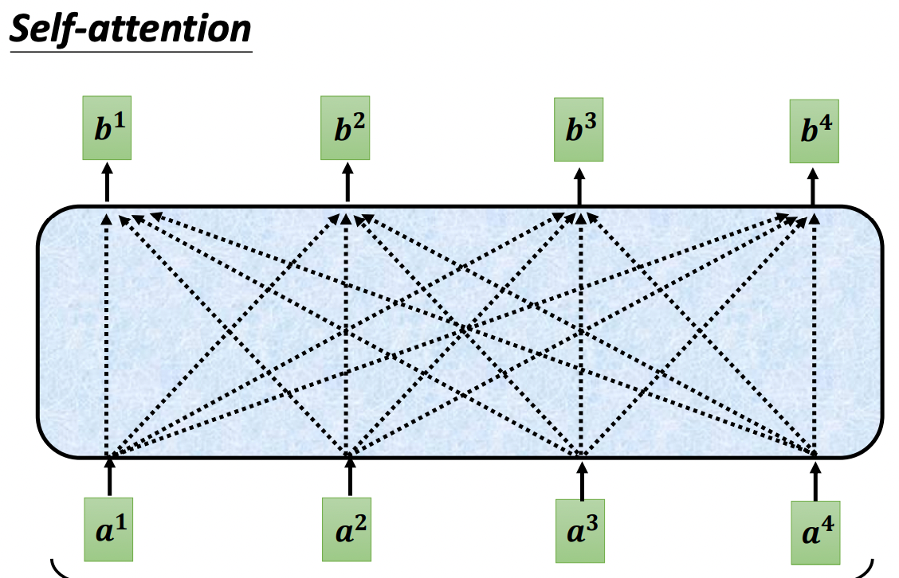
What are Large Language Models
Self Attention mechanisms try to address these problem.
Transformer-based model, adopted attention mechanisms, becomes the most preferred architecture for natural language processing tasks.
  You might heard this famous paper: Attention Is All You Need​
  The cutting-edge models like GPT-4o, Claude, and Llama​

Slide 8
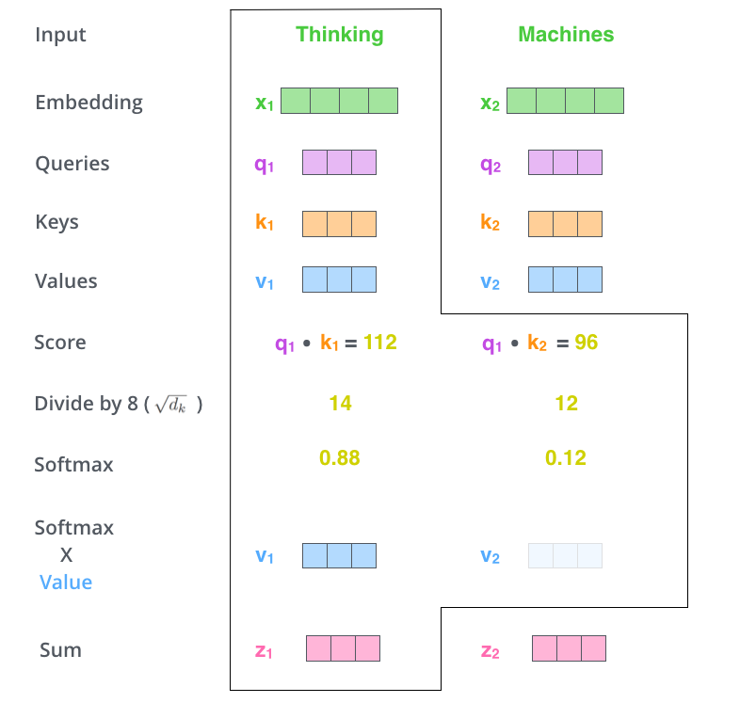
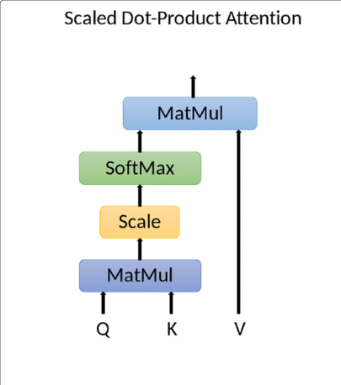
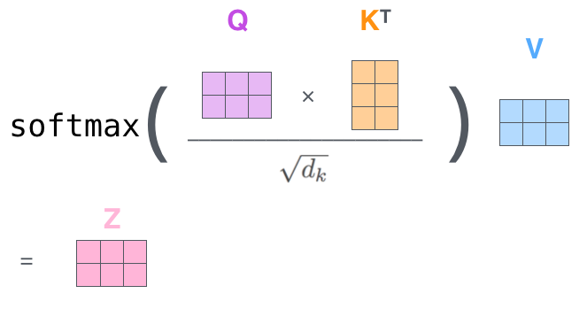
Self Attention mechanisms
Attention
  Q,K,V vectors
  dot-production
  SoftMax

Slide 9
Key LLM Terminologies
The Transformer
Language Modeling
Tokenization
Embeddings
Training/Fine-Tuning
Prediction
Context Size
Scaling Laws
Emergent Abilities
Prompts
Hallucinations and Biases

Slide 10
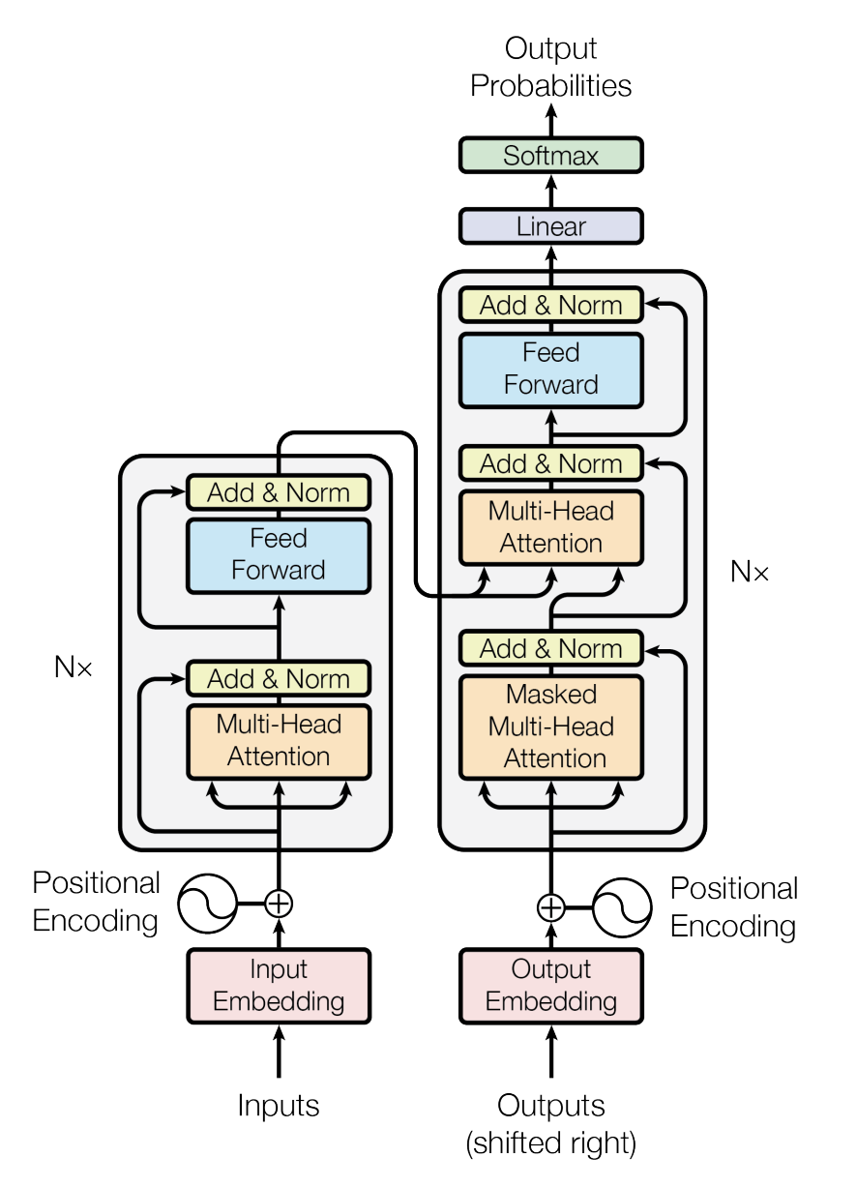

Transformer
Transformer-based models are designed as an encoder-decoder framework
Encoder: process input text, identifying important parts and creating a representation of the input.
Decoder: transform the encoder’s output into human readable text

Slide 11
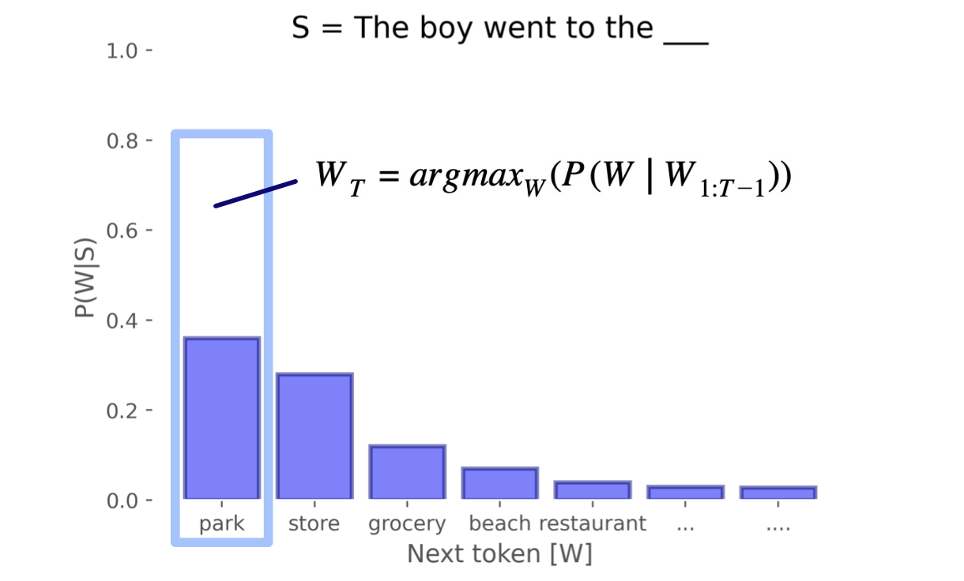
Language Modeling
Language modeling is the core part of natural language processing.
Models learn the probability distribution of words based on a large corpus.
  learn to predict
  what the next token is.
  The boy went to the ???

Slide 12
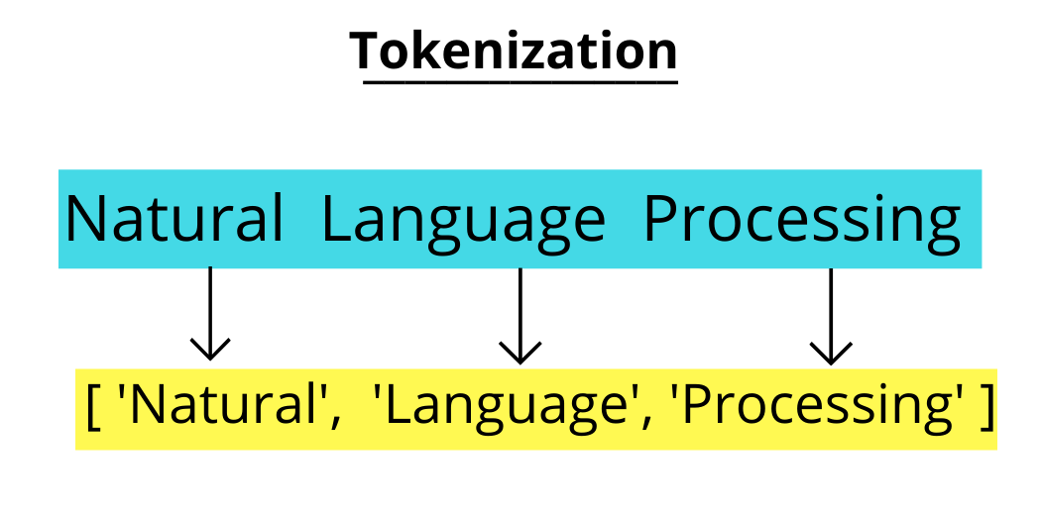
Tokenization
LLMs work with tokens, not complete words.
Tokenization is the initial phase of interacting with LLMs.
  breaking down the input text into smaller pieces known as tokens.
Tokens can range from single characters to entire words, and the size of these tokens can greatly influence the model’s performance.

Slide 13
Tokenization
Some models adopt subword tokenization, breaking words into smaller segments that retain meaningful linguistic elements.
Here are some examples:
「The child’s coloring book.」
  [“The“, “child’s“, “coloring“, “book. “] (using space only)
  [“The“, “child“, “’ “, “s“, “coloring“, “book“, “. “] (using space and punctation)
  [“The“, “child“, “’“, “s“, “color“, “ing“, “book“, “. “] (using byte-pair encoding)

Slide 14
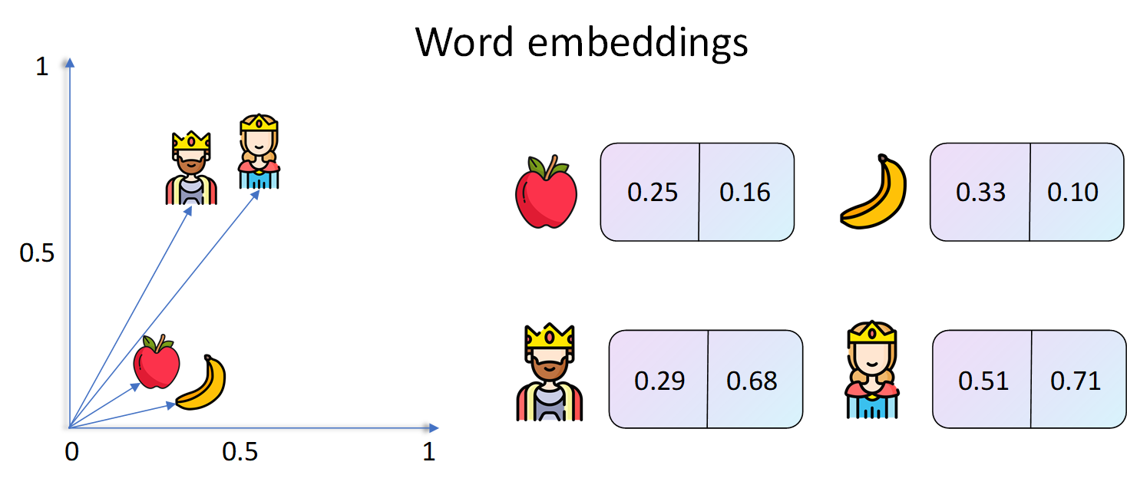
Embeddings
After tokenization, we turn these tokens into something the computer can understand and work with.
  Embeddings
An embedding gives each token a unique numerical ID that captures its meaning.
This numerical form helps the computer see how similar two tokens are, like knowing that “happy” and “joyful” are close in meaning, even though they are different words.

Slide 15
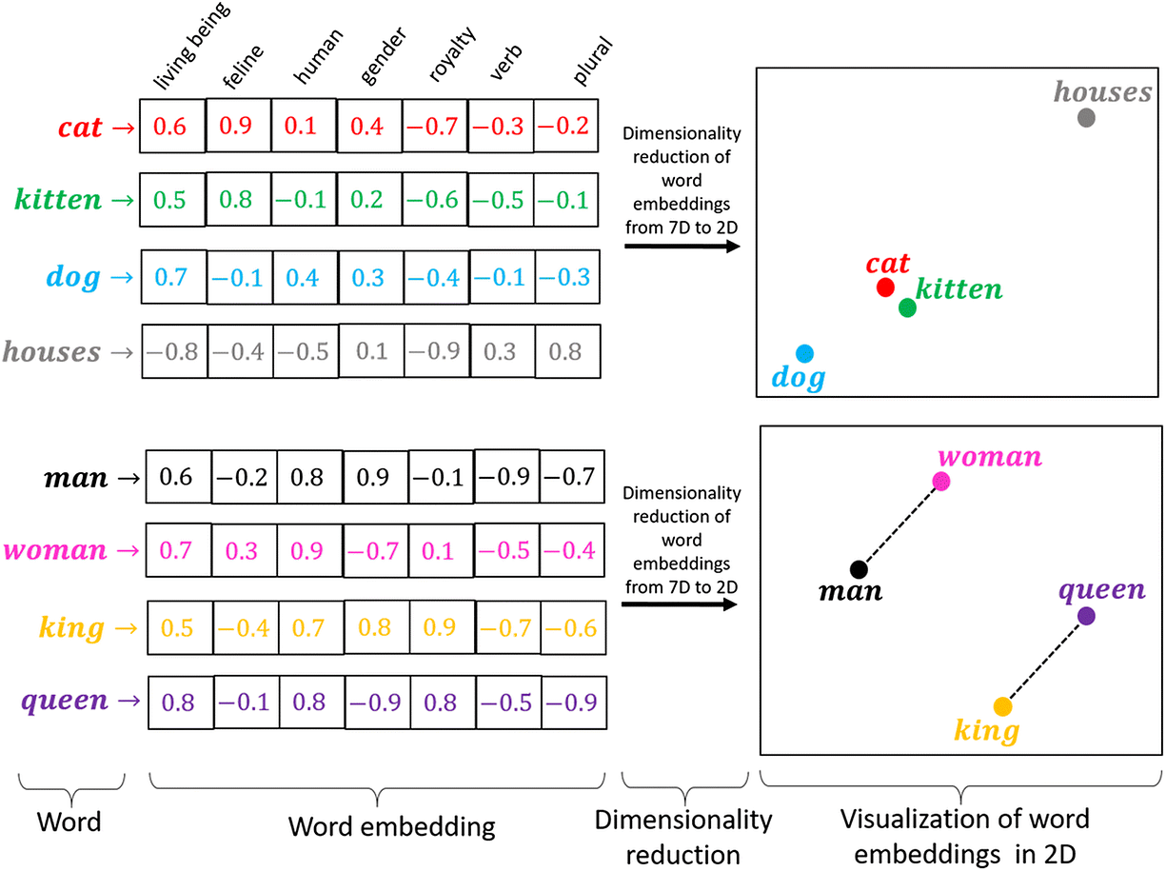
Embeddings
We use vectors because they are a straightforward method for the model to keep track of how tokens are related to each other

Slide 16
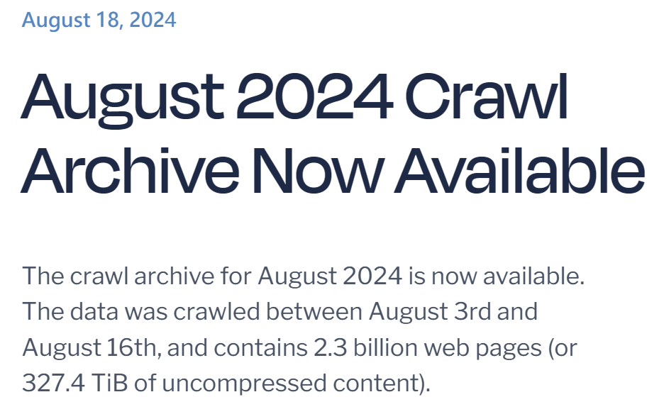
Training/Fine-Tuning
The goal is to adjust the model’s parameters
  maximize the probability of a correct prediction based on the observed data.
Typically, a model is trained on a huge general-purpose dataset of texts from the Internet,
  such as The Pile or CommonCrawl.
  Sometimes, more specific datasets
  such as the StackOverflow
This phase is also known as
the pre-training stage,
indicating that the model is trained
to learn language comprehension
and is prepared for further tuning.

Slide 17
Training/Fine-Tuning
After pre-training, the model typically undergoes fine-tuning for a specific task.
This stage requires further training on a smaller dataset for a task (e.g., text translation) or a specialized domain (e.g., biomedical, finance, etc.).
Fine-tuning allows the model to adjust its previous knowledge of the specific task or domain, enhancing its performance.
Some keywords you may want to know..
  Transfer learning
  Few-shot learning
  LoRA: Low-Rank Adaptation of Large Language Models

Slide 18
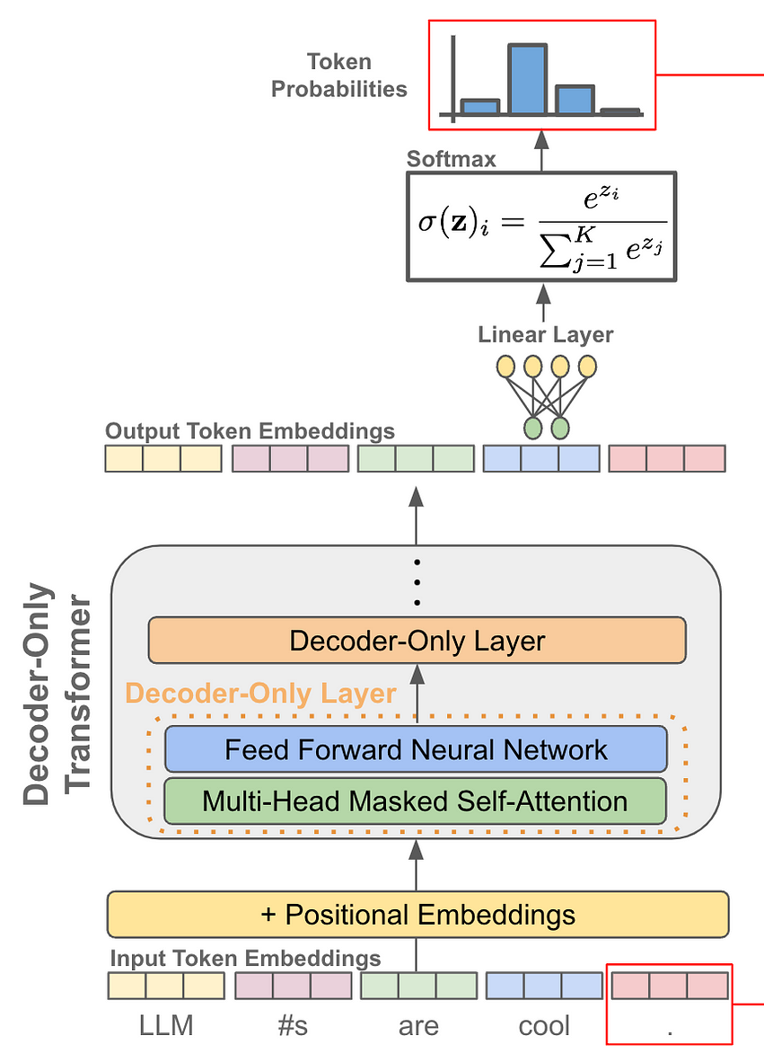
Prediction
The model can generate text after the training or fine-tuning phase by predicting subsequent tokens in a sequence.
Inputting the sequence into the model, producing a probability distribution over the potential next tokens, essentially assigning a score to every word in the vocabulary.
The next token is selected according to its score.
The generation process will be repeated in a loop to predict one word at a time.

Slide 19
Context Size
The context size, or context window, is a crucial aspect of LLMs.
It refers to the maximum number of tokens the model can process in a single request.
  The longer context length, make LLMs can ‘remember’ more things.
Context size influences the length of text the model can handle at any one time, directly affecting the model’s performance and the outcomes it produces.

Slide 20

Scaling Laws
Scaling laws describe the relationship between a language model’s performance and various factors, including
  the number of parameters
  the training dataset size
  the compute budget
  the network architecture
In the research, “Training Compute-Optimal Large Language Models”,
  trained the Chinchilla model, which comprises 70 billion parameters, on a dataset of 1.4 trillion tokens.
A scaling law proposed in the paper:
  for a model with X parameters, the optimal training involves approximately X * 20 tokens.
  For example, a model with 100 billion parameters would ideally be trained on about 2 trillion tokens.

Slide 21
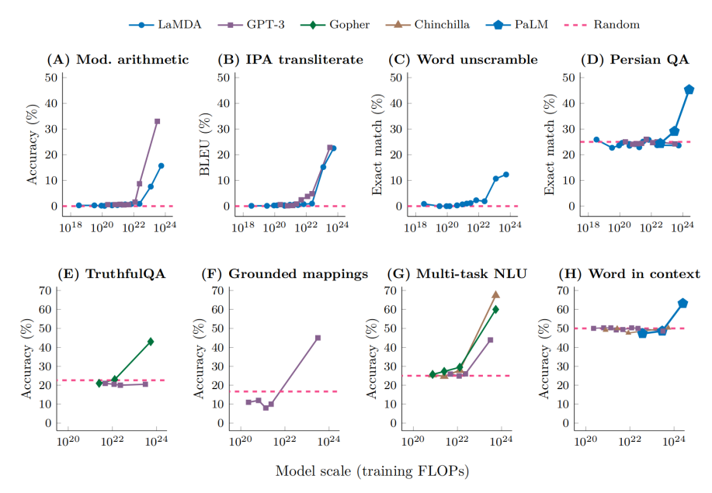
Emergent Abilities in LLMs
New skills emerge unexpectedly as model size grows.
These abilities, including arithmetic, answering questions, summarizing material, and others, are not explicitly taught to the model throughout its training.
Ref: Are Emergent Abilities of Large Language Models a Mirage?
https://arxiv.org/abs/2304.15004

Slide 22

Emergent Abilities in LLMs
Emergent properties are not only a concept that belongs to artificial intelligence but to all disciplines (from physics to biology).
Traditionally, models required task-specific fine-tuning and architectural adjustments to execute specific tasks.
However, scaled-up models can perform these jobs without architectural changes or specialized tuning.
  They accomplish this by interpreting tasks using natural language processing.

Slide 23
Emergent Abilities
LLMs’ ability to accomplish various functions without explicit fine-tuning is a significant milestone.
Emergent abilities in Large Language Models (LLMs) are empirical phenomena that occur when the size of language models exceeds specific thresholds.
Emergent abilities is influenced by factors such as
  volume and quality of the data
  the quantity of the model’s parameters.

Slide 24
Factors Leading To Emergent Abilities
Multi-step reasoning involves instructing a model to perform a series of intermediate steps before providing the final result.
  This approach, known as chain-of-thought (COT) prompting
  more effective than standard prompting only when applied to sufficiently large models.
Another strategy is fine-tuning a model on various tasks presented as Instruction Following/Instruction Finetuning.
  shows improved performance only with models of a certain size
  scale in achieving advanced capabilities indeed matters.

Slide 25
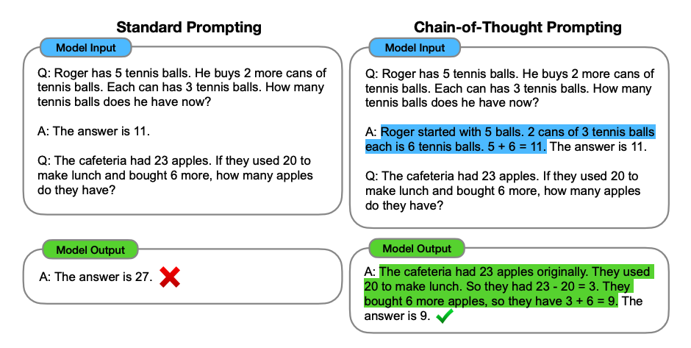
Factors Leading To Emergent Abilities
You can combine it with few-shot prompting (make the model do intermediate reasoning steps)

Slide 26
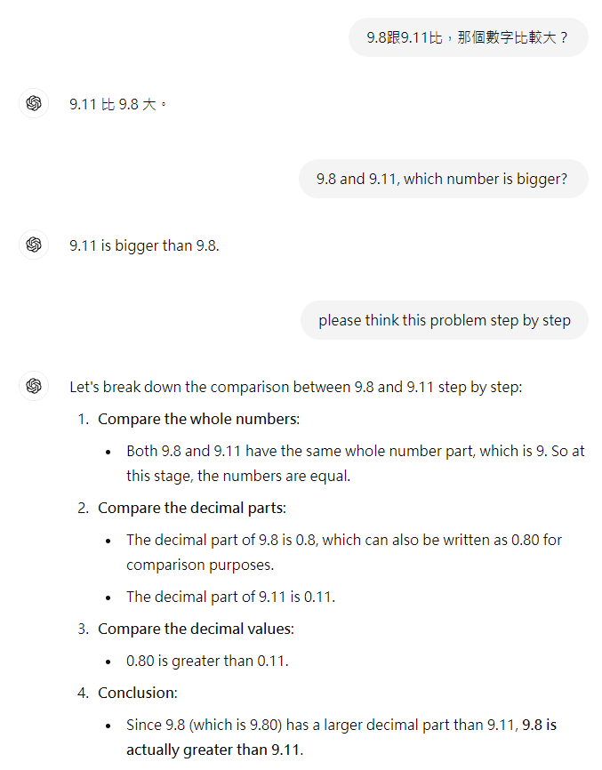

Slide 27
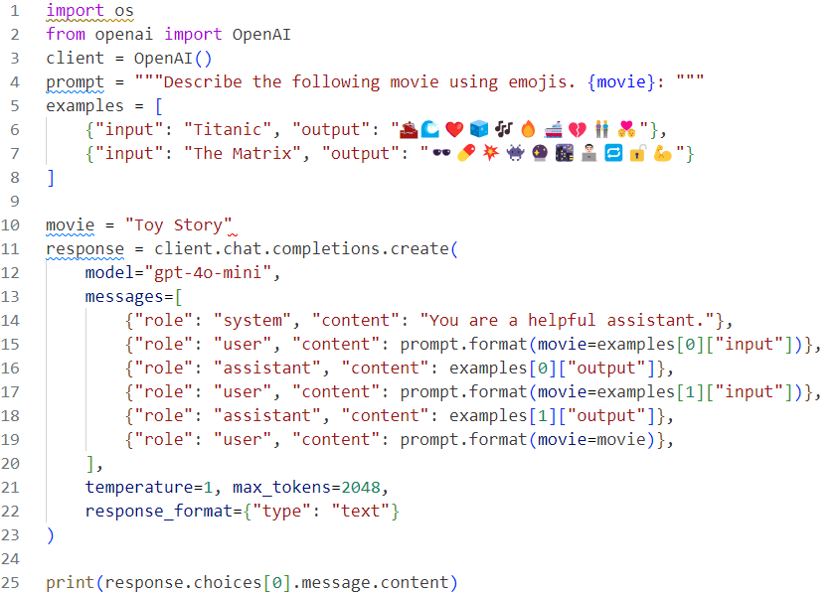


Slide 28
Prompts
The text (or images, numbers, tables…) we provide to LLMs as instructions
Prompts are instructions given to AI systems like OpenAI’s GPT-3 and GPT-4, providing context to generate human-like text
  the more detailed the prompt, the better the model’s output.
Concise, descriptive, and short (depending on the task)prompts
  more effective results, allowing for the LLM’s creativity while guiding it toward the desired output.
  Using specific words or phrases can help focus the model on generating relevant content

Slide 29
Prompts
You might have some tips:
Use Precise Language:
  Less Precise: “Write about dog food.”
  More Precise: “Write a 500-word informative article about the dietary needs of adult Golden Retrievers.”
Provide Sufficient Context: Context helps the model understand the expected output:
  Less Contextual: “Write a story.”
  More Contextual: “Write a short story set in Victorian England featuring a young detective solving his first major case.

Slide 30
Prompts
Test Variations: try with different prompt styles to find the most effective approach:
  Initial: “Write a blog post about the benefits of yoga.”
  Variation 1: “Compose a 1000-word blog post detailing the physical and mental benefits of regular yoga practice.”
  Variation 2: “Create an engaging blog post that highlights the top 10 benefits of incorporating yoga into a daily routine.”
Review Outputs: check the outputs if it saying is true.

Slide 31
Hallucinations and Biases in LLMs
Hallucinations:
  if a user asks, “Who won the World Series in 2025?” and the LLM responds with a specific winner. As of the current date (Sep 2024), the event has yet to occur, making any response speculative and incorrect.
  the model creates outputs that do NOT correspond to real-world facts or context
Bias in AI and LLMs is another critical issue.
  It refers to these models’ inclination to favor specific outputs or decisions based on their training data.
  the model maybe biased toward that region’s language, culture, or viewpoints
  For example, if a user asks an LLM, “Who is a nurse?”
    it responds, “She is a healthcare professional who cares for patients in a hospital,” this demonstrates a gender bias.

Slide 32
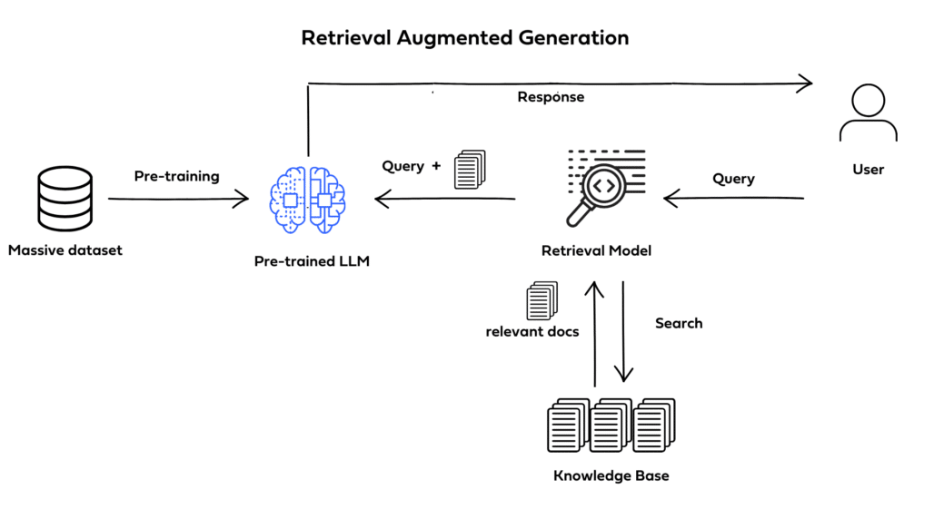
The next things
Retrieval-Augmented Generation

