Slide 1
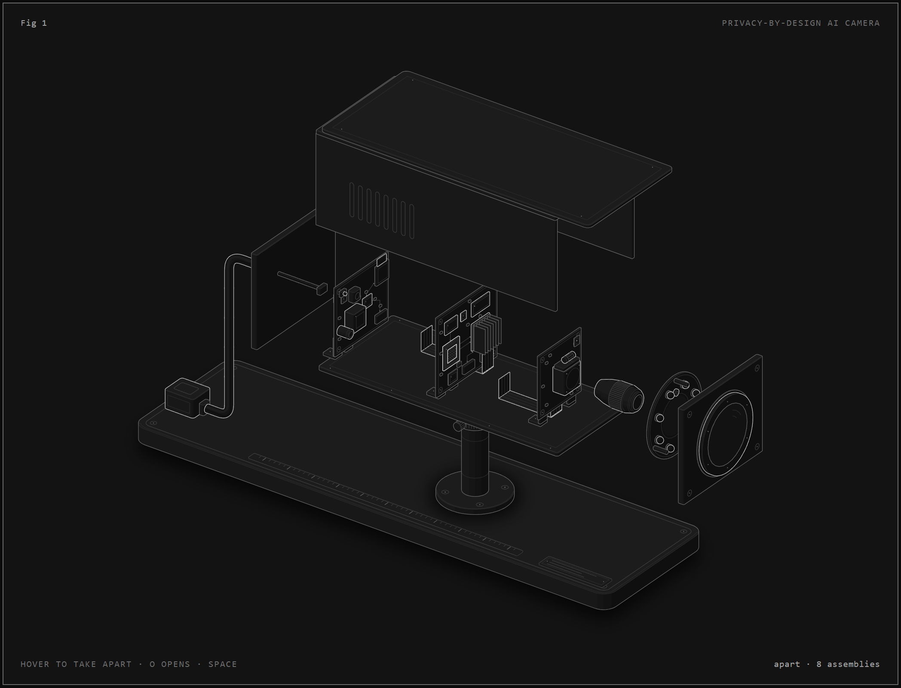
MINI PROJECT · AI-BASED IMAGE RECOGNITION
Privacy-by-Design
AI CCTV
On-camera masking of intimate body regions and UPI PIN entry with pose estimation, body-part detection and hand tracking
Leon Kaushik Deka
Third Semester Mini Project · AIML
October 2026

Slide 2
PROBLEM STATEMENT
CCTV records more than its purpose needs
Hostel corridor
Billing counter / ATM
Who can watch?
▪ Residents walk to bathrooms in towels or underwear
▪ Footage exists for safety, not bodies
▪ Recordings kept for weeks
▪ Camera sees fingers typing the UPI or card PIN
▪ PIN + stolen phone = emptied account
▪ Shoulder-surfing, at scale
▪ Control-room staff and vendors
▪ Anyone given an export
▪ Attackers: IP cameras are a top botnet target (Mirai)
Goal: remove only the sensitive regions, in real time, irreversibly, inside the camera, and keep the rest of the frame as evidence.
Judged on: (1) how well it masks sensitive areas (2) how often it masks unnecessary areas (3) speed.
Privacy-by-Design AI CCTV · Leon Kaushik Deka
02

Slide 3
AI APPROACH
Two AI branches, one permanent mask, inside the camera
Body privacy
PIN guard
▪ Pose estimation finds each skeleton -> chest and pelvis regions
▪ Pre-trained body-part detector runs per person at full resolution
▪ Nipples, buttocks, genitalia pixelated
▪ Object detector finds phones and POS terminals
▪ Hand tracking (21 points) fingertip on device face = PIN entry
▪ Screen + hand filled solid
Mask at the source
Permanent masks
Mask early, release late
Fail closed
no unmasked recording exists
solid / pixelate, never blur
12-frame hold beats flicker
model error = frame withheld
Privacy-by-Design AI CCTV · Leon Kaushik Deka
03

Slide 4
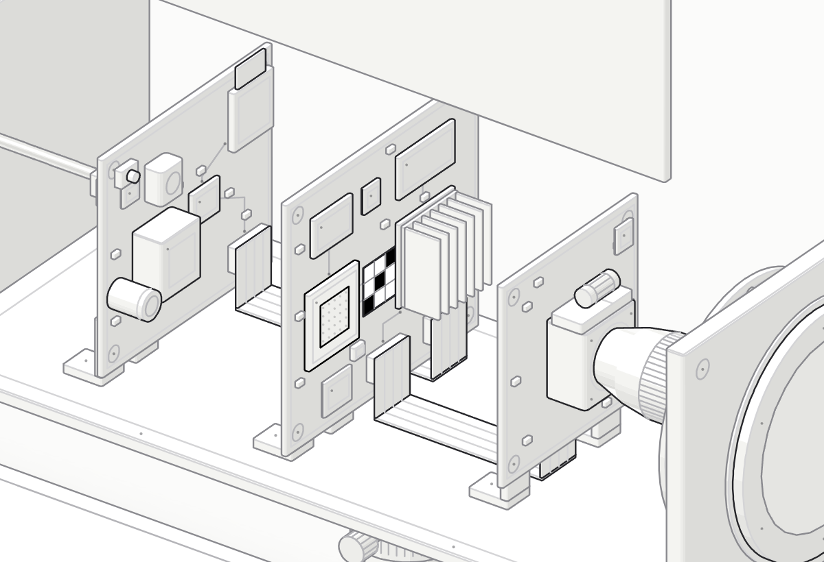
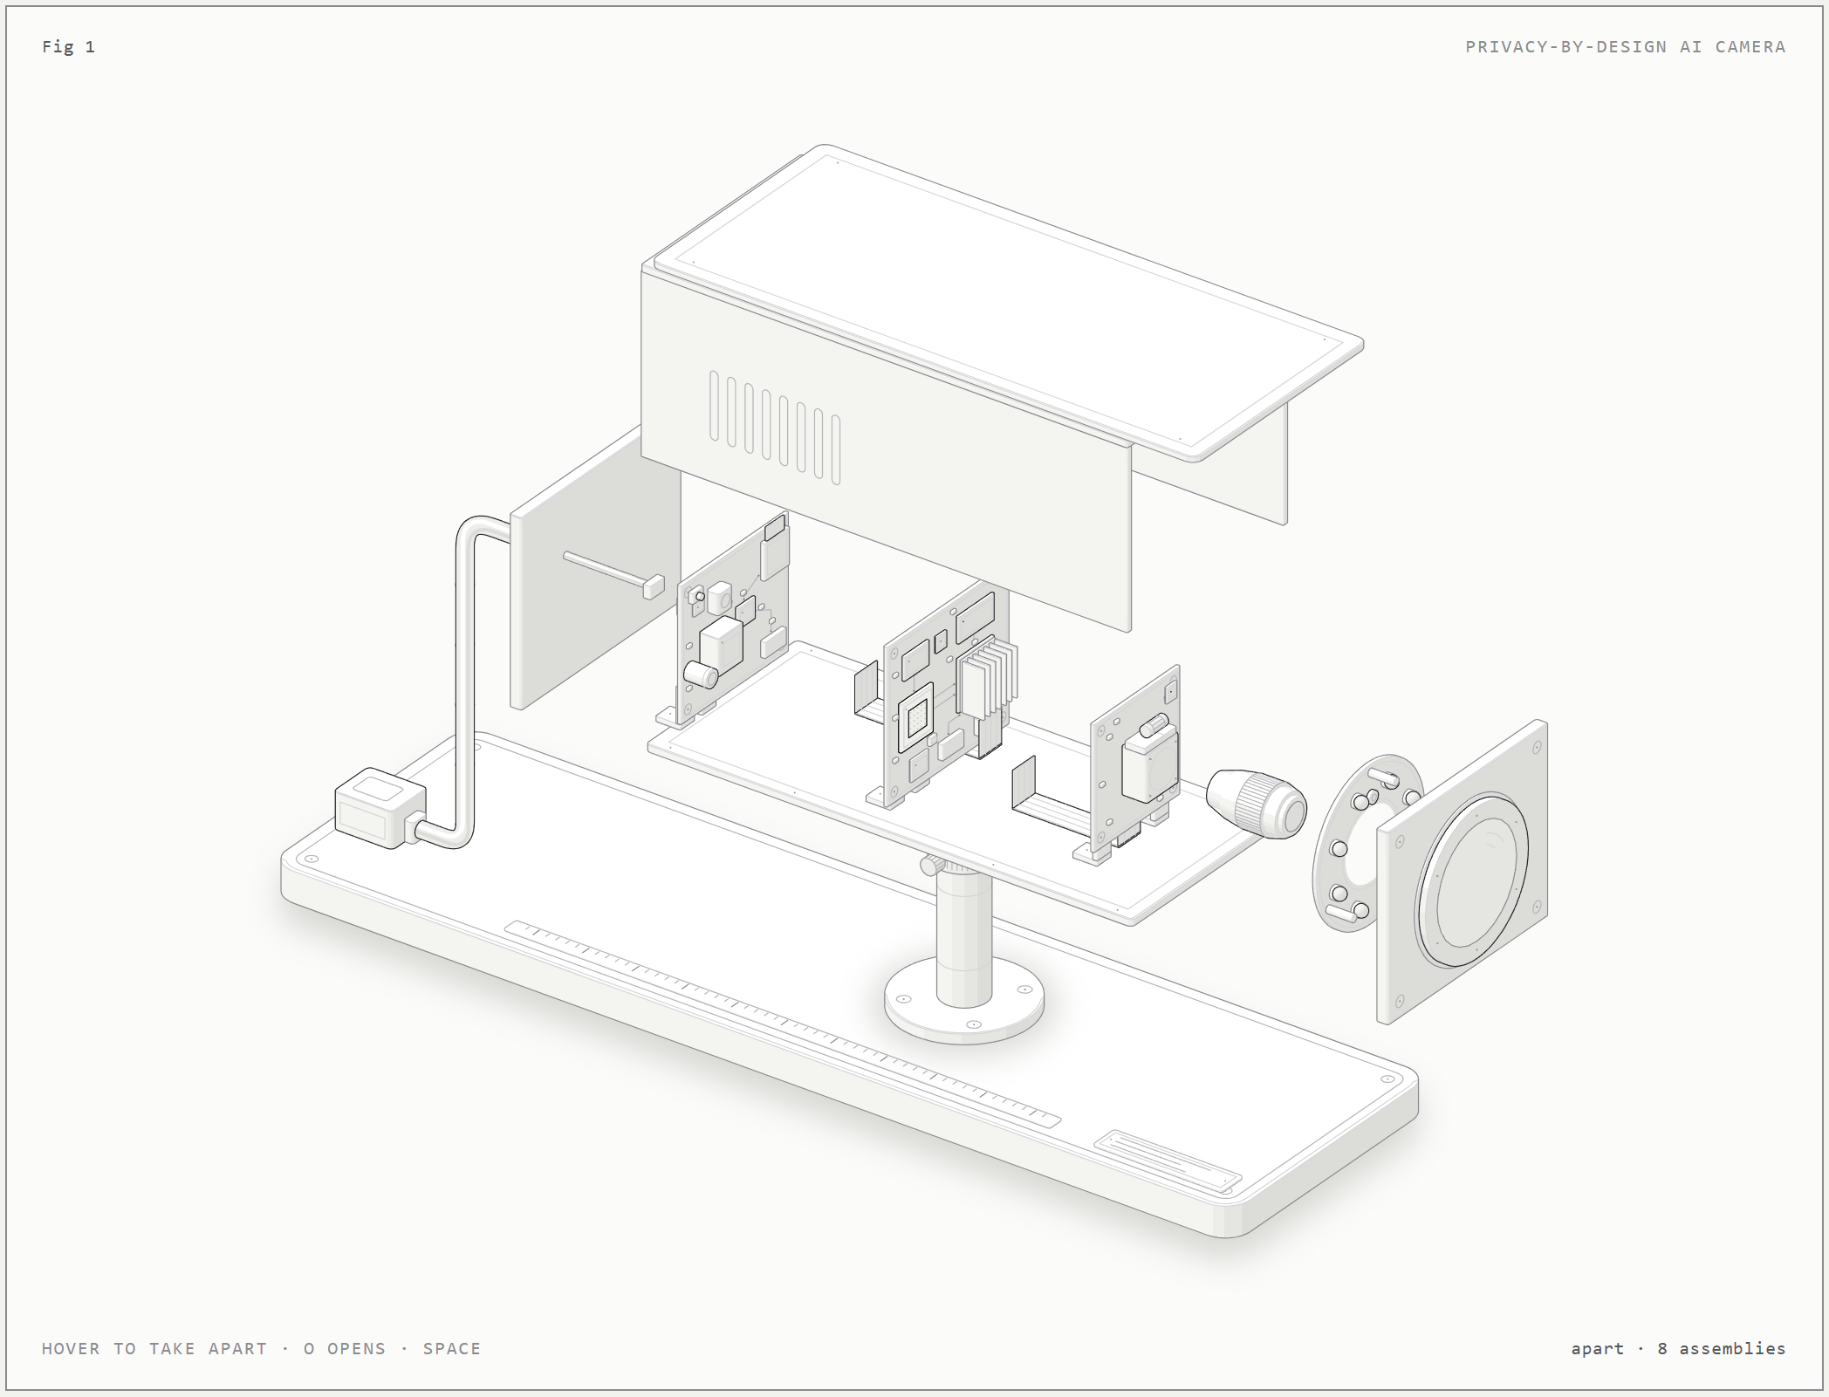
INSIDE THE CAMERA
Every frame passes the NPU before it can be stored or sent
▪ Lens + IR-cut -> CMOS sensor raw frames on one ribbon cable
▪ NPU on the main board masks the frame in its buffer (black cells)
▪ Encoder, microSD, PoE downstream of the mask: no raw path out
Privacy-by-Design AI CCTV · Leon Kaushik Deka
04

Slide 5
DATA
Pre-trained models + openly licensed test images
Hand-labelled evaluation set (Wikimedia Commons)
What the models learned from
▪ COCO 2017 EfficientDet-Lite0 (cell phone, remote)
▪ Google pose / hand datasets MediaPipe
▪ NudeNet dataset 18 body-part classes
A
8 images
hand operating a phone / POS
B
26 images
device visible, no PIN entry
C
21 images
What the system processes
ordinary clothed people
▪ Input 640x480 colour frames
▪ Intermediate 33 body + 21 hand keypoints, boxes
▪ Output masked frames + metadata only
No nudity and no real PINs were collected: that would breach the privacy being protected. The webcam app records your own consented test clips with frame-level ground truth.
Privacy-by-Design AI CCTV · Leon Kaushik Deka
05

Slide 6
TECHNIQUES AND ALGORITHMS
Four pre-trained networks + fusion logic built for privacy
▪ Pose-guided ROI crops small people seen at full detector resolution
▪ Region-aware threshold 0.25 inside chest/pelvis region, 0.45 elsewhere
▪ Vetoes reject parts on hands and anatomically impossible parts
▪ Pose-anchored masks follow the body when the detector misses
▪ PIN rule fingertip on device face (+ pointing, thumb, tapping cues)
▪ Guided zoom passes device->hand, wrist->hand, hand->device
▪ Call filter + occlusion memory ignore phone at ear; carry hidden phone
▪ Temporal hold + fail-closed mask now, release after 12 empty frames
▪ Parallel branches pose->parts, devices, hands run concurrently
Pose
MediaPipe Pose (BlazePose)
33 keypoints
Body parts
NudeNet v3 (YOLOv8n, ONNX)
18 classes
Devices
EfficientDet-Lite0 int8
COCO boxes
Hands
MediaPipe Hands (BlazePalm)
21 keypoints
Privacy-by-Design AI CCTV · Leon Kaushik Deka
06

Slide 7
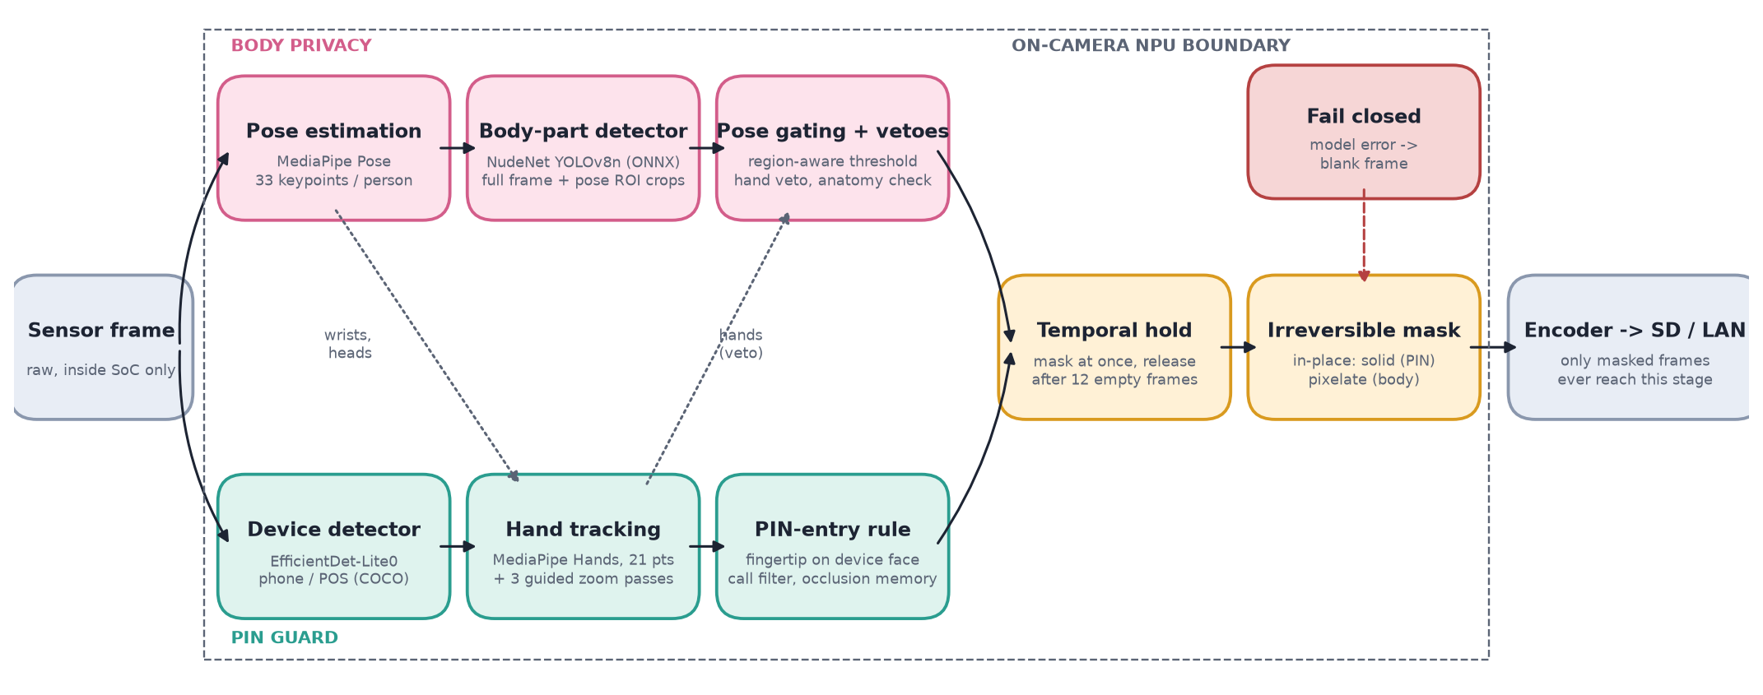
WORKING PROCESS
From sensor to storage: one frame through the pipeline
Dotted links: pose wrists and heads guide the PIN guard; tracked hands veto false body-part detections.
Privacy-by-Design AI CCTV · Leon Kaushik Deka
07

Slide 8
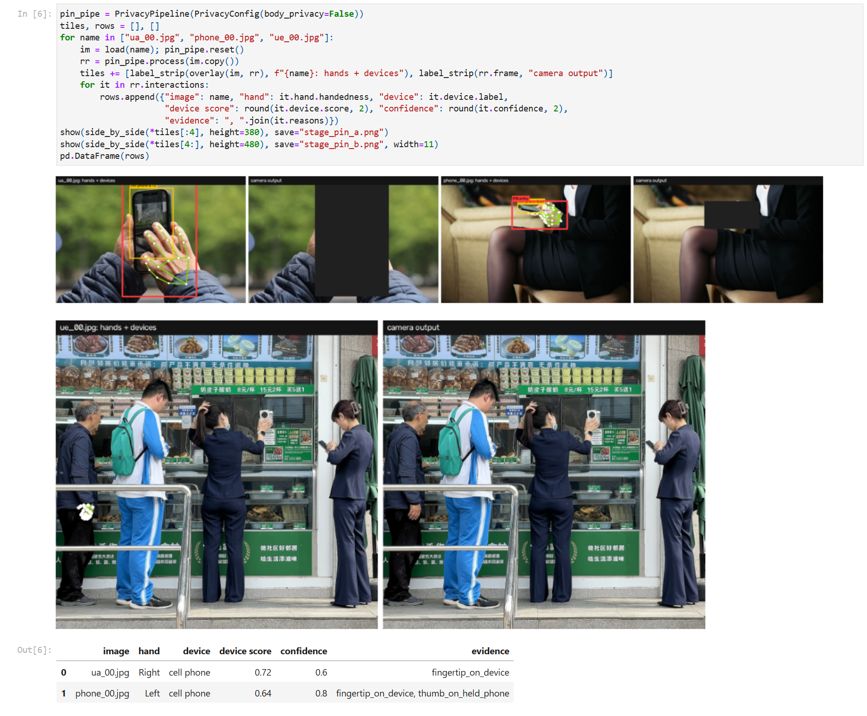
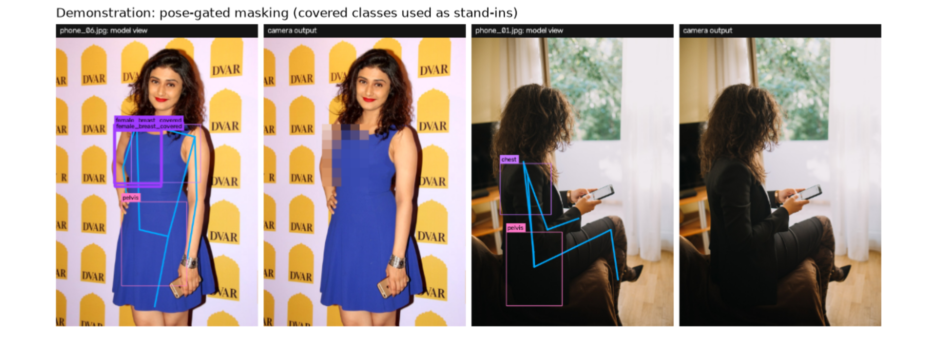
DEMO: JUPYTER NOTEBOOK
Model view vs. camera output
PIN guard (cell 6, left)
▪ Hands + phone found fingertip on the screen = PIN entry
▪ Output phone and hand filled solid; rest of frame untouched
Body privacy (pose-gated masking demo)
Privacy-by-Design AI CCTV · Leon Kaushik Deka
08

Slide 9
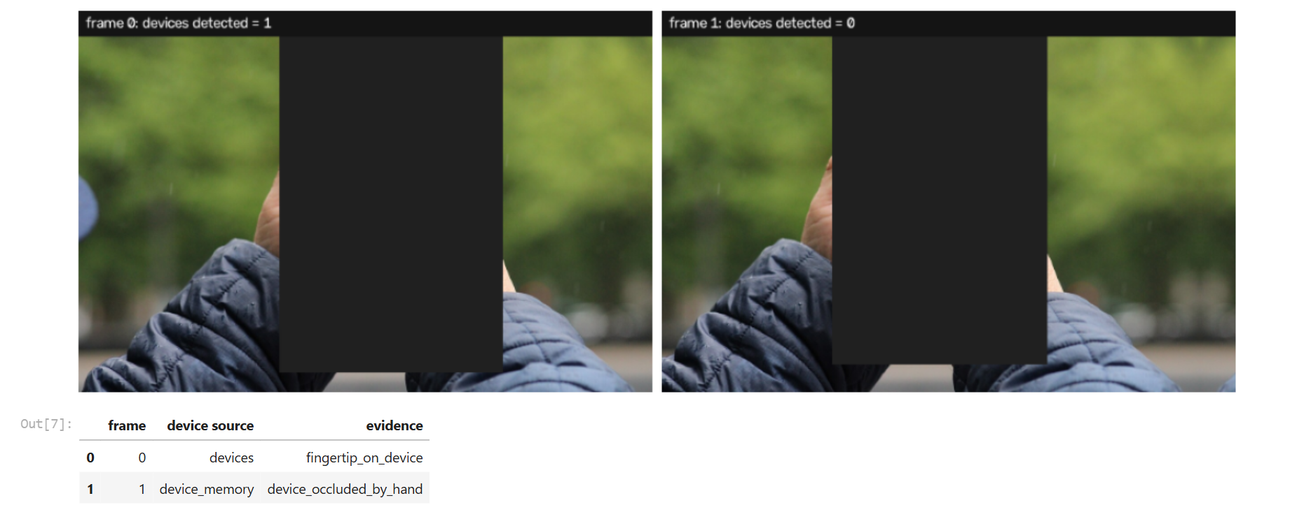
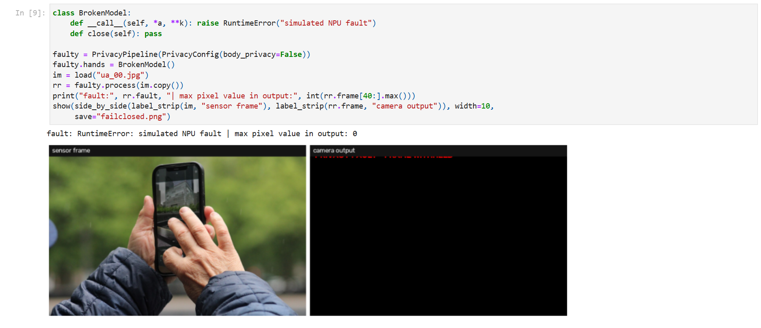
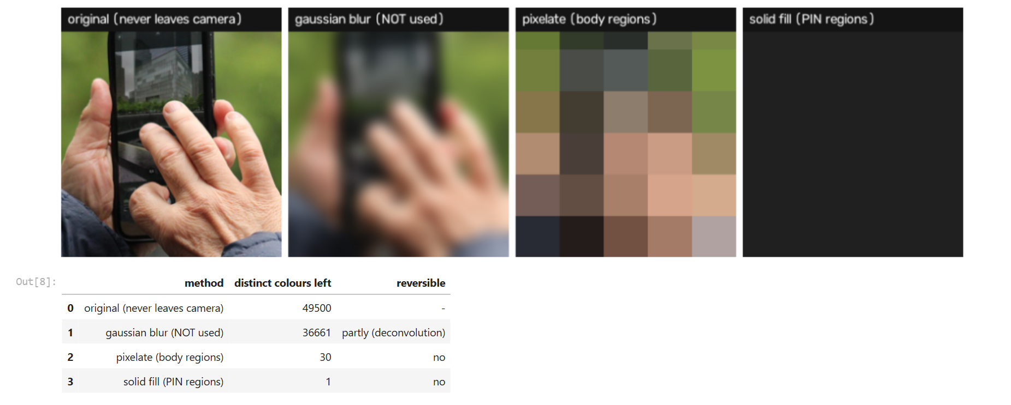
DEMO: ROBUSTNESS
Hidden devices, permanent masks, fail-closed
Device hidden by the hand: mask follows the hand
Simulated NPU fault: frame withheld
Blur is reversible; pixelate / solid are not
Privacy-by-Design AI CCTV · Leon Kaushik Deka
09

Slide 10
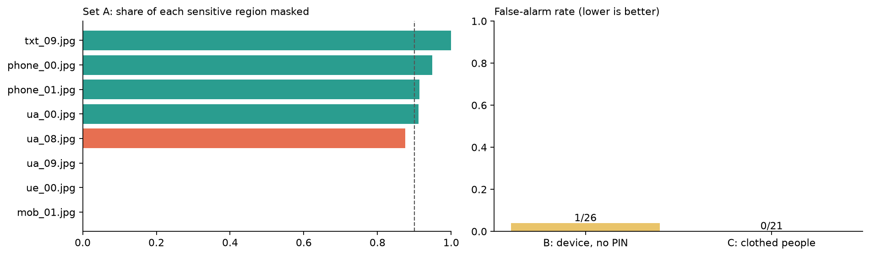
RESULTS
Accurate when the detectors see the hand and device
4/8
58.1%
1/26
0/21
PIN-entry regions fully protected
mean coverage of sensitive regions
false alarms: idle devices
false alarms: clothed people
▪ Every miss is a detection miss hand or phone not found (tiny, B&W, through glass)
▪ Fusion works when both are found, the region is masked
▪ Remaining false alarm a QR-code stand read as a phone
▪ Bank policy masks all devices: higher recall, more masking
Privacy-by-Design AI CCTV · Leon Kaushik Deka
10

Slide 11
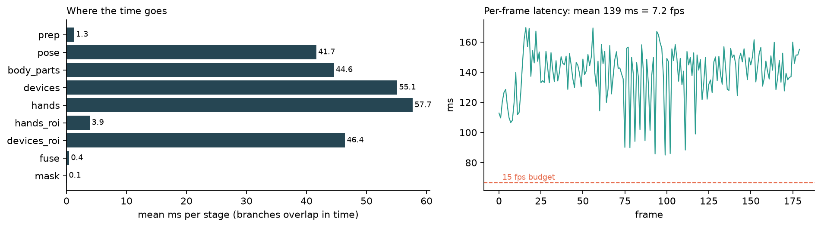
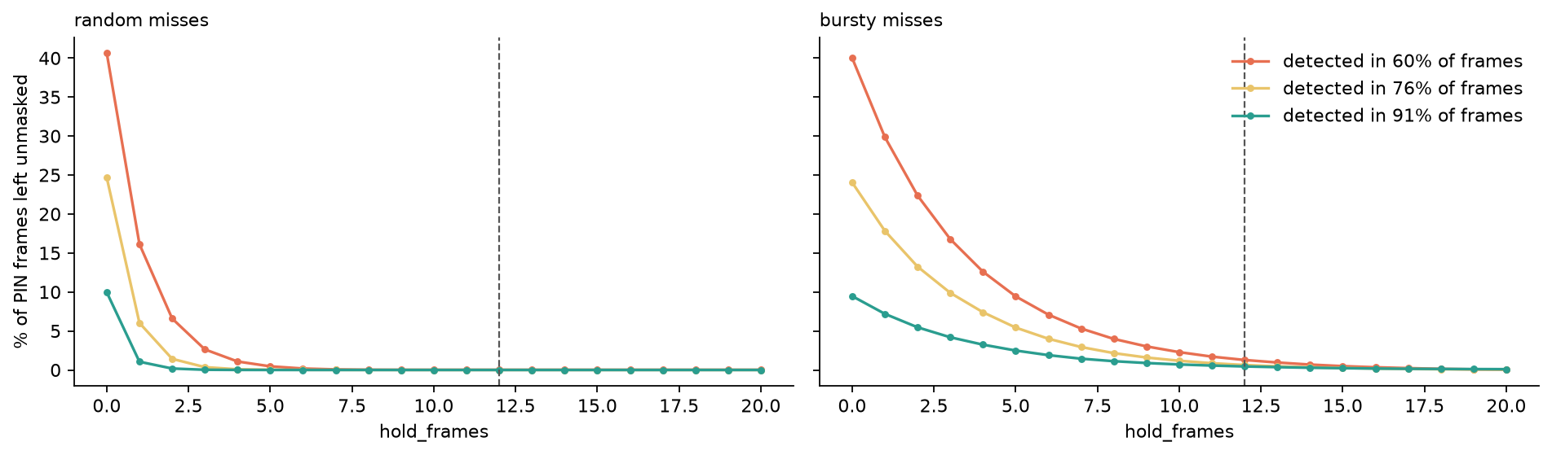
SPEED, TEMPORAL HOLD, TRADE-OFFS
7.2 fps on a laptop CPU; hold removes flicker leaks
Advantages
Limitations
Ethics
▪ No raw footage exists
▪ Evidence kept
▪ Few false alarms
▪ Fail-safe, low cost
▪ Small test set (8 positives)
▪ Tiny subjects missed
▪ No POS-specific class
▪ 7.2 fps without NPU
▪ DPDP Act 2023: data minimisation
▪ Fairness audit across skin tones
▪ No identification / function creep
▪ Signed firmware, no raw preview
Privacy-by-Design AI CCTV · Leon Kaushik Deka
11

Slide 12
FUTURE SCOPE AND CONCLUSION
The camera's own AI can protect privacy instead of eroding it
Future scope
Pose estimation + body-part detection mask intimate regions; hand tracking + device detection mask PIN entry.
Masks are permanent and applied before encoding, so unmasked footage never exists.
Prototype: 4/8 PIN regions protected, 1/26 and 0/21 false alarms, 7.2 fps on CPU.
Next: better small-object detection and an NPU for real-time speed. The architecture stays the same.
▪ Fine-tuned POS / PIN-pad detector
▪ Multi-person pose for crowded corridors
▪ int8 deployment on camera NPUs (RV1126, Hailo-8L, CVflow)
▪ Sequence model for typing (TCN / LSTM)
▪ Segmentation masks instead of boxes
▪ Consented, diverse video benchmark + fairness metrics
Privacy-by-Design AI CCTV · Leon Kaushik Deka
12

