Slide 1
Netzwerktypen
Oder 10GBASE-SX

Slide 2
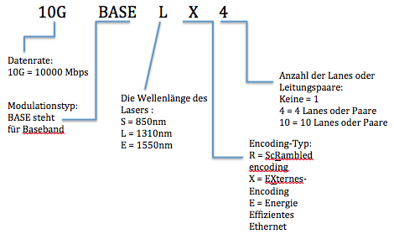
Nomenklatur der Standards

Slide 3
Netzwerkstandard | Laser | Encoding | Max. Länge | Fibermode
1000BASE-SX | 850nm | Extern | 550m | Single
1000BASE-LX | 1310nm | Extern | 5km | Single
10GBASE-SR | 850nm | Scrambled | 300m | Single/Multi
10GBASE-LR | 1310nm | Scrambled | 10km | Single/Multi
10GBASE-ER | 1550nm | Scrambled | 40km | Single
10GBASE-LRM | 1310nm | Scrambled | 220m | Multi
10GBASE-LX4 | 1310nm | Extern | 300m | Multi

