Slide 1
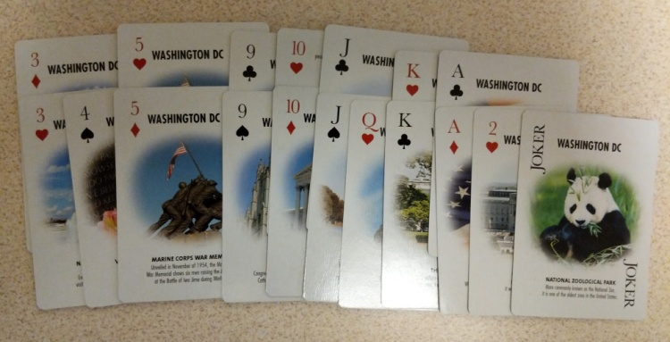
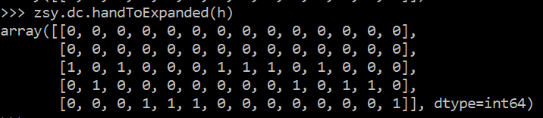
Deep ZSY
Leon Lin (leonl@stanford.edu)
Introduction
争上游 (ZhengShangYou, or“Competition Upstream”) is a Chinese card game that is part strategy, part luck. Each player is dealt about 18 cards that they must get rid of to win, and they get rid of cards by matching patterns.
Here are the game rules:
A coin is flipped to determine who starts the first round.
That player that starts a round has these options to play:
● Single: 1 card
● Double: 2 cards of the same number
● Triple: 3 cards of the same number
● Bomb: 4 cards of the same number
● Chain: a series of consecutively-valued cards, for which each ‘link’ has at least two of that number. For example, 33444, JJQQKK, are valid patterns. 5556677778899 is, but 44566 is not.
The next player must play cards that match the pattern exactly, but are higher. For example, if 777 was played, the next player could follow with 888, 999, QQQ, or so on. If 55666 was played, he could follow with 77888 or JJQQQ (but not JJJQQ). Alternatively, the player can play a “Bomb” over any pattern, and those can only be beaten by higher bombs. Or, the player could pass. When every player has passed, the last player to play some cards wins the round, and gets to start the next round, setting the new pattern. As soon as a player runs out of cards, that player wins the game.
Results
争上游 (ZhengShangYou, or“Competition Upstream”) is a Chinese card game that is part strategy, part luck. Each player is dealt about 18 cards that they must get rid of to win, and they get rid of cards by matching patterns
First Model
First, 100k games were simulated. The
Future Work
争上游 (ZhengShangYou, or“Competition Upstream”) is a Chinese card game that is part strategy, part luck. Each player is dealt about 18 cards that they must get rid of to win, and they get rid of cards by matching patterns
Data Representation
During gameplay, it is useful to represent hands as counts of cards of each value because they can be simply added to or subtracted from to represent taking a move. However, this obscures the fact that having two of a kind is fundamentally not just twice having a single: having a pair allows for different kinds of patterns to be formed.
Thus, I’ve made a dual-representation. During gameplay, the hands, the moves, and the history of moves are all represented by counts. During learning, they are represented by a stack of one-hot encodings of how many there are of each card.
Game histories are summed to represent all the cards the agent has played and all the cards the player has played. Each set of cards (hand, move, history) is thus represented by 15 one-hot vectors over 5 values, so each data point is 15*5*4 = 300 dimensional.
Try it yourself!
争上游 (ZhengShangYou, or“Competition Upstream”) is a Chinese card game that is part strategy, part luck. Each player is dealt about 18 cards that they must get rid of to win, and they get rid of cards by matching patterns
Counts of that hand
A hand of cards
A hand of cards
One-hot representation

