Slide 1
The Approach towards approval of new loans
LIM WEI FENG LEO 2002019D | P03
Notes:
So, today I will be talking about the approach to take when it comes to approval of new loans

Slide 2
01
avg_cur_bal / loan_amnt
avg_cur_bal: Average current balance of all accounts
loan_amnt: The listed amount of the loan applied for by the borrower. If at some point in time, the credit department reduces the loan amount, then it will be reflected in this value.
Notes:
Firstly, the new feature I engineered was the average current balance over the loan amount.

Slide 3
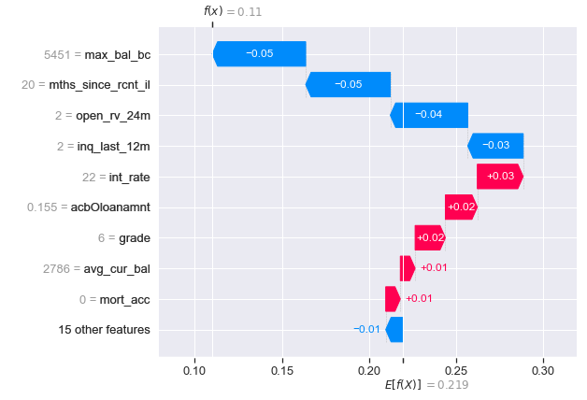
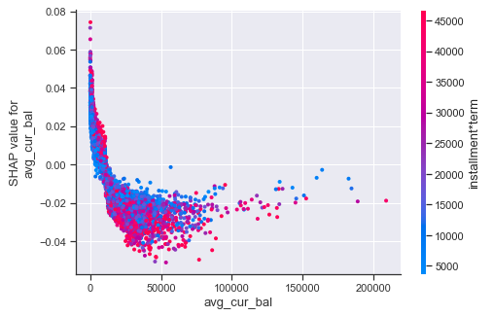
SHAP Plot
Dependence Plot
Waterfall Plot
Tend to be charged off
E[f(x)] is the base value (0.219)
f(x) is the prediction for this particular observation (0.11)
Int Rate, acbOloanamnt, grade and avg_cur_bal had a positive impact on the model.
Shows relationship with installment*term. Negative, non-linear curve, sloping downwards
Log-odds of being charged off decreases significantly between avg_cur_bal of 0 to 50,000.
Low current balance and a high installment*term, leads to people not paying back
In this case, I used loan_amnt instead of installment*term
Notes:
From the dependence plot, it includes another variable that our chosen feature interact most with, and in this case, you can see that average current balance has a relationship with installment*term. It is a negative non linear curve that slopes downwards. For This graph, it represents the log odds of being charged off, and you can see that it decrease significantly when average current balance was between 0-50,000
When you look at this plot, you can see that if a person have a low current balance and a high installment*term, he/she may not pay back, which leads to them being charged off
And for the next plot, I used loan amount instead of installment*term
And when you look at the waterfall plot, the bottom of the waterfall plot, E(fx) is the base value, which is 0.219, this is the value that would be predicted if we didn’t have any features for the current output. f(x) at the top is 0.11, which is the final prediction output for this particular observation.
You can see that the red arrows. Which consists of interest rate, average current balance over loan amount, grade and average current balance has a positive impact on the model (which is +0.02), it pushes the outcome to the right. Whereas the blue arrows, such as maximum balalance, mths since recent installment, open_rv_24m and inq_last_12m has a negative impact on the model, which pushes the outcome to the left.

Slide 4
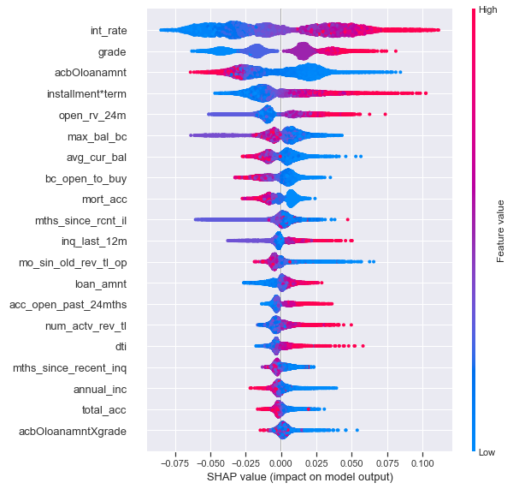
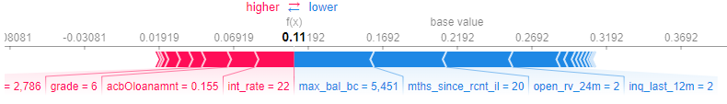
SHAP Plot
Force Plot
Int rate, acbOloanamnt and grade are the top 3 most important features pushing up the prediction
The features are ordered according to their importance. acbOloanamnt was a better form of prediction than its own original value.
Notes:
In this summary plot, you can also see the features were being ranked according to their importance.
Dots to the right will drive the target higher (which in this case is the probability of being charged off)
The new feature I created, which is acbOloanamnt was a better form of prediction than loan amnt and average current balance.
In the force plot, interest rate, average current balance over loan amount and grade are the top 3 most important features pushing up the prediction

Slide 5
02
max_bal_bc / num_actv_rev_tl
max_bal_bc: Maximum current balance owed on all revolving accounts
num_actv_rev_tl: Number of currently active revolving trades
Notes:
The next feature I created was maximum current balance over number of currently active revolving trade.

Slide 6
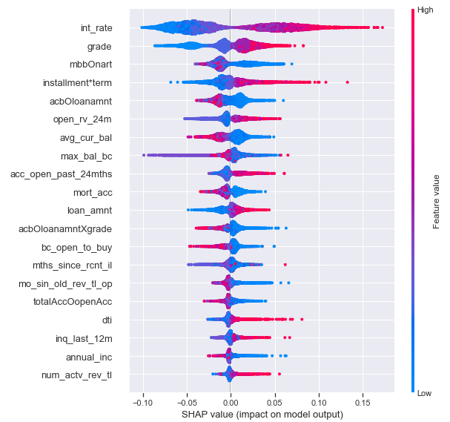
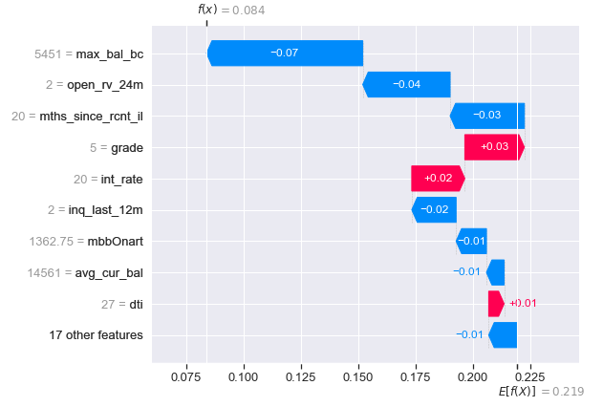
SHAP Plot
Summary Plot
Waterfall Plot
Notes:
From this summary plot, you can see that the new feature was ranked pretty high at the top, which shows that it was a useful predictor in the model and was better than the 2 original feature. For the new feature, we can see that the lower the value is, the more likely a person would be charged off
And when you look at the bottom of the waterfall plot, E(fx) is the base value, which is 0.219, this is the value that would be predicted if we didn’t have any features for the current output. f(x) at the top is 0.084, which is the final prediction output for this particular observation.
You can see that the red arrows, which consists of interest rate, grade and dti are pushing up the target value, while features like maximum current balance, open_rv_24m, inq_last_12m and our new feature is pushing down the target value

Slide 7
03
Recommendations
What to look out for
Notes:
What are my recommendations when it comes to approval of loan

Slide 8
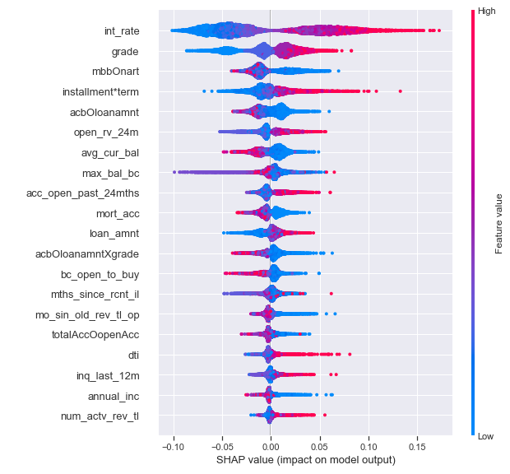
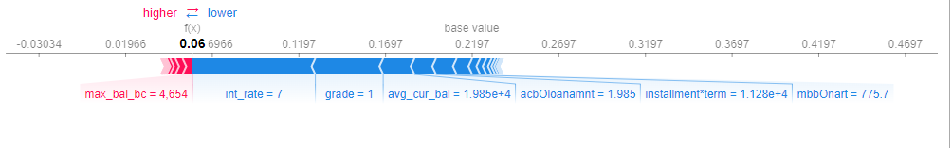
Recommendations
Most likely to be charged off
Top 5 Factors that make a person likely to be charged off
Int Rate (High)
Grade given (A-G)
Installment*term (if both are high)
Average current balance / loan amnt (low)
Dti (high)
What we can see:
Prediction for this was very low, 0.06, which means this person has paid off.
Int Rate, grade,avg_cur_bal and acbOloan_amnt was low, it pushes the prediction down, which goes to say that our new features and precautions given is feasible.
Notes:
The top 5 factors that makes a person likely to be charged off are the interest rate (when high), grade given(A-G, G being the worst), installment*term(when both are high), average current balance over loan amnt (when this is low) and when the DTI Is high. If you look closely at the graph below, it shows a force plot. What can we see from here? The prediction for this particular value was low, 0.06, which means that this person has paid off. Looking closely at their interest rate, grade, average current balance over low amnt, these values are pretty low, and it pushes the prediction down, which goes to say that our new features and precautions given are feasible.
That concludes the end of my sharing, thank you.

