Slide 1

Portal for Smart Building Energy Monitoring & Carbon Footprint
Done By: Leo from CrazyImps
Website Link: http://134.209.100.55:8000/

Slide 2
Functionalities in short
Real time tracking
Company’s consumption are tracked by minute basis
Company
Overall consumption & usage
Benchmark Chart
Comparison of usage with other commercial building
Tracking of
data
Dashboard
Usage, warning level etc.
Individual
Overall consumption & usage
Level Usage
Track how much your peer have used

Slide 3
Problem
Usage untracked
Lack of real-time data
Lack of IOTs

Slide 4
What needs to be done
1
2
3
4
Installation of IOTs | Pull data from IOT | Store into database | Render into portal
Arduino Accurate tracking Affordable Plug and play | Set up server Create a database Push data into database¹ | Per minute/hour basis Different sensor uses different items | Once data is pushed to database, data is ready to be rendered into portal’s webpage
https://create.arduino.cc/projecthub/muhammad-aqib/logging-data-to-database-using-arduino-ethernet-shield-3e9a0e

Slide 5
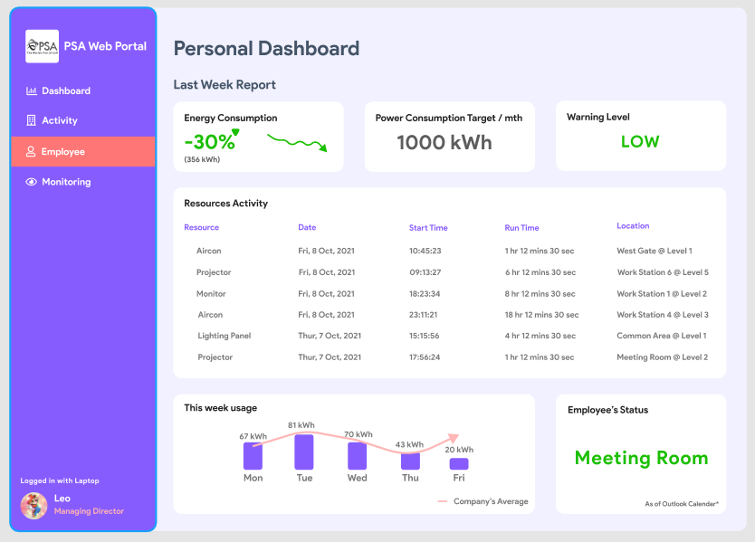
Mockup

Slide 6
How does it work?
IOTs all set up
Register to database
Real time push to portal
Each resource eg. aircon must now be turned on using a staff pass.
Arduino will now register the staff to it’s own database, and track the usage of resource (aircon etc) by the staff ID.
Every hour, Arduino will push the consumption data to the database, and warn staff is usage have exceeded

Slide 7
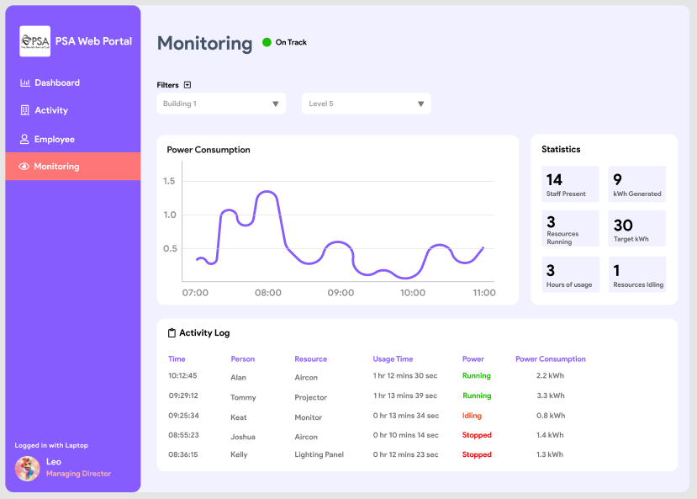
Mockup

Slide 8
Tracking of usage by different levels in the building
You
3 kWh
Colleague
How much your colleague have used
10 kWh
How much you have used

Slide 9
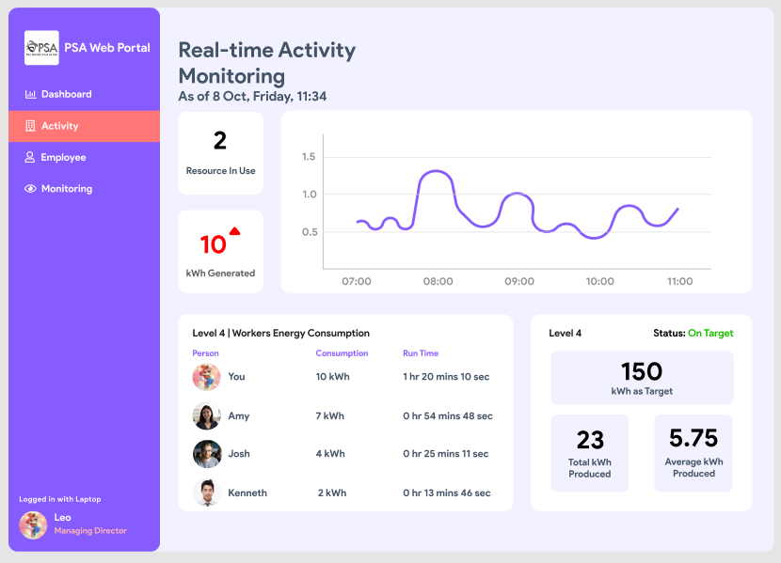

Slide 10
The roadmap to minimal usage
Collaboration
Teamwork
Comparison
Win Win
Success
Each level would be pegged to a limit level
Each staff in individual level tries not to exceed
If exceeded, warning would be issued. Those with resource idling would be flagged
If everyone sticks to the limit, PSAH would achieve a low overall carbon footprint
Benchmark against other commercial buildings to get the lowest consumption level

Slide 11
Executive Summary
Real Time
More IOTs
Data and Interaction
Tracking usage
You would not know how much you have used if there is none.
For eg. aircon usage along with staff ID would be pushed into database for references.
Strategic Plan
Past Data Records
Public
Resource Activity
Dashboard
Know what resource you have used over the past week or month.
Everyone would be able to see each other usage. PSA would be able to benchmark themselves to other commercial buildings.

