Slide 1
🌏 AktivAsia
AktivAsia Training Portal
Gideon Noel Valera
Digital Projects Manager | Regional Team
May 2026
Your Guide to Tracking Training Impact Across the Region

Slide 2
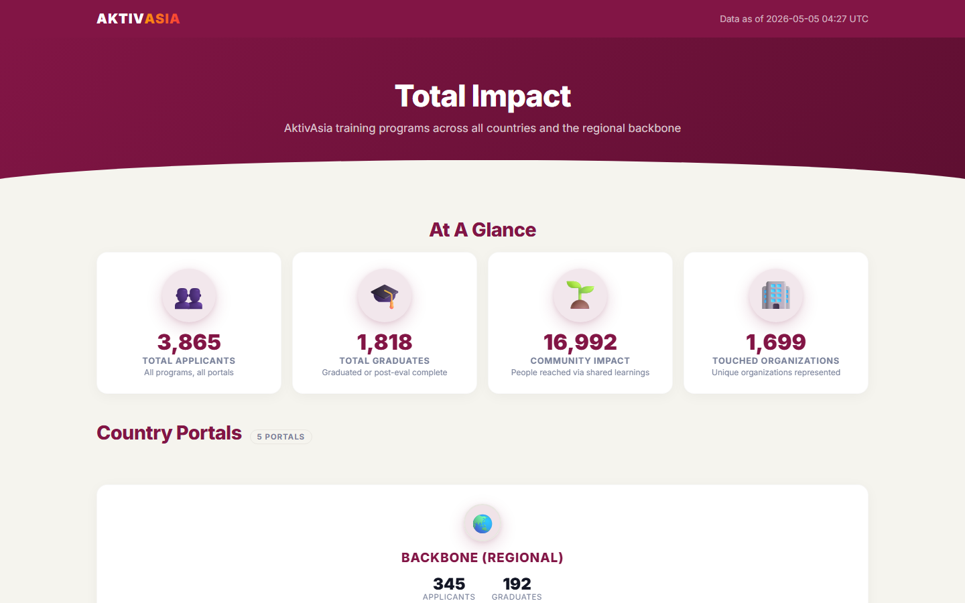
Why This Portal Exists 🌟
The Problem
Tracking applicants, graduates, and training impact was manual — spreadsheets, emails, and scattered data across the team.
What It Replaces
No more manual reports. The portal collects and displays all training data automatically, in real time.
What It Enables
Country teams and leadership get clear, consistent reports — who applied, who graduated, and what impact was made — at any time, from anywhere.
📸 Portal screenshot
AktivAsia Portal | User Guide & SOP | May 2026

Slide 3
The 5 Portals at a Glance 🌏
Each country has its own portal. The Backbone shows the full regional picture.
🌐
🇵🇭
🇵🇰
🇰🇷
🇮🇩
Backbone (Regional)
Philippines (PH)
Pakistan (PK)
Korea (KR)
Indonesia (ID)
Combined view of all countries + regional trainings
Philippines country portal
Pakistan country portal
Korea country portal
Indonesia country portal
AktivAsia Portal | User Guide & SOP | May 2026

Slide 4
The Applicant Journey 🚀
Every applicant goes through the same journey — from application to impact.
📝
✅
🏫
🎓
📊
→
→
→
→
Apply
Selected
Training
Graduate
6-Month Eval
Applicant fills in the online application form
Country team reviews and selects participants
Training takes place — attendance is recorded
Participant completes training + post-survey
Graduate shares their impact 6 months later
AktivAsia Portal | User Guide & SOP | May 2026

Slide 5
What You Can See — 4 Reports 📊
Every country portal has 4 report tabs. Each answers a different question.
📊
📅
💡
👥
Overview
Training Plan
Impact
Demographics
How many people applied, graduated, and are ongoing?
What trainings are planned, ongoing, and completed?
How did participants rate their skills — before, after, and 6 months later?
Who are our participants — by gender, age, and region?
AktivAsia Portal | User Guide & SOP | May 2026

Slide 6
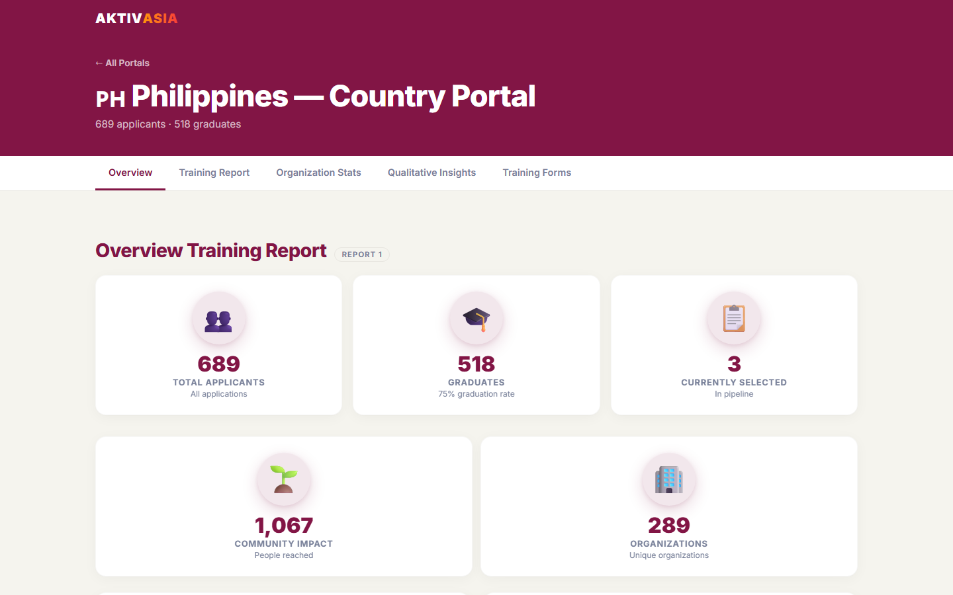
Report 1: Overview 📈
Your training programme at a glance.
🔢 Total Applicants
Everyone who ever applied to a training in your country
🎓 Total Graduates
Participants who completed training AND the post-survey
⏳ Ongoing
Participants selected for a current or upcoming training
📉 Application Funnel
See where people drop off: Applied → Attended → Graduated → 6-Month Eval
📆 Year-Over-Year Trend
Is your programme growing? Compare applicants and graduates by year
📸 Portal screenshot
AktivAsia Portal | User Guide & SOP | May 2026

Slide 7
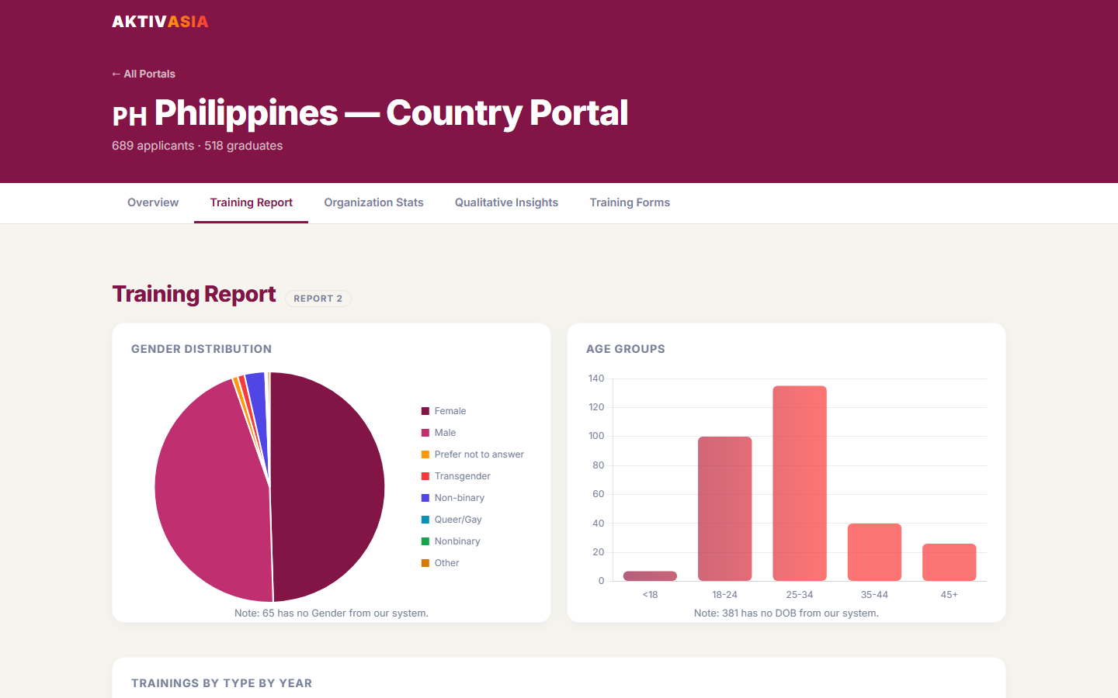
Report 2: Training Plan 📅
Everything about your training schedule — past and future.
📋 Trainings by Type
How many Foundational, TOT, Feminist Leadership, and Public Narrative trainings have been run vs. planned
🧑‍🤝‍🧑 Practice Sessions
Skills sessions held — with dates and attendance counts
📌 Upcoming Trainings
What's planned next — name, type, and date
✅ Completed Trainings
Full history of past trainings with applicant and graduate counts
📸 Portal screenshot
AktivAsia Portal | User Guide & SOP | May 2026

Slide 8
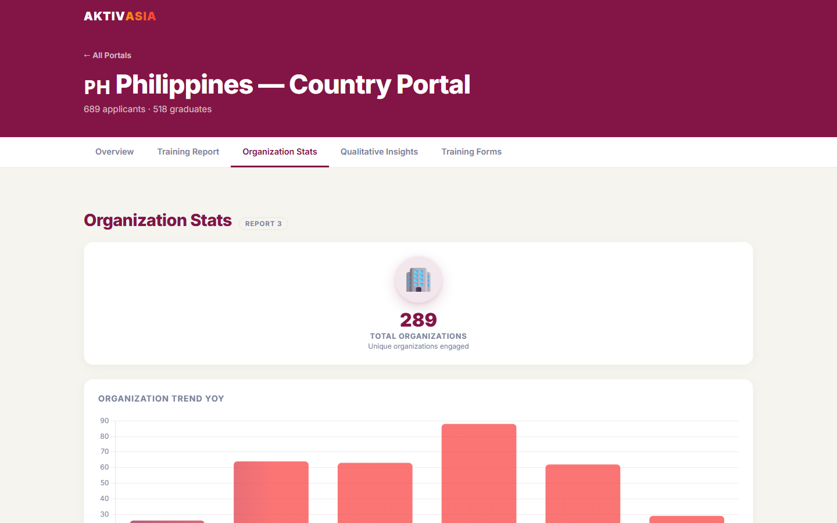
Report 3: Impact 💡
Did the training make a difference? Here's the evidence.
📊 Likert Skill Scores
Average self-rated scores (1–5) on 4 skills: Strategy, Communication, Facilitating, and Building Connections — measured Before, After, and at 6 Months
💬 Post-Survey Feedback
Written responses from participants: what went well, what they learned, their action plans
🔍 6-Month Evaluation
How graduates applied their learning, what changed in their campaigns and work
💡 Look for rising scores from Pre → Post → 6 Months. That's your proof of lasting impact.
📸 Portal screenshot
AktivAsia Portal | User Guide & SOP | May 2026

Slide 9
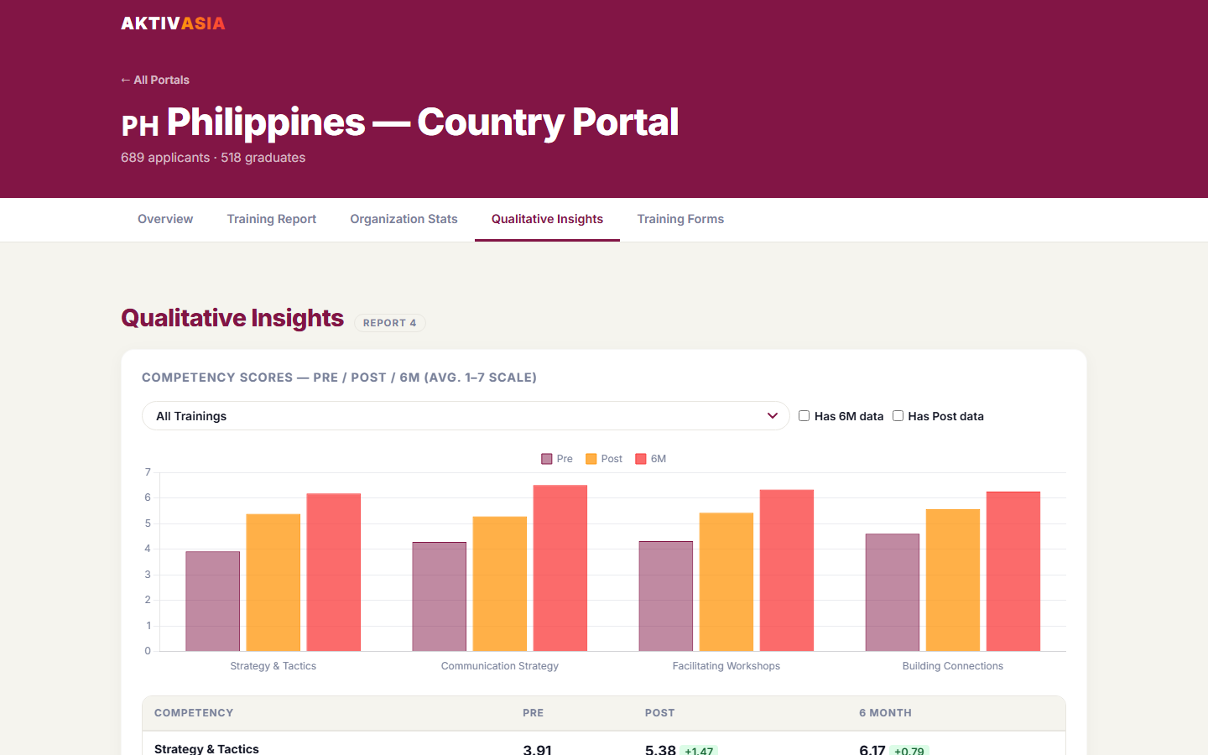
Report 4: Demographics 👥
Who is your training reaching?
⚥ By Gender
Male / Female / Other breakdown — are we reaching a balanced audience?
🎂 By Age Group
18–24 / 25–34 / 35–44 / 45+ — which age groups are we serving most?
📍 By Region
City and province breakdown — are we reaching beyond the capital?
💡 Use Demographics to guide outreach — if one group is underrepresented, target them in the next training cycle.
📸 Portal screenshot
AktivAsia Portal | User Guide & SOP | May 2026

Slide 10
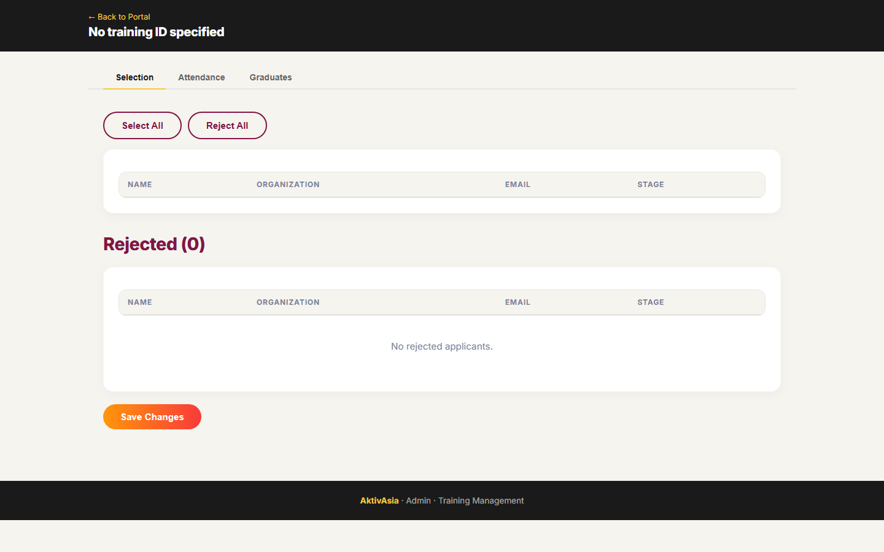
Managing a Training ⚙️
The Admin Panel has 3 steps. Always do them in order.
Step 1 ✅ Select
Step 2 📍 Attend
Step 3 🎓 Graduate
After applications close: Review applicants one by one Mark each as Selected or Rejected Click Save Changes
On or after training day: Mark each selected participant as Attended or Not Attended Click Save Changes
After post-survey closes: Mark participants who completed the survey as Graduated Track 6-Month Eval progress bar
→
→
📸 Portal screenshot
AktivAsia Portal | User Guide & SOP | May 2026

Slide 11
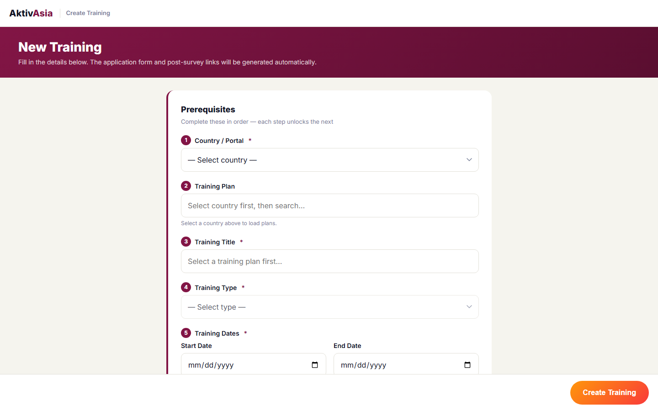
Creating a New Training ➕
Use the Create Training form to add a new training to the system.
1
Go to: aktivasia.pages.dev/create-training.html
4
Select the Country (Organised By) and enter Start & End Dates
2
Fill in the Training Title (use the official name format)
5
Set Application Form dates (open & close) and Post-Survey dates
3
Select the Training Type: Foundational / TOT / Feminist Leadership / Public Narrative
6
Click 'Create Training' — done! ✅ The training appears in the portal within 24 hours
📸 Portal screenshot
AktivAsia Portal | User Guide & SOP | May 2026

Slide 12
Automated Reminders 🔔
The system sends these emails automatically. You don't need to do anything!
📅
👥
📍
📝
Training Countdown
Selection Reminder
Attendance Reminder
Post-Survey Reminder
When: 7 days before training starts
When: After applications close — if applicants are still waiting
When: Day before / day of training
When: After training ends, when survey window opens
To: Country team
To: Facilitator
To: Facilitator
To: Participants
AktivAsia Portal | User Guide & SOP | May 2026

Slide 13
Getting Started ✅
Here's what to do right now:
🌐
⚙️
📧
Open the Portal
Bookmark Admin
Check Your Email
Go to aktivasia.pages.dev — bookmark it in your browser
Save the Admin Panel link for your country's trainings
Make sure your email is registered — reminders will go there
💬 Have a question or something looks wrong? Reach out to the Regional Team!
AktivAsia Portal | User Guide & SOP | May 2026

Slide 14
Questions? We're Here to Help! 💬
Gideon Noel Valera
Digital Projects Manager | Regional Team
📧 gideon.valera@gmail.com
Thank you for being part of the AktivAsia community 🌏

