Slide 1
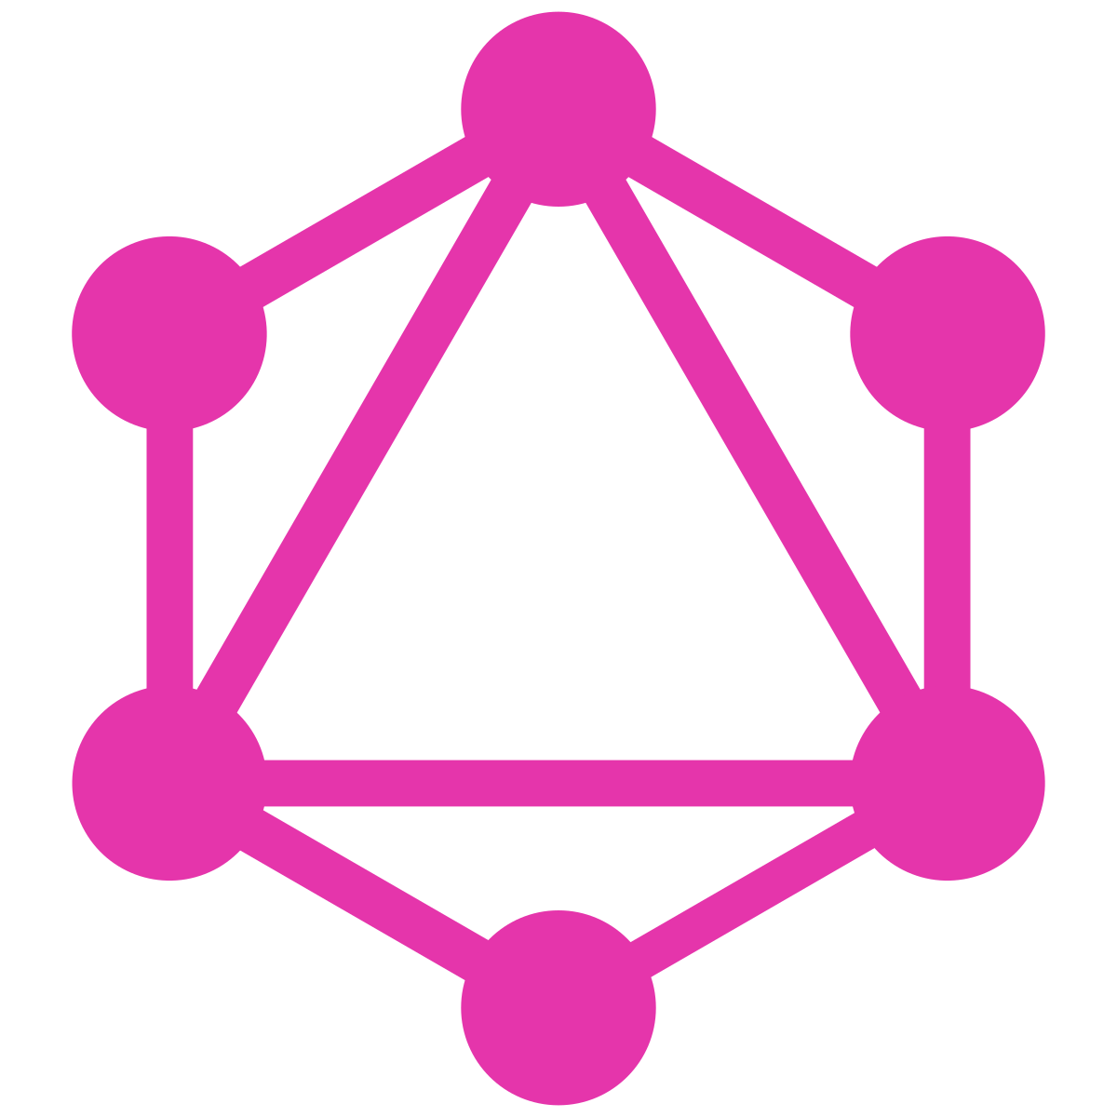
GraphQL
Presentation by Leon Oelen
DIN17SP

Slide 2
Presentation contents
What is GraphQL?
Who uses GraphQL?
When should you use GraphQL?
Common misconceptions
GraphQL vs. REST -> Structure, pros & cons
Glossary
Practical implementation
Summary

Slide 3
What is GraphQL?

Slide 4
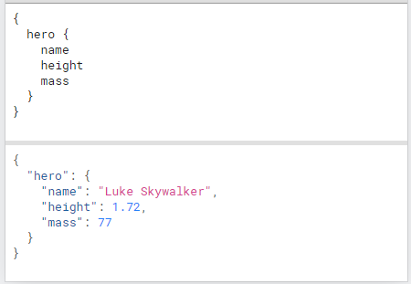
What is GraphQL?
“GraphQL is a query language for APIs and a runtime for fulfilling those queries with your existing data. GraphQL provides a complete and understandable description of the data in your API, gives clients the power to ask for exactly what they need and nothing more, makes it easier to evolve APIs over time, and enables powerful developer tools.”
Ask for what you need, get exactly that
Example

Slide 5
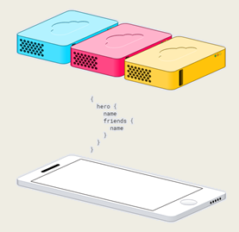
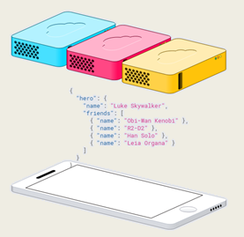
What is GraphQL?
Many resources in one single request
No loading from multiple URLs (REST APIs)

Slide 6
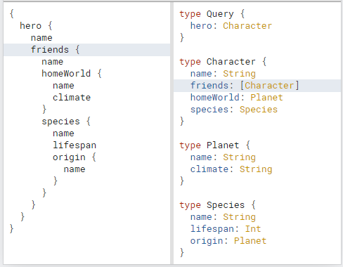
What is GraphQL?
Type system to describe what is possible and what is not
Organization in terms of types and fields rather than endpoints
Access full data capabilities from one single endpoint
Clear and helpful errors

Slide 7
What is GraphQL?
Defines a data shape -> Queries and responses are basically mirrored
Easy to use
Hierarchical
Naturally follows relationship between objects
No resource-intensive round trips or complex join statements
Protocol, not storage
Takes advantage of existing code
Version free
Additional fields can be added while leaving existing clients unaffected
Server fields can be deprecated but continue to function

Slide 8
Who uses GraphQL?

Slide 9
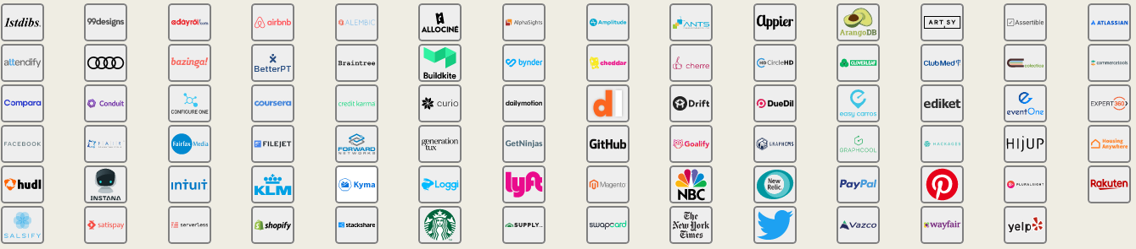
Who uses GraphQL?

Slide 10
Who uses GraphQL?
Originally developed internally by Facebook in 2012
Result of poor performance and frequent crashes
Evaluation to determine what is best
Decoupling data used by mobile applications with the server queries
Open sourced in 2015

Slide 11
When should you use GraphQL?

Slide 12
When should you use GraphQL?
Abstraction reduces complexity
No need to worry about response codes and planning out URLs like
“/project/item/somethingElse/youGetThePoint”
No need to worry about all the POST/GET/UPDATE/DELETE calls
Request/manipulation of data (query) is completely decoupled from the execution of those actions (resolvers)
When bandwidth usage matters; apps for mobile phones, smartwatches, IoT devices
Apps where nested data needs to be fetched in a single call; blog or social media platform
Composite pattern case, when the app retrieves data from multiple different storage APIs

Slide 13
Common misconceptions

Slide 14
Common misconceptions
“GraphQL exposes my database”
Reality: You have a fine-grained control over what data you expose. You can still check the user permissions before returning data.
“GraphQL queries are just as complex as SQL”
Reality: GraphQL queries are incredibly simple, even when requesting the most nested data. It’s like writing JSON. SQL queries can get very complex.
“GraphQL isn’t scalable”
Reality: GraphQL is incredibly scalable and has been widely used by massive companies
“Is GraphQL a database…?”
This is probably one of the questions you will find when simply googling “GraphQL”. It is not a database and it is not an alternative for a database, it is simply a querying language for APIs.

Slide 15
GraphQL vs. REST

Slide 16
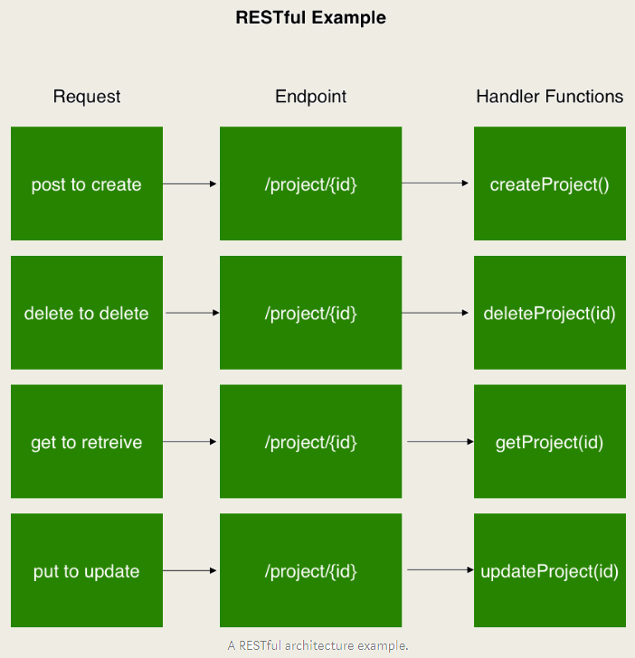
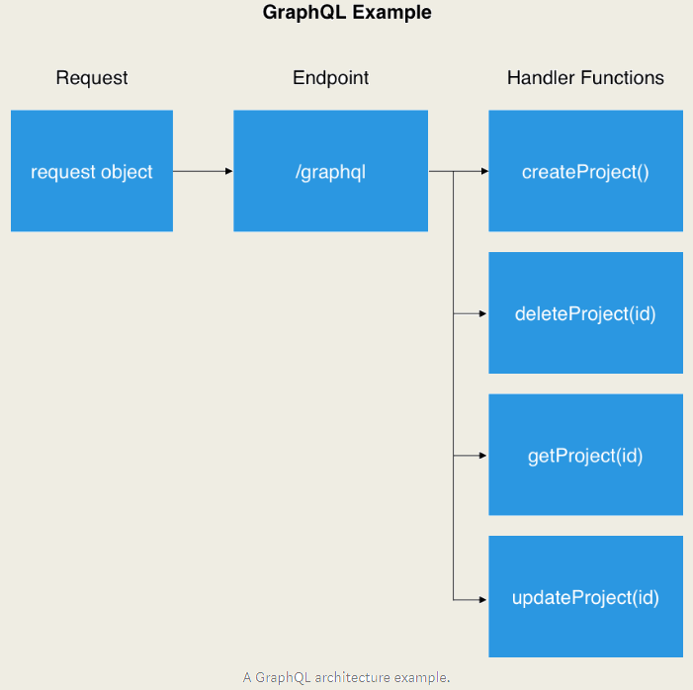
GraphQL vs. REST Structure

Slide 17
GraphQL vs. REST Pros
GraphQL REST
Good fit for complex systems and microservices - Return data in multiple different formats
Fetching requested data in a single call - Less bandwidth than SOAP
No over- and under-fetching problems - Very adaptable with cloud technology
Tailoring requests to your needs - Allows for monitoring
API evolution without versioning - Abstraction layer
Easy to learn and expand - Reused by all front ends
Notes:
The REST API is an abstraction layer: You can change your DB representation freely and maintain a consistent API (so product evolution is easier).
The REST API is reused by all frontends: You only need to implement the DB layer once.

Slide 18
GraphQL vs. REST Cons
GraphQL REST
Difficult to track a false request - Over- and under-fetching of data
Lack of monitoring endpoints - Performance issues due to chaining
Not as cacheable as REST - More difficult to use for new developers
Exposed for arbitrary requests
Notes:
The REST API is an abstraction layer: You can change your DB representation freely and maintain a consistent API (so product evolution is easier).
The REST API is reused by all frontends: You only need to implement the DB layer once.

Slide 19
Glossary
Apollo
Open source implementation to manage data between the cloud and your UI
Field
A unit of data asked for in the schema, which ends up as a field in the JSON response data
Graphiql
In-browser integrated development environment for GraphQL development
Mutation
Operation for creating, modifying and destroying data
Object Type
Type on a GraphQL schema that has fields
Root Query
Defines what queries/operations the server can execute
Schema
Describes the functionality available to the clients which connect to it

Slide 20
Practical implementation

Slide 21
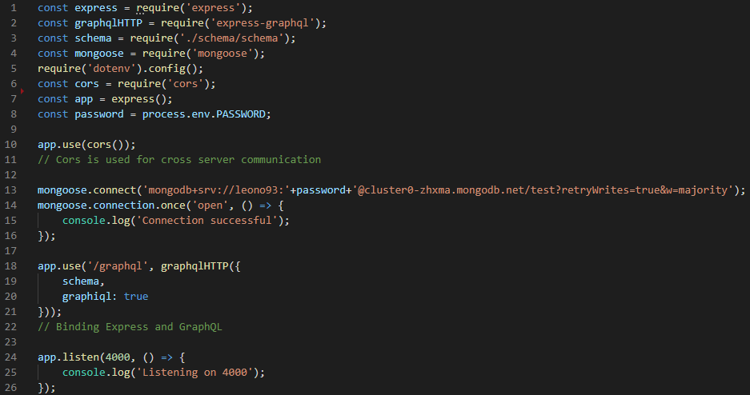
GraphQL and Graphiql setup
App.js

Slide 22
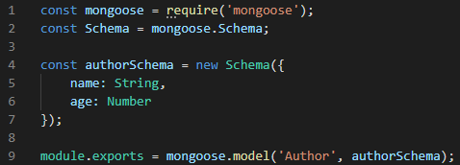
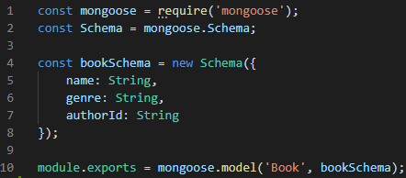
Models
Author.js Book.js
Similar to REST, we use models to define functionality and parameters in terms of adding, updating or removing data. In this case, there are two models later used in the addAuthor and addBook mutations.

Slide 23
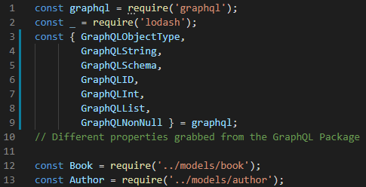
Schema
Schema.js
The GraphQL package comes with many different handy properties which will help set up the types, root queries, fields and mutations.

Slide 24
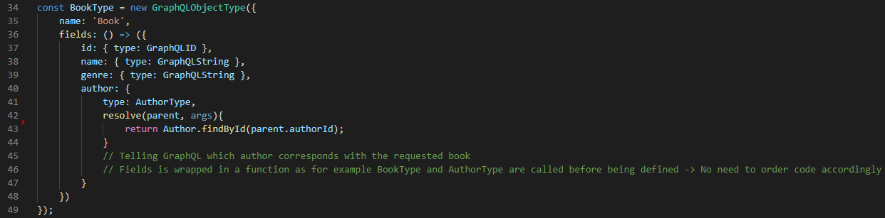
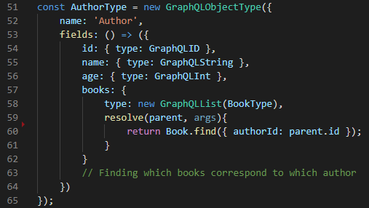
Schema
Here we define our object types, which is a GraphQL object with fields. We set the parameters, properties and the GraphQL properties assigned to the fields.

Slide 25
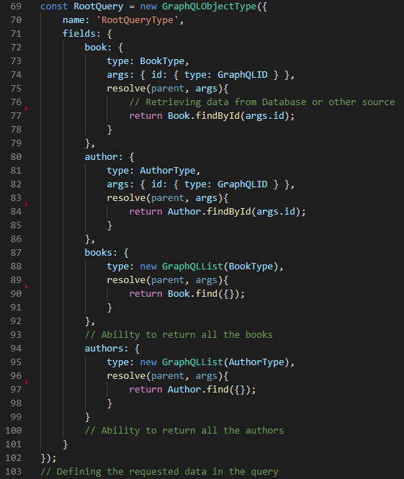
Schema
When we create a Root Query type, we define the data that is requested in the initial stage of the query. We set the arguments for requesting a certain id, or simply returning everything available using the GraphQLList property.

Slide 26
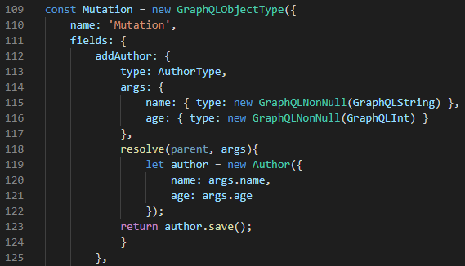
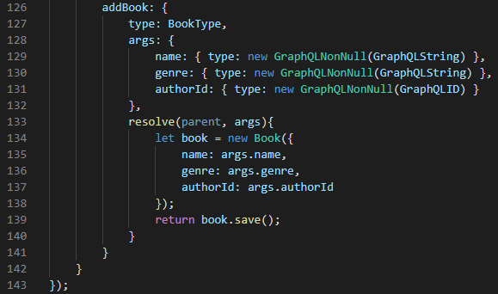
Schema
With Mutations, we can define functionality such as adding, updating, or removing objects. Our models are invoked here to create new Schemas. Note how it is once again a GraphQLObjectType. You choose the functionality you give to it by defining the fields and resolving the arguments.

Slide 27
Querying with graphiql

Slide 28
GraphQL & React

Slide 29
GraphQL & React
Use of Apollo Client
Apollo Client is a complete state management library for JavaScript apps. Simply write a GraphQL query, and Apollo Client will take care of requesting and caching your data, as well as updating your UI.
Fetching data with Apollo Client guides you to structure your code in a predictable, declarative way consistent with modern React best practices. With Apollo, you can build high-quality features faster without the hassle of writing data plumbing boilerplate.
Other dependencies from the React-Apollo library such as gql, which allows you to process GraphQL queries from React

Slide 30
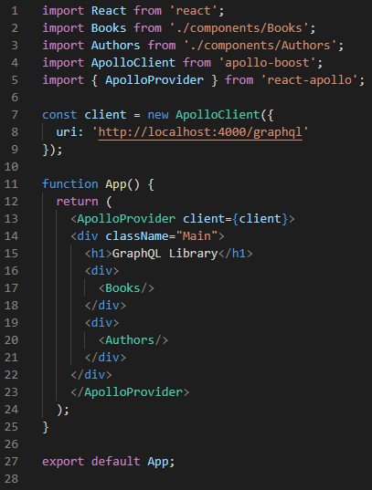
GraphQL & React
App.js
It doesn’t take much to get started with React and GraphQL. All you need is to set up an Apollo Client within your App.js file and establish a connection to the uri your backend is hosted on, and you can get started with components.

Slide 31
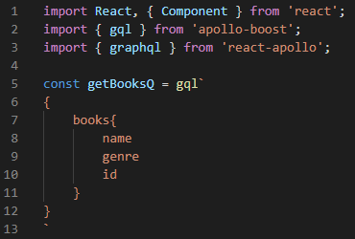
GraphQL & React Components
Components\Books.js
Since React does not understand GraphQL queries without the help of the Apollo library, you need to import the gql package. Using gql you can pass queries from your front end within the gql`` tags.

Slide 32
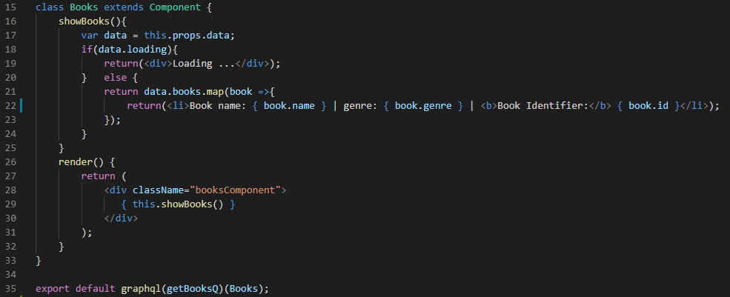
GraphQL & React Components
Components\Books.js
By exporting the graphql() function with our getBooksQ query, we can create higher-order components that can execute queries and update reactively based on the data in the Apollo “store”.

Slide 33
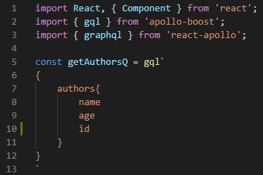
GraphQL & React Components
Components\Authors.js
The setup for our Authors component is exactly the same, except we are querying the name, age and id.

