Slide 1

G-tools Company presentation
Leon Oelen
DIN17SP

Slide 2
Contents
Who are we?
Foundation
Location
Product description
Product market
Key figures
Future prospects

Slide 3
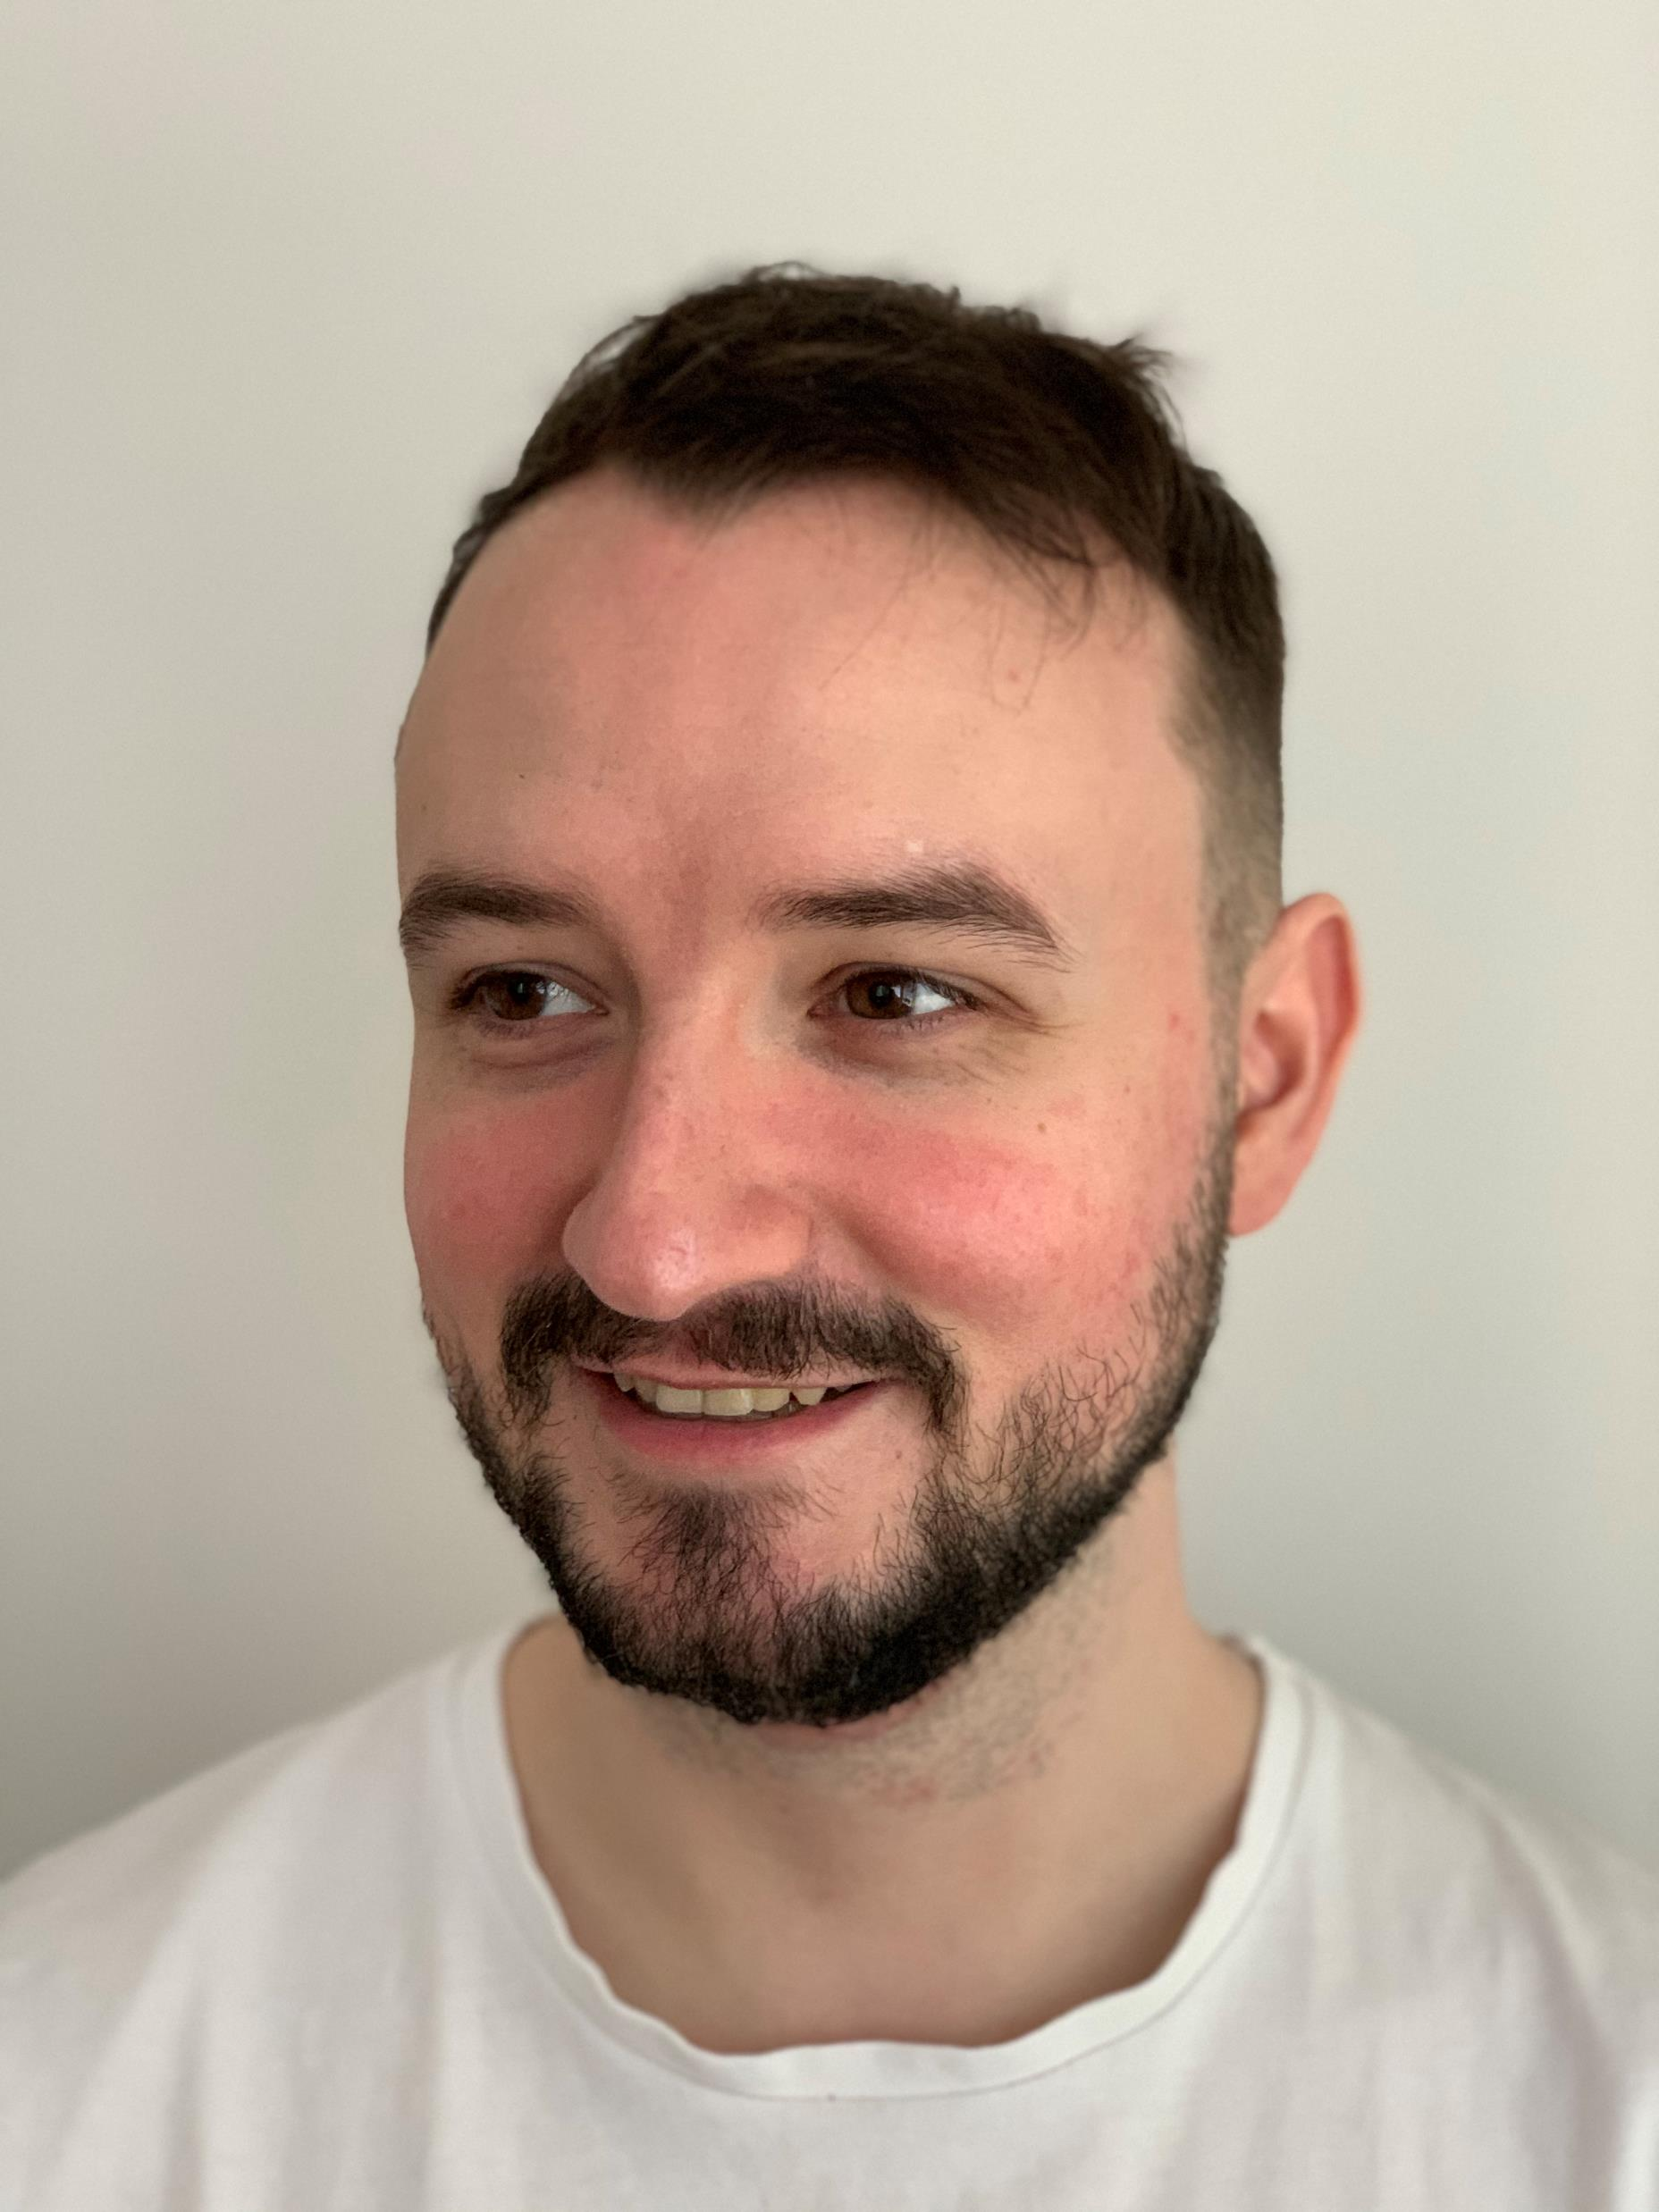
Who are we?
Leon Oelen
Co-Founder of G-Tools
Devoted gamer
Bachelor of Engineering in Information Technology

Slide 4
WHO ARE WE?
A tight-knit group of avid gamers and developers
Strong understanding of individual needs
Deep desire to work with the biggest game tycoons

Slide 5
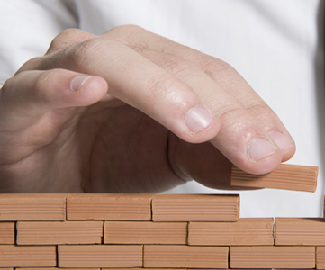
Foundation
Coincidental idea
Planning and writing
Sharing the plan

Slide 6

Location
… everywhere!
Gamers and contributors from all over the world
Digital cooperation

Slide 7

Product Description
Individualized app development; desktop and mobile
Integrated API widgets from your favourite games tailored just for you
From Steam library to World of Warcraft characters
Recycling of components, eventually creating a massive library of widgets

Slide 8
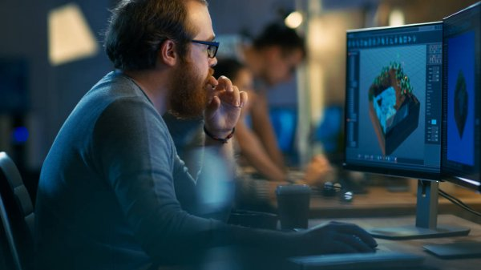
Product Market
Gamers
Developers
Game . . . developers

Slide 9
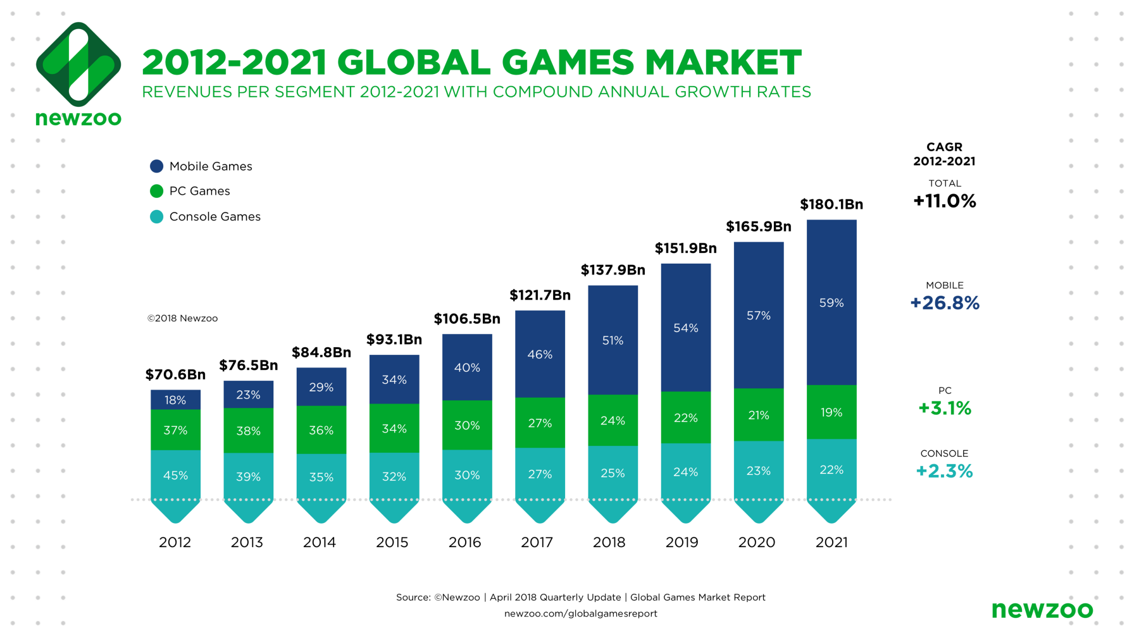
Key Figures

Slide 10
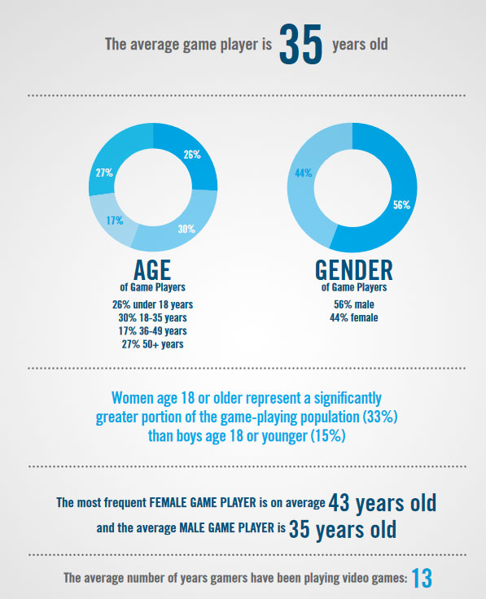
Key figures

Slide 11
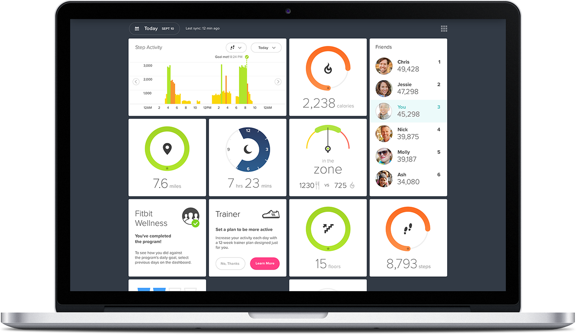
Future Prospects
Development of a massive, free platform
Massive library full of available widgets
Users can customize their dashboards
Funded by sponsors and collaborations
Fitbit 2021

Slide 12
THANK YOU!
Question and feedback round

