Slide 1

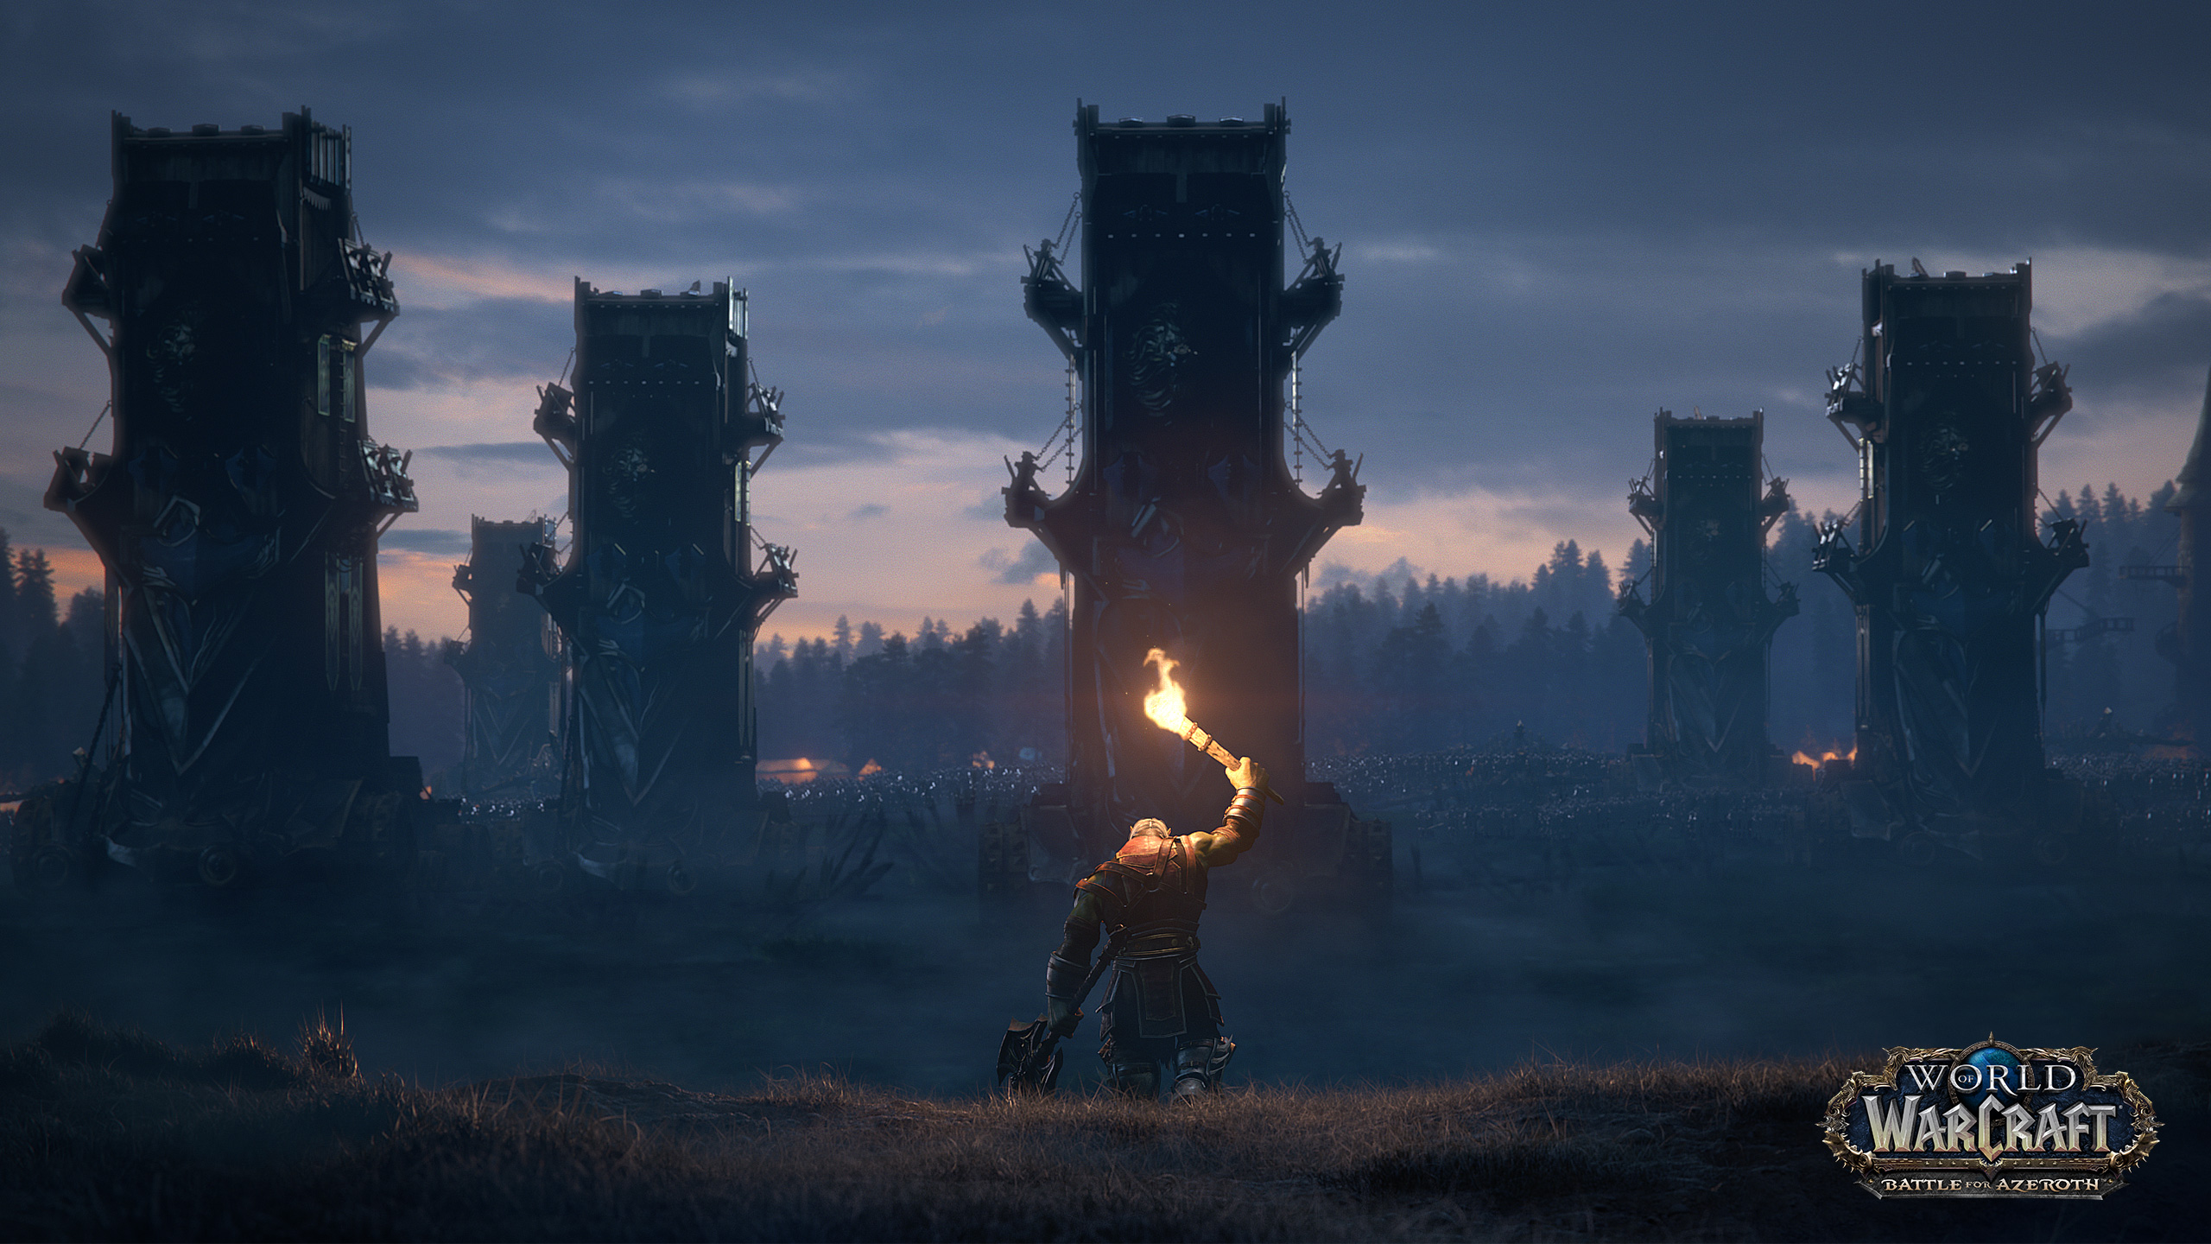

World of Warcraft: Pocket Buddy Project Plan
by Leon Oelen
DIN17SP

Slide 2
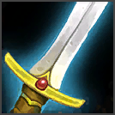
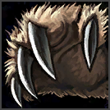
CONTENTS
Summary
Overall approach – development phases
Deliverables
Technical requirements
Timetable

Slide 3
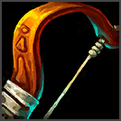
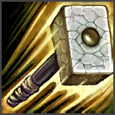
Summary
World of Warcraft-themed application
Goal to put an endless number of resources into one place
Natively compiled mobile application developed using Flutter
Usage of public APIs and a database

Slide 4
Overall approach – Requirements phase
Requirements phase
Finding out what is required in terms of UI and functionality
Learning the basics of the Flutter framework
Researching possible APIs to integrate
Researching clean development standards for mobile applications

Slide 5
Overall approach – design phase
Design phase
Mock-ups of the application
Database layout
Consistency between pages
Looking at similar applications for inspiration

Slide 6
Overall approach – implementation phase
Implementation phase
Development using tools such as Visual Studio Code, Android Studio and GitHub
Developed using the Dart programming language and numerous external libraries
Agile development despite the project being a solo project
Keeping up with the schedule

Slide 7
Overall Approach – Testing Phase
Testing phase
Making sure the latest build on GitHub is complete and functional
Making sure that each functionality is tested
Code cleanups
Removal of “dead code”

Slide 8
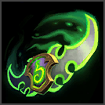
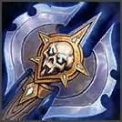
Deliverables
Project plan
Project report
Project worktime sheet
Full codebase on GitHub

Slide 9
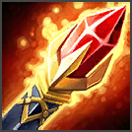

Technical Requirements
Mobile phone running either the Android or iOS operating system. Better performance on newer versions of each
Virtual emulator of a mobile device running either of the operating systems mentioned above

Slide 10

Timetable
Week | Objectives
1 | Basics of the Flutter framework
2 | Skeleton development
3 | Adding resources to each class
4 | Planning out the functional aspects
5 | API integration
6 | Database development
7 | Code cleanup and testing
8 | Finalizing the application

