Slide 1
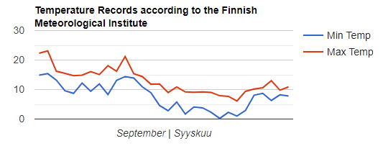
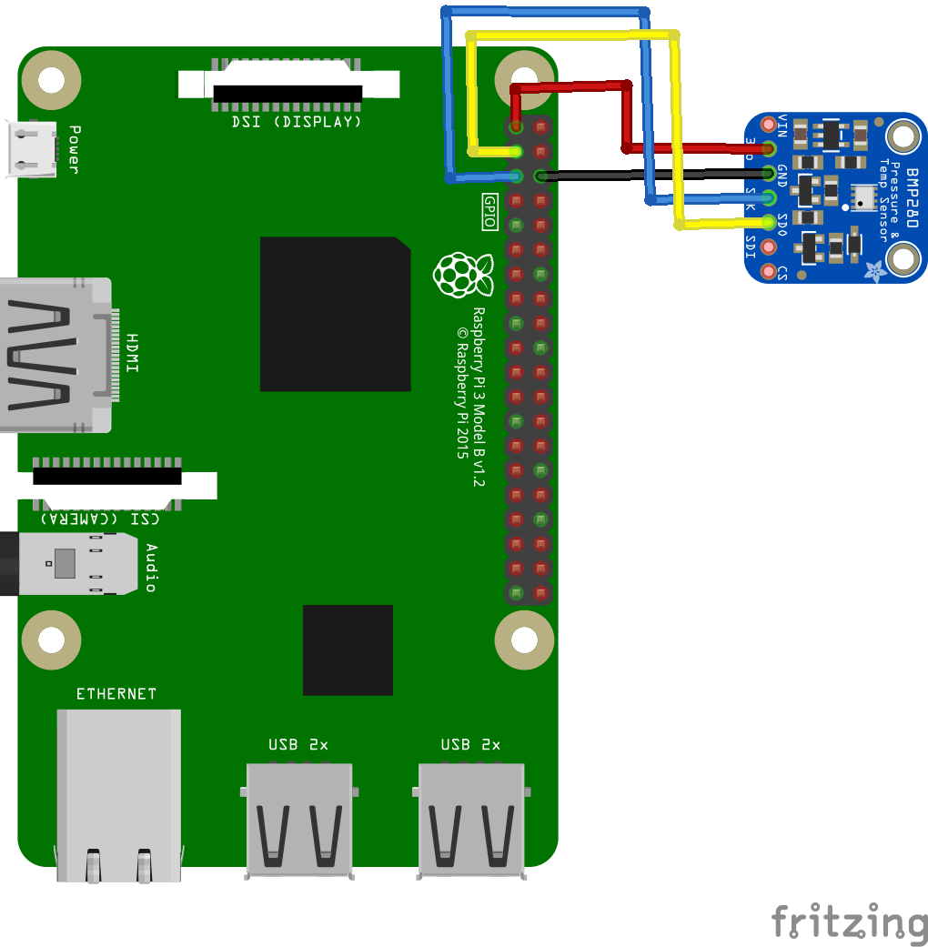

PiWeather Report
Leon Oelen (DIN17SP), Imran Qadir (Open University)
School of Engineering and Natural Resources, Information Technology, Software Engineering
Introduction
The goal of this project was to create an Internet of Things application. The choice of a weather station was made on the basis of the available sensors and difficulty. The goal of the weather station was to use a Raspberry Pi equipped with sensors to gather and transmit data to a remote server from where it is fetched, locally stored, and finally retrieved on a web application.
FIGURE 1. Raspberry Pi equipped with BMP280 sensor[1]
Hardware
The hardware that was used in this project includes a Raspberry Pi equipped with a BMP280 sensor, as shown in the figure above.
Methods
Several important methods were utilized to generate a functional application. An MQTT-broker[2] was used to enable communication between the Raspberry Pi and a remote Ubuntu server. This allowed the transfer of data from the Raspberry Pi to the remote server, where it was stored. The data was then fetched from a local computer using Python scripts and inserted into a local MySQL-database. Express.js framework[3] was used to establish connection to the local database where it then queries the data and offers it in a readable format. The data is then easily fetched and displayed on a React[4] web application.
FIGURE 2. React Framework
Results
As a result of the above methods, a functional web application was created. This web application loads the most recent entries from the MySQL-database, shows temperature and pressure data in Google charts, and loads weather information from a local weather station which is fetched from a public API at OpenWeatherMap.org.[5]
The application also includes some weather data analysis of data provided by the Finnish Meteorological Institute.[6]
FIGURE 3. Google chart displaying temperature records of September 2019
Conclusions
While there have been difficulties during the project weeks, we feel like we have learned a lot of things about many different aspects of Internet of Things. There is definitely room for improvement and things could have been done in a more efficient matter, but the knowledge gained from this project will help make future projects smoother.
References
[1] BMP280 (Bosch), https://www.bosch-sensortec.com/bst/products/all_products/bmp280
[2] M2M connectivity protocol, http://mqtt.org/
[3] Node.js web application framework, https://expressjs.com/
[4] JavaScript library, https://reactjs.org/
[5] Weather API, https://openweathermap.org/api
[6] Weather observations in Finland, https://en.ilmatieteenlaitos.fi/download-observations#!/
Internet of Things Project
ECTS credits: 15
Date of publication: 2019, Autumn
Instructor: Jukka Jauhiainen, Teemu Korpela

