Slide 1
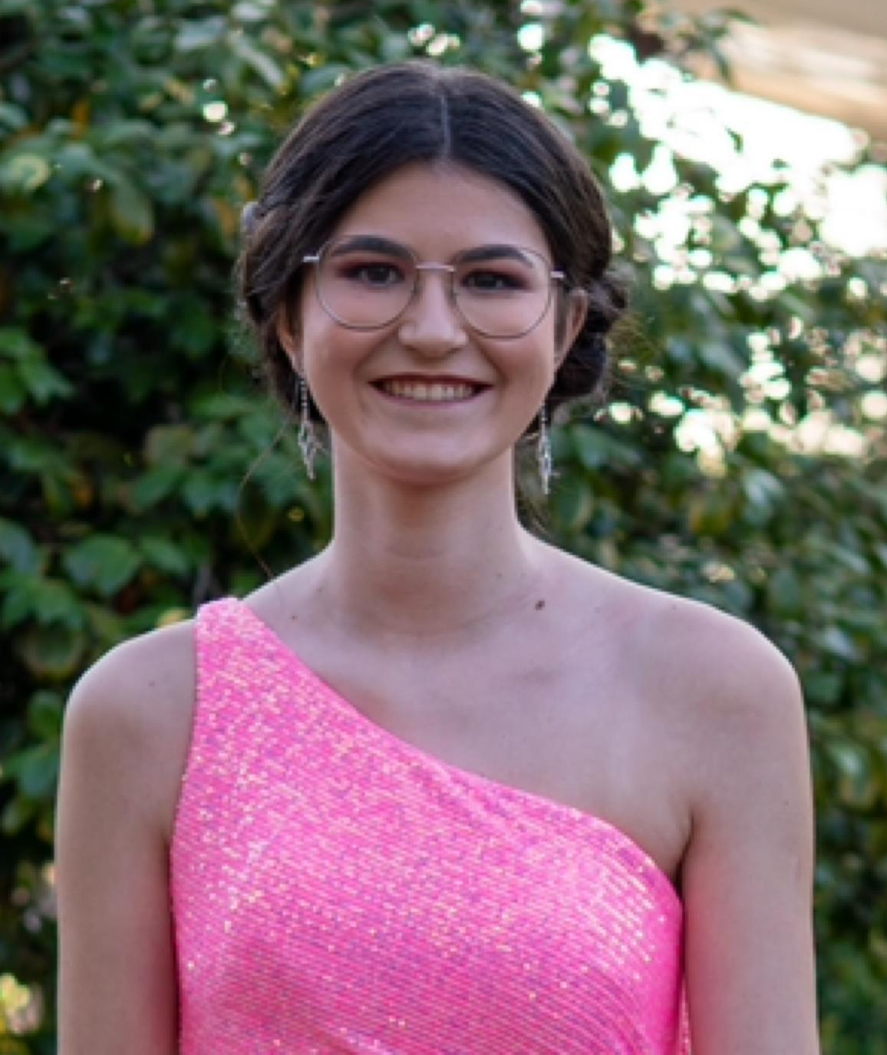
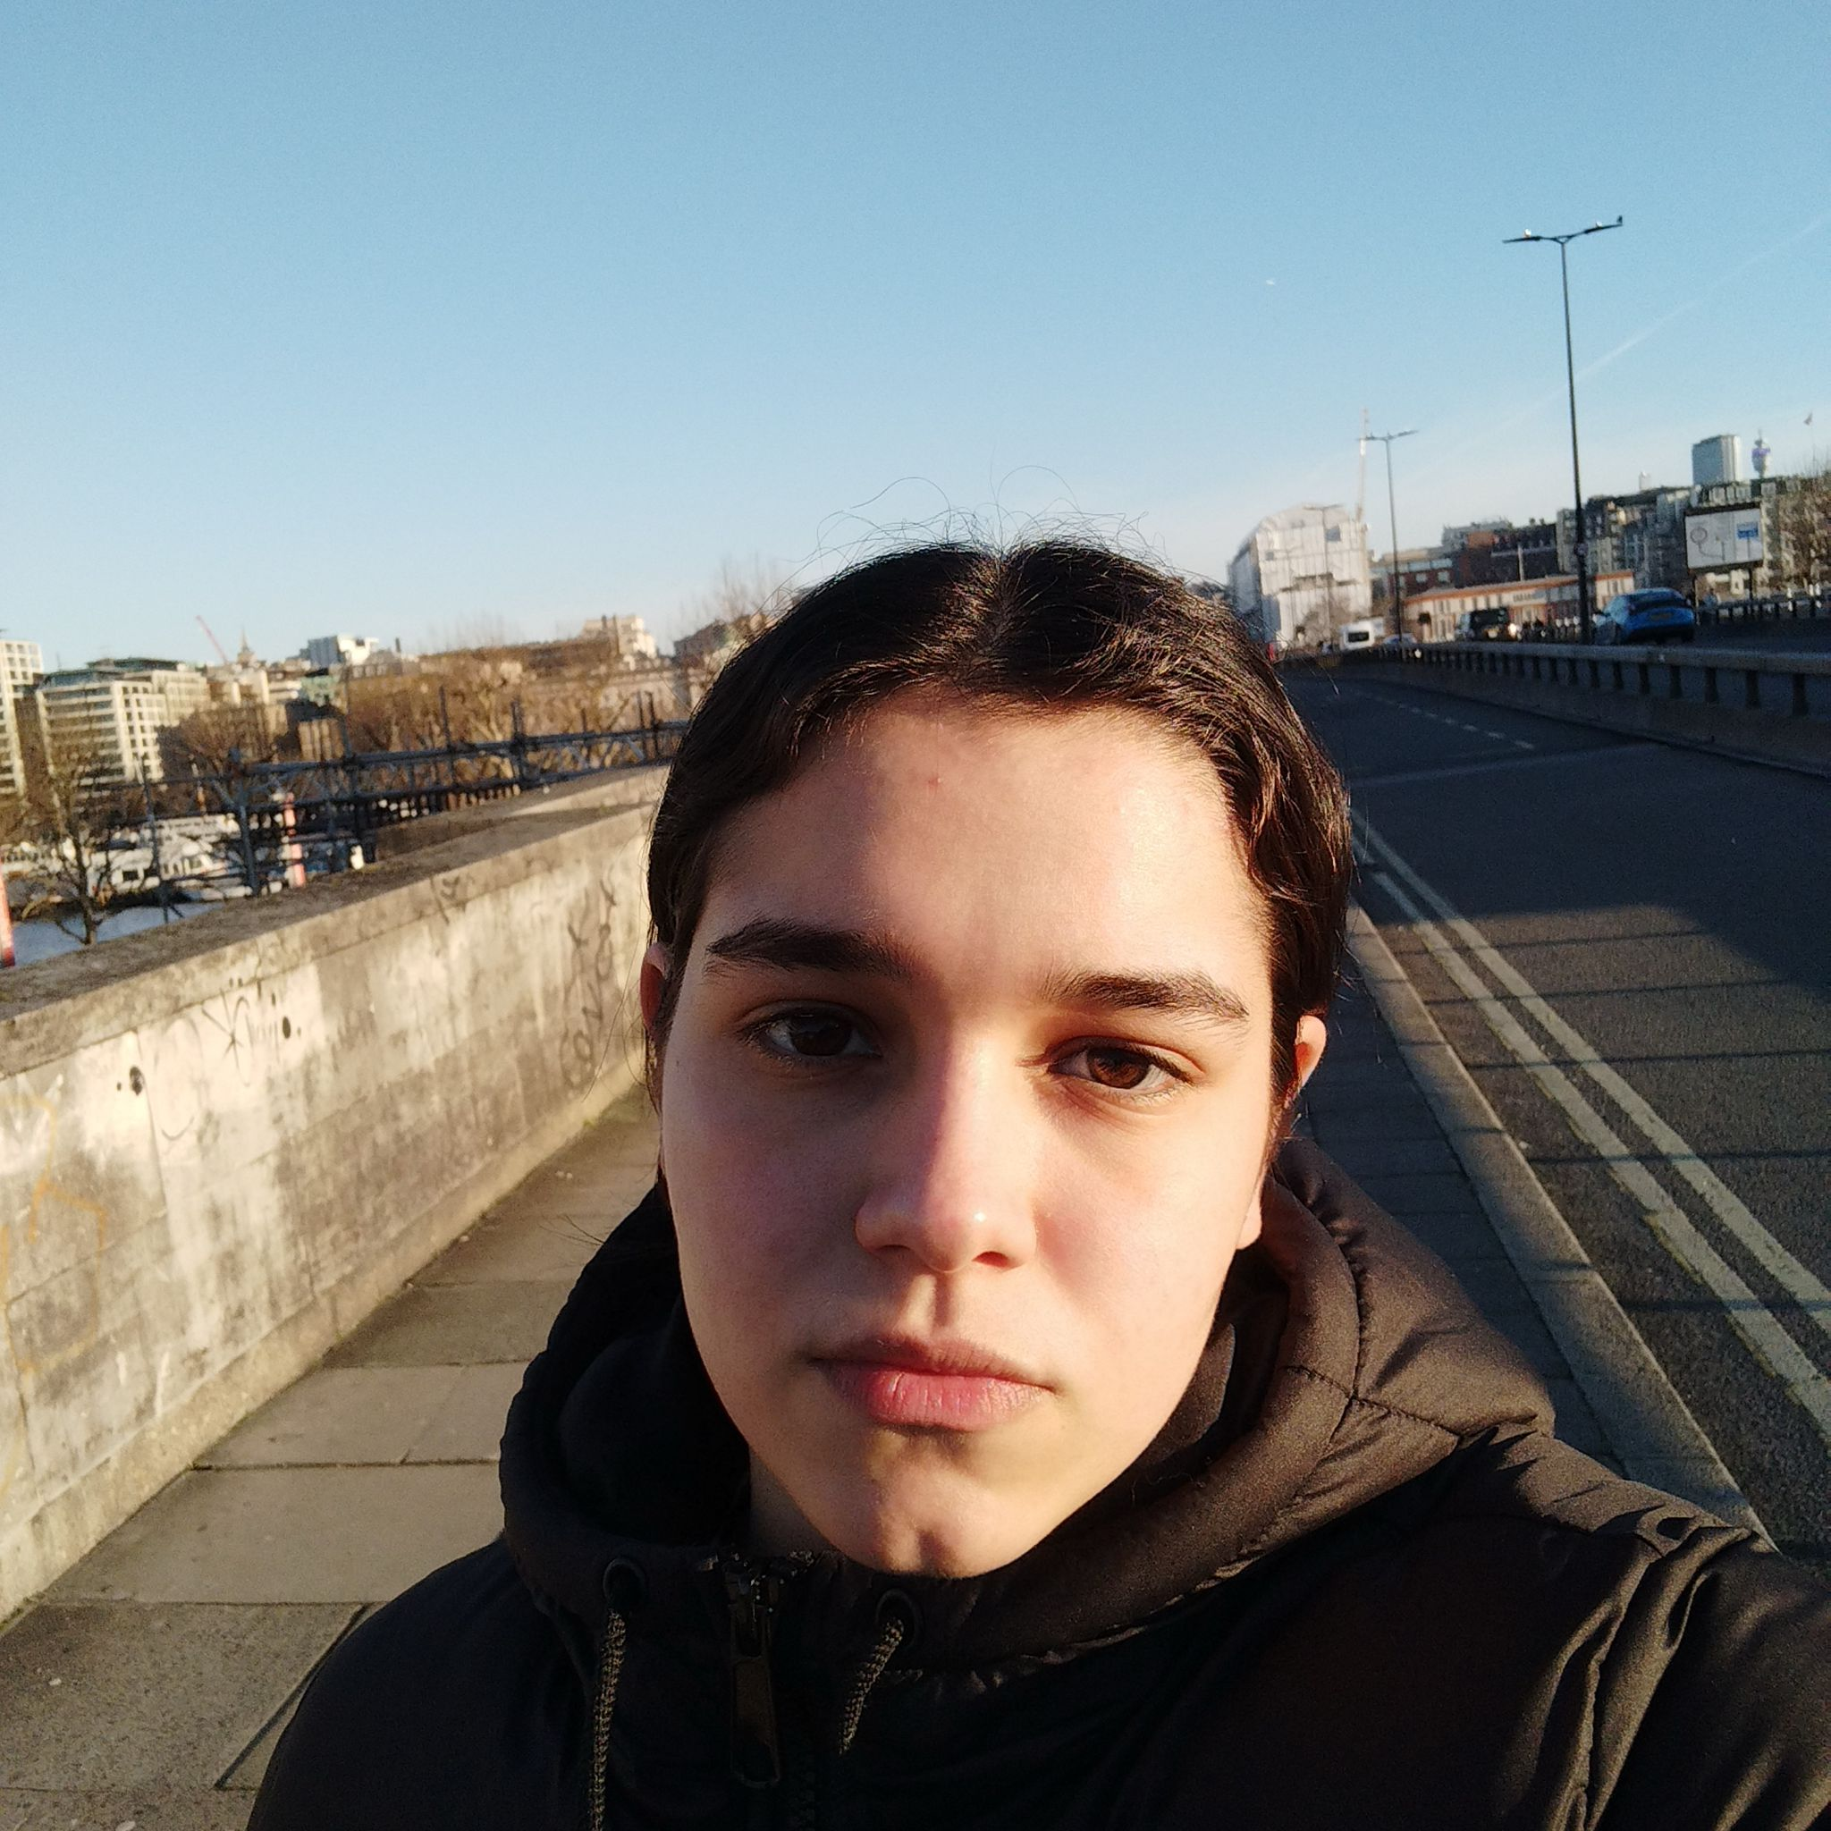

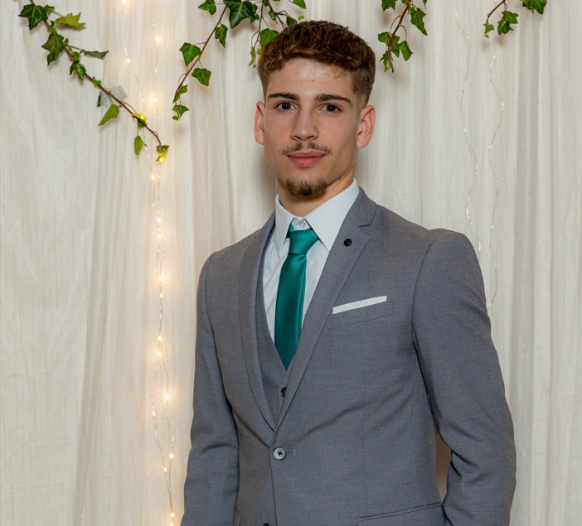
Class 2DE Group 03 SPRINT 1
LAPR4 2025_2026
Sofia Carvalho (1240898) | Mariana Moreira (1240905) | Leonor Moura (1240914) | Francisco Sá (1241341)

Slide 2
Sprint planning – Sprint 1
Planned Start Date: 09/03/2026 Real Start Date: 09/03/2026
Planned Finished Date: 05/04/2026 Real Finish Date: 03/04/2026
SPRINT BACKLOG
Number of stories | 11
Number of bugs | 0
Number of Sub-Tasks: | 17
Number of Management Tasks (Scrum) | 6
Number of team members | Planned: 4 Actual: 4
Total planned estimation vs execution | Planned hours: 34 Executed hours: 34

Slide 3
Sprint planning
Assignment US (as stated on project assignment) | Commited? (Yes / no according to team planning) | Todo | Doing | Testing | Done | Blocked
US 01 | Yes |  |  |  | x
US 02 | Yes |  |  |  | x
US 03 | Yes |  |  |  | x
US 04 | Yes |  |  |  | x
US 05 | Yes |  |  |  | x
US 06 | Yes |  |  |  | x
US 07 | Yes |  |  |  | x
US 08 | Yes |  |  |  | x
US 09 | Yes |  |  |  | x
US 10 | Yes |  |  |  | x
US 11 | Yes |  |  |  | x
Notes:
Não colocar screenshots! Preencher manualmente os valores.

Slide 4
Work by team member
Notes:
Se compilaram o registo de horas colocar as horas de trabalho, caso contrario utilizar o numero de tarefas ou algo que reflita a distribuição de trabalho.

Slide 5
Work by UC

Slide 6
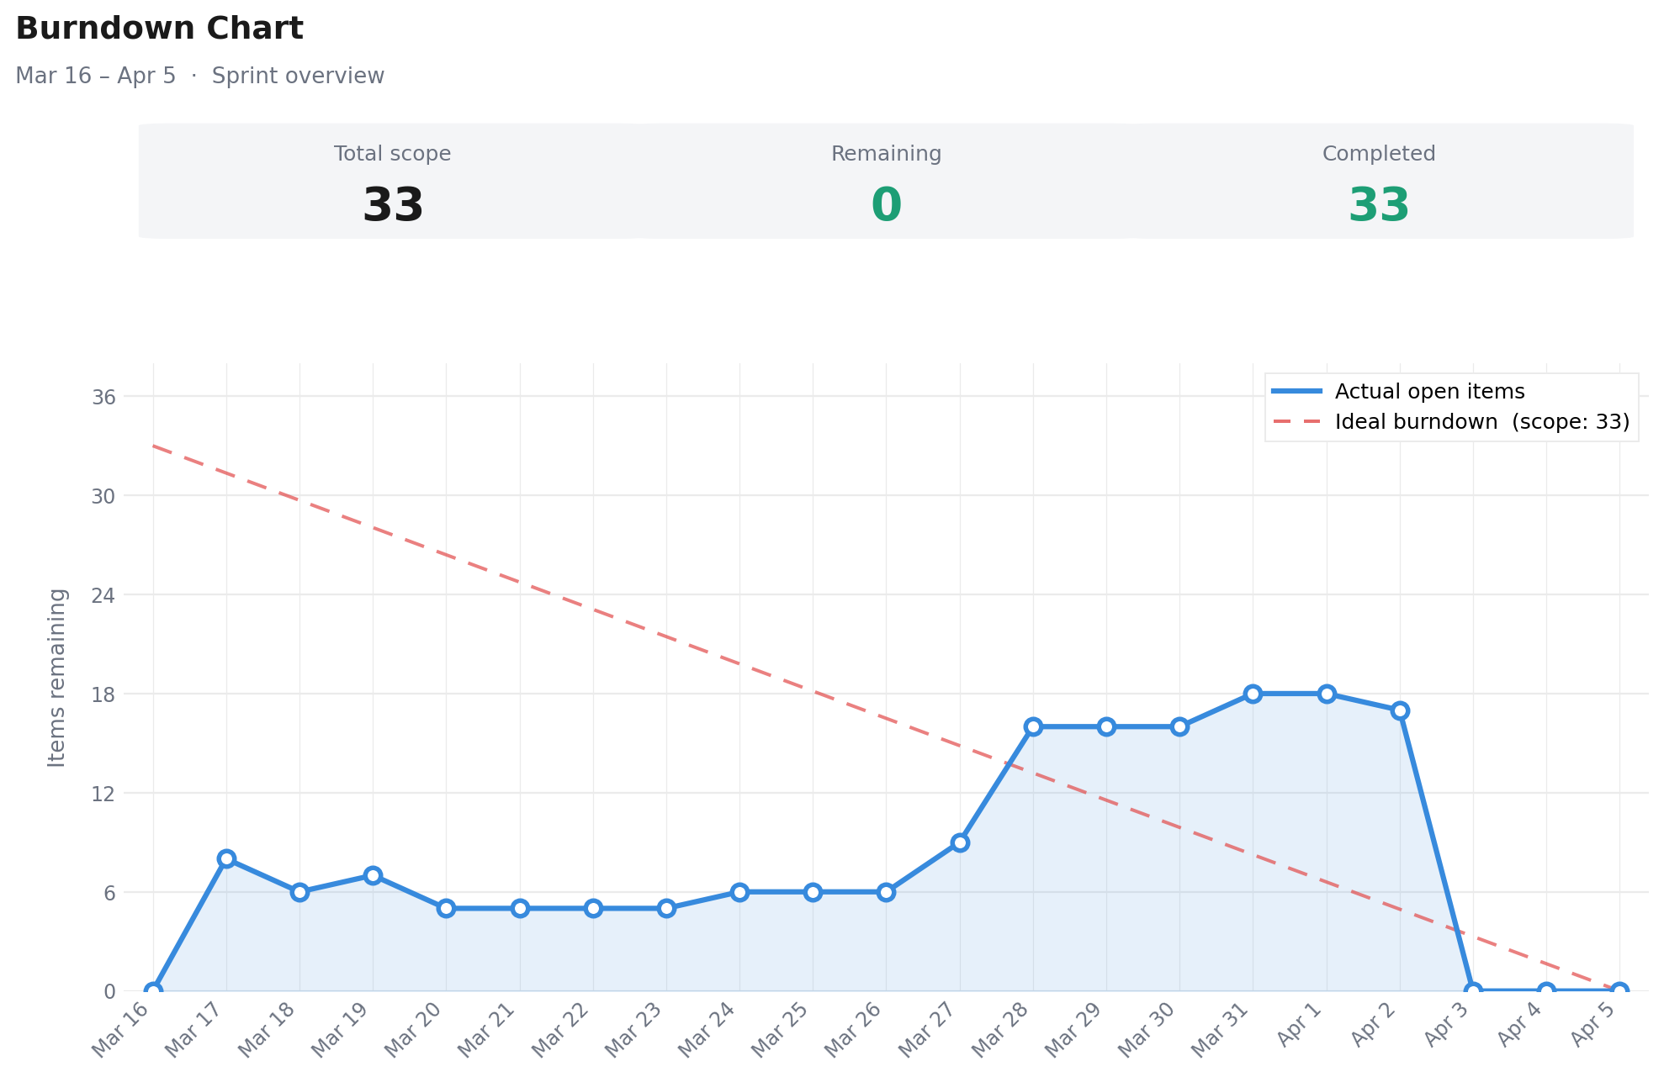
Sprint Burndown Chart

Slide 7
Issues / Assumptions / unanswered questions
Description | Responsible | Date / sprint | Related issue / item in Git
No issue in this sprint

Slide 8
Daily Meetings (Sprint 1)
Date | Place / duration | Team member 1 | Team member 2 | Team member 3 | Team member 4
17/03/2026 | Class / 15 min | x | x | x | x
18/03/2026 | Class / 15 min | x | x | x | x
19/03/2026 | Class / 15 min | x | x | x | x
20/03/2026 | Class / 15 min | x | x | x | x
24/03/2026 | Class / 15 min | x | x | x | x
25/03/2026 | Class / 15 min | x | x | x | x
26/03/2026 | Class / 15 min | x | x | x | x
31/03/2026 | Class / 15 min | x | x | x | x
03/04/2026 | Class / 15 min | x | x | x | x
Notes:
Podem criar mais páginas se estas não forem suficientes

Slide 9
LLM performance assessment - Input
Source file:
The file is stored on the repository, name as DailyMeeting.md
Input:
Let me know what you think about my team's performance in this review. Deliver a small assessment for each member.

Slide 10
LLM performance assessment - Output
Output file:
https://chatgpt.com/share/69d29f32-b894-832c-a3ce-094e9ab5781c
Output:
Francisco Sá (1241341) - Assumed structural technical tasks from early on (JPA integration, environment configuration, execution scripts), demonstrating autonomy and the ability to handle technical complexity.
Sofia Carvalho (1240898) - Showcased relevant technical skills, especially in implementing continuous integration and project structuring.
Leonor Moura (1240914) - Demonstrated a solid start, taking on important structural responsibilities (repository creation and project board management).
Mariana Moreira (1240905) - Focused on fundamental conceptual aspects, such as the domain model and the glossary, which indicates an important role in the system's semantic definition.

Slide 11
LLM performance assessment – Critical Insight
Team Members’ Opinion about the A.I. output
Francisco – I think this is correct. I tried to maintain a consistent contribution across all technical areas throughout the sprint.
Sofia – This evaluation is accurate. My focus was on ensuring a high-quality development process through software engineering.
Leonor – I agree with this assessment. Our contributions were consistent and well-balanced across the sprint.
Mariana – This assessment seems fair. Our steady work and proactive organization helped keep things on track.

Slide 12
Sprint Retrospective Date: 05/04/2026
What went well?
The sprint was completed successfully with effective communication across the team.
The team delivered all committed user stories within the sprint timeframe.
The review phase was conducted with sufficient time and attention to detail.
The entire team contributed actively and consistently throughout the sprint.
What went wrong?
Some tasks took longer than expected to be finished.
There were some merge conflicts.
What we learned?
Clear definition of acceptance criteria improves development efficiency.
Establishing clearer ownership of tasks improves execution quality.
The sprint is easier if everyone is involved.
We improved our critical thinking during the design of the user story.

Slide 13

Overall Project Mood:
Independently on the team performance, what's the final Team feeling:
Brief justification: We feel proud of everything we managed to accomplish throughout this sprint

Slide 14


