Slide 1
Level 4 Project
Week 9 Meeting
(Week 8 Recap)

Slide 2
Completed work
Dissertation work: reviewed research done on using autoencoders for dimensionality reduction
Moved code to Colab
A lot of autoencoder tuning: attempts at...
Resizing dataset
Scaling values
Visualising filters
Adding layers
Changing layer parameters
Adding normalisation post-activation
Relu vs leakyrelu
Trying autoencoder on MNIST dataset
Kept track of (most) progress in presentation

Slide 3
Completed work
Solution?: image preprocessing with edge detectors
Tested how to make the cells pop out more with Fiji ImageJ
Replicated that in code:
Used a sobel filter
Getting some more promising results
But still not ideal
Attempted to get better quality: stagnating loss

Slide 4
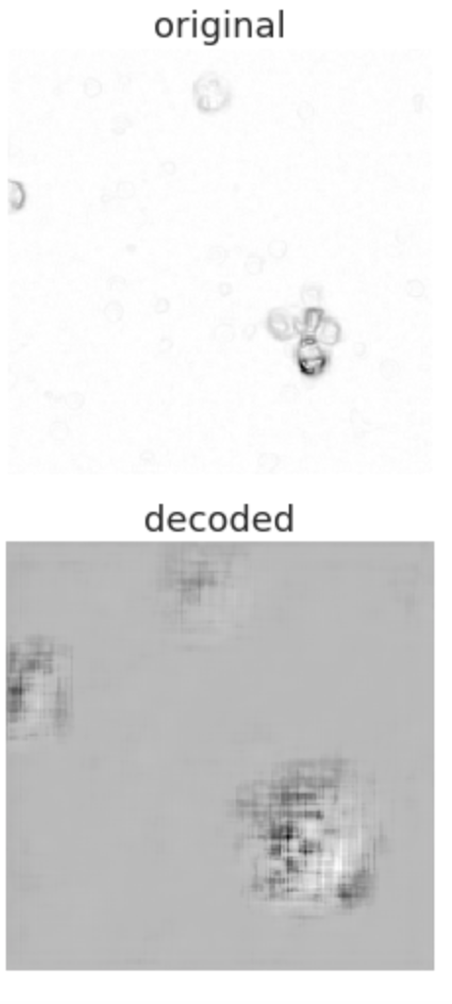
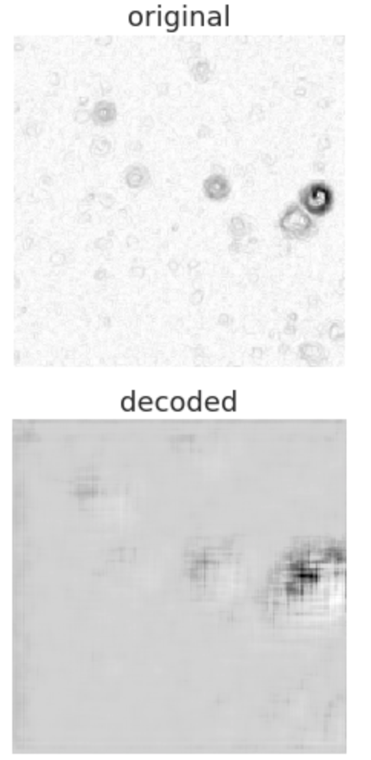
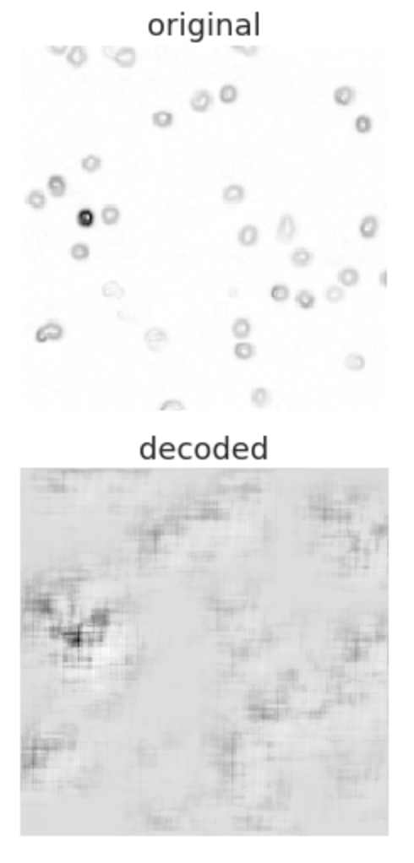
Unstimulated, conA, empty well (validation set)

Slide 5
Questions
Quick recap:
We want to use autoencoder to learn reduced version of the cell images
And use that in a clustering/visualisation algorithm like t-sne?
Dataset:
Even smaller images?
Would it be better to calculate the overlap first, then compress?
Should I do data augmentation?
Running through algorithm:
Train/test/validation split

Slide 6
Rough plan for semester, reworked
Week 8
Clean up code!
More dimensionality reduction in the encoded images
Apply chosen clustering algorithm
Tune clustering algorithms to improve performance
Week 9
Tuning autoencoder to get good images even with reduced dimensionality
If no improvement, work on image pre-processing again
Week 10
Final autoencoder tuning if needed
Run through clustering algorithm

