Slide 1
Level 4 Project
Week 12 Meeting
(Week 11 Recap)

Slide 2
Completed work
Changed pre-processing to get autoencoder working
Next: does it work better with values < 255 clipped?
Autoencoder outputs good image
Next: tune autoencoder to get smaller compression in bottleneck layer
T-sne output changes, but does not seem meaningful
Next: use tuned autoencoder to see if get better output
Write code for visualising t-sne progress along multiple steps
Wrote sliding window function to get more images out of the dataset
Used numpy compression files to compress the DMSO dataset into a .npz file for faster loading in Colab
If this is promising might be worth it to try it with the full dataset; however this requires a large amount of running memory

Slide 3
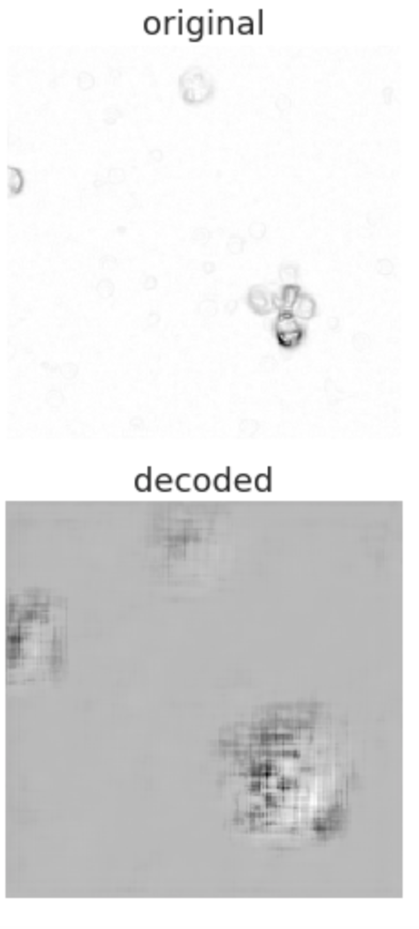
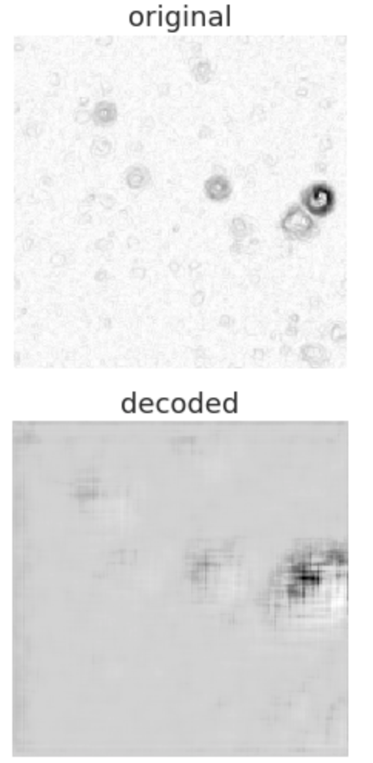
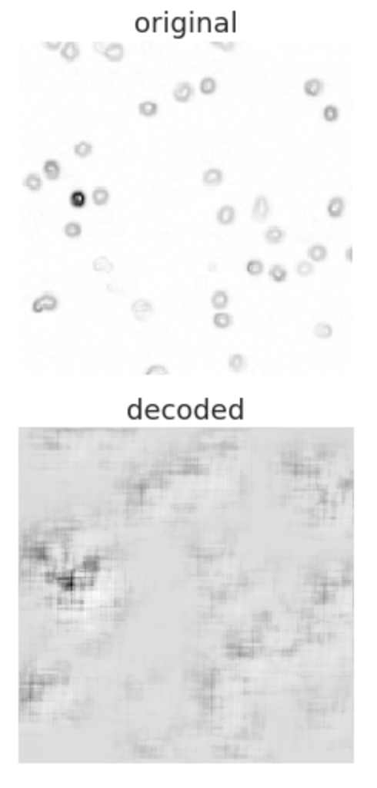
For illustration: before

Slide 4
After: autoencoder

Slide 5
Clustering
Before: https://github.com/leonore/l4-project/blob/master/src/baseline_performance.ipynb
After: https://github.com/leonore/l4-project/blob/master/data/clustering_record.md

Slide 6
Plan for the rest of week 12 and 13
Week 12
Finish evaluating best pre-processing method
Tune autoencoder for dimensionality reduction
Evaluate t-sne clustering
Week 13
Visualise t-sne
Explore methods of segmentation:
k-means clustering (2 clusters)
contour finding
structure similarity
blob detection
Top-hat transformation?
Submit status report

