Slide 1
Level 4 Project
Week 8 Meeting
(Week 7 Recap)

Slide 2
Completed work
Labelled all the datasets (CK19, CK21, CK22)
Issues with OneDrive
CK17 had no data?
Separated out the DMSO images from the dataset
However the size is limited to get good results
Tested own autoencoder code on MNIST dataset
To see if the compression helped
Ran t-sne on compressed output
Tested t-sne on DMSO dataset
Need some more data to get significant results
Tested t-sne on full dataset

Slide 3
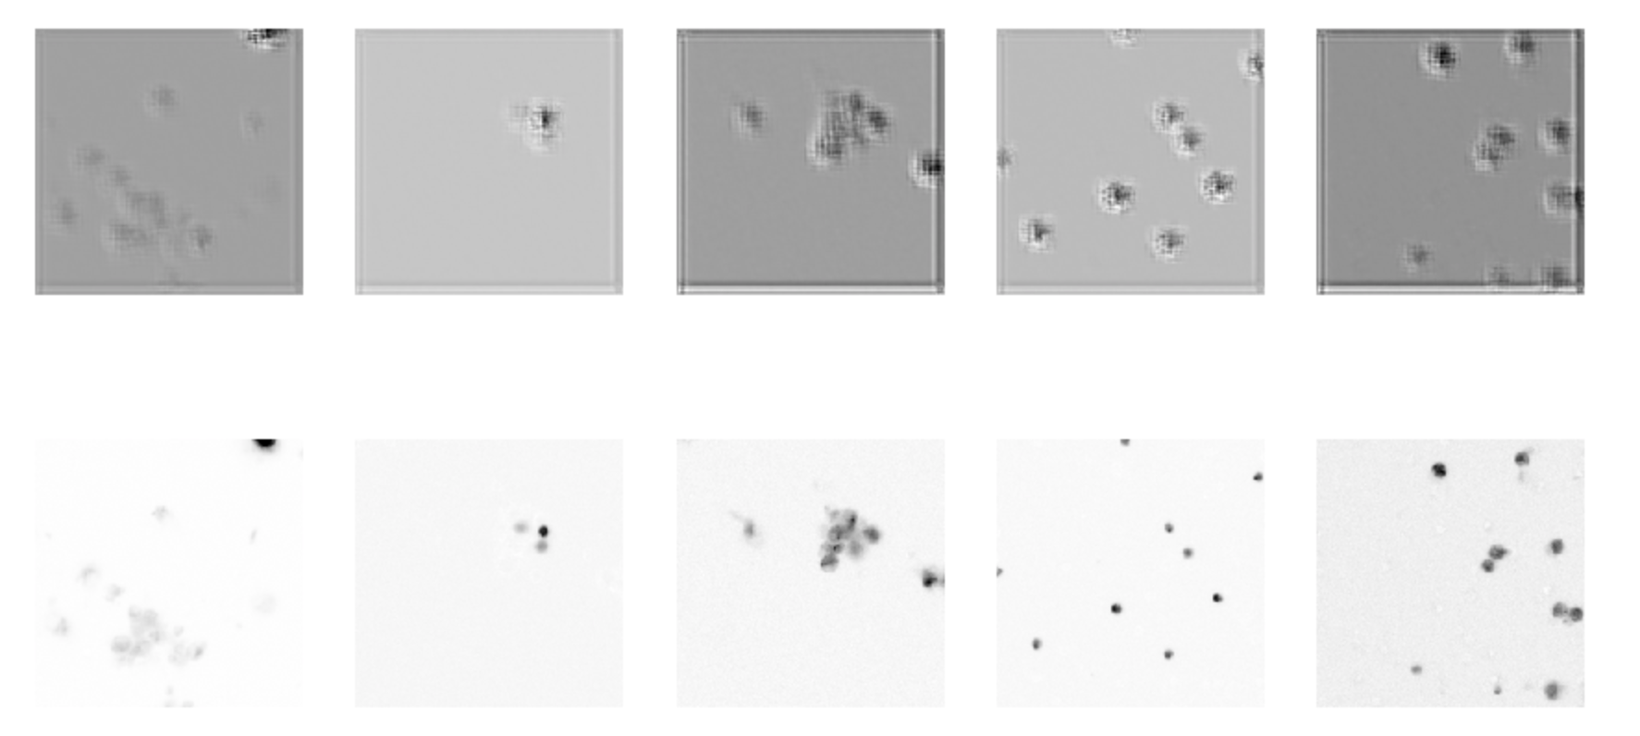
Autoencoder tuning

Slide 4
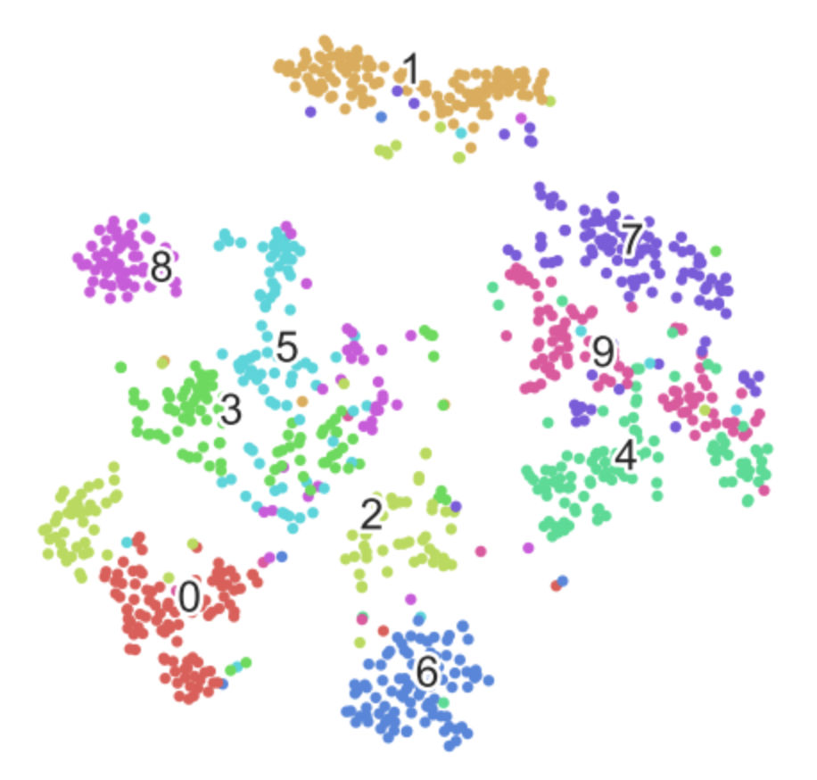
Autoencoder + t-sne on MNIST

Slide 5
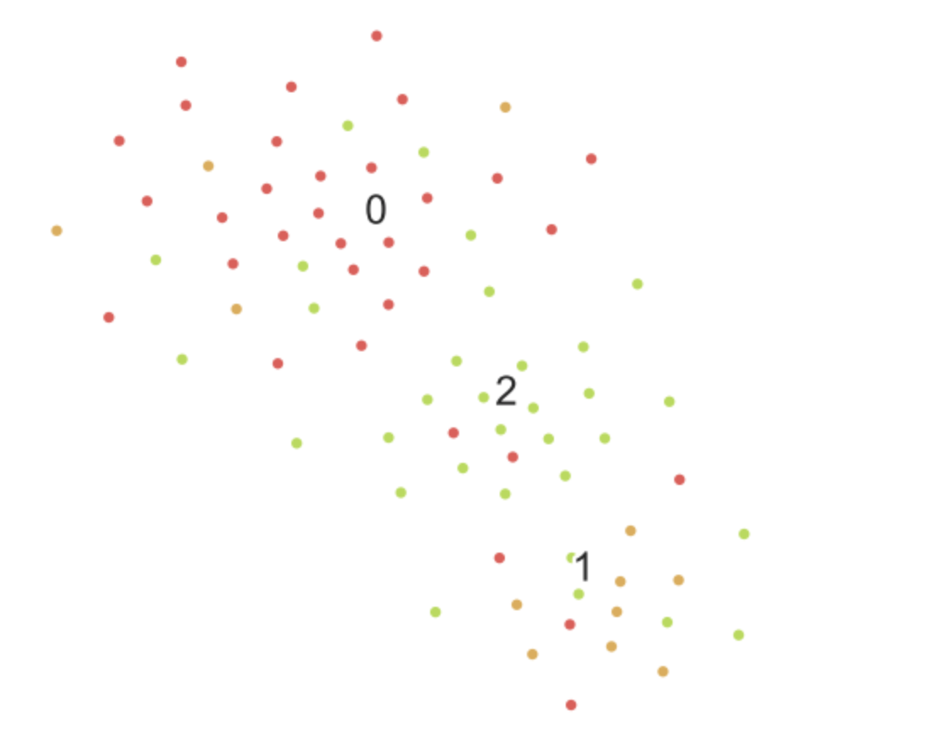
Autoencoder + t-sne on DMSO
NB: DMSO dataset has no label 3 = empty wells

Slide 6
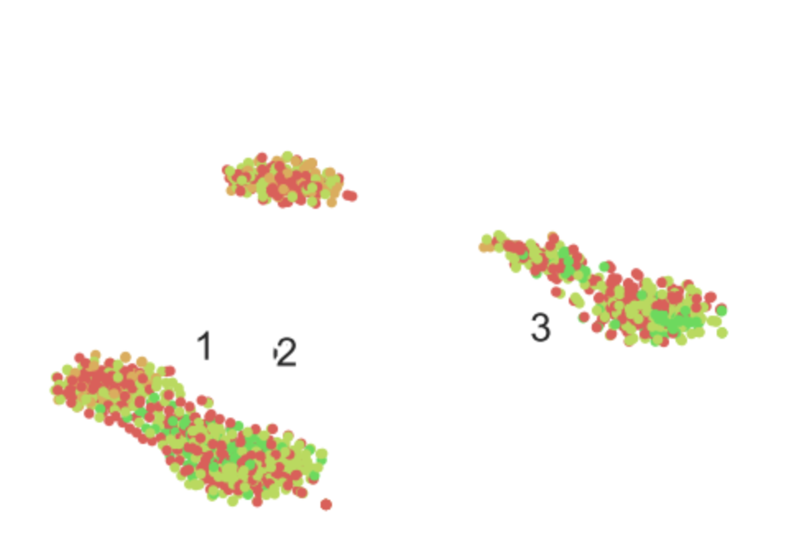
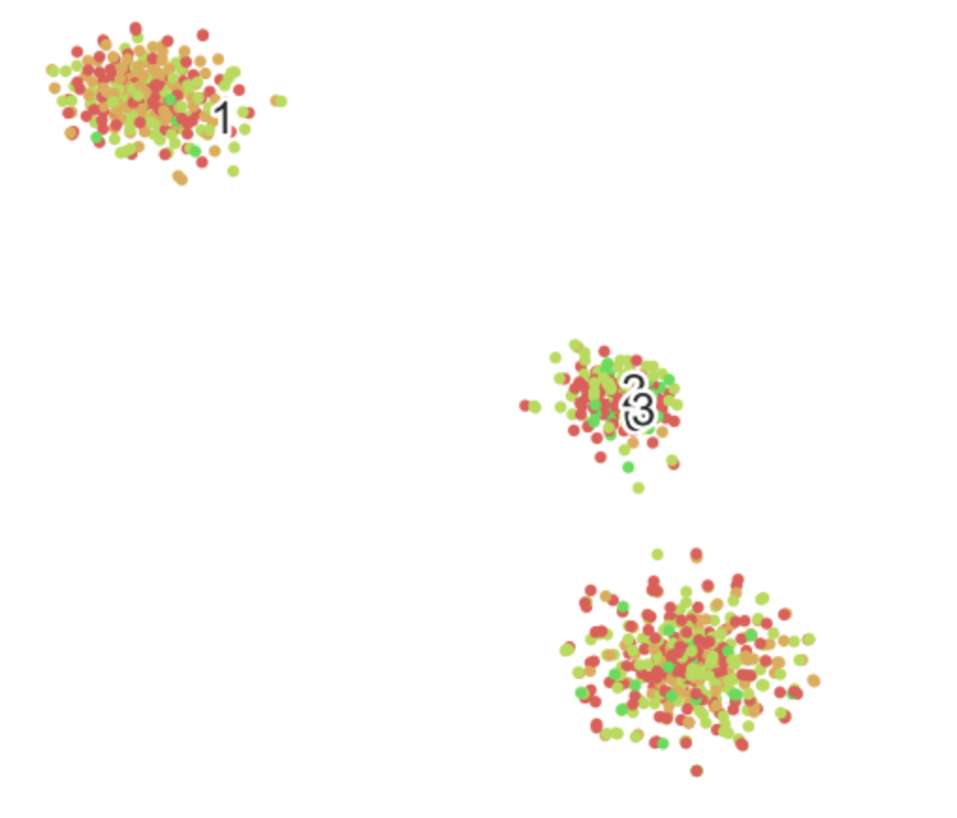
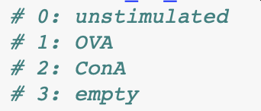
Autoencoder + t-sne on larger dataset
First image: overlapped
Second image: simple images
So not much relevant information seems to be picked out...
Also some issues with the labelling code.
Not been able to do much tuning so far.

Slide 7
Rough plan for semester, reworked
Week 7
Follow tutorial on PCA/tsne with MNIST
Separate out DMSO data
Colab move
Tune autoencoder
Week 8
Clean up code!
More dimensionality reduction in the encoded images?
Apply chosen clustering algorithm
Tune clustering algorithms to improve performance
Week 9
Tune clustering algorithms to improve performance
....

