Slide 1
Autoencoder tuning
Tweak by tweak

Slide 2
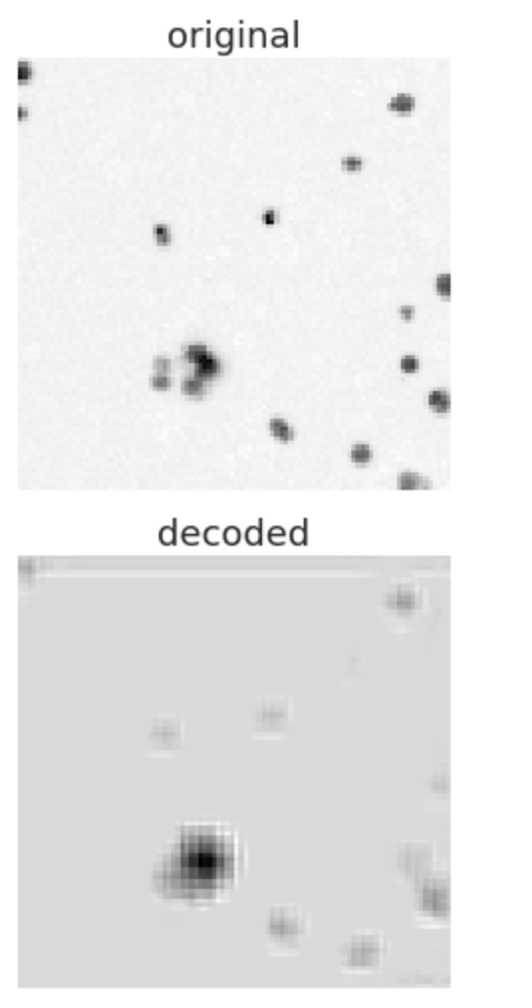
x = Conv2D(32, (5, 5), activation='relu', padding='same')(input_img)
x = MaxPooling2D((2, 2), padding='same')(x) x = Conv2D(16, (3, 3), activation='relu', padding='same')(x)
x = MaxPooling2D((2, 2), padding='same')(x)
encoded = Flatten()(x)
#encoded = x
x = Conv2D(16, (3, 3), activation='relu', padding='same')(x)
x = UpSampling2D((2, 2))(x) x = Conv2D(32, (5, 5), activation='relu', padding='same')(x)
# this will help going back the original image dimensions
x = UpSampling2D((2, 2))(x)
decoded = Conv2D(1, (3, 3), padding='same')(x)
* No reduction of dimensionality.

Slide 3
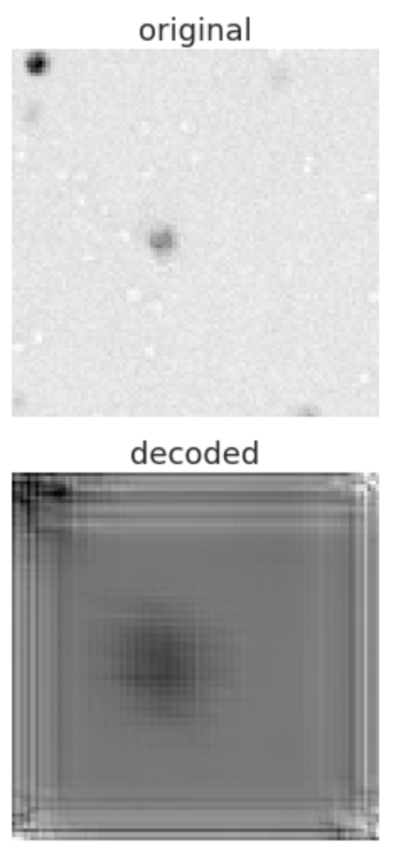
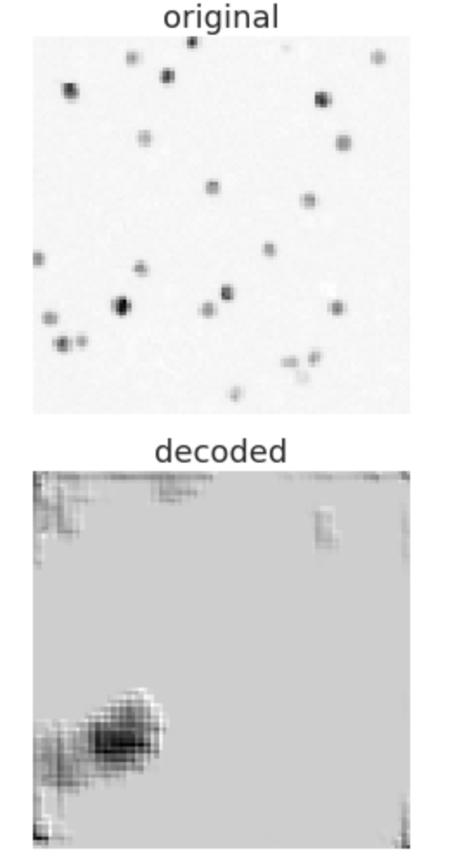
x = Conv2D(32, (5, 5), activation='relu', padding='same')(input_img)
x = MaxPooling2D((2, 2), padding='same')(x)
x = Conv2D(32, (3, 3), activation='relu', padding='same')(x)
x = MaxPooling2D((2, 2), padding='same')(x)
x = Conv2D(16, (3, 3), activation='relu', padding='same')(x)
x = MaxPooling2D((2, 2), padding='same')(x)
encoded = Flatten()(x)
#encoded = x
x = Conv2D(16, (3, 3), activation='relu', padding='same')(x)
x = UpSampling2D((2, 2))(x)
x = Conv2D(32, (3, 3), activation='relu', padding='same')(x)
x = UpSampling2D((2, 2))(x)
x = Conv2D(32, (5, 5), activation='relu', padding='same')(x)
# this will help going back the original image dimensions
x = UpSampling2D((2, 2))(x)
decoded = Conv2D(1, (3, 3), padding='same')(x)
Not a good representation
Does not do well on empty wells

Slide 4
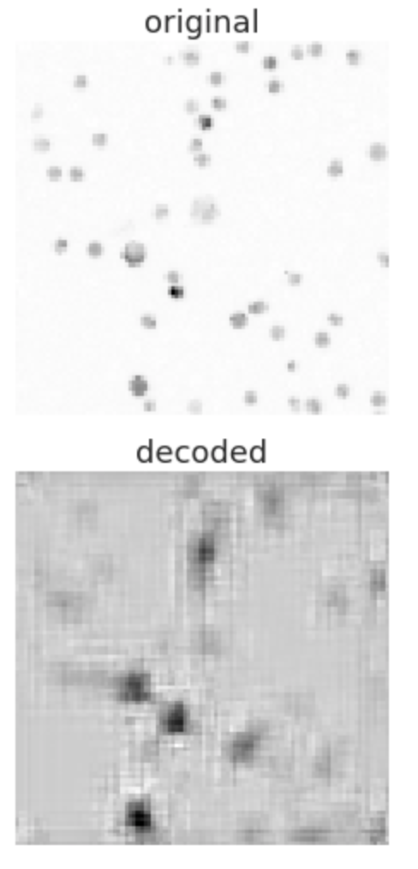
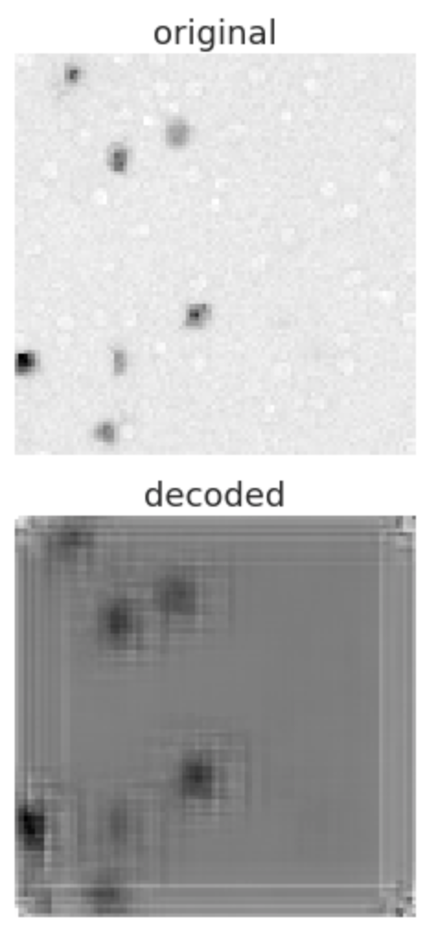
First model, but with LeakyRelu
Not better performance...
Same problem with empty wells

Slide 5
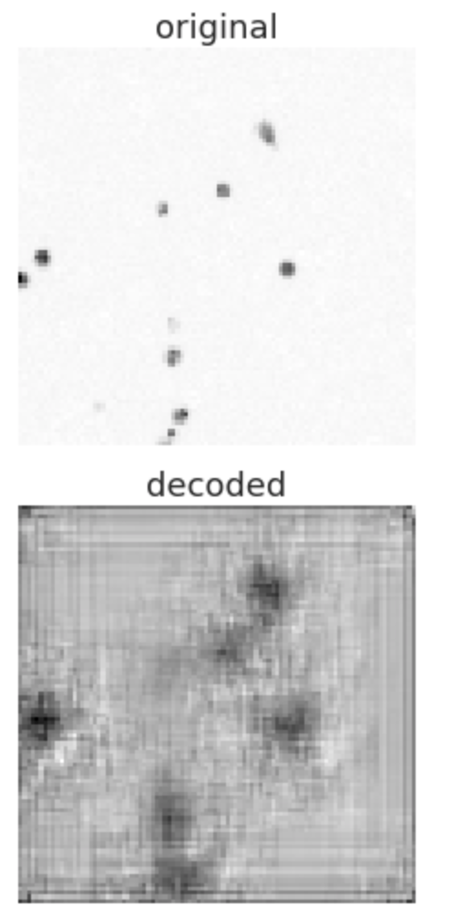
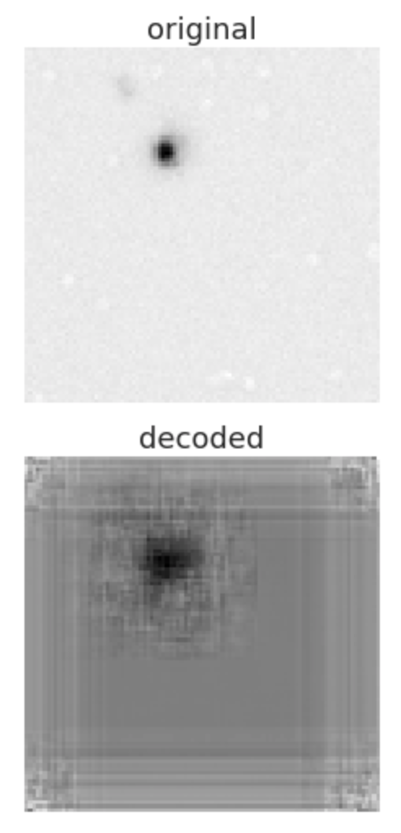
Extra convolution layer
No activation...
x = Conv2D(64, (3, 3), padding='same')(input_img)
x = MaxPooling2D((2, 2), padding='same')(x)
x = Conv2D(32, (3, 3), padding='same')(x)
x = MaxPooling2D((2, 2), padding='same')(x)
x = Conv2D(16, (3, 3), padding='same')(x)
x = MaxPooling2D((2, 2), padding='same')(x)
encoded = Flatten()(x)
#encoded = x
x = Conv2D(16, (3, 3), padding='same')(x)
x = UpSampling2D((2, 2))(x)
x = Conv2D(32, (3, 3), padding='same')(x)
x = UpSampling2D((2, 2))(x)
x = Conv2D(64, (3, 3), padding='same')(x)
# this will help going back the original image dimensions
x = UpSampling2D((2, 2))(x)
decoded = Conv2D(1, (3, 3), padding='same')(x)

Slide 6
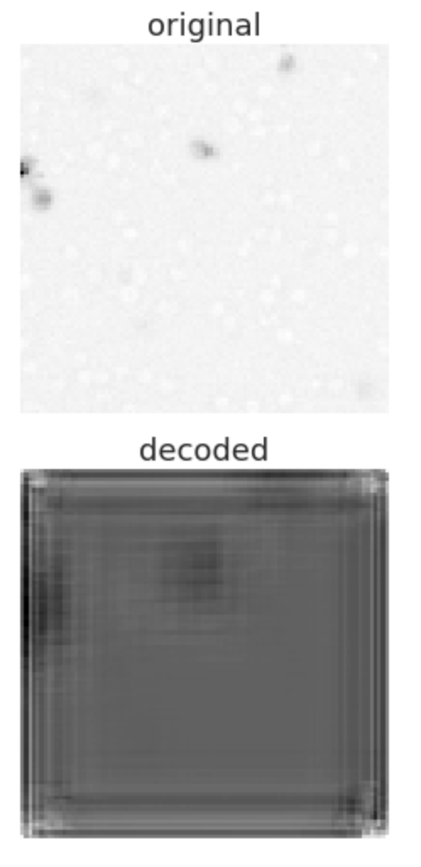
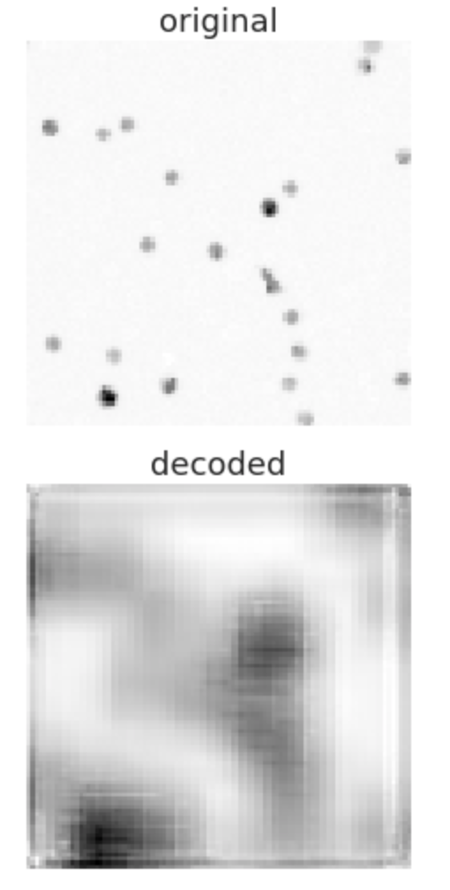
More layers
Same problem with empty wells
Very splotched
x = Conv2D(64, (3, 3), activation='relu', padding='same')(input_img)
x = MaxPooling2D((2, 2), padding='same')(x)
x = Conv2D(32, (3, 3), activation='relu', padding='same')(x)
x = MaxPooling2D((2, 2), padding='same')(x)
x = Conv2D(16, (3, 3), activation='relu', padding='same')(x)
x = MaxPooling2D((2, 2), padding='same')(x)
encoded = Flatten()(x)
#encoded = x
x = Conv2D(16, (3, 3), activation='relu', padding='same')(x)
x = UpSampling2D((2, 2))(x)
x = Conv2D(32, (3, 3), activation='relu', padding='same')(x)
x = UpSampling2D((2, 2))(x)
x = Conv2D(64, (3, 3), activation='relu', padding='same')(x)
# this will help going back the original image dimensions
x = UpSampling2D((2, 2))(x)
decoded = Conv2D(1, (3, 3), padding='same')(x)

Slide 7
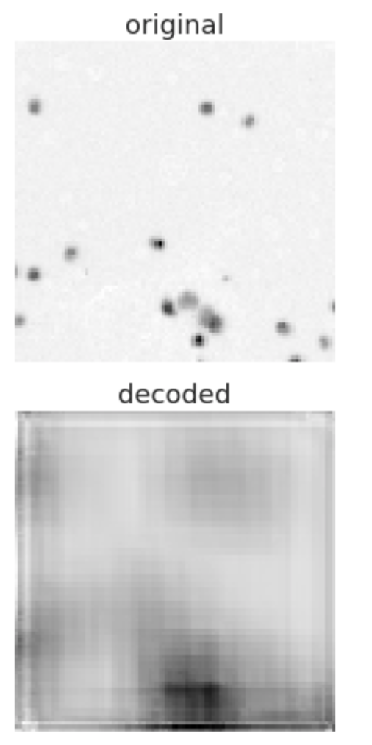
Dimensionality well reduced but big loss of information
# MODEL WORKING BEST
x = Conv2D(32, (3, 3), activation='relu', padding='same')(input_img)
x = MaxPooling2D((2, 2), padding='same')(x)
x = Conv2D(16, (3, 3), activation='relu', padding='same')(x)
x = MaxPooling2D((2, 2), padding='same')(x)
encoded = Flatten()(x)
#encoded = x
x = Conv2D(16, (3, 3), activation='relu', padding='same')(x)
x = UpSampling2D((2, 2))(x)
x = Conv2D(32, (3, 3), activation='relu', padding='same')(x)
# this will help going back the original image dimensions
x = UpSampling2D((2, 2))(x)
decoded = Conv2D(1, (3, 3), padding='same')(x)

Slide 8
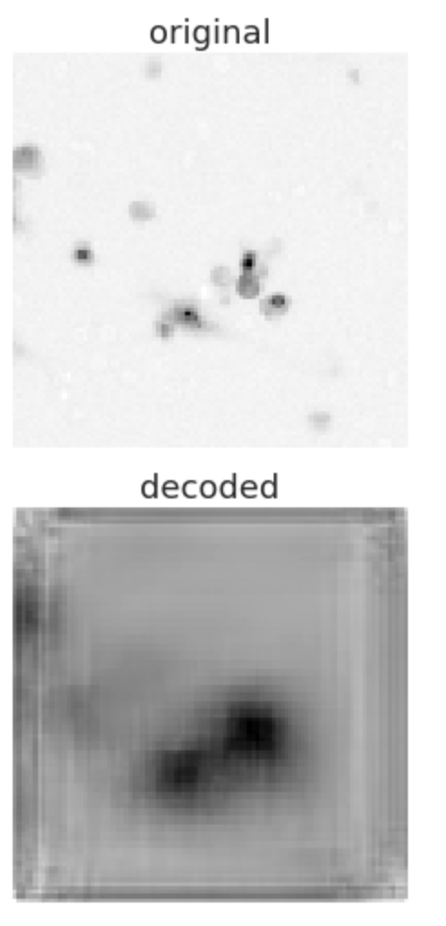
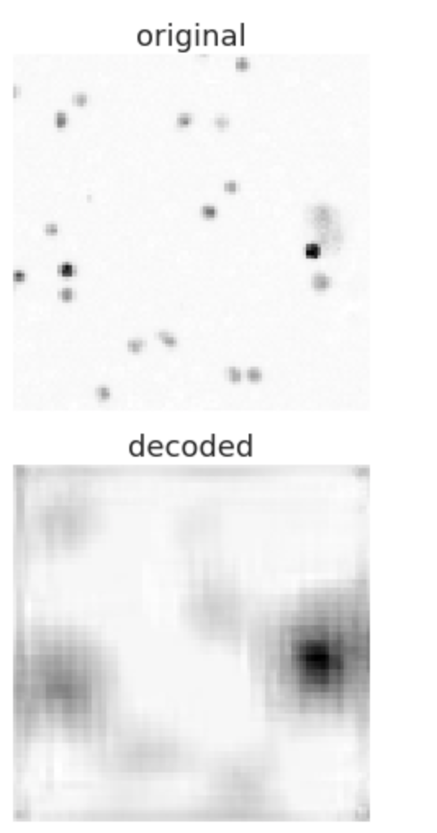
x = Conv2D(128, (5, 5), activation='relu', padding='same')(input_img)
x = MaxPooling2D((2, 2), padding='same')(x)
x = Conv2D(64, (5, 5), activation='relu', padding='same')(x)
x = MaxPooling2D((2, 2), padding='same')(x)
x = Conv2D(32, (3, 3), activation='relu', padding='same')(x)
x = MaxPooling2D((2, 2), padding='same')(x)
encoded = Flatten()(x)
#encoded = x
x = Conv2D(32, (3, 3), activation='relu', padding='same')(x)
x = UpSampling2D((2, 2))(x)
x = Conv2D(64, (5, 5), activation='relu', padding='same')(x)
x = UpSampling2D((2, 2))(x)
x = Conv2D(128, (5, 5), activation='relu', padding='same')(x)
# this will help going back the original image dimensions
x = UpSampling2D((2, 2))(x)
decoded = Conv2D(1, (3, 3), padding='same')(x)

Slide 9
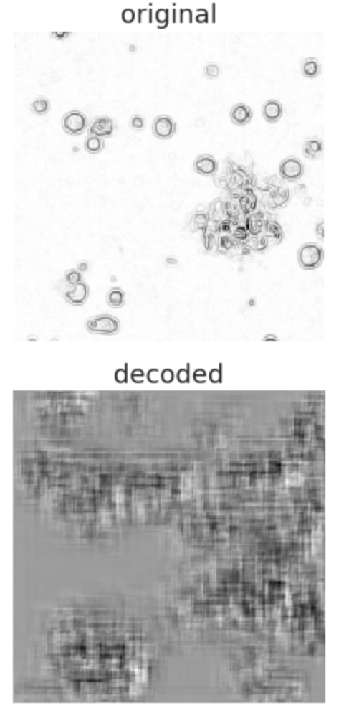
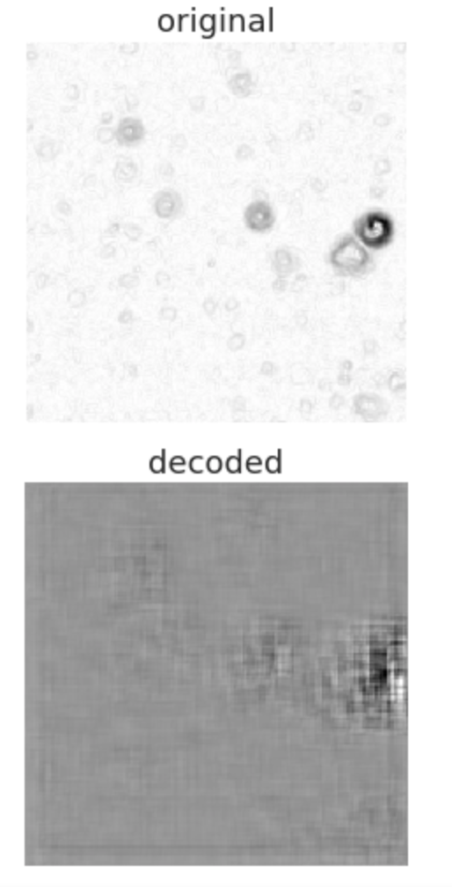
After image preprocessing
Predicting validation set values
x = Conv2D(32, (3, 3), activation='relu', padding='same')(input_img)
x = MaxPooling2D((2, 2), padding='same')(x)
x = Conv2D(16, (3, 3), activation='relu', padding='same')(x)
x = MaxPooling2D((2, 2), padding='same')(x)
x = Conv2D(16, (3, 3), activation='relu', padding='same')(x)
x = MaxPooling2D((2, 2), padding='same')(x)
encoded = Flatten()(x)
#encoded = x
x = Conv2D(16, (3, 3), activation='relu', padding='same')(x)
x = UpSampling2D((2, 2))(x)
x = Conv2D(16, (3, 3), activation='relu', padding='same')(x)
x = UpSampling2D((2, 2))(x)
x = Conv2D(32, (3, 3), activation='relu', padding='same')(x)
x = UpSampling2D((2, 2))(x)
decoded = Conv2D(1, (3, 3), padding='same')(x)

Slide 10
Observations
Loss tends to not go lower than 0.0315
Activation stabilises loss

