Slide 1
Level 4 Project
Week 5 Meeting
(Week 4 Recap)

Slide 2
Completed work
Tuned autoencoder
Followed tutorial on visualising filters
Tweaked code according to results
Current network architecture:
More filters in the convolutional layers
MaxPooling is done with 1x1 stride rather than 2x2, givs better results

Slide 3
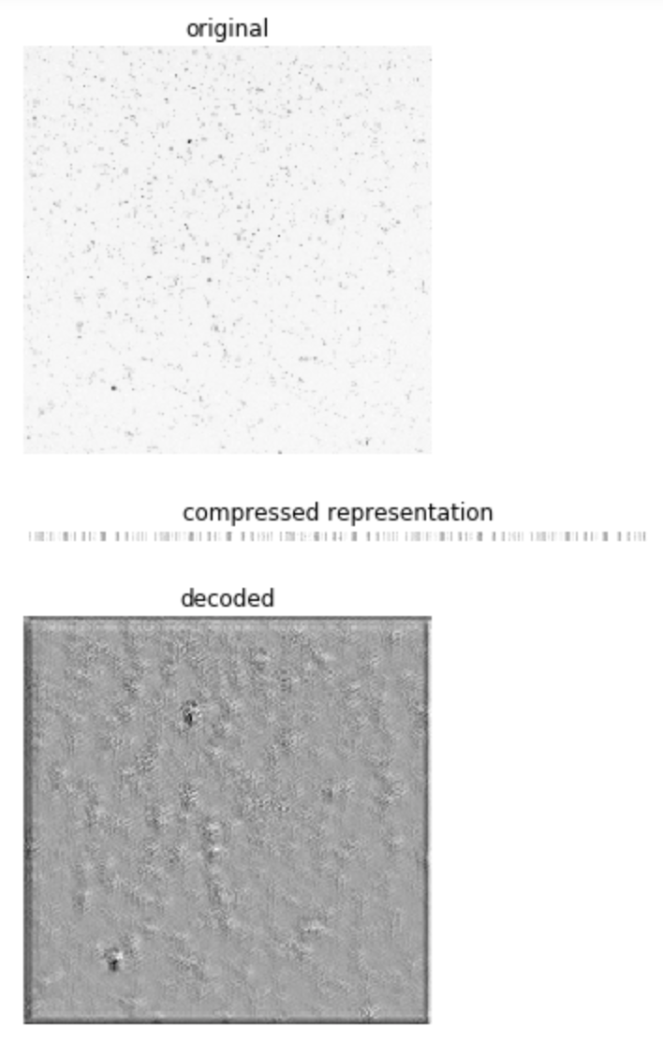
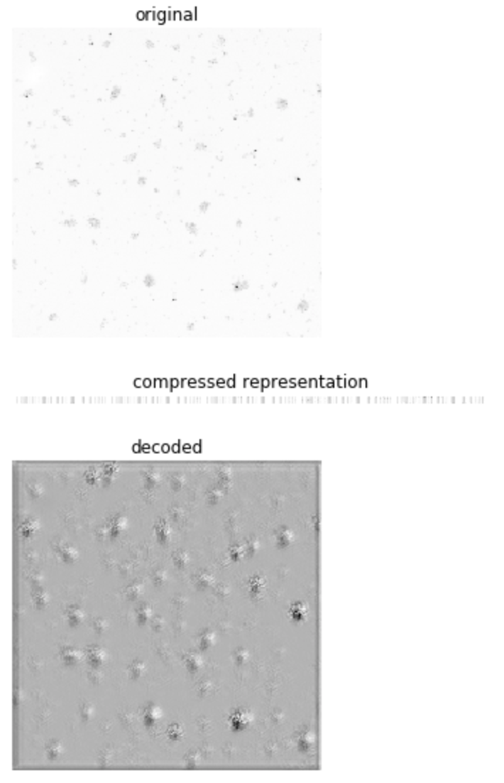
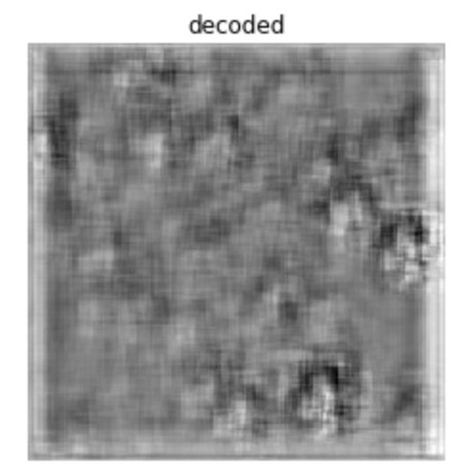

With pool size (2,2) instead of (1,1) – some tweaking to be done for speed

Slide 4
Questions
Should I keep a copy of the outputs whenever I change a parameter? --> for dissertation
The compressed representation should be lower size than original image, for speed?
Should I look to get resized images in a new directory?
Uploading files online for access to Google Colab?
In the future, if we want this to be a tool: should I make different python scripts that would be runnable in the Terminal, on top of the jupyter notebooks?
They’re more convenient for me, but might not be for a user

Slide 5
Rough plan for semester 1 (unchanged)
(potentially to be reworked following my questions)
Week 4
Tuning autoencoder
Week 5
Tuning autoencoder
Week 6
HPC training day (hopefully will help with running some models)
Calculate overlap of images
Week 7
Start working on clustering algorithm for image overlaps
Week 8
Tune clustering algorithm
Week 9
Label t-cell/dendritic cells images:
Evaluate clustering performance

