Slide 1
Level 4 Project
Week 6 Meeting
(Week 5 Recap)

Slide 2
Completed work
Cropped images to 200x200 as suggested
Got better results
Tuned autoencoder
Got better results with the 200x200 cropped
Made function to calculate overlap
Absolute difference
Is this the right way?
Made function to calculate labels
Hardcoded to one Excel sheet
Are the Excel sheets always the same format?

Slide 3
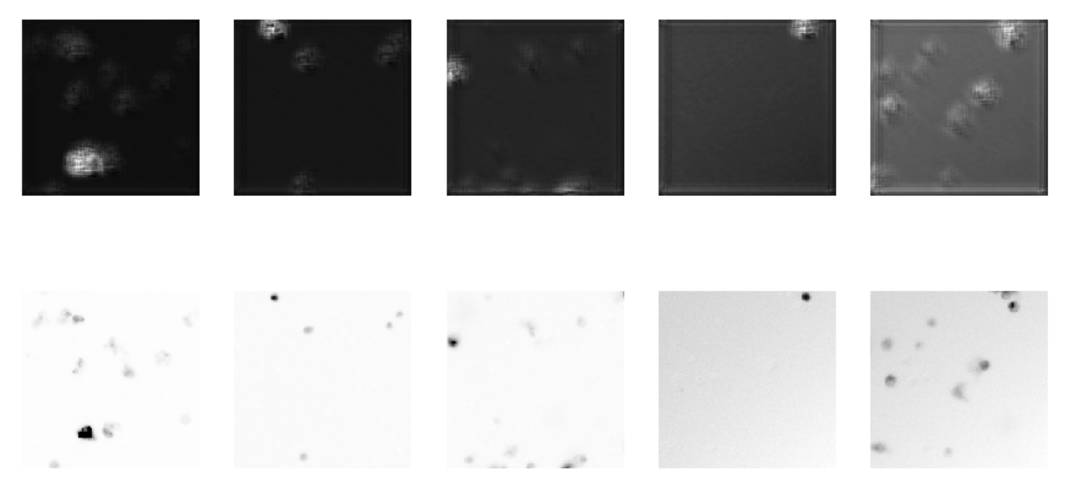
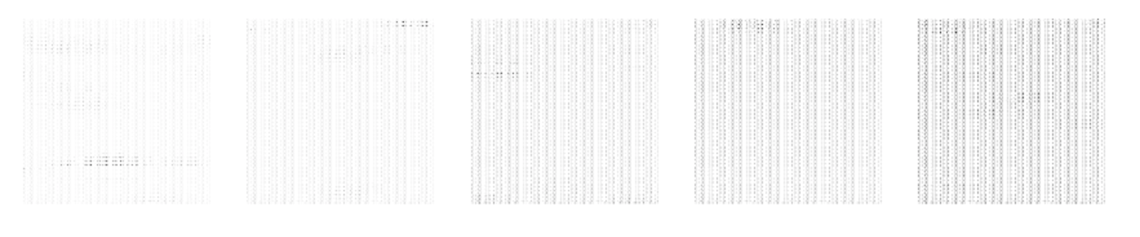
Reconstructed
Original
Compressed

Slide 4
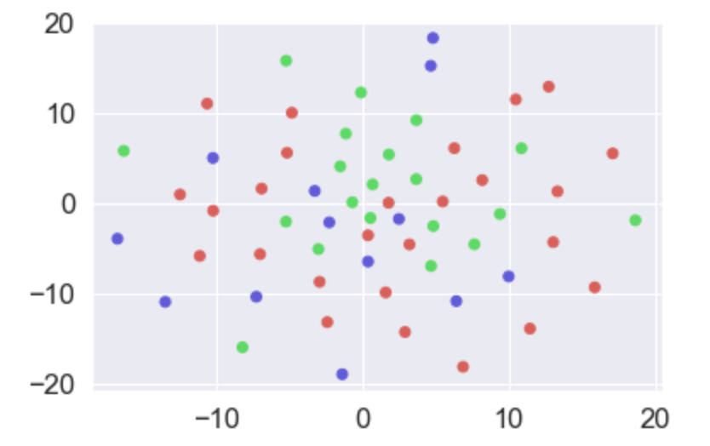
Completed work (2/2)
Read about PCA and tsne
Tried to cluster the compressed and overlapped images...
Not much luck:

Slide 5
Work to come
Script to read Excel sheet into labels
Spending time on getting resized images read back to disk so I can transfer them easier to GPU cluster or Colab
Running into a lot of issues for this though
Research on how PCA + tsne can work better for this.
Right now, even with different parameters not giving much results.
Increase dataset?
Then linked to resizing data work.

Slide 6
Rough plan for semester, reworked
Week 5
Tuned autoencoder
Calculated overlap of images
Start working on clustering algorithm for image overlaps
Week 6
HPC training day (hopefully will help with running some models)
Find way to write images back to disk without losing data
Week 7
Read on PCA/tsne
See if dataset can be expanded
Fit model, save weights
Week 8
Tune clustering algorithms to improve performance
Week 9
Tune clustering algorithms to improve performance
Evaluate model performance

