Slide 1
Level 4 Project
Week 4 Meeting
(Week 3 Remote Recap)

Slide 2
Completed work
All helper functions for transferring correct images (not Brightfield) to the project, reading in the TIF images, resizing them, plotting them in grayscale, splitting the dataset into train/test.
Built autoencoder, with appropriate functions to grab encoded, decoded, and compressed representations (see next slide)
Imported dissertation latex onto Overleaf, read through it. I’m planning on adding to it and restructuring it as the semester goes along.

Slide 3
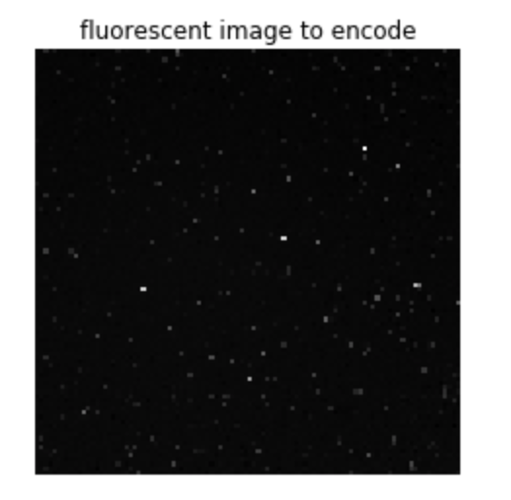
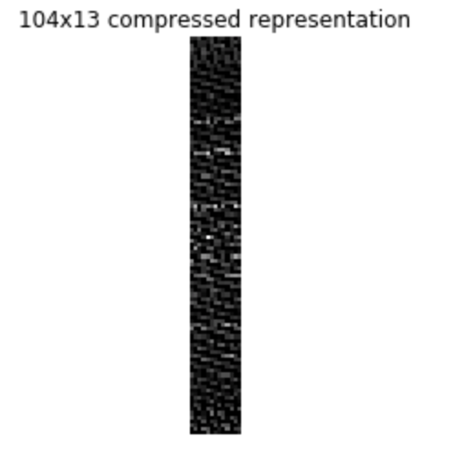
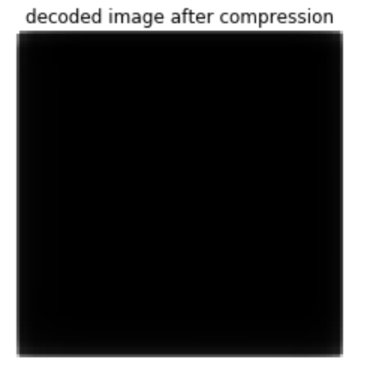
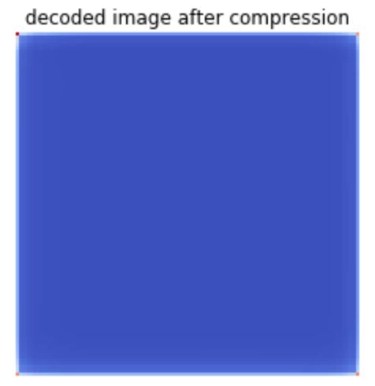
Fed the autoencoder ~470 items, size 100x100.
I added a different colourmap for the decoded image to highlight that it only outputs some changes in pixels around the borders. As you can see there is still some work to be done for the autoencoder to output something that looks more like the original image. I tried changing the size of the input images but will have to change more parameters, as that did not seem to make much difference.

Slide 4
Questions
Right now I’m feeding all the pictures into the autoencoder without any labels or differentiation for different drugs etc. When doing data visualisation you said they should hopefully cluster around the same conditions, so are we hoping it would do the same on a new dataset?
I was looking at TSNE for data visualisation, which is usually used after using something for dimensionality reduction. Is this what you had in mind to visualise the data after calculating overlap?
Because of all the different cell conditions, I’m struggling to conceptualise how we want to calculate the overlap between the images. Do we want to do pairwise comparison? It would make more sense to me to do it on images from the same condition, but then we would have to label them.

Slide 5
Rough plan for semester 1
(potentially to be reworked following my questions)
Week 4
Tuning autoencoder
Week 5
Tuning autoencoder
Week 6
HPC training day (hopefully will help with running some models)
Calculate overlap of images
Week 7
Start working on clustering algorithm for image overlaps
Week 8
Tune clustering algorithm
Week 9
Label t-cell/dendritic cells images:
Evaluate clustering performance

