Slide 1

CS 3100, Models of Computation, Fall 2020
Ganesh Gopalakrishnan
School of Computing
University of Utah
Salt Lake City, UT 84112

Slide 2
TO DO EACH WEEK
Look at bit.ly/cs3100fall20 and scroll thru it
This is one place where we will say it all (deadlines, what’s due, all lessons etc)
Look at the Canvas
Each week, you have
one Quiz,
one Assignment,
one Ungraded Survey, (but 15 are needed per semester; may qualify for bonus pts)
one Practice Problem Set (to get ready for the next exam coming your way)
Read the book, listen to the lectures (recordings before lectures are in the Jove notebooks; Zoom recordings after are on Canvas)

Slide 3
TO DO THIS WEEK
PLZ READ THE SYLLABUS VERY CAREFULLY
Look at the URL bit.ly/cs3100fall20
Follow the instructions in README.md in these directories
Run all the notebooks within the directory 1_Computability_Languages
Start working on the notebooks in the ASSIGNMENT-1 directory (PDF on Canvas)
Reminders
Lecture Slides and Lecture Videos are posted on Canvas
Quizzes are posted on Canvas
Assignment are posted on Canvas
Ungraded course survey also on Canvas
Assignments involve running/solving Jove notebooks in bit.ly/cs3100fall20
Assignment submissions : one ZIP file
PLZ READ SYLLABUS VERY CAREFULLY

Slide 4
Course Intro and Chapter 1

Slide 5
Team
Ganesh Gopalakrishnan (“Prof. Ganesh”)
TAs
Xinyi (Nicole) Li
Archit Rathore
Leon Tran
Shashank Vadlamani

Slide 6
Course Introduction

Slide 7
Textbook and software
Textbook authored by instructor is provide on Canvas
ONLY for this course – courtesy of publisher
Google “Automata and Computability : A Programmer’s Perspective” and an Amazon link will show up – Publisher requests that this be considered
Software “Jove” authored by instructor
Jove is freely available – and can be used even if you don’t buy my book
https://github.com/ganeshutah/Jove.git
Available on Google’s colab
Full Playlist from Fall 2019 is found at: bit.ly/3100f19Syllabus
The Fall’20 offerings will have their own videos and are recommended above others

Slide 8
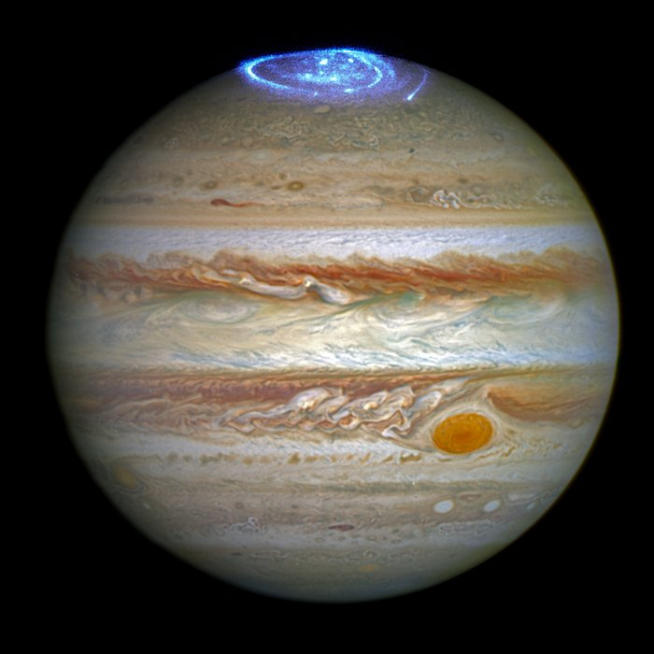
How our software got its name: Jove, Roman sky-god also known as “Jupiter”)
This image of Jupiter combines
an image taken
with Hubble Space
Telescope in the
optical
(taken in spring 2014)
and observations of
its auroras in the
ultraviolet, taken
in 2016.
Credit:NASA, ESA
https://www.spacetelescope.org/images/
heic1613a/

Slide 9
Expectations before each class
The class will run flipped (students must come prepared)
Do the canvas quiz for the day
Run the notebooks for the day
Will have embedded videos and book reading suggestions
Read the chapters for the day
One quiz and one assignment per week, two MTs, one Finals
Quiz and Asg given out on a Monday
Quiz allows 3 attempts with feedback for the wrong answers, due same week as the lectures it covers
Asg is due the Friday after the week of lectures it covers
See https://github.com/ganeshutah/Jove/tree/master/For_CS3100_Fall2020 for course specifics (also the syllabus on Canvas)

Slide 10
Lecture-1 : Why Automata and Computability

Slide 11
Lecture-1 : Why Languages?

Slide 12
Lecture-1 : Chomsky Hierarchy

Slide 13
Lecture-1 : Practical Stuff you’ll learn

Slide 14
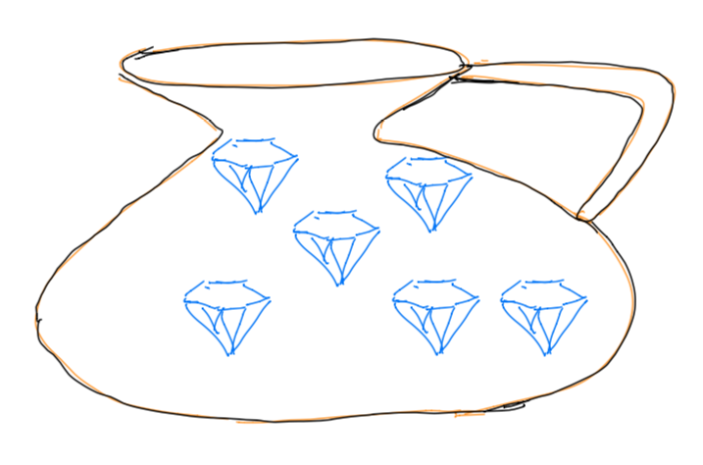
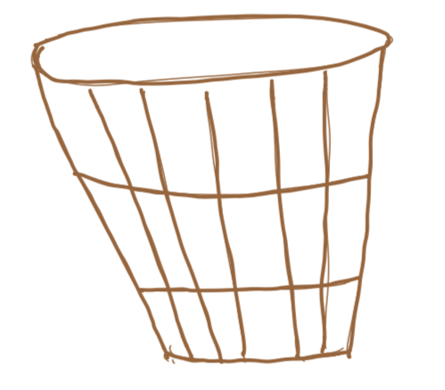
This course in one picture
Computational Devices of interest as
Precise Classifiers
“Good”
All
Possible
Strings
over
0 and 1
“Bad”
The computational devices we study are
Deterministic Finite Automata (DFA)
Nondeterministic Finite Automata (NFA)
Pushdown Automata (PDA)
Turing Machines ( TM)

Slide 15
How to think of computational devices
DFA and NFA
Simple devices such as
Handheld counters for recording how many people entered a store
traffic light signal controllers that sense cars and cycle the lights
These can be written using a simple subset of C or Java
PDA
More complex devices such as those that check whether your expression is properly parenthesized
Allow ( a * (b + c) ) and not ( a * )(b + c ))(
TM
A general-purpose C or Java program

Slide 16
Why classify strings?
Check whether the inputs are legal
The input could be
Code : Java program
Data : A spreadsheet
Then do something with the input
Generate machine-level code
Process the data, producing outputs
Cannot be sloppy in classification
It is pointless (and dangerous) to compile a syntactically malformed program

Slide 17
Definition: Language
A language is the set of all strings of interest

Slide 18
Examples of Languages
SS number:
111-22-3333 – the string is legal and may be accepted
1a3-33-4?556 – must be rejected
Phone #s
(801) 581-8224 – the string is legal and may be accepted
(801(581-356 – must be rejected
C and Java programs
main(){ … } ; -- the string is legal and may be accepted
man({}) [ … ] ; -- must be rejected
(more good/bad strings)

Slide 19
The basic focus in this course
Discover how powerful a machine must be in order to classify strings into various classes; here are examples
QUESTION: classify these into easy / medium / hard / impossible (impossible algorithmically)
“It is a string of length 5”
“It is a string that contains a 0 and a 1”
“It is a string that has equal number of 0’s and 1’s”
“It is a string that contains a prime-number number of 0’s”
“It is a string that encodes a country map and a salesperson’s tours such that s/he visits all state capitals exactly once and returns to the starting point while burning the least fuel”
“It is a string that encodes a Diophantine equation with an exact solution”

Slide 20
The basic focus in this course
Discover how powerful a machine must be in order to classify strings into various classes; here are examples
QUESTION: classify these into easy / medium / hard / impossible (impossible algorithmically)
“It is a string of length 5” - Easy
“It is a string that contains a 0 and a 1” -- Easy
“It is a string that has equal number of 0’s and 1’s” -- Medium
“It is a string that contains a prime-number number of 0’s” -- Medium
“It is a string that encodes a country map and a salesperson’s tours such that s/he visits all state capitals exactly once and returns to the starting point while burning the least fuel” -- Hard
“It is a string that encodes a Diophantine equation with an exact solution” – Impossible algorithmically

Slide 21
The Notebooks to Run
1a_Jupyter_Basics.ipynb
1b_Diophantine.ipynb
1c_Language_Basics.ipynb
1d_Language_Details.ipynb
1e_nthnumeric.ipynb
Also look into the directory ASSIGNMENT-1/ and the notebooks in this directory

Slide 22
BEGIN: Study of Symbols, Strings, Languages

Slide 23
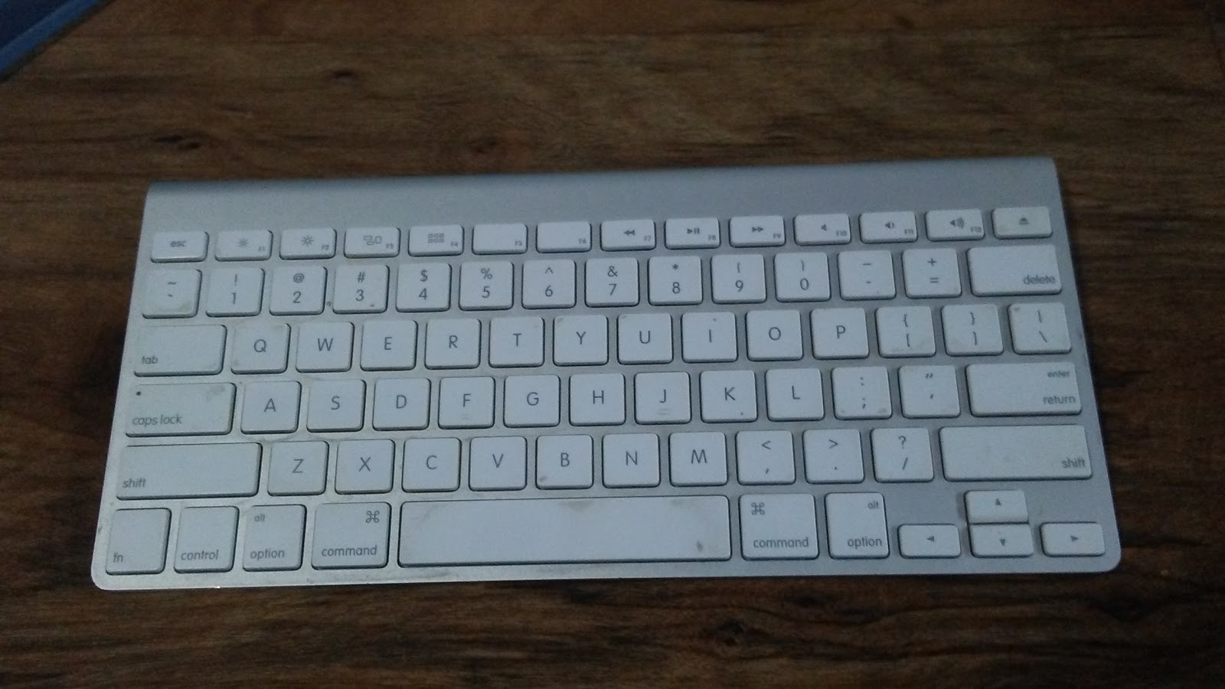
To enter any string into a computer, you need a keyboard

Slide 24
Each key is a symbol, and can also be viewed as a string of length 1
s
a

Slide 25
You form a string by typing symbols one after the other This can be viewed as concatenating strings of length 1 For example, “ass” is a followed by s followed by s
s
a

Slide 26
Math versus Python
In math, we write ass which is a string
In Python we write ‘a’ + ‘s’ + ‘s’ which is a python string

Slide 27
If you typed nothing, what string did you type?

Slide 28
If you typed nothing, what string did you type?
In math, we say you typed the zero-length string
In Python, we say you typed ‘’
Remember that ‘’ or is a string and not a symbol
‘’ is called ”epsilon”

Slide 29
Alphabet

Slide 30
Alphabet
An alphabet is the set of all symbols you are allowed to use in forming all the strings you may create
Think of it as all the keys of your keyboard
We use the Greek symbol for it
Example: = {a,b,c,…,z, 0,1,…9}

Slide 31
Alphabet
Alphabets are non-empty
You are allowed to type something
The keyboard has at least one key

Slide 32
Alphabet
Alphabets are finite
You are not allowed to keep inventing new symbols
The keyboard fits in a stadium

Slide 33
Quiz
Here are some strings. What are minimal alphabets needed to express these strings? Remember that blanks are allowed to be in the alphabet in general
010001
Abba
234.75
(801) 581-8224

Slide 34
Quiz Answers
Here are some strings. What are minimal alphabets needed to express these strings? Remember that blanks are allowed to be in the alphabet in general
010001 : Minimal Alphabet = {0,1}
Abba : Minimal Alphabet = {A,b,a} or {a,A,b} etc… (sets don’t care about order)
234.75 : Minimal Alphabet = {4,2,3,.,7,5}
(801) 581-8224 : Minimal Alphabet in Python =
{‘(‘, ‘8’, ‘0’, ‘1’, ‘)’, ’ ‘, ‘5’, ‘1’, ‘2’, ‘4’}

Slide 35
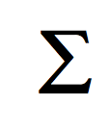
“This is my alphabet, This is my Alphabet, … but in CS3100, I’ll be a two-finger typist and use {0,1} or {a,b} or sometimes a three-finger typist and use {0,1,2} etc."

Slide 36
All strings (in CS 3100) are finite
You stop typing eventually

Slide 37
Language

Slide 38
Language
A language is a set of strings

Slide 39
Language
I did not say finite set

Slide 40
Language
I did not say non-empty set

Slide 41
A language can be empty ( any alphabet)
The empty language is denoted by
In Python, it is { }

Slide 42
A language must be allowed to be infinite
There are an infinite number of Java programs
Each such program is a string
You are interested in syntax-checking or compiling any of those infinite programs
You don’t need to worry whether it will need an arbitrary amount of memory
All you need is finite memory
But finite is a tricky word
Finite does not mean “capped under 10000000000000000000000000000000”

Slide 43
Quiz: Is there one infinite language over {0,1}? I.e. is it unique?
No
You can have {0,00,000,0000,00000, …} which is infinite and still is a language over the alphabet {0,1}
You can have {01, 001, 0001, 00001, 000001, …} – another infinite language
So what is the most inclusive language over alphabet {0,1} ?

Slide 44
Most inclusive language over {0,1}
Is it {0,1,00,01,10,11,000,001,010,011,100,101,110,111,0000,…} ?

Slide 45
Most inclusive language over {0,1}
Is it {0,1,00,01,10,11,000,001,010,011,100,101,110,111,0000,…} ?
Are we missing something?
Something very short…

Slide 46
Most inclusive language over {0,1}
Is it {0,1,00,01,10,11,000,001,010,011,100,101,110,111,0000,…} ?
Are we missing something?
Yes!
We must include ‘’ (Epsilon)
It is also a string
We must have the most inclusive language --- so we cannot exclude ‘’

Slide 47
Summary
An alphabet is non-empty and finite
A string is finite (could be non-empty)
A language is anything
could be empty
could be finite
could be infinite

Slide 48







Quiz: Identify sets, symbols, alphabets, and strings (say which alphabet the string is over)

Slide 49

Quiz : Which of these are languages (and over which alphabet); cardinality of language?

Slide 50
Observations
A symbol is also a string
Of length 1
There isn’t a symbol of zero length
There isn’t a symbol of length larger than 1
Strings can be of any finite length
An alphabet is also a language
A language of strings of length 1 each

Slide 51
How does one define symbols?

Slide 52
How does one define symbols?
You are given an alphabet. Work with it!

Slide 53
How does one define strings?
State the strings
E.g. alabama
E.g. 1008900

Slide 54
How does one define strings?
You may also define it via concatenation
E.g. alabamaMosquito is a concatenation of alabama and Mosquito
In Python it will be “alabama” + “Mosquito”
Note that alabama is the same as alabama
In Python, ‘’ + “ala” + ‘’ + “bama” + ‘’ is the same as “alabama”

Slide 55
No more methods to define strings

Slide 56
How does one define a language?

Slide 57
How does one define a language?
Does it matter?
Yes
Will English do?
English helps, but not sufficient
Will math alone do?
No, why don’t you say it in English and then also in math?

Slide 58
How does one define a language using math?
Remember that a language is a set of strings
Thus, use any method available to define sets

Slide 59
Defining languages using math
Just state it
{a, rotten, apple}
In Python, it is
{“a”, “rotten”, “apple”}
Fine idea
Works only for finite languages

Slide 60
What if I get the urge to define an infinite language?
Then use the set builder notation
Also known as set comprehension

Slide 61
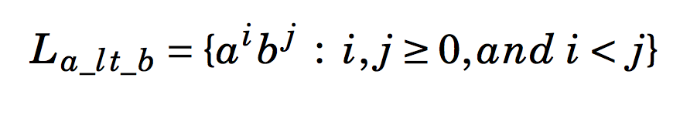
Language definition via set comprehension

Slide 62
Language definition via set comprehension

Slide 63
Assessment: Languages via set comprehension
Why no Epsilon in L_a_lt_b ?
How would you change the constraint (one way) to include Epsilon in it ?

Slide 64
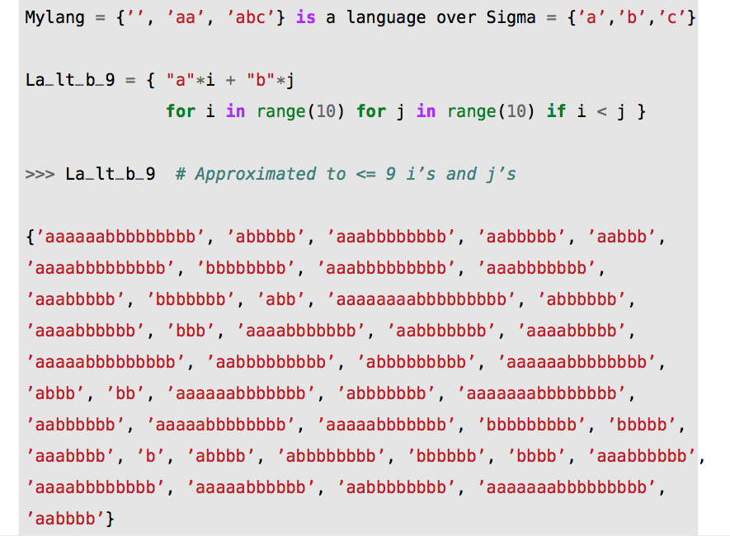
Language definitions in Python

Slide 65
Language definitions in Python
Python
= ”brain glue”

Slide 66
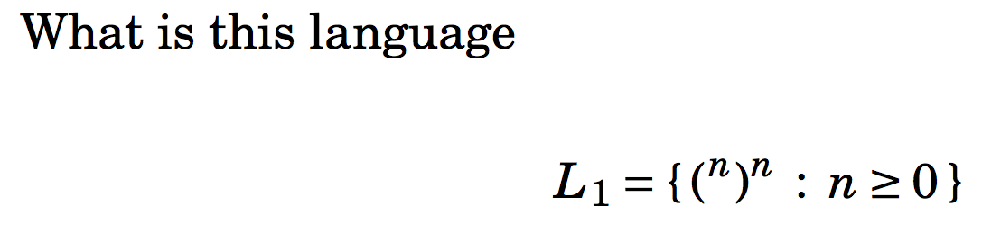
Another example language

Slide 67
Recap: String Concatenation
Simply abut the strings (run one after the other)

Slide 68
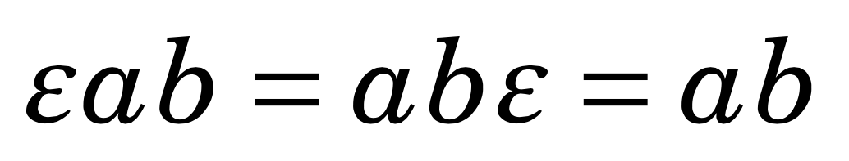
Recap: String concatenation with Epsilon works quite predictably
In math

Slide 69
Recap: String concatenation with Epsilon works even in Python
“h” + “e” + “l” + “l” + “o” = “hello”
“h” + “e” + “l” + “l” + “o” + “” = “hello”
“” + “h” + “” + “” + “e” + “l” + “l” + “o” + “” = “hello”

Slide 70
Notice that is like “1” (identity)
Modeling string concatenation as “multiplication”, we can notice that serves the role of the unit element

Slide 71
Concatenation
Hey, I like string concatenation
Is there something akin to it for languages?
That is, is there a notion of language concatenation?
Why would you want to do it?

Slide 72
Why would one concatenate languages?
One example: The language of C programs
You declare variables in a certain way
It has a “syntax”
Thus identify the infinite language of variable definitions
You then define the main program in a certain way
There are an infinite number of main programs
Thus, the language of C programs (CP) is the concatenation of
The variable definition (VD) language
The main-program (MP) definition language
The slogan “CP = VD concatenation MP” captures this example
There are 1000s of such examples one can think of
Example: Phone number = AreaCode Concatenation ActualNumber
Example: Binary file = Header Concatenation Body

Slide 73
Why would one concatenate languages?
Concatenation of languages also written by juxtaposing the languages
CP = VD MP
PhoneNumber = AreaCode ActualNumber
BinaryFile = Header Body
In CS 3100, we study simple made-up languages
{a, all} {rotten, fresh} {apple, apples, fish}
This language concatenation generates 12 strings – list them all
Insert blanks just to make it look interesting

Slide 74
Language concatenation
Expressed as juxtaposition of two languages
An arbitrary string
from L2
This here
is string concatenation
An arbitrary string
from L1

Slide 75
Interesting facts : let alphabet Sigma = {0,1}
{‘’} = all strings of length 0
{0,1} = all strings of length 1
{0,1} {0,1} = all strings of length 2
{0,1} {0,1} {0,1} = all strings of length 3
…

Slide 76
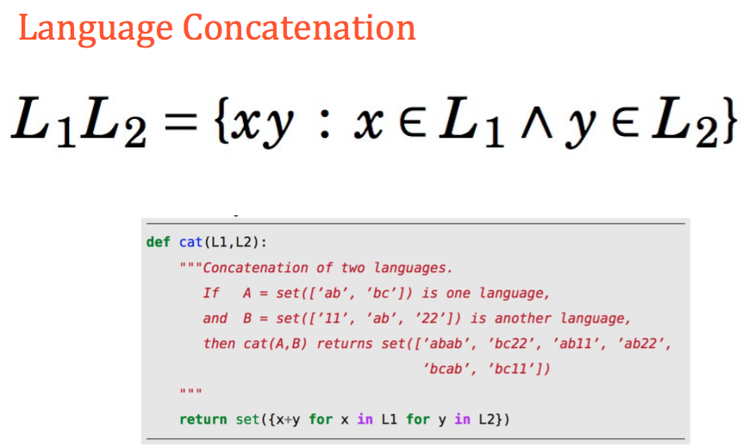
Language Concatenation Expressed in Python

Slide 77
The notions of Zero and One for mult and exp
In most algebraic systems, we have a “Zero” and a “One”
Let’s denote them by 0 and 1, with these identities
0 times x = x times 0 = 0
1 times x = x times 1 = x
x raised-to 0 is 1
We will now define One for string concatenation
There is no Zero
We will now define Zero and One for language concatenation

Slide 78



Assessment: Language concatenation

Slide 79


Assessment: Language concatenation

Slide 80
Zero and One for Language Concatenation
If we now view
language concatenation
as multiplication, then
What is the Zero of language concatenation?
What is the One of language concatenation?

Slide 81






Assessment: Language Concatenation
Is this true ??

Slide 82


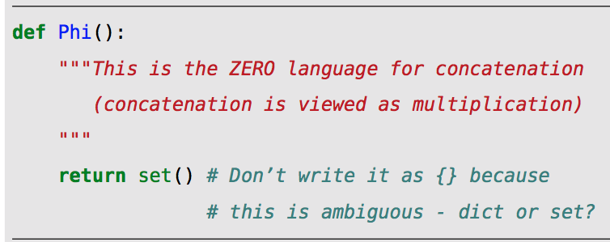


Zero and One of Concatenation
If we now view
language concatenation
as multiplication, then
What is the code for Unit() in Python ?? [ One and Unit are the same ]

Slide 83
Exercise: Set Comprehension for Palindromes
Write a set comprehension listing all palindromes over {a,b}
Call it Pal
Is Pal Pal = Pal ?
Justify your answer

Slide 84
This finishes Chapters 2 (Ch1 is mainly a self-study)

