Slide 1

CS 3100, Models of Computation, Fall 2020
Ganesh Gopalakrishnan
School of Computing
University of Utah
Salt Lake City, UT 84112

Slide 2
Lecture-2 focus: Ensure good grasp of Ch 2,3
Will be achieved by solving many problems today!
You’ll get more practice while finishing Asg-1
Forgot to publish Quiz-1
Just did so!
What’s due this Friday:
Quiz-1
Survey-1
bit.ly/3100S20Syllabus
Has material from Spring 2020
But I’ll be recording fresh videos and upgrading
the slides – so pay attention to this semester’s material
This semester’s videos are embedded within the Jove
notebooks!

Slide 3
Tips on Assignment-1
Glad to see that you have started on Asg-1
Problem-1: Python Refresher
Clarified in problem 1 that 0 <= i,j,k <= 4
Problem-2: Concat versus Cartesian Product
I changed the wording of the condition to an “If”
Concat < CartesianProduct IF ConditionHolds
Would be good to think of an IFF (coming later)
Problem-3: Concat versus Intersection
We showed that the conjecture is false
Problem-4: DeMorgan’s Law
You’ll need today’s material to define complementation
Which, in turn, needs the definition of STAR

Slide 4
Checking that you can run the Jove notebooks
Follow along with me by running these files a little bit
Run 1d_Language_Details.ipynb
Run 1e_nthnumeric.ipynb
Run Overview_Of_CS3100.ipynb

Slide 5
Lecture-2: Practical uses of Concat and Star

Slide 6
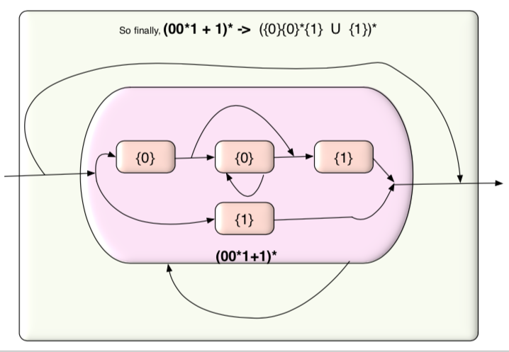
Lecture-2: Where we are going with all this
How do you
Understand
a complex
language?

Slide 7
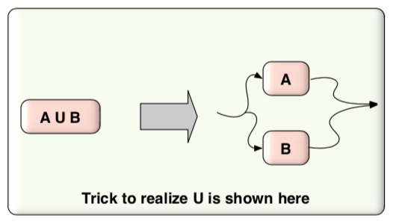
Lecture-2: Where we are going with all this
Break it up
Into its
parts!

Slide 8
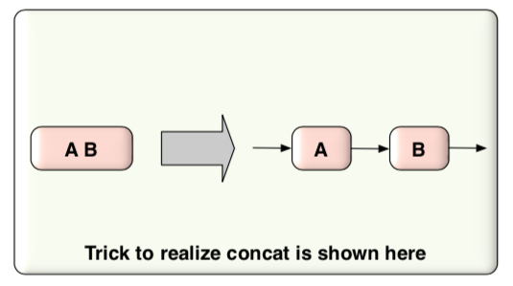
Lecture-2: Where we are going with all this
Break it up
Into its
parts!

Slide 9
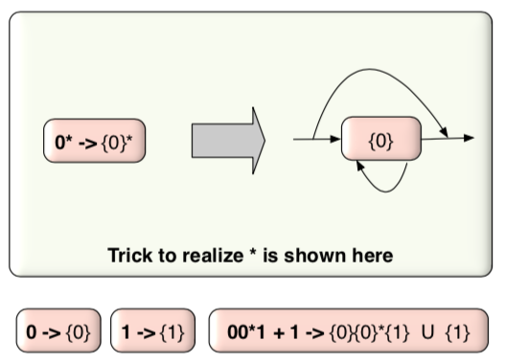
Lecture-2: Where we are going with all this
Break it up
Into its
parts!

Slide 10
Lecture-2: Where we are going with all this
Now do you see
all the
parts?
The parts
Being
Union
Concat
Star

Slide 11
Language concatenation
Expressed as juxtaposition of two languages
An arbitrary string
from L2
This here
is string concatenation
An arbitrary string
from L1

Slide 12
Interesting facts : let alphabet Sigma = {0,1}
{‘’} = all strings of length 0
{0,1} = all strings of length 1
{0,1} {0,1} = all strings of length 2
{0,1} {0,1} {0,1} = all strings of length 3
…

Slide 13
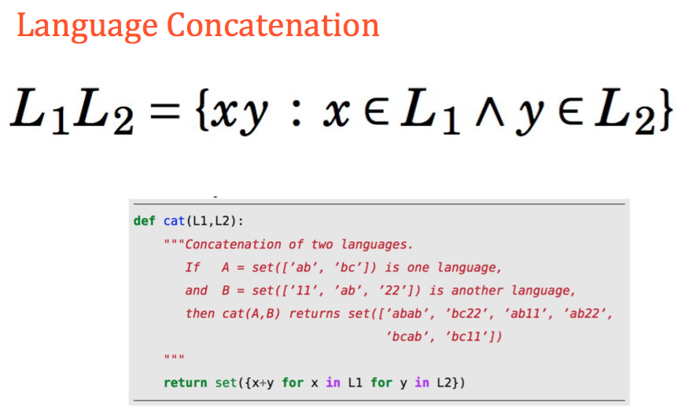
Language Concatenation Expressed in Python

Slide 14
The notions of Zero and One for mult and exp
In most algebraic systems, we have a “Zero” and a “One”
Let’s denote them by 0 and 1, with these identities
0 times x = x times 0 = 0
1 times x = x times 1 = x
x raised-to 0 is 1
We will now define One for string concatenation
There is no Zero
We will now define Zero and One for language concatenation

Slide 15



Assessment: Language concatenation
We will wait for you to work out these
Then message me privately on Zoom for about 2 mins
A1 = …
A2 = …
A3 = …
I will take some of the answers I receive, at random

Slide 16
(wait a few mins)

Slide 17
Assessment: Language concatenation
Answers
{ab}
{a,aa,ab,aaa,aab}
{aa, aaa, aaaa}
(do you now see that the conjecture in asg-1 is false?)

Slide 18


Assessment: Language Concatenation
(Message me the answer): L1 L2 = “….sentence or phrase…"

Slide 19
Assessment: Language Concatenation
(Message me the answer): L1 L2 = “….sentence or phrase…"
How to derive the answer?
L1 is the set of all odd-length strings of 0’s
L2 is the set of even-length strings of 0’s
When you take any string from L1 and follow it with a string from L2, you are doing the
addition of “odd” and “even”, which is always odd
Thus, you end up getting back all the odd-length strings!
An example follows on the next page!

Slide 20
Assessment: Language Concatenation
(Message me the answer): L1 L2 = “….sentence or phrase…"
How to derive the answer?
L1 = {0, 000, 00000, 00000, …. }
L2 = {E, 00, 0000, … }
Take all the strings of L1 you see above and follow it with a string from L2 and see what we get
(I will put a blank to indicate FOLLOWED BY)

Slide 21
Assessment: Language Concatenation
(Message me the answer): L1 L2 = “….sentence or phrase…"
How to derive the answer?
L1 = {0, 000, 00000, …. }
L2 = {E, 00, 0000, … }
L1 L2 = {0 E , 0 00, 0 0000,
000 E, 000 00, 000 , 0000,
00000 E, 00000 00, 00000 0000 , …. }

Slide 22
Assessment: Language Concatenation
(Message me the answer): L1 L2 = “….sentence or phrase…"
How to derive the answer?
L1 L2 = {0 E , 0 00, 0 0000,
000 E, 000 00, 000 0000,
00000 E, 00000 00, 00000 0000 , …. }
This simplifies to { 0, 000, 00000, 000, 00000, 0000000,
000, 00000, 0000000,
00000, 0000000, 000000000, …. }

Slide 23
Assessment: Language Concatenation
(Message me the answer): L1 L2 = “….sentence or phrase…"
BUT WE ARE BUILDING SETS!
This simplifies to { 0, 000, 00000, 000, 00000, 0000000,
000, 00000, 0000000,
00000, 0000000, 000000000, …. }
So we simplify it down to a set form finally
{0, 000, 00000, 0000000, 000000000, … }

Slide 24



Assessment: Language Concatenation
Message me the answer as
A1 = …
A2 = …
A3 = …
If you can simplify the result and express it as one of the given languages, say so
Please now try these based on the video
I sent you plus the explanations I sent you !!
This video is on Canvas too.

Slide 25

Assessment: Language Concatenation
(Message me the answer) : Yes/No and Why (one phrase)

Slide 26
Assessment: Language Concatenation
(Message me the answer) : Yes/No and Why (one phrase)
Not true because we never get E ( ‘’ ) by doing L1 L1. We get everything else!

Slide 27


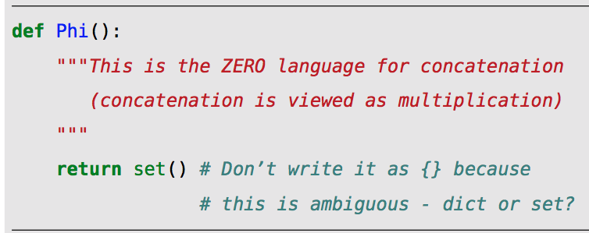


Zero and One of Concatenation
If we now view
language concatenation
as multiplication, then
What is the code for Unit() in Python ?? [ One and Unit are the same ]

Slide 28
If concatenation is like multiplication, then doing concatenation many times is like …. ?

Slide 29
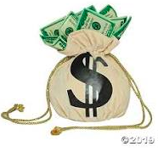
If concatenation is like multiplication, then doing concatenation many times is like …. Exponentiation

Slide 30



Assessment: Exponentiation of a Language
If we now view
language concatenation
as multiplication, then
Exponentiation is
Repeated multiplication
Which of these two must be true ??
Does it follow the rule “x raised to 0 is 1” ?

Slide 31

Answer for Language Concatenation Definition
Much like with numbers, 33 raised to 0 is 1
Likewise, a “language raised to Zero is the One language”

Slide 32
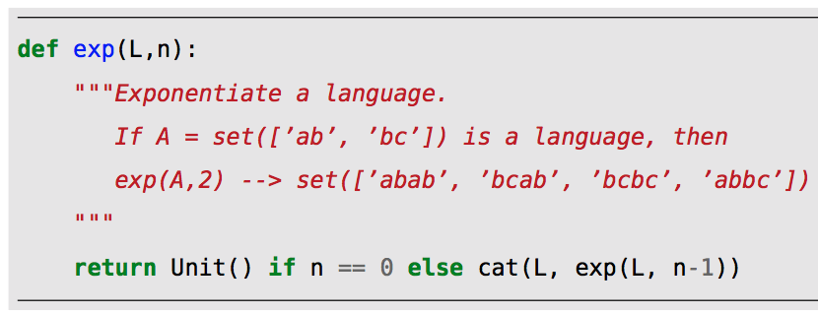

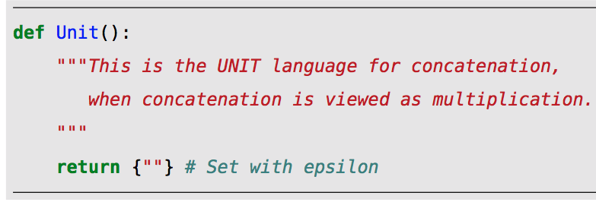
Defining lexp in Python (`language exp’)

Slide 33
What else can we do with languages?

Slide 34
What else can we do with languages?
Remember that languages are sets
So you can do to languages what you can do to sets
Which is union and intersection
I won’t repeat what these mean … but we can take a short quiz
Short quiz
What is the intersection of { a,b} and {a,c} ? Do you use \cap or \cup in Latex?
What is the union of {a,b} and {a,c} ? Do you use \cap or \cup in Latex?
A1 = …
A2 = …

Slide 35
What else can we do with languages?
Remember that languages are sets
So you can do to languages what you can do to sets
Which is union and intersection and complement
The complement of a set S is Universe - S

Slide 36
Universal Language (over an alphabet)
It is the set of all strings over the given alphabet
Please do not forget the empty string!
E.g. if the Alphabet is {0,1}, then the Universal set is
{ ’’, 0, 1, 00, 01, 10, 11, 000, 001, 010, 011, 100, 101, 110, 111,
0000, 0001, 0010, 0011, 0100, 0101, 0110, 0111,
1000, 1001, 1010, 1011, 1100, 1101, 1110, 1111, … }

Slide 37
The universe of all strings over {0,1} is as below The first line defines the set of strings of length 0 The second line defines the set of strings of length 1 , etc.
{‘’}
{0,1} {0,1} {0,1}
{0,1} {0,1} {0,1}
{0,1} {0,1} {0,1}
… to infinity

Slide 38
We define the “star” operator that takes the repeated unions of these exponents

Slide 39
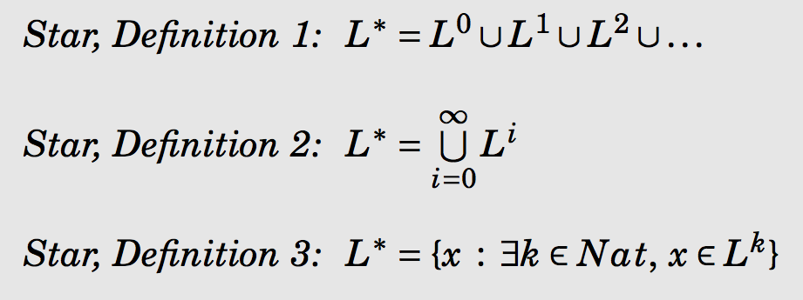
Definition of Star (three equivalent ones)
“Pick your poison…”

Slide 40
Example : What is {0,1}* ?

Slide 41
For use in Jove, define a convenient operator called “star upto n”
Of course, we can also write it as Star from n down to 0

Slide 42
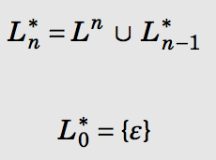
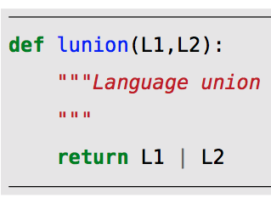
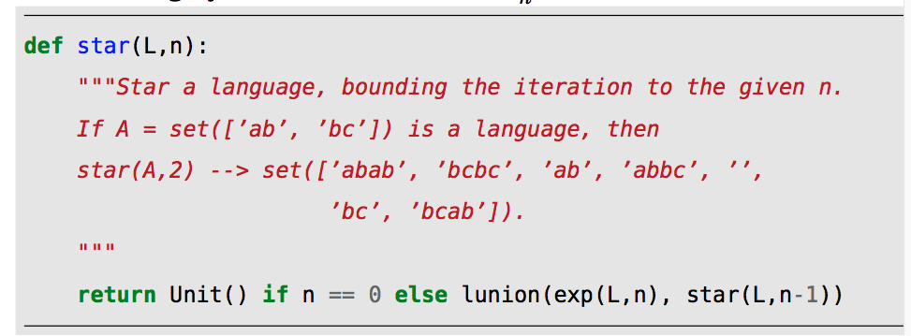
We can now define “star upto” recursively

Slide 43

Once we define “star upto n”, we can define the “true star” by sending n to infinity!
The “star upto n” idea is to help you experimentally discover “what star looks like”
In the actual theory, we only use the “true Star” , i.e. L*

Slide 44

Summary of ideas
If we want to complement a language defined over an alphabet , you do this:
Sigma^* can be defined directly and quite compactly

Slide 45
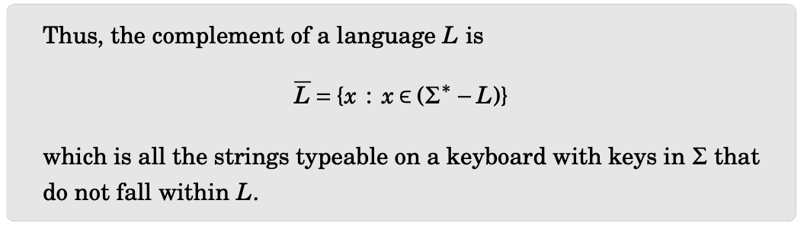

THE COMPLEMENT OF A LANGUAGE, L

Slide 46
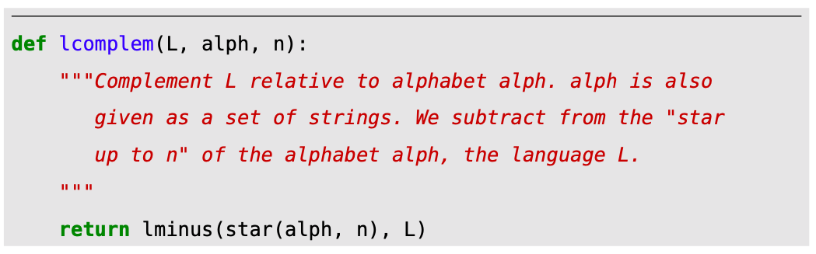
Defining the complement in Python

Slide 47
Assessment
Let L = { a, bc }
Let Sigma = {a, b, c}
1. Write out star(Sigma, 2)
2. Then write lcomplem(L, Sigma, 2)
Message me the answer as
A1 = …
A2 = …

Slide 48
Notice that Star can be applied to any language – not just alphabets! Example: What is {a, ba}* ?
Message me the answer for this * up to 2

Slide 49


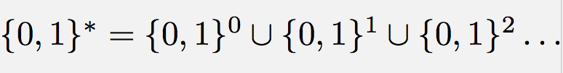

The star of ANY language CONTAINS
Simplify the last one going up to 2 and message me

Slide 50


The star of ANY language CONTAINS

Slide 51
Assessment: Property of Star
There are just two languages L1 and L2 such that L1* and L2* are finite
L1 = ?
L2 = ?
The Star of any other language is … finite / infinite ?
Message me the answer

Slide 52
Assessment: Property of Star
There are just two languages L1 and L2 such that L1* and L2* are finite
L1 = ?
L2 = ?
The Star of any other language is … finite / infinite ?
Message me the answer
Answer: {} and {‘’} are the only two such languages

Slide 53
Listing the Contents of Infinite Languages Conveniently

Slide 54
Listing the Contents of Infinite Languages Conveniently
We often need to list strings from a language
To feed the strings to some tool
To show someone what the language contains (by way of example)
How do we ”smartly” list the contents of an infinite language?

Slide 55
An English word “lexicographic” defined…
Lexicographic
Means “as in a dictionary”
i.e. list apple before pop etc.
What about 001 versus 10 ?
Pretend that 0 is before 1
Then 001 comes before 10 in the lexicographic order!

Slide 56
Basic Idea
Choose a listing method that guarantees that you will list each string eventually
E.g. suppose you take {0,1}*
If you go lexicographically, you will go like this:
‘’, 0, 00, 000, 0000, 00000, …. (never will you list a 1
We therefore (almost always) prefer the enumeration order !

Slide 57
Example of enumeration and non-enumeration
Numeric order : This is an enumeration (gets to any string eventually, i.e. in a FINITE NUMBER of steps)
Lexicographic order : NOT an enumeration. Does not guarantee to EVER get to some strings (anything containing 1 won’t be listed !!)

Slide 58
See the book for code that enumerates

Slide 59
Language Reversal
Reverse each string in the language

Slide 60


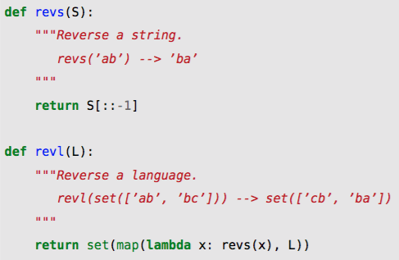
String and Language Reversal

Slide 61
Exercise: Set Comprehension for Palindromes
Write a set comprehension listing all palindromes over {a,b}
Message me the answer, writing
Pal = { pattern : condition }
Requirement: Form the “pattern” using three concatenations as follows
SomeLanguage SomethingInTheMiddle SomeLanguage
The “condition” can be something obvious such as “w \in Sigma^*

Slide 62
Exercise: Set Comprehension for Palindromes
Is star(Pal) = Pal ?
Justify your answer (Sigma = {a,b})
Message me the answer, sending a counterexample if false, and a short proof if so
Please try this analytically and also through experimentation!
We will discuss on Tuesday.

Slide 63
Exercise: Enumerate 8 strings from (({a,ab}{a,ab})^R)^*
Here, juxtaposition is concatenation, ^R is reverse, and ^* is Kleene star
Message me (or try at home if we don’t get to it in class). Expand the * upto 2.

Slide 64
This finishes Chapters 2 and 3 (Ch1 is mainly a self-study)

