Slide 1

CS 3100, Models of Computation, Fall 2020, Lec 3
Ganesh Gopalakrishnan
School of Computing
University of Utah
Salt Lake City, UT 84112

Slide 2
Survey-1 Gist + Adjustments
Week-1 survey summarized
bit.ly/CS3100_Wk1_Survey_Gist
Will conduct maybe not 25 (but say 15)
And I’ll require 10 to be submitted – very helpful to us!
Still prefer private 1-1 replies to limit distractions (will broadcast answers back)
Not quite a “flipped” class – more like “easy over”
We will make adjustments and ask you if the trend is right (in Survey-2)
Enjoyed reading about you!
Now to connect your stories to your name + face
Show up more at my office hours and I’ll get to know more of you
Here are a few things about me (ask for advise anytime)
Work in correctness checking of concurrent software (advising 5 PhD students)
Have advised 21 PhD students (3 more soon) and 42 UG researchers
Love automata, swimming, good sleep.

Slide 3
FAQs and advice
Some concepts will require studying a few times and reading the book carefully
The material is very “applied” till Midterm-1
Then we will be able to do the theory better after that
How are the asgs graded?
We will manually grade the Jove notebooks (no ‘auto-grade’)
How to express IF x THEN y ?
This is a proposition that you’ve studied
and CRUCIAL for the Pumping Lemma studied after Midterm-1
This is the I - - l - c - t – o n operator (“ IF smoke THEN fire” )
Encode using AND, OR, NOT
In the Python refresher, you must express your answer as a single set comprehension with this expression in the CONDITION part
IF (i==2) THEN (j==k) must be turned into a single Boolean expression
The amount of Python needed in this class is negligible!
We only choose those parts of Python that illustrate the math – nothing more!

Slide 4
Plan for Weeks till Midterm-1
With the foundation of Languages, beginning today, we will study three equivalent ways to realize a simple class of languages called regular languages
Regular languages are those that can be exactly described by
Deterministic Finite-State Automata (DFA, studied this week)
Nondeterministic Finite-State Automata (NFA, next week)
Regular Expressions (RE, week after that)
These mechanisms are central to the whole of CS
All compiler lexical analyzers that check the syntax of strings, numbers etc
E.g. 1.234 E – 07, (801) 581-8224 , etc.

Slide 5
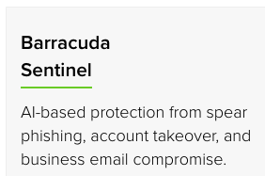
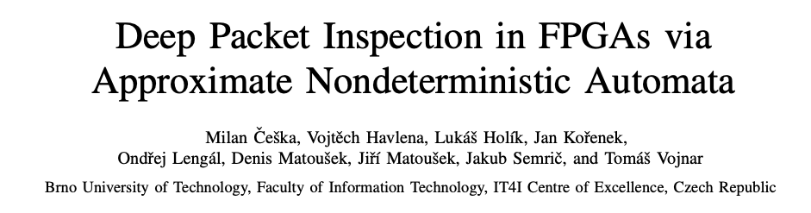
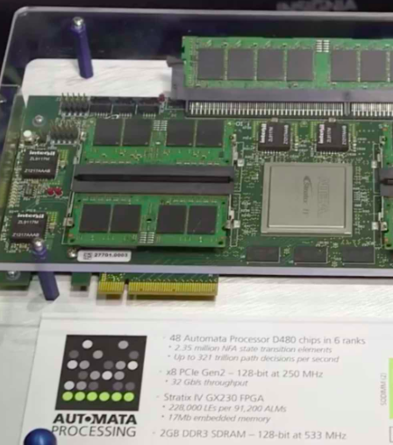
DFA in the field
Packet filters for detecting malware
In actual DFA chips once made by Micron, Boise ID
Can “learn” DFA
one of the first ML algorithm was how to learn a DFA from examples of positive and negative examples

Slide 6
Puzzle from the Post-Lec2 Video
Message me (privately) the answer for: Is Pal* = Pal ?
Recall that L1 = L2 if
L1 is contained in L2
AND
L2 is contained in L1
This is because L1 and L2 are sets, and two sets are equal
when they contain each other.

Slide 7
Puzzle from the Post-Lec2 Video
Answer: Pal* != Pal
Why?
Think of what Pal* is made of
Union of all exponentiations
Which strings in Pal* are not in Pal?
Message me some answers!

Slide 8
Puzzle from the Post-Lec2 Video
Example answer:
00100010 is in Pal* but not in Pal

Slide 9
Now we will cover Lecture 3, Ch 4.1-4.5 and Ch-5

Slide 10
Introducing DFA
Machines with a finite set of states : “Q”
Is defined for an alphabet Sigma (usually {0,1})
Has a single initial state
Has some number of final states “F”
Could be none, all of Q, but typically something in-between
Has moves defined
for every state q in Q and for every member of Sigma
Helps define a language!
Any string that takes the DFA from the initial state (I or IF) to one of the states in “F” is accepted by the DFA (it belongs to the DFA’s language)
All such strings are recognized by a DFA
Called “the language of the DFA”
A regular language is the language of some DFA
Not all languages are regular --- think of the “supermarket entry counter”

Slide 11
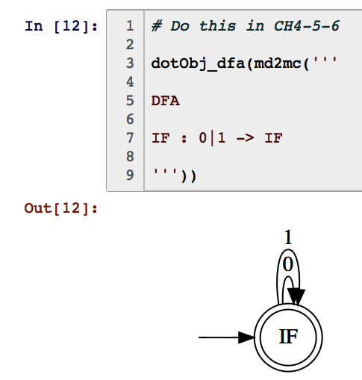

Is this a DFA? Which strings are accepted by it? What language is recognized by it?
Message me your answers
privately on Zoom
I’ll broadcast correct answer

Slide 12
pause

Slide 13
Is this a DFA? Which strings are accepted by it? What language is recognized by it?
It is a DFA (all conditions for its defn
are met.
(Q, Sigma,Delta,q0,F) are all “good”
It accepts all strings from Sigma
So the language is Sigma*
All strings
that start from the “I” state
end up in an “F” state
The state happens to be an IF state
That is allowed!

Slide 14

Confirm (can I move on?)

Slide 15
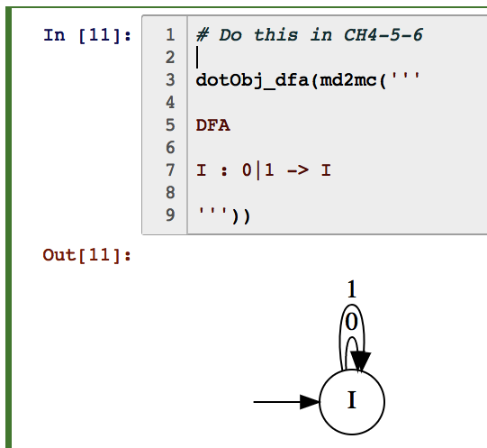
Is this a DFA? Which strings are accepted by it? What language is recognized by it?
Message me your answers
privately on Zoom
I’ll broadcast correct answer

Slide 16
Is this a DFA? Which strings are accepted by it? What language is recognized by it?
It is a DFA (all conditions for its defn
are met.
(Q, Sigma,Delta,q0,F) are all “good”
It accepts NO strings from Sigma
So the language is the zero language { }
NO strings
that start from the “I” state
end up in an “F” state
There is no F state; that is allowed

Slide 17
Confirm (can I move on?)

Slide 18
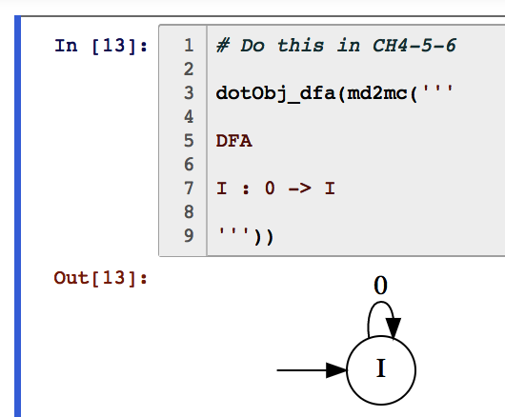
Is this even a DFA over {0,1} ?? Why or why not?
Message me your answers
privately on Zoom
I’ll broadcast correct answer

Slide 19
Is this even a DFA over {0,1} ?? Why or why not?
It is NOT DFA
(Q, Sigma,Delta,q0,F) is broken
with respect to Delta
It does not have a move on a ‘1’
Thus Delta is not a function!
(it must be a function for a legal DFA)
A DFA must have a specified move
on every member of Sigma

Slide 20
Confirm (can I move on?)

Slide 21
Is that “DFA” a DFA over {0} ??
Message me your answers
privately on Zoom
I’ll broadcast correct answer

Slide 22
Is this a DFA over {0} ?
It is a DFA now!
(Q, Sigma,Delta,q0,F)
Delta is a function with domain
(Q x Sigma)
Defined everywhere on Q x Sigma
… and its language is ? … quick answer…

Slide 23
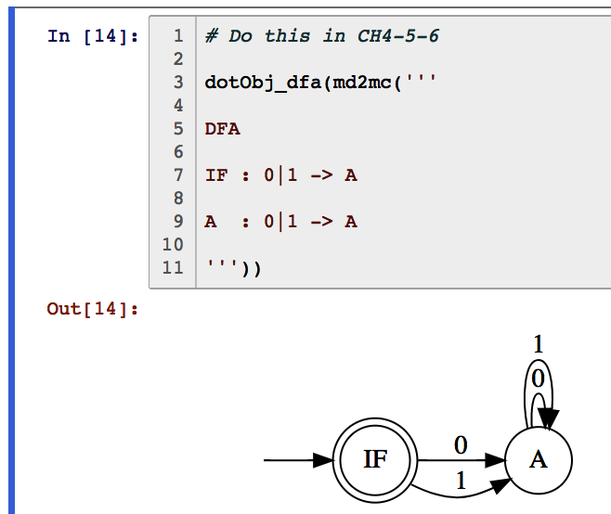
Is this a DFA? Which strings are accepted by it? What language is recognized by it?

Slide 24
Is this a DFA? Which strings are accepted by it? What language is recognized by it?
Wait a minute
Let’s apply the
FuseEdges=True argument
See the next slide for the result

Slide 25
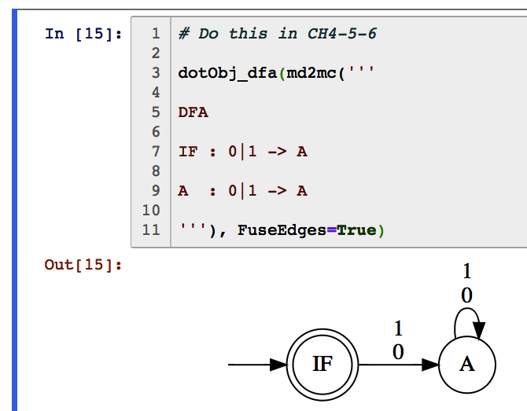
Is this a DFA? Which strings are accepted by it? What language is recognized by it?
Message me you’re a nswers
privately on Zoom
I’ll broadcast correct answer

Slide 26
Is this a DFA? Which strings are accepted by it? What language is recognized by it?
Its language is the unit language
Now you know the trick to make
the language of a DFA finite
… what is the trick? ….
(send me a message)

Slide 27
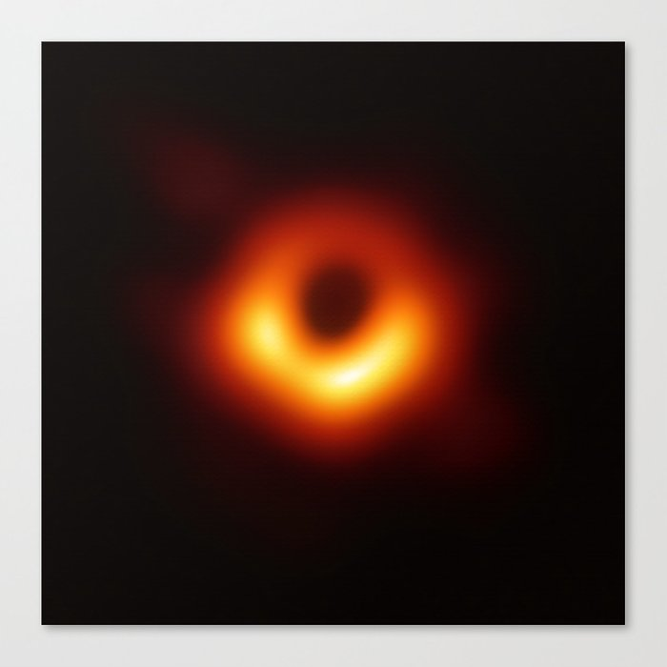
Is this a DFA? Which strings are accepted by it? What language is recognized by it?
Its language is the unit language
Now you know the trick to make
the language of a DFA finite
… what is the trick? ….
To “dead-end” a DFA into a
black-hole !!

Slide 28
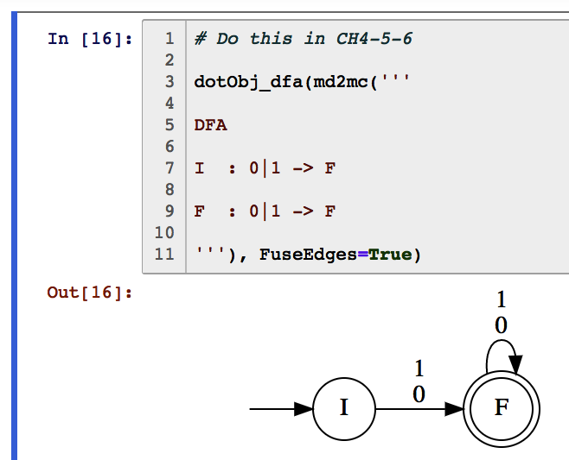
Is this a DFA? Which strings are accepted by it? What language is recognized by it? Write your answer as a language concatenation!
Message me you’re a nswers
privately on Zoom
I’ll broadcast correct answer

Slide 29
Is this a DFA? Which strings are accepted by it? What language is recognized by it?
Answer
Otherwise
Known as …

Slide 30
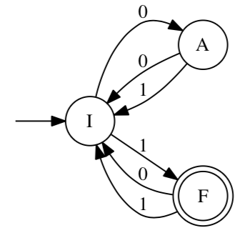
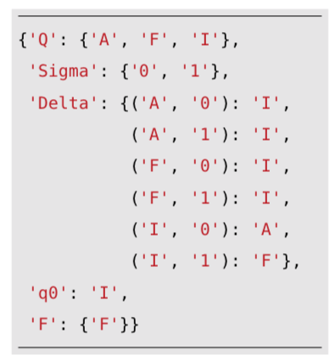
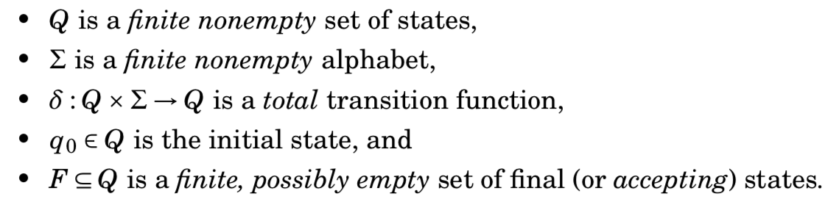
Formal structure of a DFA, and an example
The language of a DFA is
“ the strings that take the DFA from the initial state to one of the final states ”
(if the initial state is also a final state, then the language also contains epsilon)
List five strings in this DFA’s language (in numeric order); then write a concise summary of the language of this DFA!

Slide 31
Language L? Five numeric-order strings in L?

Slide 32
Language L? Five numeric-order strings in L?
Ends in 1 and of odd length
1, 001, 011, 111, 00001
ok?

Slide 33
You should be studying these on your own
BEGIN SELF_STUDY… (quick overview in class)
Good time to be studying:
Today!
Put these definitions at the end of Basic_DFA.ipynb and execute

Slide 34

Dissecting a DFA
Like..

Slide 35
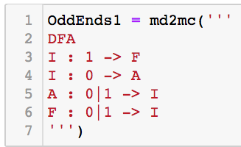
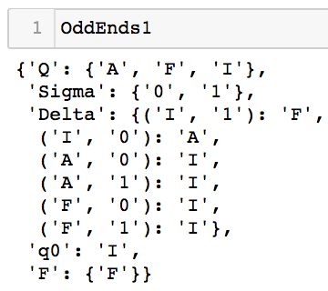
Dissecting a DFA

Slide 36



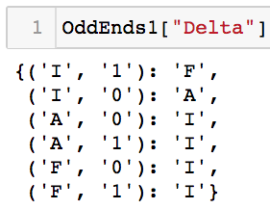

Dissecting a DFA

Slide 37


Dissecting a DFA

Slide 38
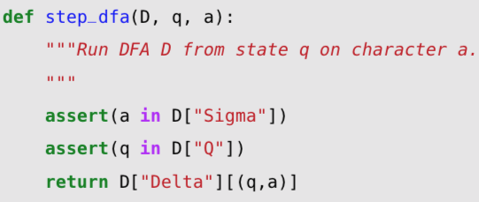

step_dfa, run_dfa, accepts_dfa in code

Slide 39

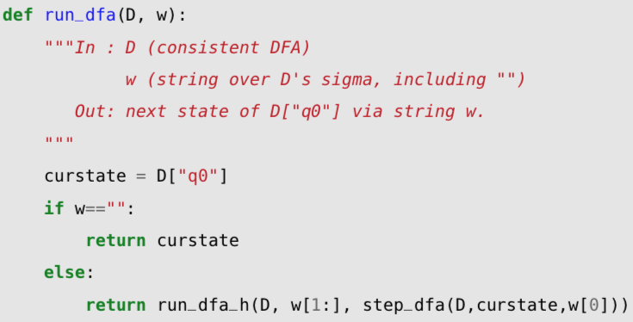

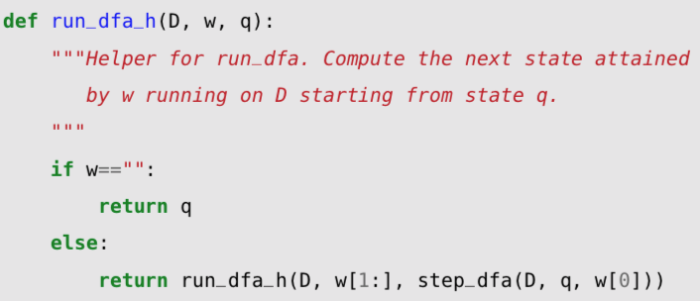
step_dfa, run_dfa, accepts_dfa in code

Slide 40
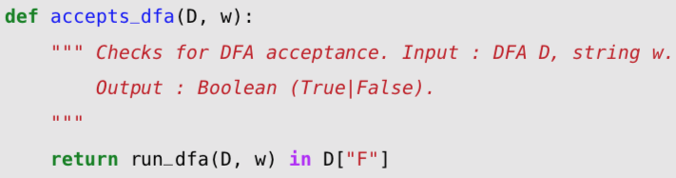
step_dfa, run_dfa, accepts_dfa in code

Slide 41
You should be studying these on your own
END SELF_STUDY… (quick overview in class)

Slide 42
Design a DFA for “ends with 0101”
Express mathematically as a language
Design in Jove syntax, keeping the relevant piece of the input in the state name
i.e. S010 means “seen 010 so far”
Instructor Live-code in class

Slide 43
Design a DFA for “contains 0101”
Express mathematically as a language
Design in Jove syntax, keeping the relevant piece of the input in the state name
i.e. S010 means “seen 010 so far”
Some prefer to draw the DFA out also. But still, name states consistently.
Students work on it … and message me the DFA
in their Zoom message box!
I shall copy/paste the solutions and run it for you!

Slide 44
Design a DFA for {0,1} where every block of length 3 contains exactly two 1’s
Instructor live-codes this in class

