Slide 1

CS 3100, Models of Computation, Fall 20, Lec 6
Ganesh Gopalakrishnan
School of Computing
University of Utah
Salt Lake City, UT 84112

Slide 2
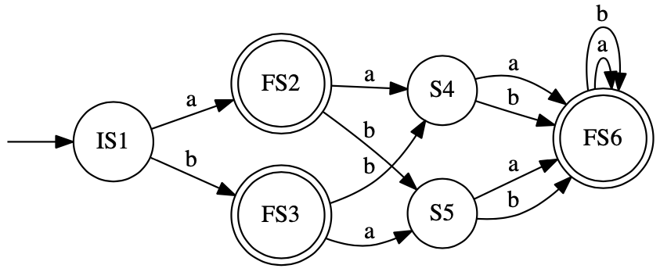
The reverse of a DFA results in an NFA Algorithm: 1) Reverse all the edges 2) New Start state = all the old Final States 3) New Final State = the original Start State

Slide 3
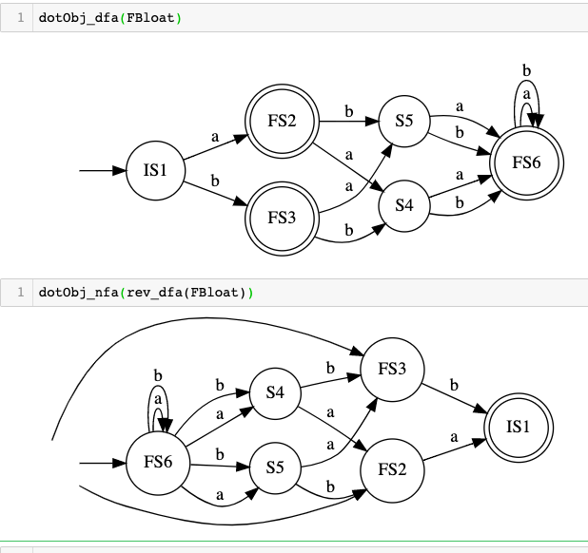
The reverse of a DFA results in an NFA

Slide 4
Brzozowski’s Minimization: 1) Reverse 2) Determinize 3) Reverse 4) Determinize Steps 3 and 4 can be eliminated if L = reverse(L) Why does this work?

Slide 5
Brzozowski’s Minimization: 1) Reverse 2) Determinize 3) Reverse 4) Determinize Steps 3 and 4 can be eliminated if L = reverse(L) Why does this work?

Slide 6
Brzozowski’s Minimization: 1) Reverse 2) Determinize 3) Reverse 4) Determinize Steps 3 and 4 can be eliminated if L = reverse(L) Why does this work?

Slide 7
Brzozowski’s Minimization: 1) Reverse 2) Determinize 3) Reverse 4) Determinize Steps 3 and 4 can be eliminated if L = reverse(L) Why does this work?

Slide 8
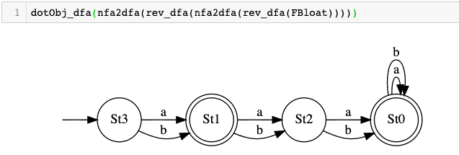
R ; D ; R ; D is Brzozowski’s minimization!

Slide 9
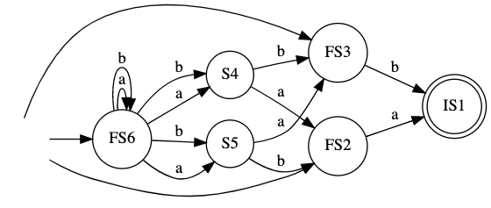
Reversal followed by nfa2dfa i.e. R ; D so far Do subset constrn.
dotObj_dfa(nfa2dfa(rev_dfa(FBloat), STATENAME_MAXSIZE=50), STATENAME_MAXSIZE=50).render('/private/tmp/rdbloat')

