Slide 1

CS 3100, Models of Computation, Spring 20, Lec 10
Ganesh Gopalakrishnan
School of Computing
University of Utah
Salt Lake City, UT 84112
bit.ly/3100s20Syllabus

Slide 2


Lecture 10, covering Ch 1-9 ☺
Walk the Kleene-Pipeline
The Postage-Stamp Problem

Slide 3
Walk the Kleene-Pipeline
Review
Once
More
Practice
Once
More
Study
Again
RE
NFA
DFA
minDFA
Brand New
Trivial, but a Useful
Stepping-Stone
(this way we don’t
need to implement
a separate DFA to RE
procedure)

Slide 4
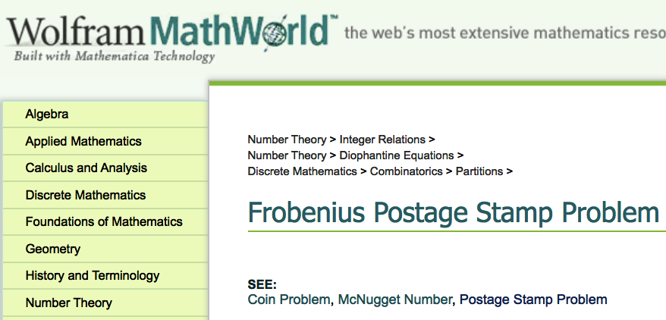
The Postage-Stamp Problem

Slide 5
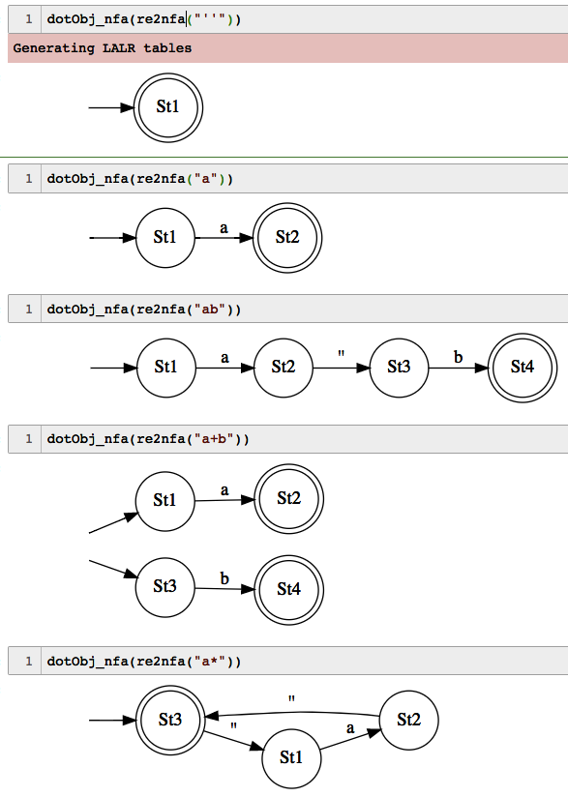
RE → NFA examples

Slide 6
What are RE?
Epsilon
a in Sigma
If R1 and R2 are RE, then R1 + R2 is an RE
If R1 and R2 are RE, then R1 R2 is an RE
If R is an RE, then ( R ) is an RE
If R is an RE, then R* is an RE
Nothing else is an RE

Slide 7
Cover RE → NFA for each case
Epsilon
a in Sigma
If R1 and R2 are RE, then R1 + R2 is an RE
If R1 and R2 are RE, then R1 R2 is an RE
If R is an RE, then ( R ) is an RE
If R is an RE, then R* is an RE
Nothing else is an RE

Slide 8
Cover RE → NFA for each case
Epsilon
a in Sigma
If R1 and R2 are RE, then R1 + R2 is an RE
If R1 and R2 are RE, then R1 R2 is an RE
If R is an RE, then ( R ) is an RE
If R is an RE, then R* is an RE
Nothing else is an RE

Slide 9
Cover RE → NFA for each case
Epsilon
a in Sigma
If R1 and R2 are RE, then R1 + R2 is an RE
If R1 and R2 are RE, then R1 R2 is an RE
If R is an RE, then ( R ) is an RE
If R is an RE, then R* is an RE
Nothing else is an RE

Slide 10
Cover RE → NFA for each case
Epsilon
a in Sigma
If R1 and R2 are RE, then R1 + R2 is an RE
If R1 and R2 are RE, then R1 R2 is an RE
If R is an RE, then ( R ) is an RE
If R is an RE, then R* is an RE
Nothing else is an RE

Slide 11
Cover RE → NFA for each case
Epsilon
a in Sigma
If R1 and R2 are RE, then R1 + R2 is an RE
If R1 and R2 are RE, then R1 R2 is an RE
If R is an RE, then ( R ) is an RE
If R is an RE, then R* is an RE
Nothing else is an RE

Slide 12
Cover RE → NFA for each case
Epsilon
a in Sigma
If R1 and R2 are RE, then R1 + R2 is an RE
If R1 and R2 are RE, then R1 R2 is an RE
If R is an RE, then ( R ) is an RE
If R is an RE, then R* is an RE
Nothing else is an RE

Slide 13
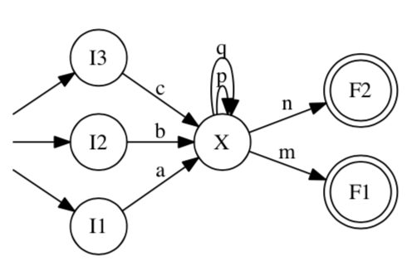
NFA to RE conversion
What is the language of this NFA?
Let’s convert this to an RE and check our work against this RE

Slide 14
NFA to RE conversion
(space for work)

Slide 15
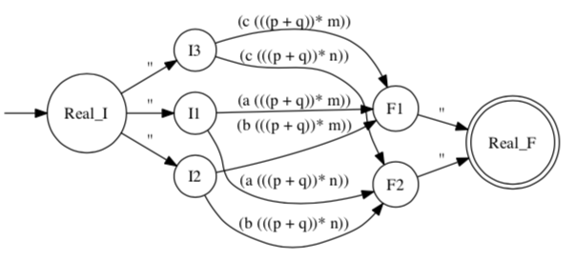
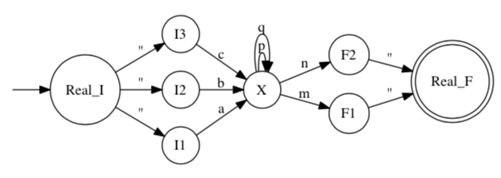
NFA to RE conversion: Results

Slide 16
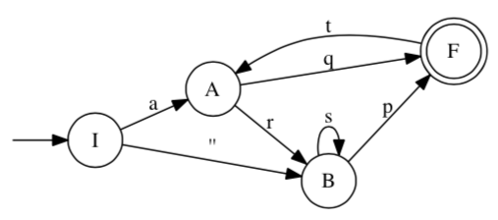
Another example of NFA to RE
(space for work)

Slide 17
One more example of RE -> NFA -> DFA
ac* + acd*, simplified as a(c*+cd*)

Slide 18
Postage-stamp problems
For relatively prime numbers a,b what is the largest integer not expressible as a linear combination of a, b ?
Let a = 2, b = 3
(for larger numbers, let’s use a tool)
How about for more pairwise relatively prime numbers a,b,c
How about non relatively-prime numbers?

Slide 19
Review

Slide 20
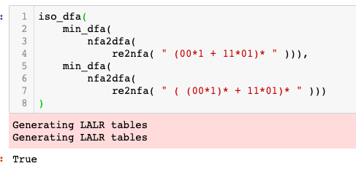
Find the strings in the language of these RE
(00*1 + 11*01)*
( (00*1)* + 11*01)*
( 00*1 + (11*01)*)*
Find out by developing a min DFA
Use iso_dfa

Slide 21
Compare these RE pairwise
( 00*1 )*
( 0 (0+1)* 1 )*

Slide 22
Compare these RE pairwise
(00*1 + 11*01)*
(0 (0+1)* 1 + 11*01)*

