Slide 1

CS 3100, Models of Computation, Spring 20, Lec 11
Ganesh Gopalakrishnan
School of Computing
University of Utah
Salt Lake City, UT 84112
cp ../Lec10.pptx ./Lec11.ppt
bit.ly/3100s20Syllabus

Slide 2
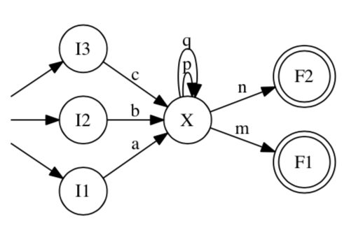
NFA to RE conversion
What is the language of this NFA?
Let’s convert this to an RE and check our work against this RE

Slide 3
NFA to RE conversion
(space for work)

Slide 4
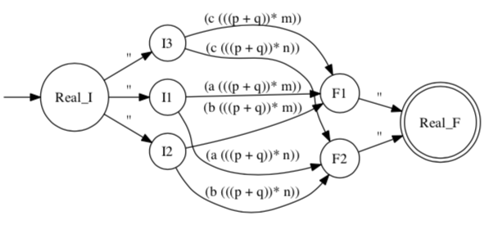
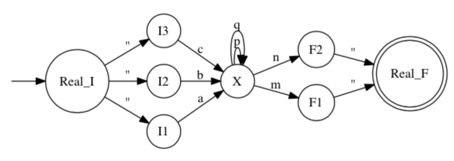
NFA to RE conversion: Results

Slide 5
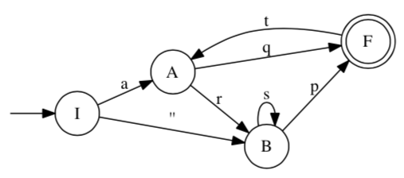
Another example of NFA to RE
(space for work)

Slide 6
Lecture 11, covering many topics
Ch11 basics
Basics of CFL and CFG
Ch12 basics
Basics of PDA
Conversion of CFG to PDA
Ch9 and before
NFA to RE and related topics

Slide 7
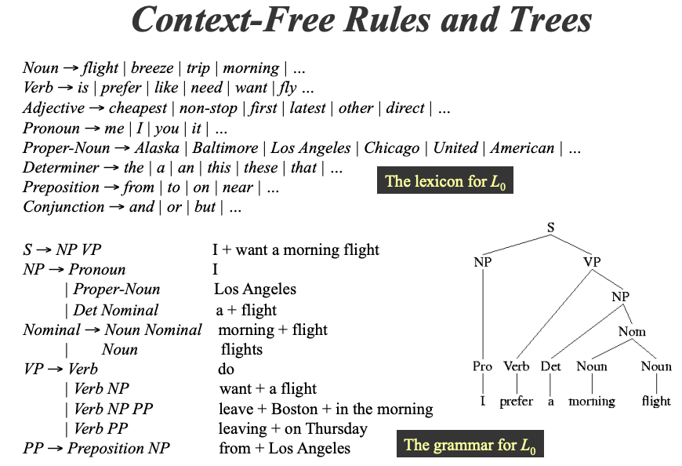
Grammars are widely used: e.g. English
From http://www.cs.uccs.edu/~jkalita/work/cs589/2010/12Grammars.pdf

Slide 8
Grammars used for Formal Languages also
Regular expressions (also known as Regular Grammars)
Context-free Grammars (we are about to study this now)
Later we will mention the Chomsky Hierarchy that includes:
Context-sensitive grammars
Unrestricted grammars

Slide 9
We study Languages & Grammars & Machines
Languages versus Grammars versus Machines
Regular languages – Regular Expressions – NFA
Context-free languages – Context-free Grammars - PDA

Slide 10
Example of design
Language: L_wwr = { ww^R for w in {a,b}* }
PL proof of non-regularity
Otherwise, why bother designing anything but a RegExp or NFA ??
Design a Context-free Grammar for it
Recursive programming that generates strings in L_wwr
Design a PDA
Direct design
Stack things
Nondet switch to begin matching
Design by converting CFG to PDA
Standard design for any CFG

Slide 11
Language L_wwr and PL proof of non-reg.

Slide 12
A CFG for L_wwr

Slide 13
How to read/interpret a PDA
Each PDA carries an additional state : the stack state
The stack keeps changing as the PDA runs
There is no theoretical depth-bound for the stack
In practice, Jove limits it… to finish running on time
Thus the total state is: < Control state (or “circle”), Stack state >
Each transition has
Input , Top-Of-Stack ; Stack-Push-String
If the Top-Of-Stack field is ‘’ , then works like an NFA
Except the Stack-Push-String may get pushed
If the Top-Of-Stack field is a member of Sigma, then the runtime stack’s top must match that Sigma entry for the transition to fire
When the transition fires, the Stack-Push-String is pushed in

Slide 14
Example PDA

Slide 15
A PDA directly from L_wwr

Slide 16
A PDA by converting L_wwr’s CFG to a PDA

Slide 17
Basics
A CFL is the language of a PDA
A CFL is the language defined by a CFG
For every PDA there is an equivalent CFG, and Vice-Versa

Slide 18
Grammars
What we are going to study are formal grammars
Example from Formal Languages:
S -> ( S ) | ‘’

Slide 19
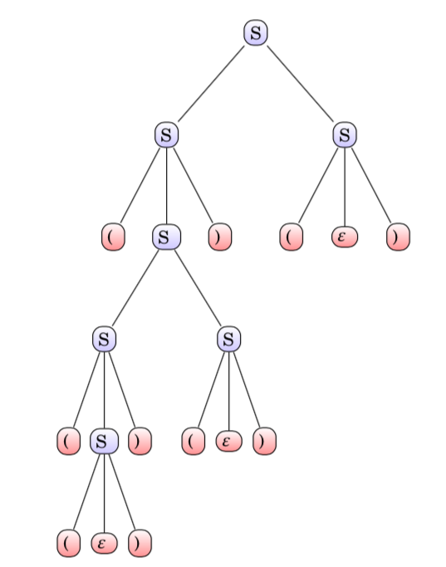
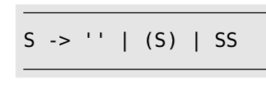
A Formal Grammar and its Parse Tree
Parse trees depict how a sentence in the language of the grammar can be derived by applying the grammar rules.
Contrast this grammar to
S1 -> ( S1 ) | ‘’
Is Language(S1) contained in Language(S) or vice-versa?

Slide 20
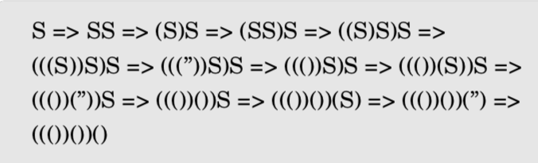
Context-free Grammars: Derivation Sequences

Slide 21
Important Notational Convention
Instead of writing three CFG productions, such as
S → ‘’
S → (S)
S → SS
We write one short-hand
S → ‘’ | (S) | SS
IT IS ONLY A SHORT-HAND !! MEANING THERE ARE 3 PRODUCTIONS HERE !!

Slide 22
Exercises
Design a CFG for the set of all odd-length strings over {0,1}
Start with a recursive programming mind-set
Basis case: smallest odd-length is 0 or 1
Else it is …. What is the recursive rule? Can you think of two recursive rules?

Slide 23
Exercises
Design a CFG for the set of all odd-length strings over {0,1}
Recursive rule 1:
Odd length = a smaller odd-length of 1 and then TWO MORE

Slide 24
ExerciseS
Design a CFG for the set of all odd-length strings over {0,1}
Recursive rule 2:
Odd length = an Even length grammar and then ONE MORE

Slide 25
Solutions for Odd Length: All are OK for us
OddL -> Len1 Len1 OddL | Len1
Len1 -> 0 | 1
OddL -> OddL Len1 Len1 | Len1
Len1 -> 0 | 1
OddL -> Len1 OddL Len1 | Len1
Len1 -> 0 | 1
In general, right-most recursion is easier
for humans to wrap their head around
For compiler parser generators, it does not matter.

Slide 26
Related Exercise
Design CFG for Even Length
Then design Odd Length in terms of Even Length

Slide 27
Solution for Even and Odd
OddL -> Ch EvenL
EvenL -> Ch Ch EvenL | ‘’
Ch -> 0 | 1
Another approach : control how the basis case ends!
EvenL -> Ch Ch EvenL | ‘’
OddL -> Ch Ch OddL | Ch

Slide 28
Exercises
CFG for all even-length strings that end in a 1
Again break up the rules into convenient “subroutines”
EvEnd1 -> SomeNonTerminal 1
What must SomeNonTerminal be?

Slide 29
Exercises
EvEnd1 -> SomeNonTerminal 1
SomeNonTerminal has to be Odd…

Slide 30
Exercise: a^n b^n
Grow the strings inside-out

Slide 31
Exercise: Equal number of a’s and b’s
Begin with template
S -> …..a…..b….. Or S -> …..b….a…..
CFGs have to “tally at the top” and then recurse within

Slide 32
Equal a’s and b’s
Finally we can do a CFG of the form
S -> aSbS | bSaS | ‘’

Slide 33
Converting a CFG to a PDA
Set up “S” (the top level symbol) as the parsing goal
Pop the current parsing goal
Push the RHS of the rules

Slide 34
Converting a CFG to a PDA
Given a grammar S -> aSbS | bSaS | ‘’
md2mc(’’’PDA
I : ‘’,’’; S -> Work
Work : ‘’, S -> aSbS
…
’’’)

Slide 35
Grammars vs. Ambiguity
A grammar G1 may be ambiguous
Another grammar G2 such that L(G1) = L(G2) may be unambiguous
I.e. no string has two distinct parse trees
While L(G1) = L(G2), there is only one parse-tree for L(G2)
Parse trees determine how
A calculator evaluates
A compiler generates code
Let us review the expression grammar (next slide)

Slide 36
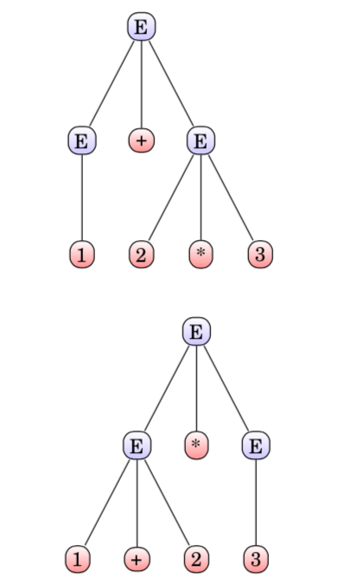

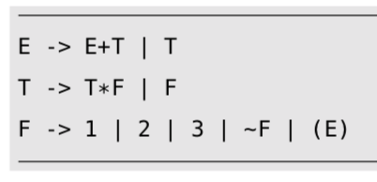
Ambiguity and Disambiguation

Slide 37
Ambiguity and disambiguation
Gist : by changing the grammar,
The same set of strings are still derivable
Ambiguity goes away !!
The basic idea is to “layer the grammar”

Slide 38
Pushdown Automata
Finite control (like DFA/NFA)
Unbounded stack added
The stack models the recursion stack (in a prog language)
Allows us to store away information and match
Still no “arbitrary counting” (other than matching in stack order)

Slide 39
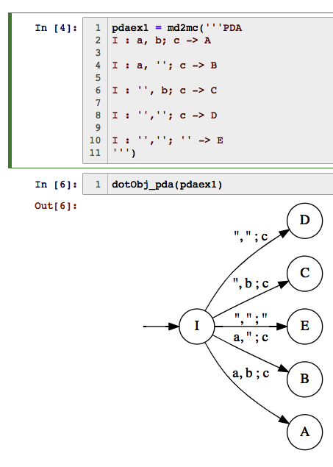
PDA ex

Slide 40
How our PDAs are set up
The input is as before
Contains the string to be examined
The stack is an unbounded last-in first-out stack
Like any other unbounded stack
We initialize the stack with #
A single character # sits on top of the stack when the PDA is powered up
The stack has nothing else (i.e. the stack has exactly one thing – the #)
Whenever # is on top of the stack, we know that the stack is empty
When we something else on top of the stack, we know it is not empty
… see next slide for more facts…

Slide 41
How our PDAs are set up
We initialize the stack with #
A single character # sits on top of the stack when the PDA is powered up
The stack has nothing else (i.e. the stack has exactly one thing – the #)
Whenever # is on top of the stack, we know that the stack is empty
When we something else on top of the stack, we know it is not empty
We put something on the stack by pushing it
Only one character (symbol) at a time is pushed
We remove by popping
Only one symbol is popped
When we pop all we pushed, we see # reappear on top of the stack
Then we know the stack is empty!
That is the ONLY test for stack emptiness

Slide 42
How a PDA accepts a string
In every state (a “single circle” or ”double circle”)
It CAN looks at both the input
And the stack top
In every state
It CAN ALSO IGNORE THE INPUT
It CAN ALSO IGNORE THE STACK
It can ignore both
It can ignore neither
It chooses a step based on how you have programmed the PDA
Programming the PDA means providing it with transitions
…more facts next slide…

Slide 43
How a PDA accepts a string
The PDA is deemed to have accepted a string
when it “accepts by final state”
A PDA is also deemed to have accepted a string
when it empties the stack – we will NEVER study this idea in this course .

Slide 44
How a PDA accepts a string
The PDA is deemed to have accepted a string
when it “accepts by final state”
ALL OUR PDAs are non-deterministic
Deterministic PDAs are there
They are useless for us
Some others care about them

Slide 45
How a PDA accepts a string
The PDA is deemed to have accepted a string
when it “accepts by final state”
ALL OUR PDAs are non-deterministic
Deterministic PDAs are there
They are useless for us
Some others care about them
THEREFORE we can say
A PDA accepts a string when ONE OF ITS NON-DETERMINISTIC journeys ends up in a final state ( an “F” or “IF” state)
With the input all gone – fully consumed
The stack may have stuff in it or nothing in it
The contents of the stack are immaterial when the PDA “accepts”
I.e. acceptance == IN A FINAL STATE + INPUTS ALL-GONE!

Slide 46
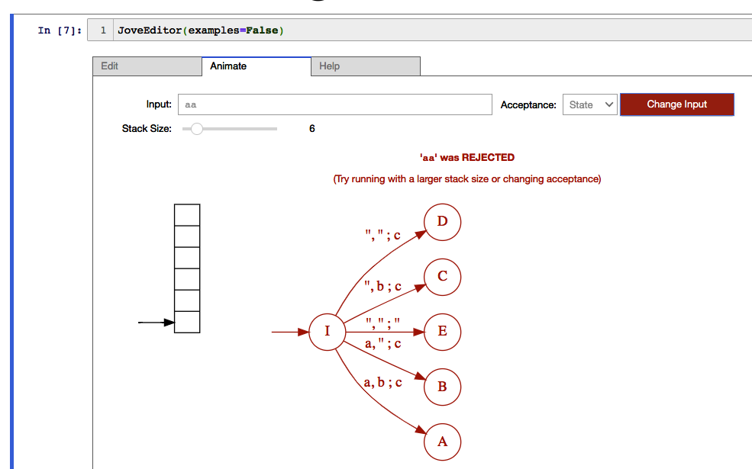
PDA ex2

Slide 47
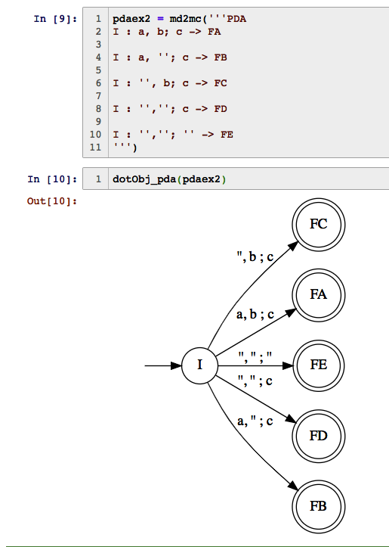
PDA ex3

Slide 48
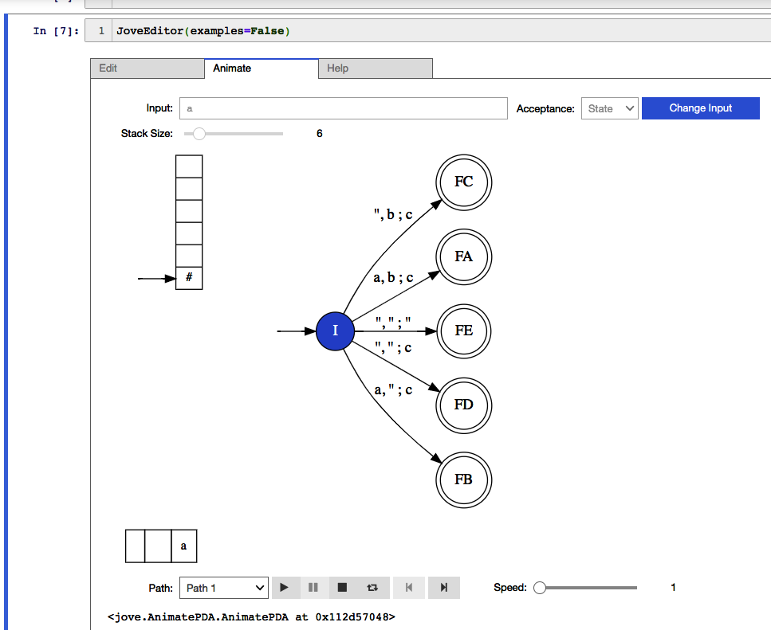
PDA ex4

Slide 49
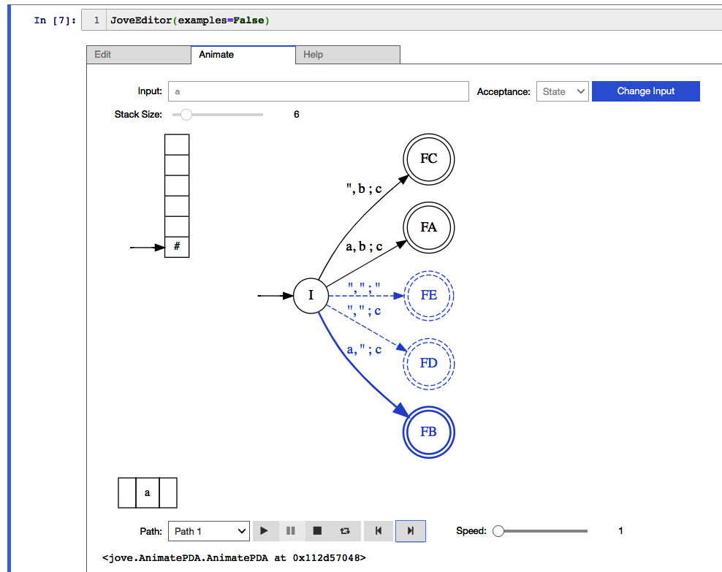
PDA ex5

Slide 50
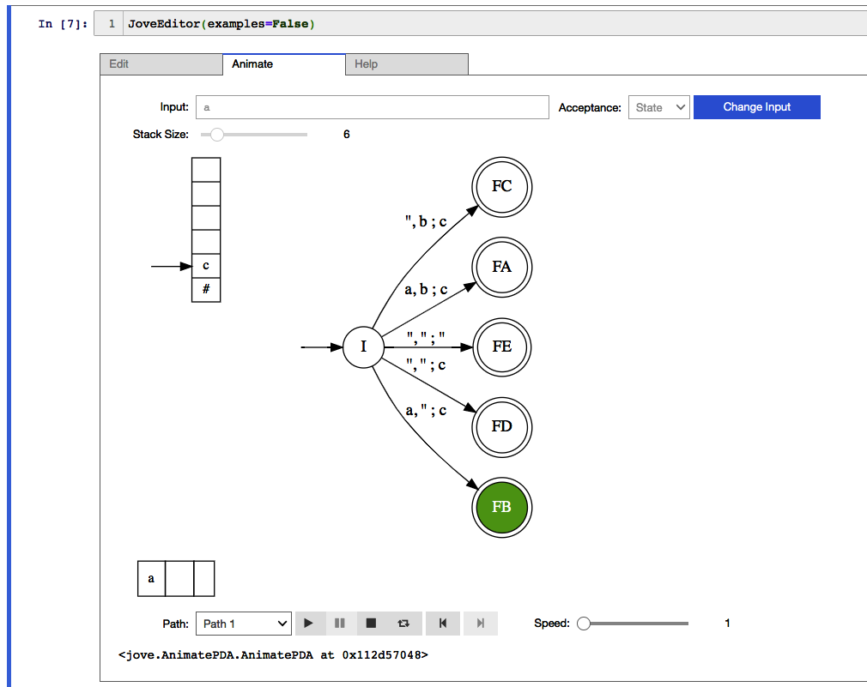
PDA ex6

Slide 51
Design a PDA for #a = 2 times #b
Design a trick to do this “double match”
Implement it exploiting nondeterminism
Now try other variants
#a = 2#b + #c etc

Slide 52
Solution
# num a's = 2 times num b's
# for every b, match two a's
# idea : currency conversion: each b is converted into two c's
P2a1b = md2mc('''PDA
I : a,#; a# -> I
I : a,a; aa -> I
I : b,#; cc# -> I
I : a,c; '' -> I
I : b,a; '' -> W
W : '',a; '' -> I
W : '',#; c -> I
I : '',''; '' -> F
''')

Slide 53
Design a PDA or CFG first?
Depends on the language
Design a PDA for #1 > #0
VERSUS
Design a CFG for #1 > #0

Slide 54
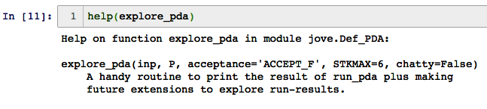
Once you are an expert, do this

Slide 55
Putting it all together
Design a CFG for “equal a’s and b’s”
Translate this CFG into a PDA using a standard algorithm that imitates parsing

Slide 56
Walk the Kleene-Pipeline
Review
Once
More
Practice
Once
More
Study
Again
RE
NFA
DFA
minDFA
Brand New
Trivial, but a Useful
Stepping-Stone
(this way we don’t
need to implement
a separate DFA to RE
procedure)

Slide 57
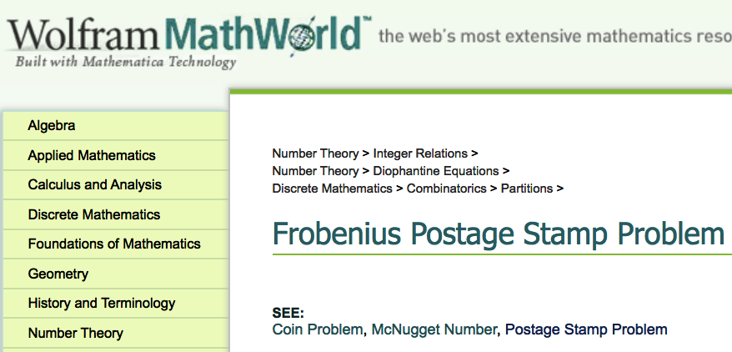
The Postage-Stamp Problem

Slide 58
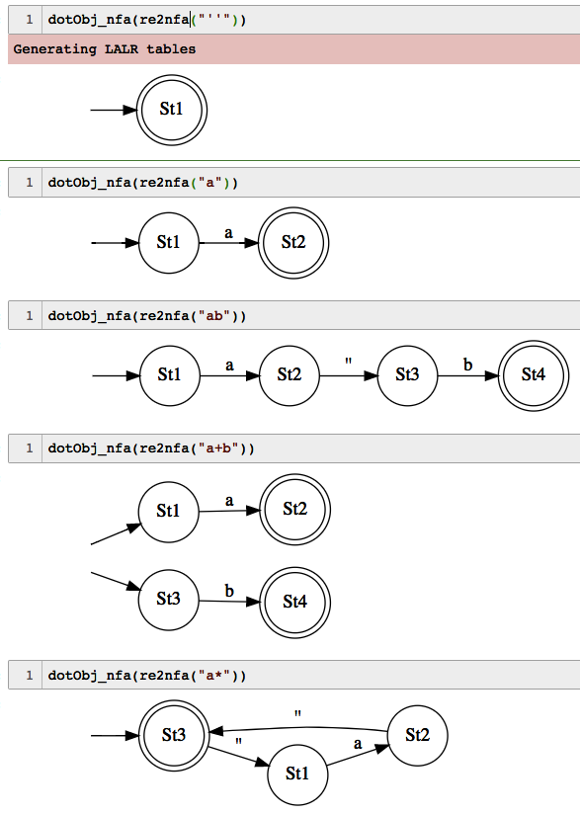
RE → NFA examples

Slide 59
What are RE?
Epsilon
a in Sigma
If R1 and R2 are RE, then R1 + R2 is an RE
If R1 and R2 are RE, then R1 R2 is an RE
If R is an RE, then ( R ) is an RE
If R is an RE, then R* is an RE
Nothing else is an RE

Slide 60
Cover RE → NFA for each case
Epsilon
a in Sigma
If R1 and R2 are RE, then R1 + R2 is an RE
If R1 and R2 are RE, then R1 R2 is an RE
If R is an RE, then ( R ) is an RE
If R is an RE, then R* is an RE
Nothing else is an RE

Slide 61
Cover RE → NFA for each case
Epsilon
a in Sigma
If R1 and R2 are RE, then R1 + R2 is an RE
If R1 and R2 are RE, then R1 R2 is an RE
If R is an RE, then ( R ) is an RE
If R is an RE, then R* is an RE
Nothing else is an RE

Slide 62
Cover RE → NFA for each case
Epsilon
a in Sigma
If R1 and R2 are RE, then R1 + R2 is an RE
If R1 and R2 are RE, then R1 R2 is an RE
If R is an RE, then ( R ) is an RE
If R is an RE, then R* is an RE
Nothing else is an RE

Slide 63
Cover RE → NFA for each case
Epsilon
a in Sigma
If R1 and R2 are RE, then R1 + R2 is an RE
If R1 and R2 are RE, then R1 R2 is an RE
If R is an RE, then ( R ) is an RE
If R is an RE, then R* is an RE
Nothing else is an RE

Slide 64
Cover RE → NFA for each case
Epsilon
a in Sigma
If R1 and R2 are RE, then R1 + R2 is an RE
If R1 and R2 are RE, then R1 R2 is an RE
If R is an RE, then ( R ) is an RE
If R is an RE, then R* is an RE
Nothing else is an RE

Slide 65
Cover RE → NFA for each case
Epsilon
a in Sigma
If R1 and R2 are RE, then R1 + R2 is an RE
If R1 and R2 are RE, then R1 R2 is an RE
If R is an RE, then ( R ) is an RE
If R is an RE, then R* is an RE
Nothing else is an RE

