Slide 1

CS 3100, Models of Computation, Spring 20, Lec16
Ganesh Gopalakrishnan
School of Computing
University of Utah
Salt Lake City, UT 84112
URL: bit.ly/3100s20Syllabus

Slide 2
Motivations for studying DFA and PDA
DFA
Lexers (scanners)
Typestate encoding
Fast text search, malware filtration, etc…
PDA
Program static analysis
Weighted pushdown systems
in PPoPP 2020 that I just attended in San Diego

Slide 3


Slide 4

Talk in PPoPP 2020 on FSM !!
A way to process very long strings using parallel processing
This is a hard problem because FSM are sequential
Idea! Chunk the string … and speculatively process the tail pieces
Then find a way to connect the head with the tail!

Slide 5
The idea was spurred by this paper from 2014 Data-Parallel Finite-State Machines
Todd Mytkowicz, Madanlal Musuvathi, and Wolfram Schulte
Microsoft Research
Research published in ASPLOS 2014
Has spurred considerable research since then
(even in PPoPP 2020, San Diego, that I just attended)

Slide 6
New method to break data dependencies
Preserves program semantics
Does not use speculation
Generalizes to other domains, but this talk focuses on FSM
Notes:
A new method to break data dependencies across loops
Our method preserves a program’s semantics
It does not speculate and therefore has predictable performance
And, we have been able to generalize it to other domains, notably some important dynamic programming algorithms.

Slide 7
FSMs contain an important class of algorithms
Unstructured text (e.g., regex matching or lexing)
Natural language processing (e.g., Speech Recognition)
Dictionary based decoding (e.g., Huffman decoding)
Text encoding / decoding (e.g., UTF8)
Want parallel versions to all these problems, particularly in the context of large amounts of data
Notes:
Why do we care about Finite State Machines?
Well, FSMs are an important class of algorithms and particularly in the relm of large amounts of data, creating structure from unstructured text through regular expressions is an important problem.
And we would like to have low-power parallel approaches to all these problems, particularly in the context of large amounts of data

Slide 8
*x
/
/x
*
/
*
$$S_{0}$$
$$S_{1}$$
*
$$S_{2}$$
$$S_{3}$$
x
x
/
T | / | * | x
$$S_{0}$$ | $$S_{1}$$ | $$S_{0}$$ | $$S_{0}$$
$$S_{1}$$ | $$S_{1}$$ | $$S_{2}$$ | $$S_{0}$$
$$S_{2}$$ | $$S_{2}$$ | $$S_{3}$$ | $$S_{2}$$
$$S_{3}$$ | $$S_{0}$$ | $$S_{3}$$ | $$S_{2}$$
state = $S_{0}$;
foreach(input in)
state = T[in][state];
Data Dependence limits ILP, SIMD, and multicore parallelism
Notes:
So why is this hard: Let’s take a look at a simple FSM to help explain why breaking data dependencies is difficult
Here I am displaying a FSM that accepts or rejects C style comments. The details of what this FSM does are not important but the idea is that the FSM encodes how to recognize C style comments
Traditionally, an FSM is represented by a table, such as the one on the left here. The way to read this table is to look at the first column and find the current state; then when reading a character, find that character along the top row. The FSM will transition to the state in the table for the intersection of the row and column.
The code here on the right is a simple abstraction for how one traditionally processes input with an FSM. Given a table, called T, and a current state, the code walks through each character in the input and updates the current state based on the current input symbol.
Sometimes programmers use switch statements to represent the table, but the end result is the same:
There is little to no parallelism in this code. It is difficult to exploit ILP, SIMD and Multicore hardware because of the state variable is a loop carried data dependence

Slide 9
Demo UTF-8 Encoding
Notes:
OK before I get to the meat of our talk I want to give a quick demo to show we execute the prior loop in parallel
This demo uses a slightly more complicated FSM: UTF-8 encoding. UTF-8 encoding is the process of transforming a sequence of Unicode into bytes. It is a variable width encoding and is based on a state machine so it fits almost exactly our model from the prior slide.
Do demo…
This machine has 4 logical processors but only 2 cores and we get about a 2X speedup over the sequential C# implementation
The rest of this talk is about how we make this happen

Slide 10
Breaking data dependences with enumeration
$$P_{0}$$
$$P_{1}$$
/ | * | X | X | X | * | * | / | X | X
$$S_{0}$$
$$S_{1}$$
$$S_{2}$$
$$…$$
$$S_{0}$$
$$S_{1}$$
$$S_{2}$$
$$S_{3}$$
$$S_{0}$$
$$S_{2}$$
$$S_{3}$$
$$S_{3}$$
$$S_{0}$$
$$S_{3}$$
$$S_{3}$$
$$S_{3}$$
$$S_{1}$$
$$S_{0}$$
$$S_{0}$$
$$S_{0}$$
T | / | * | x
$$S_{0}$$ | $$S_{1}$$ | $$S_{0}$$ | $$S_{0}$$
$$S_{1}$$ | $$S_{1}$$ | $$S_{2}$$ | $$S_{0}$$
$$S_{2}$$ | $$S_{2}$$ | $$S_{3}$$ | $$S_{2}$$
$$S_{3}$$ | $$S_{0}$$ | $$S_{3}$$ | $$S_{2}$$
Enumeration breaks data dependences but how do we make it scale?
- Overhead is proportional to # of states
Notes:
Let’s go back to our simple C style FSM to see how we break data dependences
Suppose we have 2 processors, each working on half of the input.
The first processor computes normally as it would in the sequential case
Clearly the second processor needs the result of the first processor to continue;
Rather than wait, or speculate, we have the second processor start on its section of the input on ALL states in the FSM. It reads the first character in its section of the input and finds how that character transitions ALL states.
We call this “Enumeration” because the 2nd processor is enumerating all possible solutions.
When the first processor finishes with its section of the input we plug that value into the enumeration of the 2nd processor to get the final state of the FSM in parallel.
Clearly the overhead of our approach is proportional to the number of states.
When the # of states is small---which we found to be often----this approach works great. However, the real challenge is getting our enumerative approach to scale with the number of states in the FSM is large.

Slide 11
Intuition: Exploit convergence in enumeration
$$P_{0}$$
$$P_{1}$$
/ | * | X | X | X | * | * | / | X | X
$$S_{2}$$
$$…$$
$$S_{0}$$
$$S_{2}$$
$$S_{3}$$
$$S_{3}$$
$$S_{0}$$
$$S_{3}$$
$$S_{3}$$
$$S_{3}$$
$$S_{1}$$
$$S_{0}$$
$$S_{0}$$
$$S_{0}$$
$$S_{0}$$
$$S_{1}$$
$$S_{0}$$
$$S_{1}$$
$$S_{2}$$
$$S_{3}$$
$$S_{0}$$
$$S_{3}$$
$$S_{1}$$
$$S_{0}$$
After 2 characters of input, FSM converges to 2 unique states
- Overhead is proportional to # of unique states
Notes:
How do we do that?

Slide 12
Back to what we are studying now
Today:
CFG and CFLs
Two key topics
Consistency
“Do not do anything bad”

Slide 13
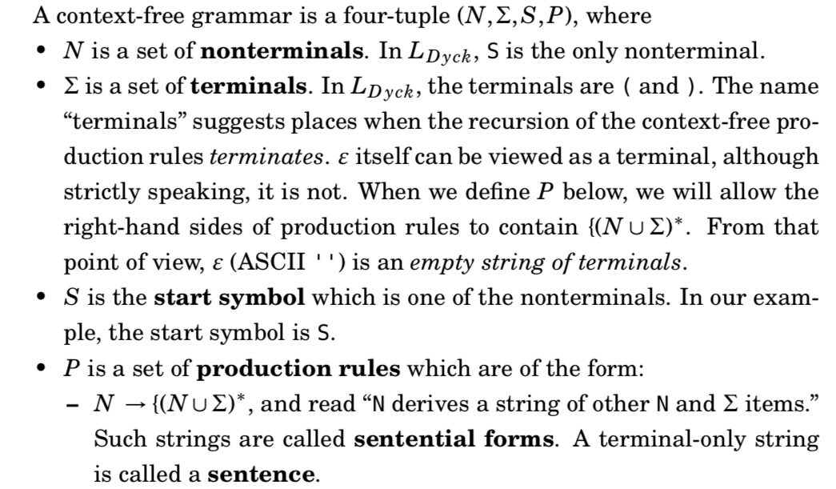
Context-free Grammars (CFG)

Slide 14
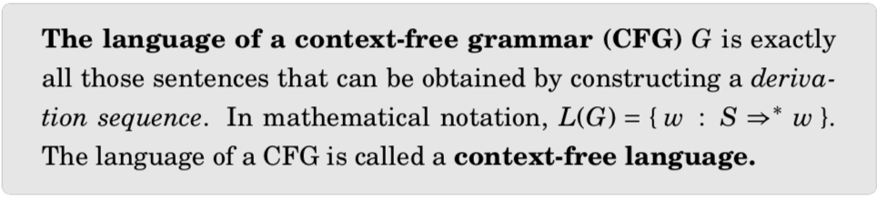
The language of a CFG

Slide 15
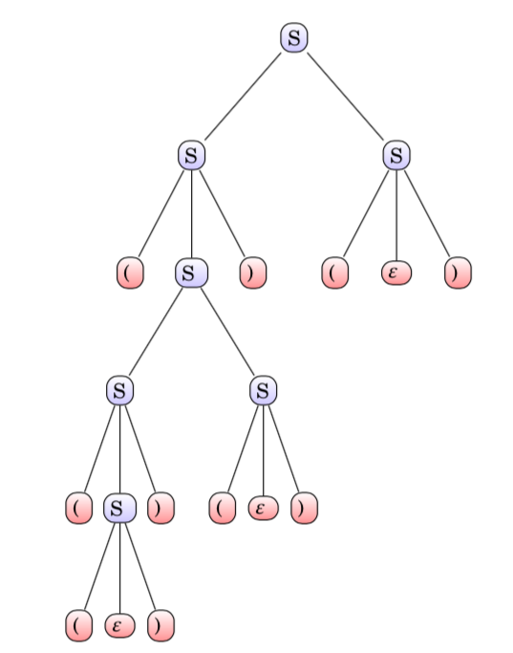
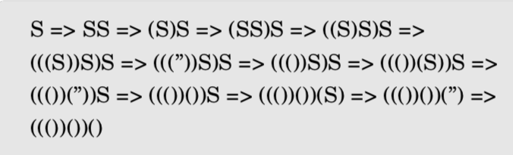
Context-free Grammars: Derivation Sequences

Slide 16
Goals of Grammar Design
We want consistent grammars
Grammars that do not yield strings outside the language of interest
E.g. S -> (S) | ( is inconsistent for the grammar of matched parentheses
E.g. for Odd number of 0’s, we don’t want this grammar
OddZ -> 0 | 0 OddZ 0 | ‘’
Also,
OddZ -> 1 | 0 0 OddZ | 0 is inconsistent
We want complete grammars
Grammars that yield all the strings in the language of interest
E.g. for “equal a’s and b’s,” we don’t want this grammar [ why ? ]
S -> SabS | SbaS | ‘’
We want grammars that are non-redundant
Complete but with no redundancies
E.g. for “equal a’s and b’s” we like to avoid this grammar [ why ? ]
S -> aSbS | bSaS | SS | ‘’

Slide 17
Grammar Desiderata
Grammars must be consistent
With respect to the language you want to capture
Grammars must be complete
With respect to the language you want to capture
Are there other desirable properties of grammars?
Yes! Grammars must be non-ambiguous
All these properties are difficult to show for large grammars…
Being aware of these notions, we can at least “keep an eye”

Slide 18
Summary: Properties of good grammars
Grammars must be consistent
With respect to the language you want to capture
Grammars must be complete
With respect to the language you want to capture
Grammars must be non-redundant
By being redundant, we can add to the ambiguity
The redundant production rules can be used to generate redundant parser trees
Grammars must also be non-ambiguous

Slide 19

Arguing Consistency: Induction on CFG
Basis case:
Take the first rule S -> ‘’
Observe that ‘’ is derivable and that has equal a’s and b’s
Inductive cases:
Take each rule, e.g. S – aSbS
By inductive hypotheses, the strings derivable by the RHS `S’ are shorter
than the whole string derivable from aSbS, AND contain equal # of a’s and b’s

Slide 20
Arguing Consistency: Induction on CFG
Basis case:
Take the first rule S -> ‘’
Observe that ‘’ is derivable and that has equal a’s and b’s
Inductive cases:
Take each rule, e.g. S – aSbS
Based on induction hypothesis in S -> aSbS ,
we are simply adding one more a and one more b --
hence MAINTAINING consistency

Slide 21
Arguing Consistency: Testing your knowledge
Is this grammar consistent for generating all palindromes over {a,b} ?
G1: S -> ‘’
G2: S -> a S a
G3 : S -> ’’ | a S a | b S b
G4 : ?
(Hint: The above are all consistent but not complete…)
(Strive to make G4 complete … i.e. be able to generate all pals.)

Slide 22
Completeness: Equal number of a’s and b’s
Completeness means “ALL the correct strings (according to the definition
of the language) will be obtainable via the given CFG
Example: Show that this grammar is complete with respect to the
intended language “ equal number of a’s and b’s ”

Slide 23
Completeness: Equal number of a’s and b’s
Basic idea
By induction hypotheses, assume that all strings in “equal a’s and b’s
of length N-2 are generatable via the given productions
* Argue that all strings of length N are generatable (induction step)

Slide 24
Arguing Completeness (in general)
Find a way to decompose strings in the given language into “shorter strings” via one less derivation step
That is, we used the next smaller parse tree to get that string
There will be many cases here
Show that the next longer string can be obtained via the given grammar
That is, we can build the shorter strings and THEN add one more production rule to finish building the bigger parse tree

Slide 25
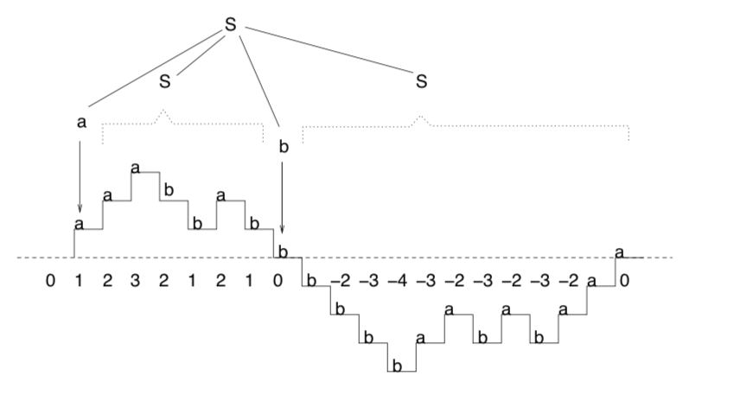
Arguing Completeness: Hill/Valley Plots
All “equal a’s and b’s strings” look like this in
general
Draw it as if “a” takes the
plot going up (tally of a’s goes up)
Draw “b”s as if bringing the tally down

Slide 26
Arguing Completeness: Hill/Valley Plots
Many cases in equal a’s and b’s strings
Starts with a and ends with a (shown to the left)
Three more cases exist:
Starts with b and ends with b
Starts with a and ends with b
Starts with b and ends with a
ARGUE FOR ALL CASES!

Slide 27
Arguing Completeness: Hill/Valley Plots
Take one of these cases.
Start and end with a.
Such a string must have a “hill-valley” plot.
Crosses the X axis.
By induction hypotheses, all “short strings” derivable.
Show longer strings derivable.

Slide 28
Arguing Completeness: Hill/Valley Plots
Assumption:
All strings of even length of <= length N are derivable.
The given string that starts and ends with “a” is of the form a …string… a
If we take away the first and last a, then what is left is derivable from S via their own parse trees.
(this is by induction
hypothesis)

Slide 29
Arguing Completeness: Hill/Valley Plots
That is, there is a piece
a …piece in the middle… b
The piece in the middle is a string of length < N.
It is derivable.
Then we have
a ..first piece… b …second piece…
The second piece is also derivable as it is a shorter string.

Slide 30
Arguing Completeness: Hill/Valley Plots
Thus, the whole string is derivable by a production
a S b S
Thus, all strings that
start and end with a are
derivable.
Like that, cover all the four cases.

Slide 31
Argue for “starts with a, ends with b”

Slide 32
Another example to test your understanding
Palindromes
We “know” what that set of strings is
We must somehow express the strings recursively in such a way that matches the given grammar
S -> a S a | b S b | M
M -> ‘’ | a | b
Strings in the language of S (palindromes) are
A string of length 0 or 1 over {a,b}
A palindrome with an extra “a” attached at both ends
A palindrome with an extra “b” attached at both ends

Slide 33
#1 > #0
Hint
Find a way to plot the “tally” or “hill/valley” plot
Dissect the plot recursively into pieces
You can obtain the grammar by thinking about the completeness proof!

Slide 34
Consistency/Completeness proof for #a = 2 . #b
Will be in Asg-5

Slide 35
Grammars vs. Ambiguity
A grammar G1 may be ambiguous
Another grammar G2 such that L(G1) = L(G2) may be unambiguous
I.e. no string has two distinct parse trees
While L(G1) = L(G2), there is only one parse-tree for L(G2)
Parse trees determine how
A calculator evaluates
A compiler generates code
Let us review the expression grammar (next slide)

Slide 36
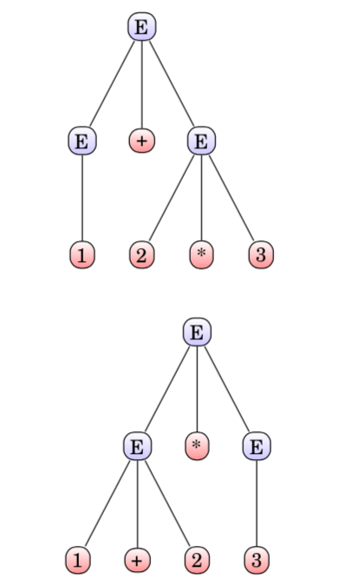

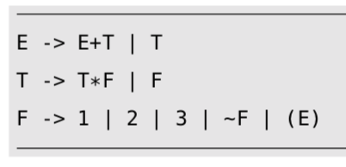
Ambiguity and Disambiguation

Slide 37
Ambiguity sometimes possible to eliminate
Idea
“Layer the grammar” to
capture the precedences
correctly.
Often this works!
Gist : by changing the grammar,
The same set of strings are still derivable
Ambiguity goes away !!
The basic idea is to “layer the grammar”

Slide 38
In general….
Ambiguity cannot be gotten rid of
There are languages for which NO grammar is UNAMBIGUOUS!
(Later in this course)
There is no algorithm to check whether a given CFG is ambiguous!
This is harder than “Np-complete etc”.
There isn’t ANY algorithm of ANY complexity whatsoever !!!

Slide 39

Inherently Ambiguous CF Languages
No matter which CFG we try --- layering or otherwise --- ambiguity NEVER goes away !!!
The proof that the above language is inherently ambiguous is long, and is skipped.
But I can give you papers that cover it (if you wish).

Slide 40
DFA are a special case of CFGs…
All regular languages are context-free languages also
Proof is by building a CFG for a given DFA

Slide 41
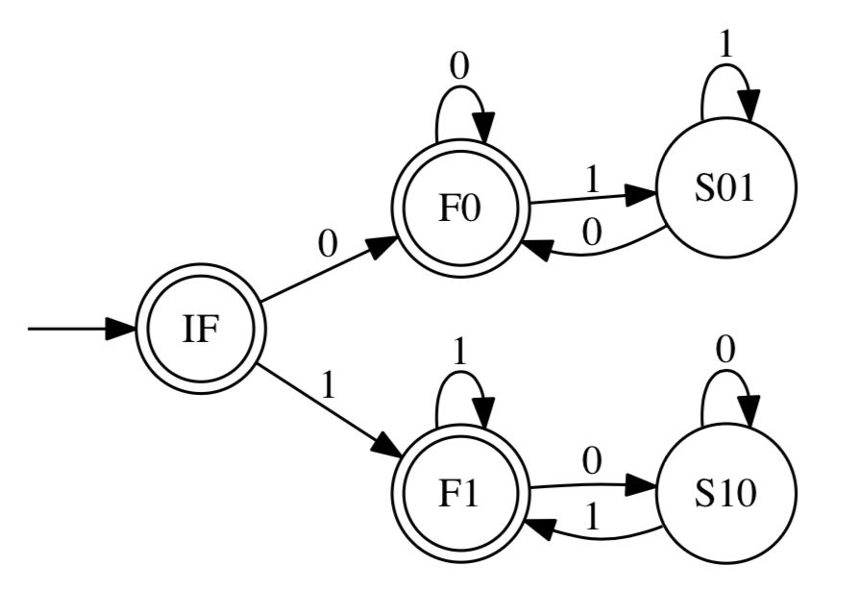
DFA and CFGs describing them
Every DFA has an “easy” CFG one can obtained “just by staring at the DFA”
Hence all regular languages are also context-free !!!

Slide 42
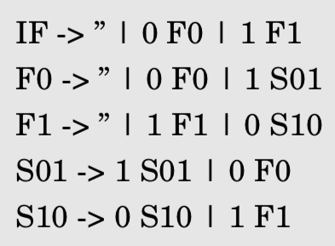
DFA via CFG: Purely Right Linear CFGs
The most natural way is to “stare at a DFA” and write down a PURELY RIGHT LINEAR CFG. What is that ??
What is so PURE about it ??

Slide 43
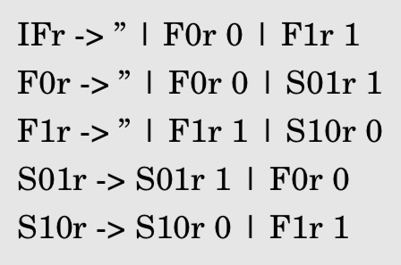
Purely Left Linear CFGs “are reversed DFA”
Using the “rotating pair of dogs trick”, we can turn a right-linear CFG into a left-linear CFG also!! This proves that even PURELY LEFT LINEAR CFGs denote regular languages. What is PURELY Left Linear ?? What is so pure about it ??

Slide 44

Obtaining Purely L. Lin. from Purely R. Lin.
Rotating pair of dogs trick to convert a
Purely right linear CFG
Into a Purely left linear CFG
Example:
S -> 0 A B becomes
Sr -> Br Ar 0
Etc.
Check previous example.
See how I turned the purely right-linear
Into a purely left-linear CFG

Slide 45

Mixed Linearity is NOT Guaranteed Regular!
If you can express the given language as PURELY left linear, then that language is regular
If you can express the given language as PURELY right linear, then that language is regular
If you expressed a given language using LEFT-LINEAR and RIGHT-LINEAR rules, then… no bets!

Slide 46
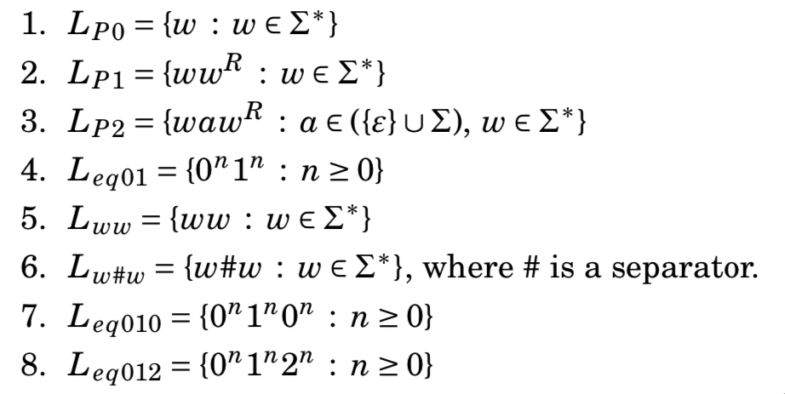
Which are CFL and which aren’t? (intuitively)

Slide 47
How to prove that a language is NOT a CFL?
We have a Pumping Lemma for CFLs!
Used to show that a given language is not context-free
Usage similar to the regular-language pumping lemma
The “pump” happens for a different reason
Actually a “parse tree pump”

Slide 48
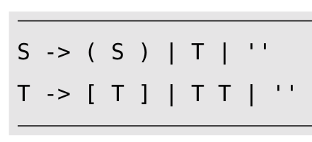
Getting to Pump CFGs: Part 1 of 4

Slide 49
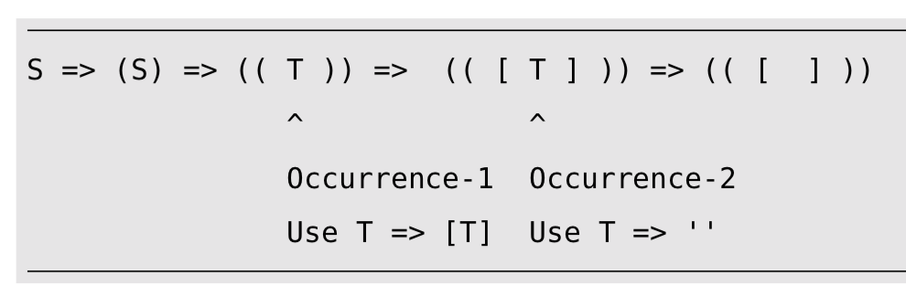
Getting to Pump CFGs: Part 2 of 4

Slide 50
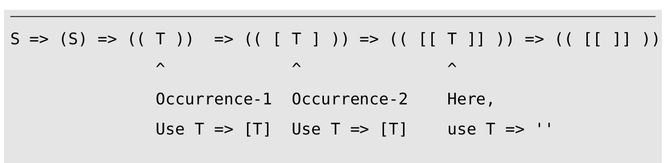
Getting to Pump CFGs: Part 3 of 4

Slide 51
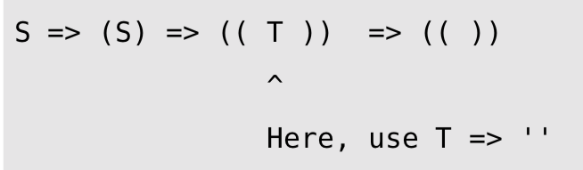
Getting to Pump CFGs: Part 4 of 4

Slide 52
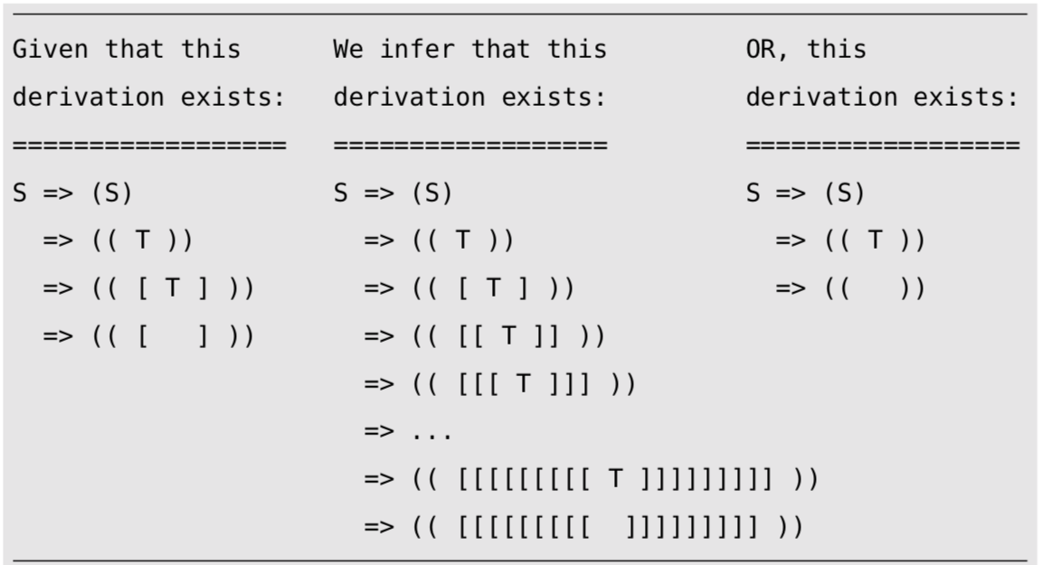
Summary of Example

Slide 53
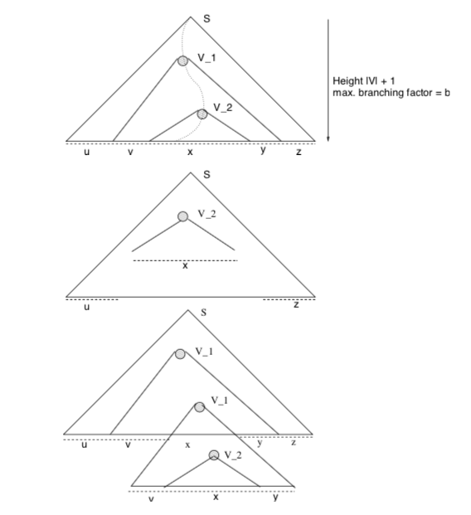
CFL PL in Pictures

Slide 54
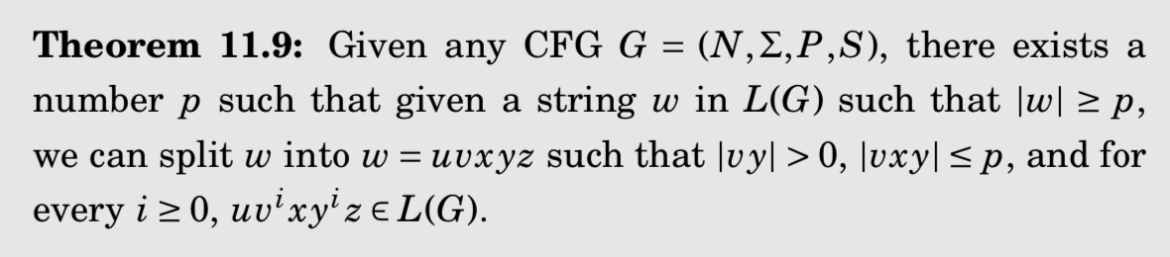
The CFL PL finally! (pictures)

Slide 55
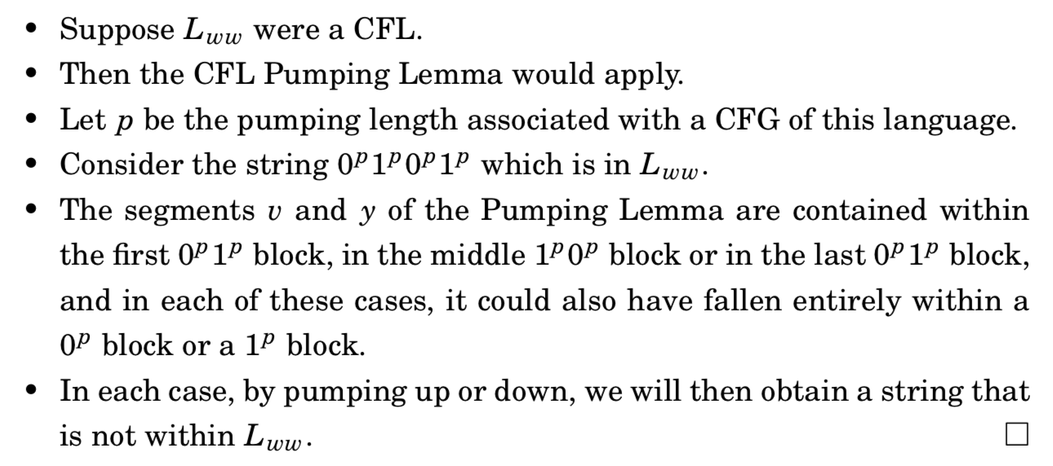
The CFL PL finally! (words)

