Slide 1

CS 3100, Models of Computation, Spring 20, Lec15
Ganesh Gopalakrishnan
School of Computing
University of Utah
Salt Lake City, UT 84112
URL: bit.ly/3100s20Syllabus

Slide 2
Recap
DFA → Purely right-linear
Take purely right-linear productions and reverse each rule to obtain a purely left-linear production system
By doing so, we would have reversed the language of a DFA
This result (after reversal) is also regular
Thus we can argue that purely left-linear productions also denote regular languages
Thus, purely right-linear and purely left-linear productions denote regular languages
With mixed linearity, we don’t have this guarantee
S -> ( A | ‘’
A -> S ) | ‘’

Slide 3
Recap
Consistency:
Are we producing ONLY legal strings?
S -> a S b S | ‘’ as a single rule is consistent (it is not complete)
Proof by induction:
Assume that the RHS “S” are consistent; showthat the LHS “S” are consistent
Completeness:
Are we producing ALL legal strings?
S -> a S b S | b S a S | ‘’ makes it complete for “equal a’s and b’s”
Assume that all strings of length <= N and in the language of interest are derivable. Show that the next eligible length of stings are derivable
Proof by visualizing the strings
“hill/valley” plots

Slide 4
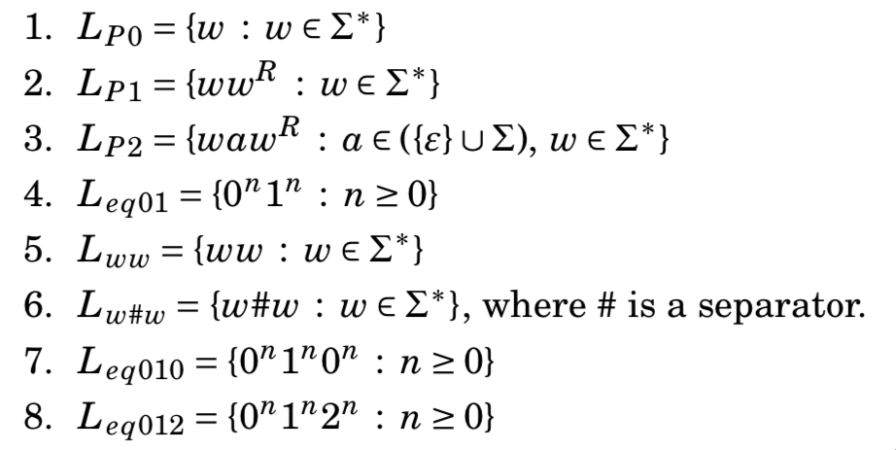
Which are CFL and which aren’t? (intuitively)

Slide 5
How to prove that a language is NOT a CFL?
We have a Pumping Lemma for CFLs!
Used to show that a given language is not context-free
Usage similar to the regular-language pumping lemma
The “pump” happens for a different reason
Long strings have tall parse trees
In any tall parse tree, some nonterminal repeats along a tree path
This gives us the opportunity to generate LONGER or SHORTER strings

Slide 6
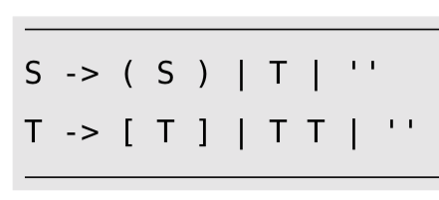
Consider this CFG… let’s show the pump.

Slide 7
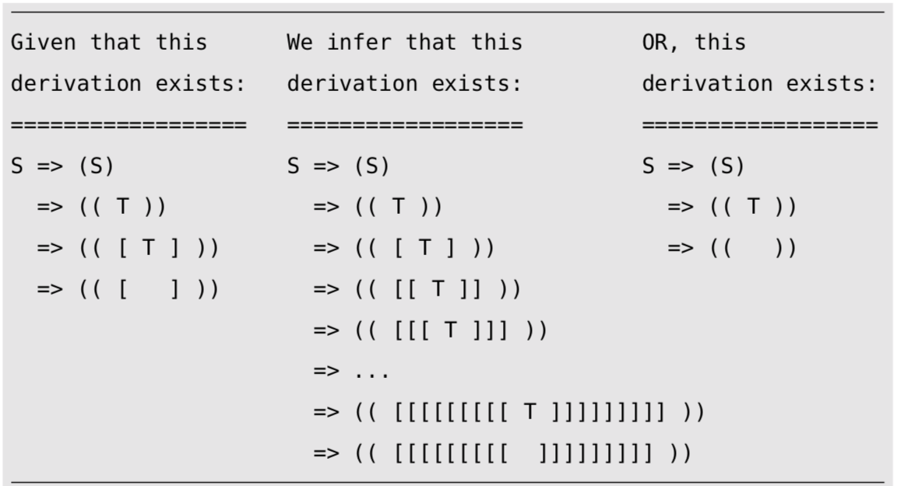
Summary of Example

Slide 8
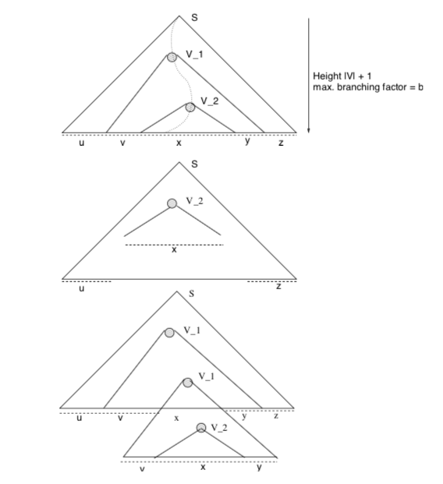
CFL PL in Pictures

Slide 9
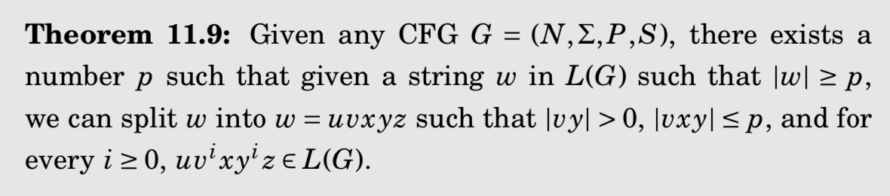
The CFL PL finally! (pictures)

Slide 10
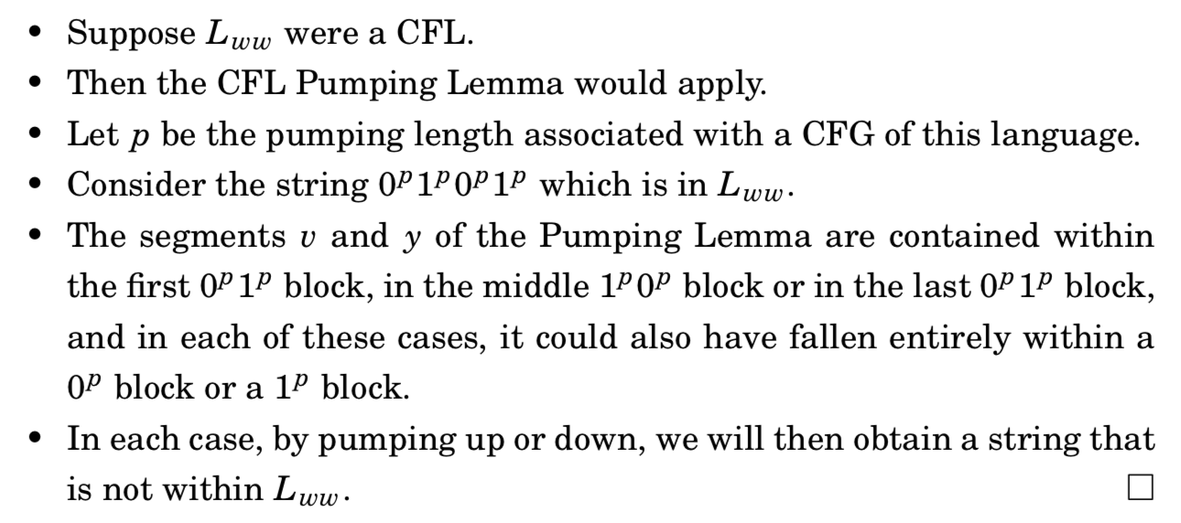
The CFL PL finally! (words)

Slide 11
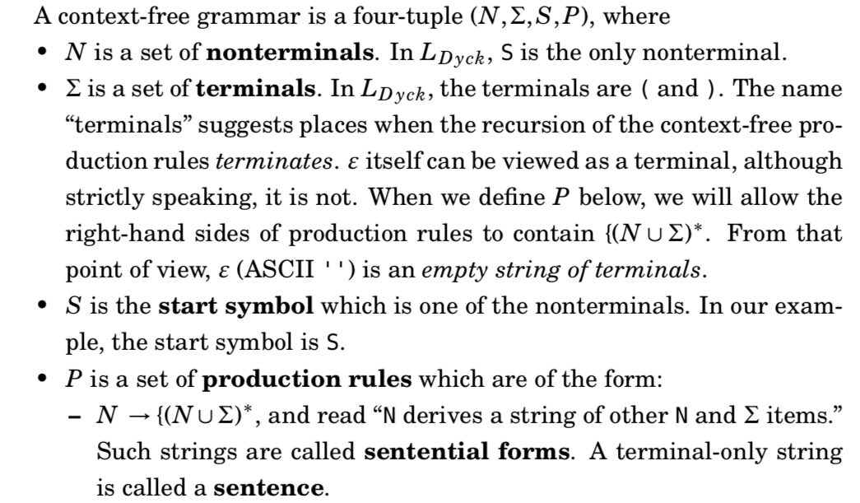
Context-free Grammars (CFG)

Slide 12
A complete exercise
Show that
{ w w : w in Sigma* } is not a CFL but its complement is a CFL

Slide 13
An exercise on consistency and completeness
Consider the CFG
S -> ( W S | ’’
W -> ( W W | )
What language does S generate? Prove via Consis. Compl.
Consistency: State the consistency goals of S and W
Prove the consistency of S and W
Completenes: State the completeness goals of S and W
Prove the completeness goals of S and W

Slide 14
The Makeup Midterm question
#1 > #0
Draw hill-valley plots
Dissect the plot
Express as a CFG!

