Slide 1

CS 3100, Models of Computation, Spring 20, Lec 15
Ganesh Gopalakrishnan
School of Computing
University of Utah
Salt Lake City, UT 84112
bit.ly/3100s20Syllabus

Slide 2
Pushdown Automata
Finite control (like DFA/NFA)
Unbounded stack added
The stack models the recursion stack (in a prog language)
Allows us to store away information and match
Still no “arbitrary counting” (other than matching in stack order)

Slide 3
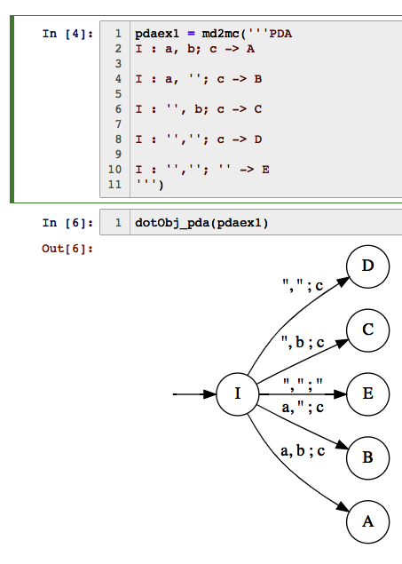
PDA ex

Slide 4
How our PDAs are set up
The input is as before
Contains the string to be examined
The stack is an unbounded last-in first-out stack
Like any other unbounded stack
We initialize the stack with #
A single character # sits on top of the stack when the PDA is powered up
The stack has nothing else (i.e. the stack has exactly one thing – the #)
Whenever # is on top of the stack, we know that the stack is empty
When we something else on top of the stack, we know it is not empty
… see next slide for more facts…

Slide 5
How our PDAs are set up
We initialize the stack with #
A single character # sits on top of the stack when the PDA is powered up
The stack has nothing else (i.e. the stack has exactly one thing – the #)
Whenever # is on top of the stack, we know that the stack is empty
When we something else on top of the stack, we know it is not empty
We put something on the stack by pushing it
Only one character (symbol) at a time is pushed
We remove by popping
Only one symbol is popped
When we pop all we pushed, we see # reappear on top of the stack
Then we know the stack is empty!
That is the ONLY test for stack emptiness

Slide 6
How a PDA accepts a string
In every state (a “single circle” or ”double circle”)
It CAN looks at both the input
And the stack top
In every state
It CAN ALSO IGNORE THE INPUT
It CAN ALSO IGNORE THE STACK
It can ignore both
It can ignore neither
It chooses a step based on how you have programmed the PDA
Programming the PDA means providing it with transitions
…more facts next slide…

Slide 7
How a PDA accepts a string
The PDA is deemed to have accepted a string
when it “accepts by final state”
A PDA is also deemed to have accepted a string
when it empties the stack – we will NEVER study this idea in this course .

Slide 8
How a PDA accepts a string
The PDA is deemed to have accepted a string
when it “accepts by final state”
ALL OUR PDAs are non-deterministic
Deterministic PDAs are there
They are useless for us
Some others care about them

Slide 9
How a PDA accepts a string
The PDA is deemed to have accepted a string
when it “accepts by final state”
ALL OUR PDAs are non-deterministic
Deterministic PDAs are there
They are useless for us
Some others care about them
THEREFORE we can say
A PDA accepts a string when ONE OF ITS NON-DETERMINISTIC journeys ends up in a final state ( an “F” or “IF” state)
With the input all gone – fully consumed
The stack may have stuff in it or nothing in it
The contents of the stack are immaterial when the PDA “accepts”
I.e. acceptance == IN A FINAL STATE + INPUTS ALL-GONE!

Slide 10
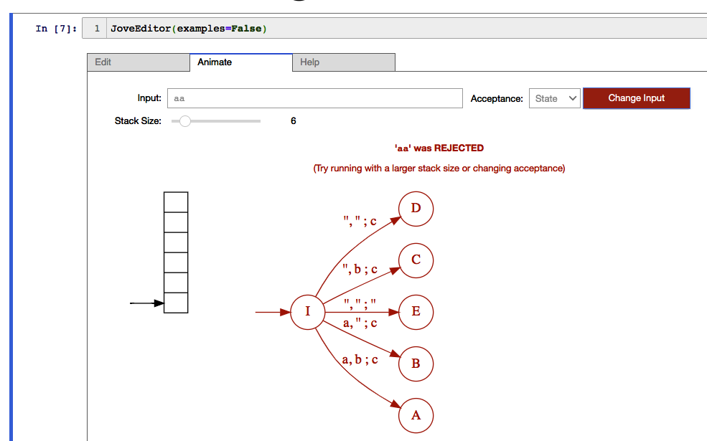
PDA ex2

Slide 11
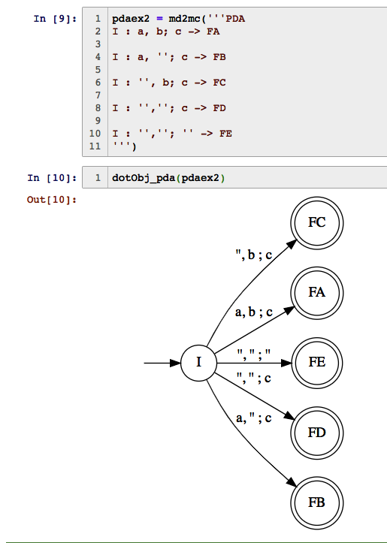
PDA ex3

Slide 12
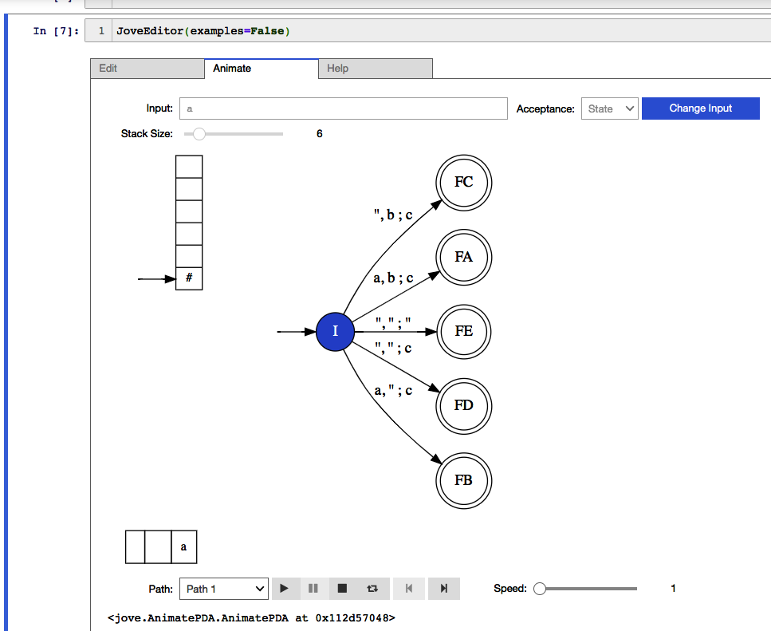
PDA ex4

Slide 13
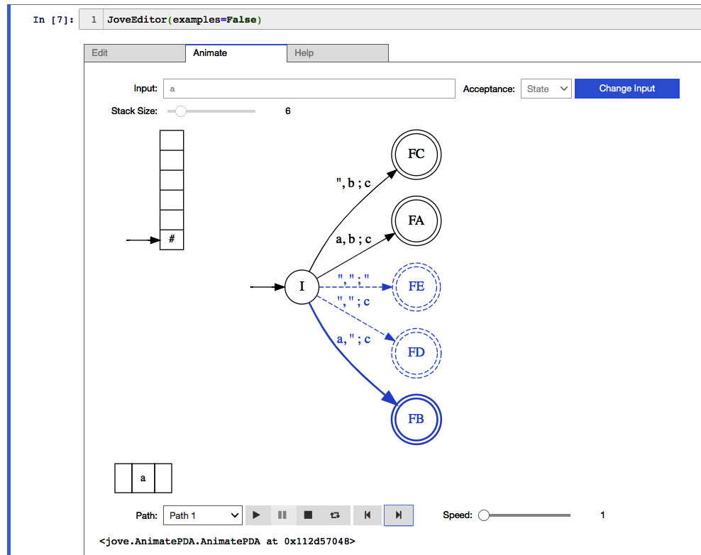
PDA ex5

Slide 14
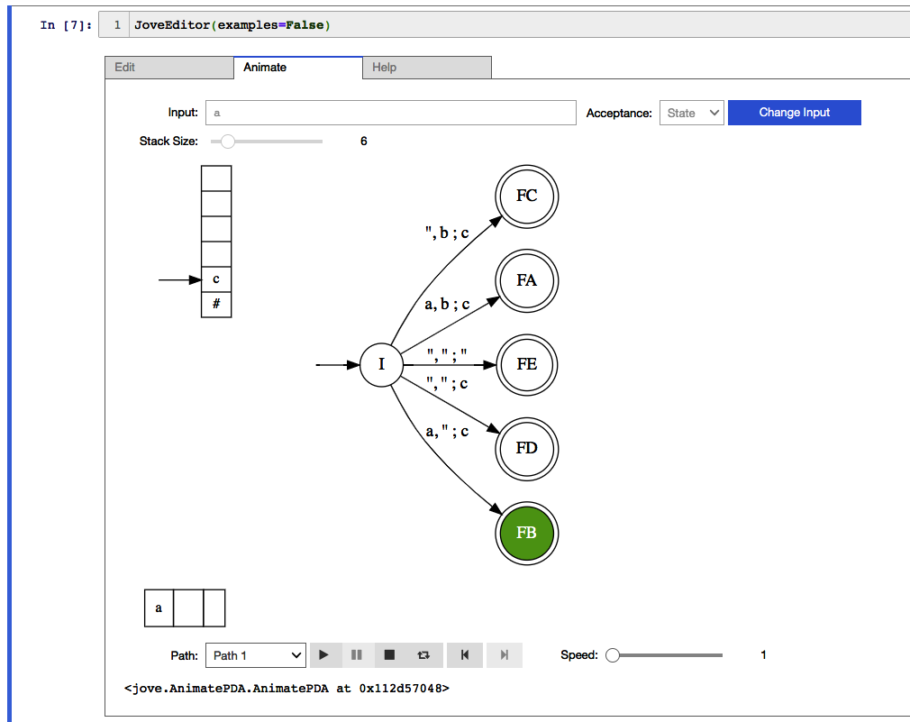
PDA ex6

Slide 15
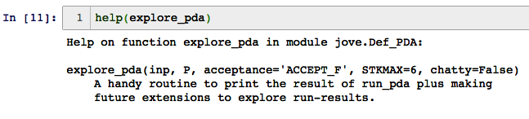
Once you are an expert, do this

Slide 16
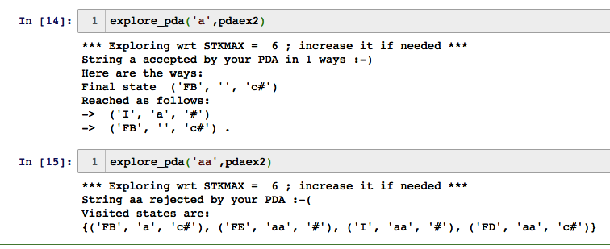
Once you are an expert, do this

Slide 17
Programming a PDA for (^n )^n : n >= 0
Algorithm
The PDA starts with # on top of the stack
What state should we be in when # is on top of stack initially?
Accept? Not accept?
Suppose we stay in the initial state and do the push/pop game
And decide to accept when # shows up…
Suppose we just provide ((( )) what must we do?
OK we will interactively program the machine with your help!

Slide 18
Designing Pushdown Automata
Like with any new programming language, there are standard approaches for programming multiple situations
In these slides (and the accompanying Jupyter notebook), we will present many PDA designs
These designs are significantly harder than those asked in our Asg-3. But practicing on these PDAs is highly recommended
Then you can discover your own programming idioms

Slide 19
Simple PDAs and their languages
pdaeven1 : Checks whether the input string is even in length
Approach: Ignore the stack, and pretend to be an NFA for this language!
Interaction: Students now help define pdaodd1 – checking for odd-length inputs, pretending to be NFA
Allow 5 minutes and then show solution, eliciting feedback/input

Slide 20
Simple PDAs and their languages
pdaeven2 : Same specification as pdaeven1
Approach: Keep stacking {a,b}. Then nondeterministically switch over to matching something on the stack with something in the input
If there is an exact match, the length of the input string must be even
Interaction: Students now help define pdaodd2 – checking for odd length using nondet. Hint: guess some input to be the midpoint and skip over it; then match around that input!
i.e. Keep stacking
Boom! Guess that this is the midpoint, skip over one character
go to another state
Now match what is in the stack…
Students finish this design at home

Slide 21
More Involved PDAs and their languages
pdaabc = a PDA that implements the equation
# a = 2 #b + 3 #c
Approach:
Convert each b to two B’s when stacking
Convert each c to three C’s when stacking
i.e. “we change the currency”
This way, an ‘a’ and a ‘B’ have the same ”value”
The same way, an ‘a’ and a ‘C’ have the same value

Slide 22
More Involved PDAs and their languages
pdaabc = a PDA that implements the equation
# a = 2 #b + 3 #c
Approach (continued)
When we get a ‘b’, we must check to see if there are two stacked and waiting ‘a’ on the stack; if so, cancel; else push the “unmet obligations” on the stack
When we get a ‘c’, we must check to see if there are three stacked and waiting ‘a’ on the stack; if so, cancel; else push the ”unmet obligations” on the stack
Students can be asked to solve #a = 2 #b alone. Then introduce the Cs and then finish the construction

Slide 23
One more involved PDA
PDA aibjck does this
{ a^i b^j c^k d^l : if i=2 then j=k else l > k }
This means, we have a leading path that checks for the number of a’s which could be 0, 1, 2, or more than 2
Based on the # a’s seen, we can take multiple actions
0 or 1 a’s : look for #d > #c
2 a’s : look for #b = #c
3 or more a’s : look for #d > #c

Slide 24
Concluding Remarks
These PDAs were hastily designed (during an airplane ride)
They could have bugs
Finding and fixing them would be good
PDAs are very low level code
The only way to get them right is through a rigorous mathematical proof
In this class, we will:
Document their design well
Test well
Think of all the ”invariant conditions”
E.g. Can the stack contain aaaBaaa etc? This is not allowed
Such conditions need to be thought of in looking for “2 a’s underneath”

