Slide 1

CS 3100, Models of Computation, Spring 20, Lec18
Ganesh Gopalakrishnan
School of Computing
University of Utah
Salt Lake City, UT 84112
URL: bit.ly/3100s20Syllabus

Slide 2
Connections between regular and CFL
All regular languages are CFL
Why?
Can you argue via : “given a DFA, I can obtain a PDA” ?
Can you argue via : ”given a DFA, I can obtain a CFL?
The first is easy. (Obtain answer in class.)

Slide 3
Connections between regular and CFL
All regular languages are CFL
Why?
Can you argue via : “given a DFA, I can obtain a PDA” ?
Can you argue via : ”given a DFA, I can obtain a CFL?
For the second, let’s state a mechanical construction algorithm

Slide 4
DFA to CFL
Given a DFA with initial state I
And final states F1 F2 …
Obtain a set of productions
Let state “S” of the CFG correspond to (or model) the initial state I
For every move A : a -> B in the DFA, introduce a rule like that in the CFG
For every final state F1 F2 …, introduce a rule F1 → ‘’ F2 → ‘’
Try an example now

Slide 5
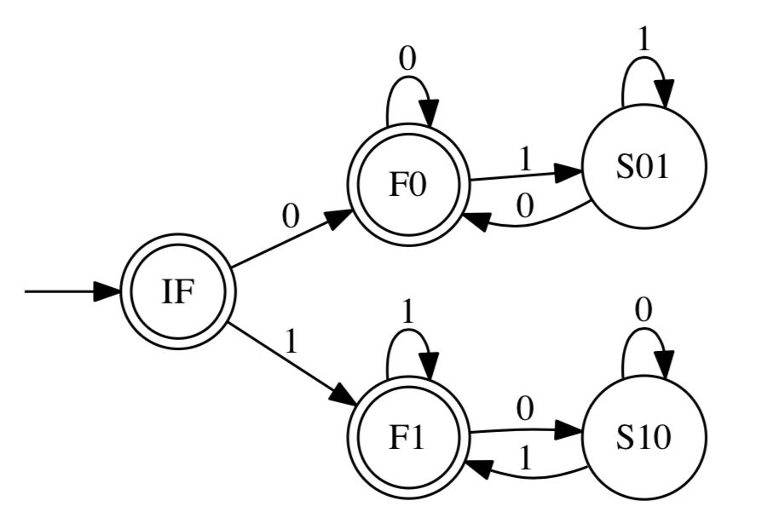
Write a CFG for this DFA
Every DFA has an “easy” CFG one can obtained “just by staring at the DFA”
Hence all regular languages are also context-free !!!

Slide 6
Solution (obtaining a purely right-linear CFG)
”S” of the CFG models state “IF” of the DFA
S → ‘’ (since IF is a final state)
S → 0 F0 (there are these transitions in the DFA)
S → 1 F1 (there are these transitions in the DFA)
F0 → ‘’ (it is a final state)
F1 → ‘’ (it is a final state)
…finish this construction…

Slide 7
Use the info from prev. slide to handle this CFG
What is S’s language?
Can you write it as a regular expression?
S → a S b | b Y | Y a
Y → b Y | a Y | ‘’

Slide 8
Draw a parse-tree for ababb using this grammar
S → a S b | b Y | Y a
Y → b Y | a Y | ‘’

Slide 9
Calculator with Parse-tree Drawing
This will be part of Asg4
This Jove file draws parse-trees for you!
Look for
First_Jove_Tutorial/ACMDSP/Calculator_with_Parse_Tree_Drawing.ipynb
Look for First_Jove_Tutorial/ACMDSP/Drive_Chatty_Parser.ipynb
Will be in Asg4
Shows how Jove’s internals work !!

Slide 10
Now we will study linearity
There are purely left-linear and purely right-linear.
They are equivalent.
Read about this conversion from the book (we will review it before the exam to the extent needed)
Read the portions around the “dog picture”

Slide 11

Obtaining Purely L. Lin. from Purely R. Lin.
Rotating pair of dogs trick to convert a
Purely right linear CFG
Into a Purely left linear CFG
Example:
S -> 0 A B becomes
Sr -> Br Ar 0
Etc.
Check previous example.
See how I turned the purely right-linear
Into a purely left-linear CFG

Slide 12
Studying consistency and completeness
Consistency – only good strings
Completeness – all good strings

Slide 13
Exercise: Equal number of a’s and b’s
Begin with template
S -> …..a…..b….. Or S -> …..b….a…..
Replacing all the … with S is an overkill
Just having S -> a S b | b S a is insufficient (why? Ans: Incomplete!)
Imagine just enough generality to cover all cases
We arrive at S -> S a S b | S b S a | ‘’
Or it can be S -> a S b S | b S a S | ‘’ (one of these)

Slide 14

Consistency: It is through structural induction
When a string structure (in this case) is elaborated as above
i.e. S (“strings from s”) are derived via
‘’ – assert that this string is consistent : has equal a’s and b’s
By induction hypothesis, examine all CFG rules
a followed by simpler strings s1 from S followed by b followed by simpler strings s2 from S [ this is for the aSbS rule ] forming string a s1 b s2
…or the bSaS rule similarly…
By induction hypothesis, s1 and s2 are consistent
Then the induction step says a s1 b s2 is consistent

Slide 15
Completeness Illustrated on the Grammar of Equal number of a’s and b’s
Completeness argues that ALL strings can be derived.
Induction strategy:
Assume that all “substrings of a given string s can be derived”
Then show that the string s itself can be derived

Slide 16
Completeness Illustrated on the Grammar of Equal number of a’s and b’s
Completeness argues that ALL strings can be derived.
Induction strategy:
Assume that all “substrings of a given string s can be derived”
Then show that the string s itself can be derived
Suppose we assume S -> a S b | b S a | ‘’
Can we argue it is complete?

Slide 17
Completeness Illustrated on the Grammar of Equal number of a’s and b’s
Completeness argues that ALL strings can be derived.
Induction strategy:
Assume that all “substrings of a given string s can be derived”
Then show that the string s itself can be derived
Suppose we assume S -> a S b | b S a | ‘’
Can we argue it is complete?
If we consider a long string a……………a
we immediately see that there is NO parse tree from “S”
hence incomplete!

Slide 18
Completeness Illustrated on the Grammar of Equal number of a’s and b’s
Completeness argues that ALL strings can be derived.
This tells us that there are FOUR cases to consider
a……………..a (consider this case now; all other cases have to be considered)
a……………..b
b……………..a
b………………b

Slide 19
Arguing Completeness: Hill/Valley Plots
The “hill/valley plot” is just a way to visualize CFL completeness proofs involving counting arguments.
For other completeness proofs, we will need to invent other ways of visualizing the proof (there is no general approach).
Studying one approach thoroughly is all we aim for.

Slide 20
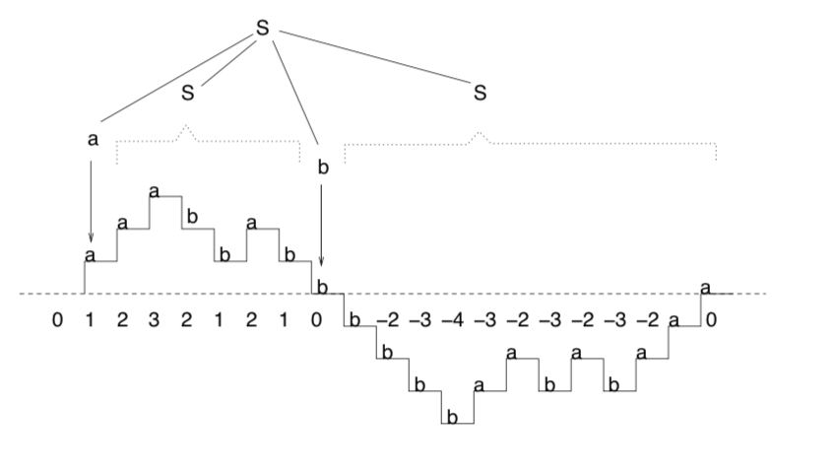
Arguing Completeness: Hill/Valley Plots
As soon as we draw a string that starts and ends with “a”
AND has equal # of 0’s and 1’s
We realize that it must achieve a count > 0 somewhere, then a count = 0, then achieve a count < 0, and the final “a” must restore the count back to 0.
So there are smaller strings that have equal counts!
Induct on them!

Slide 21
Arguing Completeness: Hill/Valley Plots
Induction argument:
The small strings in this picture are derivable from S
Then we can piece together a whole parse-tree that explains that the WHOLE string can also be derived!

Slide 22
Two Nontrivial Exercises
Recall L_{ww} = { w w : w in Sigma^* } ?
L_{ww} is not a CFL
But the complement of L_{ww} is a CFL
Write its CFG (maybe part of Asg-4)
Write a CFG for { w : w in {0,1}^* and #1(w) > #0(w) }
Part of Asg-4 most likely

Slide 23
Grammar Desiderata
Grammars must be consistent
With respect to the language you want to capture
Grammars must be complete
With respect to the language you want to capture
Are there other desirable properties of grammars?
Yes! Grammars must be unambiguous.
Reason grammars must be unambiguous:
Grammars are used to generate code, implement interpreters, etc.
Example: Our calculator grammar (let us take a look)

Slide 24
Grammars vs. Ambiguity
A grammar G1 may be ambiguous
Another grammar G2 such that L(G1) = L(G2) may be unambiguous
I.e. no string has two distinct parse trees
While L(G1) = L(G2), there is only one parse-tree for L(G2)
Parse trees determine how
A calculator evaluates
A compiler generates code
Let us review the expression grammar (next slide)

Slide 25
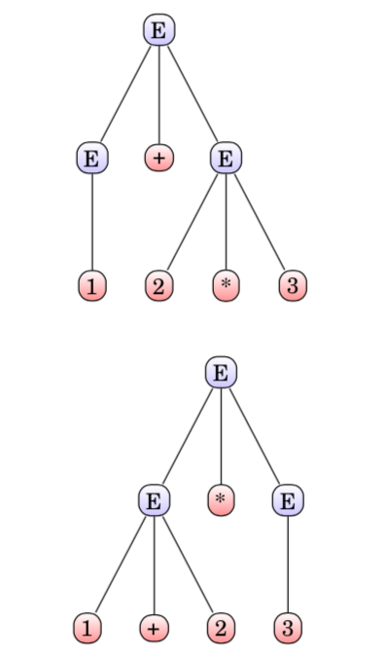

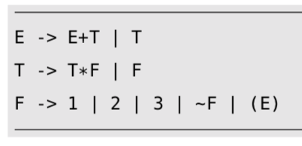
Ambiguity and Disambiguation

Slide 26
Ambiguity and disambiguation
Gist : by changing the grammar,
The same set of strings are still derivable
Ambiguity goes away !!
The basic idea is to “layer the grammar”

Slide 27
Calculator Problem of Assignment
In this assignment, you get to see, for the first time, how the theory of regular languages and context-free languages helps you build a calculator
You must understand the calculator
You must then modify it to have a new operator called ”!” or successor
3 + !4 = 3 + (4+1) = 8
!(3+!4 - !!1) * !5 = ?

Slide 28
Notes on the Calculator Problem
We relied on PLY to disambiguate for us
Defines associativity
Defines precedences
But we can also modify the grammar and achieve this
More on that on Thursday next week
We will also study Jove’s parsers (we have 3 of them inside Jove)

Slide 29

Inherently Ambiguous CF Languages
No matter which CFG we try --- layering or otherwise --- ambiguity NEVER goes away !!!
The proof that the above language is inherently ambiguous is long, and is skipped.
But I can give you papers that cover it (if you wish).

Slide 30
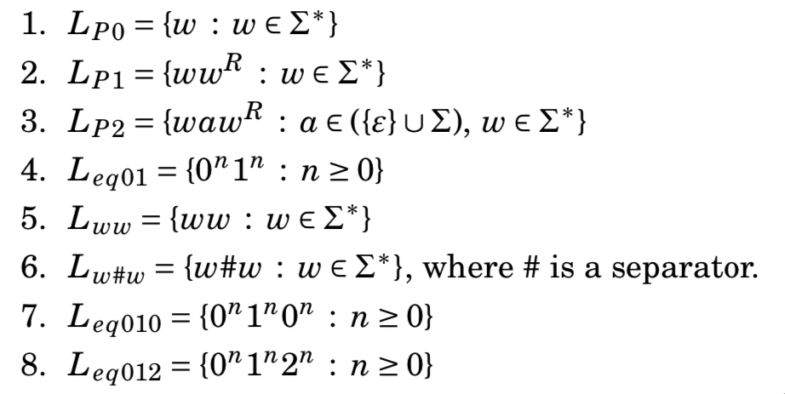
Which are CFL and which aren’t?

Slide 31
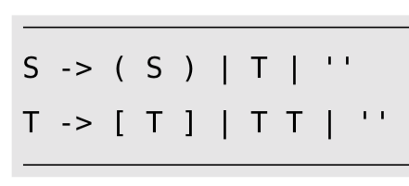
Getting to Pump CFGs: Part 1 of 4

Slide 32
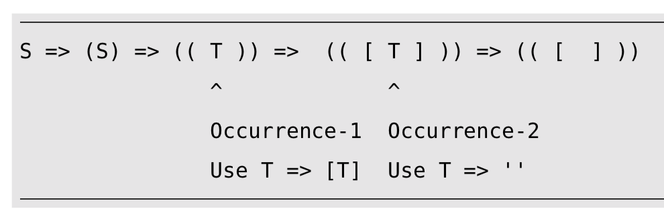
Getting to Pump CFGs: Part 2 of 4

Slide 33
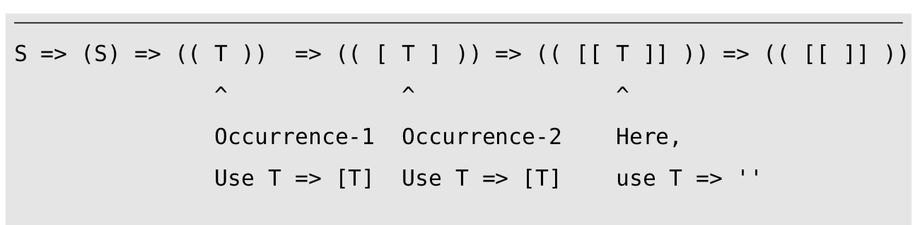
Getting to Pump CFGs: Part 3 of 4

Slide 34
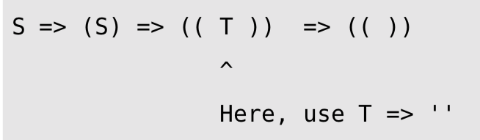
Getting to Pump CFGs: Part 4 of 4

Slide 35
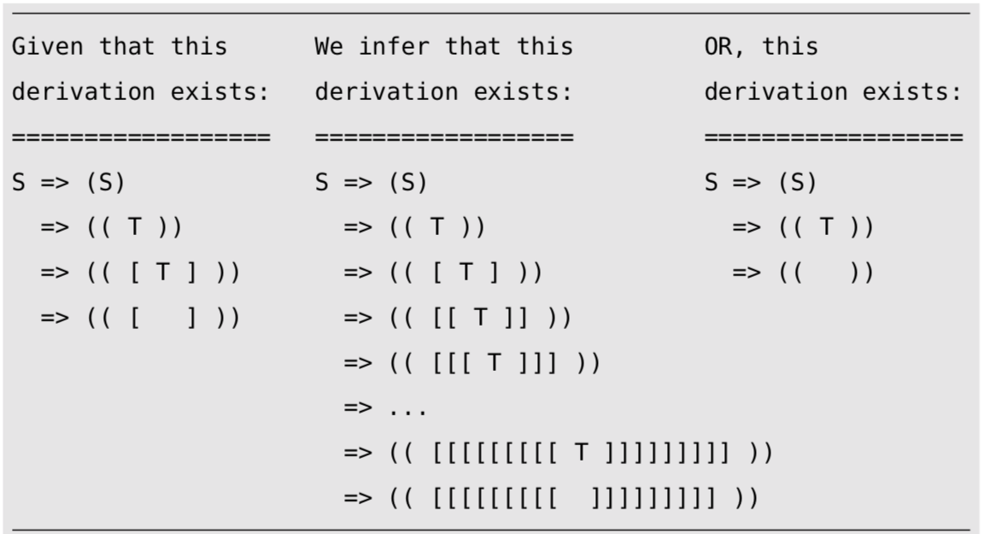
Summary of Example

Slide 36
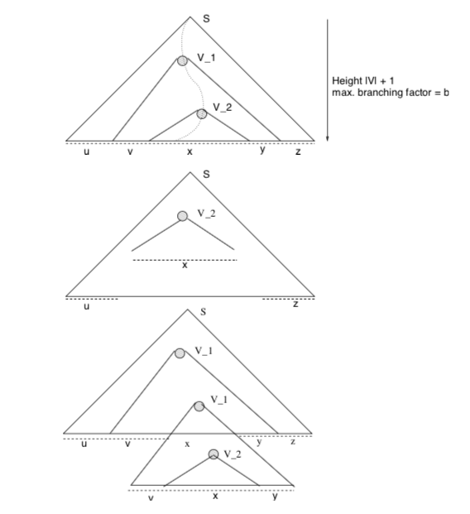
CFL PL in Pictures

Slide 37
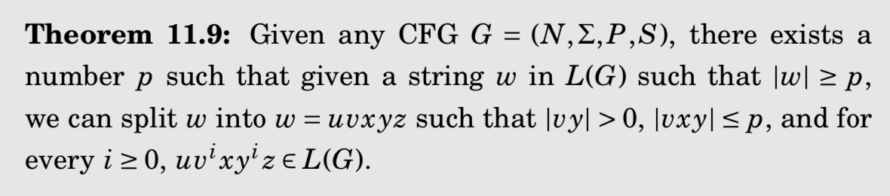
The CFL PL finally! (pictures)

Slide 38
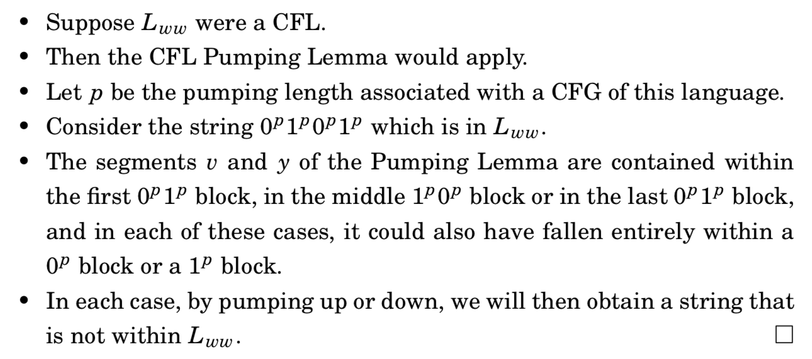
The CFL PL finally! (words)

Slide 39
Exercise on CFL PL
Show that { 0^{i^2} : i >= 0 } is not a CFL

Slide 40
Exercise on CFL PL from Sipser
Show that this language is not a CFL
{ w # x : w is a substring of x, where w in {a,b}* }
here # is a simple delimiter character
A substring is a contiguous sequence of strings embedded in another
A subsequence is more general – need not be contiguous

