Slide 1

CS 3100, Models of Computation, Spring 20, Lec 19,20 March 23, 25, 2020
Ganesh Gopalakrishnan
School of Computing
University of Utah
Salt Lake City, UT 84112
URL: https://bit.ly/3100s20Syllabus

Slide 2
Agenda for Wed March 25
Walk through First_Jove_Tutorial/CH13/CH13.ipynb in full detail
Live-code a TM for w#w where w in {0}*
At this point, expect students to read and try out the other examples suggested in these notebooks and successfully code-up a DTM
Also expect them to do Asg-6 Problem-1
START EARLY! This is potentially tricky!
Live-code an NDTM to look for “11” in a string
At this point, assume the students can do Asg-6 Problem-2
Go over PCP once more
At this point, assume the students can do Asg-6 Problem-3
Devote the rest of the lecture to Quiz-7 and Asg-6 Qn 4,5
2-stack simulation of a TM
RE and Recursive Sets
But we will go thru all the basic material quicky, do quizzes etc

Slide 3
Agenda for the rest of the semester
Learn the topics of Turing Machines and Computability Theory
By solving Asg-6,7, Quiz-7,8,9, Midterm-3, and Finals
Lectures will focus on these mileposts
Quizzes posted; Asg-6 posted; Asg-7 will soon be

Slide 4
Nature of the upcoming material
Some practical topics, many theoretical topics
A huge number of notions, individually not hard, together tricky
Will provide glossary of terms you’ll need to learn
Will provide summary of approaches also
Four uses of Jove and allied software
Build and simulate Turing machines (Asg-6)
Solve the Post Correspondence Problem (Asg-6)
Refresh Boolean (Propositional) Logic (Asg-7)
Experience the power of Boolean Satisfiability, or SAT (Asg-7)
To see if you are following along (and in lieu of “in class” quizzes) I’ll set up mini Canvas quizzes due at the end of the day
Will record and save Zoom session (hopefully will work)

Slide 5
What we will study (and what material tests you)
13.1-13.3: Turing machines as low-level devices you can program
DTM and NDTM programming in Asg-6
13.2: Simulating a TM using two unbounded stacks
Quizzes ask you about this

Slide 6
What we will study (and what material tests you)
13.3: Formal definition of TMs
You understand the components of a DTM and an NDTM
There is no separate “programming notation” for DTM
Either in Jove or in Mathematics
For example, ”no special Epsilon move” for a TM
A TM MUST always consider the current character under its head and write a character (maybe the same)
THEN it may move left (L), move right (R ), or stay put at the same place (S)
HOWEVER, we will study NDTMs separately in the following senses
When you want to solve a problem, you can decide -- a priori – whether you are going to define a DETERMINISTIC ALGORITHM or a NONDETERMINISTIC ALGORITHM
If you decide to program a deterministic algorithm, pretend you are a low-level programmer…. and program-away!
If you decide to program a nondeterministic algorithm, you can “take a guess” and then check whether the guess is true (this will be illustrated)
Later (when we study NP-completeness), you will see how we take into account the “cost of taking a guess”

Slide 7
What we will study (and what material tests you)
13.3: Whether it is a DTM or an NDTM, these ideas are common
Halting
Halting means GETTING STUCK IN A STATE
If we get stuck in a final state, it is called ACCEPTANCE
If we get stuck in a non-final state --- ANY NON-FINAL-STATE --- it is called REJECTION
If neither of the above, then the TM is said to be LOOPING
Language of a TM
For a DTM, it is determined by a single execution that ends and GETS STUCK in a final state
For an NDTM, it is determined by ANY ONE of the executions that ends and GETS STUCK in a FINAL STATE

Slide 8
What we will study (and what material tests you)
13.3: You understand the conventions of setting up a TM
Set up the input string you want to process on the tape, with the ”head” of the TM facing the left end of the string.
The input alphabet SHALL NOT have a blank symbol in it
In Jove, we use “.” to denote a blank (so that your eyes can see the blank)
YOU SHALL NOT PUT a blank in the middle of the string you want to run the TM on
To feed an “epsilon” to a TM, simply run it on a “blank tape”
A “blank tape” means NOTHING BUT BLANKS
or <…………to infinity both ways………….> in Jove

Slide 9

Elements of a TM, one by one
Turing machines are structures
Has finite-state control (as with a DFA, NFA, or PDA)
Has an input alphabet Sigma
Strings over this input alphabet can be submitted as “input” to the TM
The input w in Sigma*
Has a tape that is doubly infinite
The read/write head faces one cell initially
That cell
Transitions mention what character is being looked at, what it must be changed to, and which way the head must move
Head motions are L,R,S for “move left”, “move right”, “stay at the same place”

Slide 10
General TM conventions
Initialize input on tape
don’t put blanks in the middle of your input
End input with blanks
To present “epsilon”, leave a complete blank tape
Blanks denoted by “.” in our Jove input
“readable blank”
A TM may read an input multiple times
It can move its head back to an already read input
It can modify a tape cell and read that modified value also
A TM halts when it gets “stuck”
It may not have read any of its input
Still, if it gets stuck in the accept state, that input which was laid out on the tape is deemed to have been accepted
All other states are “reject” states – being stuck in a non-accept state is tantamount to rejecting the input
A TM may never get stuck (in an accept or a non-accept state)
It is then said to loop
It may zig-zag away .. Never repeating any looping pattern

Slide 11
“Care and feeding” of a TM
To feed a TM epsilon
Leave its tape fully blank
To feed a TM something else other than Epsilon
Make sure that we don’t put anything outside of its Sigma on the tape
The TM may in fact put things outside of Sigma on its tape
But it can do so as special “markers”
This was allowed even for a PDA, so a TM is also allowed
But when a string from Sigma* is to be presented,
DO NOT insert any blanks in the middle!
A TM “thinks” that a blank in the middle is the end of your string.

Slide 12
Language of a TM
The language of a TM is the set of inputs that lead to the TM eventually being stuck in an accepting state
A TM may halt or loop
”Loop” means “not stuck yet” (I’m still a journey-man)
Halt means found stuck in an “F” state
We will make sure that all useful TMs (from which we want an accept/reject decision)
Go to an ”F” state from which there are no outlets (no moves possible) for announcing “success”
It is like a program that goes to the “success label”
Go to a ”non-F” state to announce rejection (no outlets from there either)
It is like a program that goes to a label “unsuccessful”
Till there is positive evidence (of being stuck in an F state), we can’t say what is in the language of a TM
A TM may never have read the input or only parially read the input or read the input multiple times….
Just the mere act of placing ”w” on the tape and later finding the Turing machine stuck at “F” is enough to declare “w is accepted”

Slide 13
Run this! First_Jove_Tutorial/Start_with_These_Animations.ipynb Study the basics of DTM and NDTM behavior from there

Slide 14
Let us now see what the book says
See Sections 13.1 through 13.4

Slide 15
Let us now see what Asg-6 says
See Problems 1 and 2

Slide 16
Consult the book for larger TMs
To solve Problems 1 and 2, we need to learn about larger TMs
Chapters 13.1 through 13.6 cover these (take a look)

Slide 17
Run this! First_Jove_Tutorial/CH13/CH13.ipynb See some serious TMs from here, and get ideas for Asg-6 from here

Slide 18
Take a look at Asg-6, Question 3
The topic is the Post Correspondence Problem (Chapter 15)
Let us examine its significance
A hugely important problem in CS --- yet, easily explained even to a 7-year old
Can be used as the starting point to show that
CFG Ambiguity is undecidable
First-order Validity is undecidable
Checking the reachability of communicating finite-state machines is undecidable

Slide 19
Run this! First_Jove_Tutorial/CH15/CH15.ipynb Get to use a PCP-solver The only one out there that solves hard problems (as far as I know) Authored by Ling Zhao of Univ of Alberta in early 2000’s (posted by some kind person at https://github.com/chrozz/PCPSolver )

Slide 20
Where is all this material going?
We will study the Chomsky Hierarchy
We will understand the full picture of formal language results

Slide 21
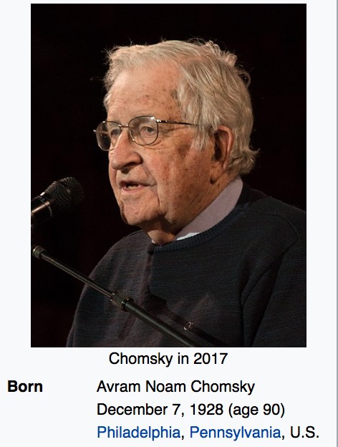
The Chomsky Hierarchy of Machines/Languages
Studying
This
Now

Slide 22
Full picture of Formal Language Results (Ch 14, Fig 14.2)

Slide 23
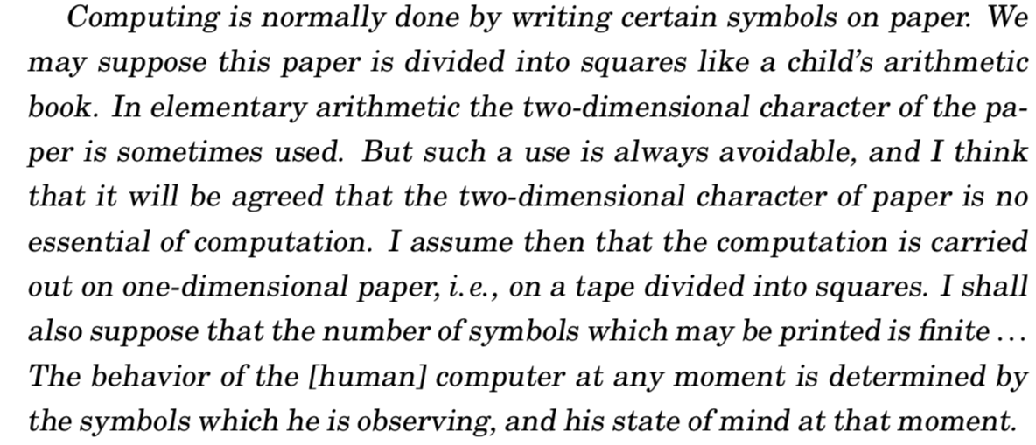
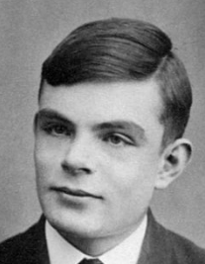
TM in Turing’s Own Words… (Hodge’s biography)

Slide 24
An in-depth study of TMs and Computability
We will now go through the details of TMs
This will be followed by results from Computability
We will need to carefully understand the notions of recursively enumerable and recursive sets (Asg-6, Question-4’s parts)
The goal of Wed’s lecture (3/25) will be to cover these topics

Slide 25
Example TM dtm1
Task for you:
Is this a DTM or NDTM?
What is the language of this TM?
Answer in set-comprehension form.
Can this TM loop? If so, on what input(s)?
How do you feed an ‘’ to any TM? This TM?

Slide 26
Example TM dtm2
Task for you:
Is this a DTM or NDTM?
What is the language of this TM?
Answer in set-comprehension form.
Can this TM loop? If so, on what input(s)?

Slide 27
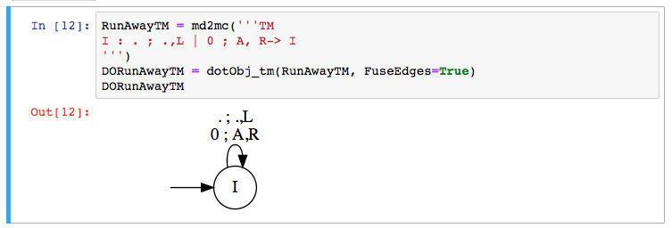
Languages of these TM?

Slide 28
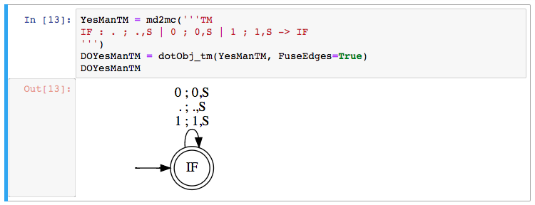
Languages of these TM?

Slide 29
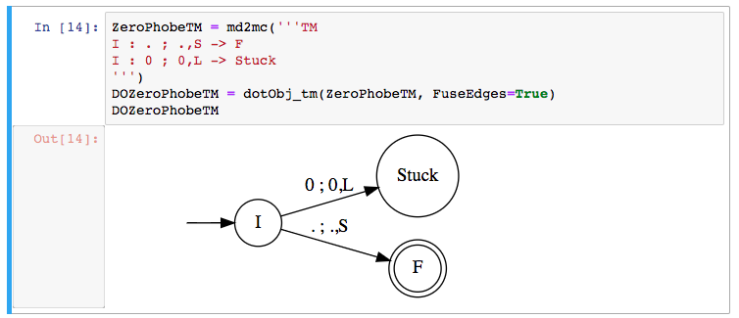
Languages of these TM?

Slide 30
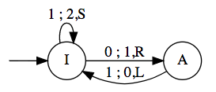
Simulating TMs using “PDA with 2 stacks”
If you can operate on 2 stacks in an extended PDA, you get a TM
Simulate the various moves as follows
Let [ ….) mean the left stack
Let ( …. ] mean the right stack
[….a) means “a” is on top of the left stack
(b….. ] means “b” is on top of the right stack
[…..a) (b….] means that we have L-stack and R-stack
This is how the “TM” tape is modeled:
[…xa) (by….] … i.e. we choose to show what’s under the T.O.S. also!
We are always looking at the top of the right-hand side stack – arrange things to be so!

Slide 31
Simulating TMs using “PDA with 2 stacks”
If you can operate on 2 stacks in an extended PDA, you get a TM
Simulate the move
“If I’m looking at q under my TM head, I want to change q to an x,
and then move right”
I’ll write [ …ab) (qp…] → [ ….abx) (p… ]
i.e.
Pop the right stack
Push x on the left stack
Example: the transition from I to A is 0; 1,R
This will be captured as
[..ab) (0p …] → [..ab1) (p…]

Slide 32
Simulating TMs using “PDA with 2 stacks”
If you can operate on 2 stacks in an extended PDA, you get a TM
Simulate the move
“If I’m looking at q under my TM head, I want to change q to an x,
and then move left”
I’ll write [ …ab) (qp…] → [ ….a) (bxp… ]
i.e.
Capture the top of the left stack (call it b)
Pop it (left stack)
Push x on the left stack and then push b on the right stack
Example: the transition from A to I is 1 ; 0, L
This will be captured as
[..ab) (1p …] → [..a) (b0p…]

Slide 33
Checklist to do Quiz-7
TM
Alphabets, looping, language
NDTM versus DTM (go over more)
Two-stack simulation (TODAY)
RE versus Recursive languages (TODAY)

Slide 34
Procedure versus Algorithm
When a program is known to halt on all inputs, it is said to realize an algorithm
When a program may loop on some of its inputs (we don’t know whether it would halt on all inputs), we say that the program realizes a procedure

Slide 35
Key Features of Algorithms
Algorithms are special cases of procedures (”always halt”)
It is only for algorithms that we meaningfully specify the runtime using the Big-O notation
For a procedure, the Big-O runtime is INFINITY!
REASON ?

Slide 36
Key Features of Algorithms
REASON:
Big-O tracks the worst-case runtime of a program.
If a program can loop, the worst-case is infinity.

Slide 37
Example TM dtm2
Task for you:
Does this TM realize a procedure
or an algorithm?
If an algorithm, what time
complexity (# of steps taken by
the TM as a function of the
input length)

Slide 38
Example DTM dtm3
Task for you:
Is this a DTM or NDTM?
What is the language of this TM?
Answer in set-comprehension form.
Can this TM loop? If so, on what input(s)?

Slide 39
Example DTM dtm4
Task for you:
Is this a DTM or NDTM?
What is the language of this TM?
Answer in set-comprehension form.
Can this TM loop? If so, on what input(s)?

Slide 40
Example DTM dtm5
Task for you:
Is this a DTM or NDTM?
What is the language of this TM?
Answer in set-comprehension form.
Can this TM loop? If so, on what input(s)?

Slide 41
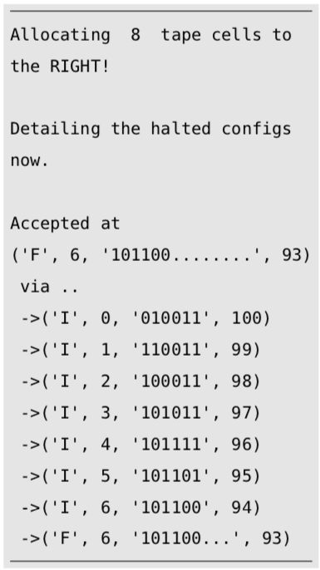
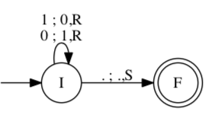
Example-1: Flip bits given on input tape
Initialize input on tape
Fire-up the machine
See how it gets stuck (with input-tape flipped)
How to run it:
explore_tm(TM, input, fuel)
“fuel” = number of allowed
time-steps
Prevents “run-away” looping
(no ^C)
Measures time-complexity
(number of TM-steps executed)
Jove markdown description:
I : 0 ; 1,R -> I
I : 1 ; 0,R -> I
I : . ; .,S -> F

Slide 42
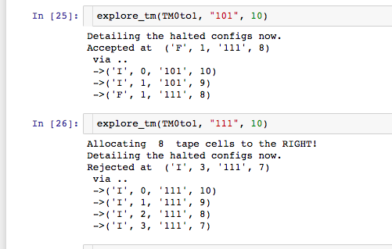
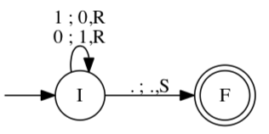
Example-2: Look for 0; turn into a 1; accept

Slide 43
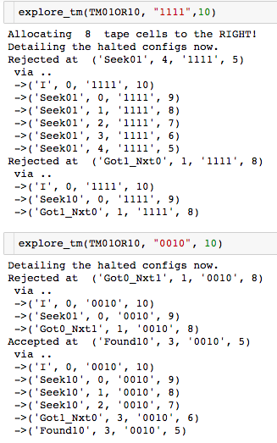
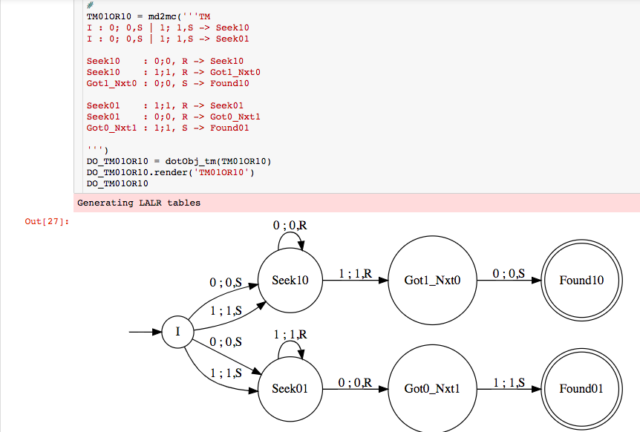
Example-3: Look for 01 or 10 using nondet.

Slide 44
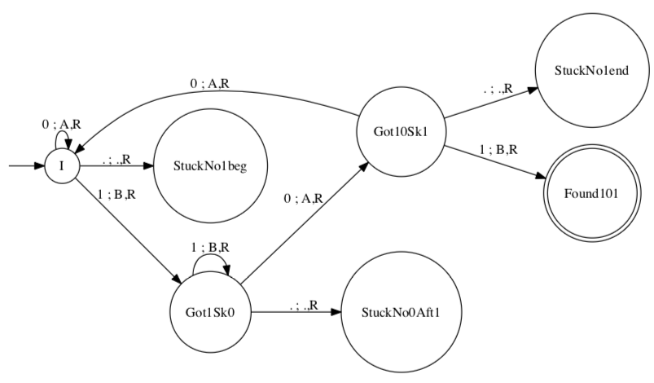

Example-4: DTM to accept inputs with “101” in it
This is what we write against each “arrow” (transition) of a TM :

Slide 45
Example-4: DTM to accept inputs with “101” in it
Task for you:
Language of this TM?
Realizes a procedure or an algorithm?
If an algorithm, what time
complexity (# of steps taken by
the TM as a function of the
input length) ?
This is what we write against each “arrow” (transition) of a TM :

Slide 46

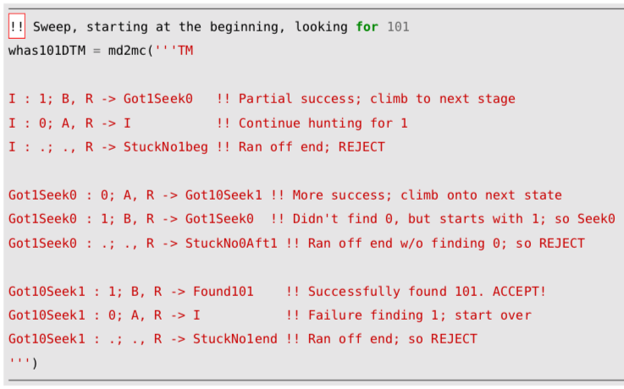
Example-4: DTM to accept inputs with “101” in it
Task for you:
Specify the mapping for
(Got10Sk1, 0) that yields
(Q, Gamma, {L,R,S}
Answer:

Slide 47
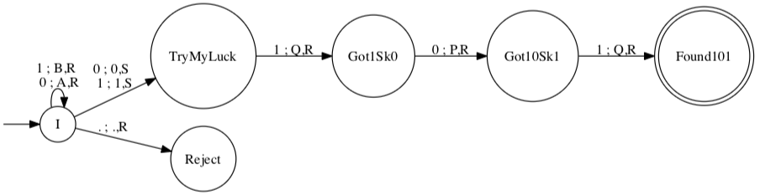

Example-5: NDTM to accept inputs with “101” in it
Task for you:
Locate nondeterminism
in the Delta function above.
Express your answer as a set of
(Q, Gamma, {L,R,S})
Answer:

Slide 48
DTMs and NDTMs are Equivalent in Power
Given any DTM, there is a language-equivalent NDTM
Proof: Direct, because any DTM is also an NDTM
Given any NDTM, there is a language-equivalent DTM
Proof Sketch: One can build a DTM that can simulate each non-deterministic option taken along the computational tree
The simulation may increase the runtime exponentially
But it still ensures halting!

Slide 49
How to “Determinize” this NDTM
Determinizing any NDTM (the way it is usually done):
Show that a “multi-tape TM” is equivalent to a single-tape TM
Keep the ND choices on one tape
Search through them one by one
In this example, this conversion would remember that at “I”, one could have
executed an ND step, and builds a tree of choices to explore

Slide 50
Which Machines have ND “more powerful” ?
This one is known
to be so (ND
more powerful)
This one is open
(no one knows
if NLBA and DLBA
are equivalent)

Slide 51
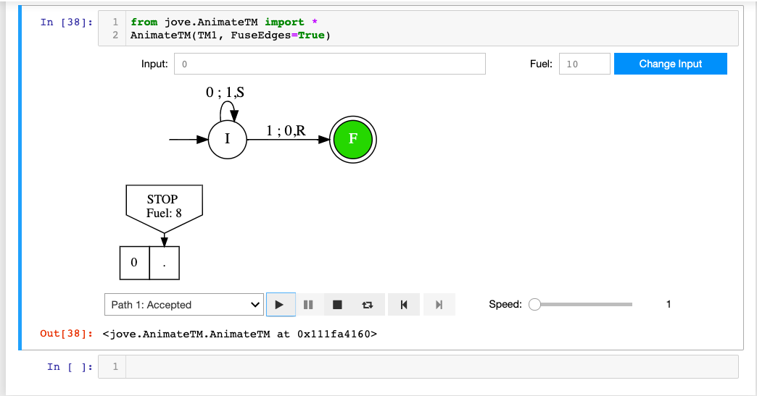
Explain This Halting Configuration

Slide 52
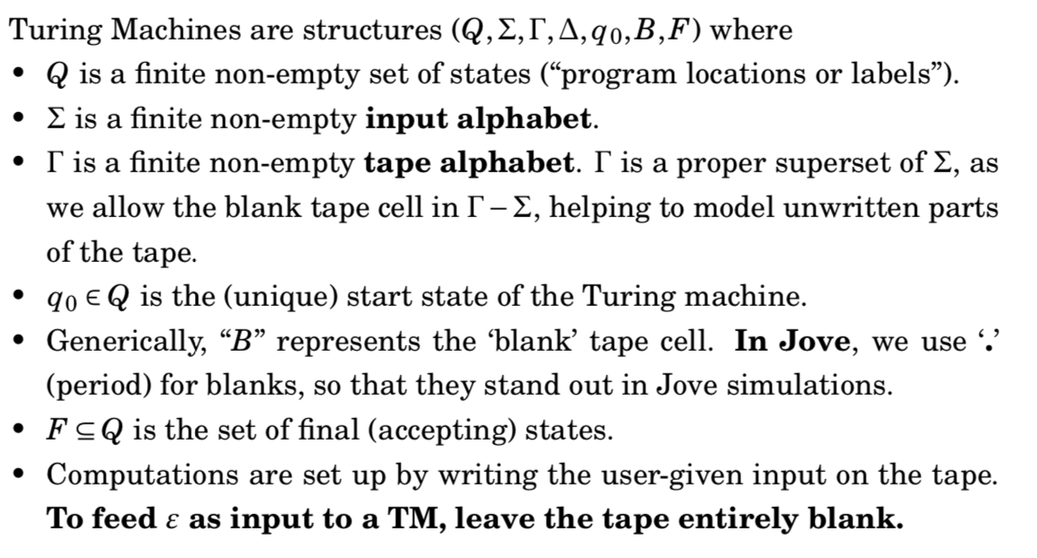
What is a TM (formal version)?

Slide 53
Transition Functions for DTM and NDTM
DTM:
NDTM:

Slide 54
Feeding inputs to a TM, etc.
We always feed a finitary input to a TM
That is, eventually there will be a blank to the RHS
The left-side of the head always has an infinite number of blanks

Slide 55
Key Features of NDTMs
NDTMs can “take a guess”
If one of the guesses succeeds, the TM accepts
This makes the construction of NDTMs often “easier”

Slide 56
Example-5: NDTM to accept inputs with “101” in it
Answer, including a definition of the language of an NDTM:
Task for you: What is the language
of this NDTM ?

Slide 57
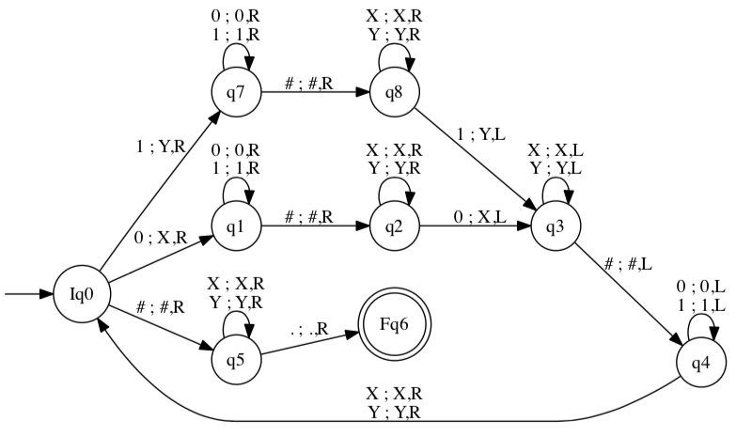
Example-6: DTM to accept w#w
Task for you:
What is the language of this TM?
Answer:
The set of strings that
Make the TM “stuck at Fq6”
Which is
{ … , … , … }
OR in set comprehension:

Slide 58
Example-7: NDTM to accept ww
Task for you: What is the language of this TM?
Answer in set-comprehension form:

Slide 59
Most Important Proof in Chapter 14
There is no algorithm to tell whether a given TM realizes a procedure or an algorithm

Slide 60
Most Important Proof in Chapter 14
There is no algorithm to tell whether a given TM realizes a procedure or an algorithm
There are of course procedures that tell whether a given TM realizes a procedure or an algorithm
But…. It…… May…… Loooooooooooooooooooooo…

Slide 61
Most Important Proof in Chapter 14
There is no algorithm to tell whether a given TM realizes a procedure or an algorithm
In other words, the “halting problem” is undecidable.

Slide 62
IMPORTANT: Recursive Sets
The language of a TM that always halts (i.e. the language of a TM realizing an algorithm) is a RECURSIVE SET
This term is historic in importance

Slide 63
IMPORTANT: Recursive Sets
The language of this TM is a recursive set

Slide 64
IMPORTANT: Recursively Enumerable Sets
The language of a TM that may loop (i.e. the language of a TM realizing a PROCEDURE) is a RECURSIVELY ENUMERABLE set
This term is historic in importance

Slide 65
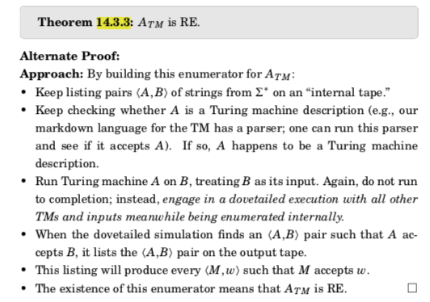
A general proof of a set being RE (14.3.3)

Slide 66
IMPORTANT: RE sets (not ‘regexp’ but rec. enum)
The language of this TM is an RE set

Slide 67
IMPORTANT: RE sets (not ‘regexp’ but rec. enum)
The language of this TM is an RE set
Question: What is that recursive set?

Slide 68
IMPORTANT: RE sets (not ‘regexp’ but rec. enum)
The language of this TM is an RE set

Slide 69
IMPORTANT: RE sets (not ‘regexp’ but rec. enum)
The language of this TM is an RE set
Question: What is that RE set?

Slide 70
IMPORTANT: RE sets (not ‘regexp’ but rec. enum)
The language of this TM is an RE set
Reason for calling them Recursively Enumerable:
We can enumerate these sets by going by the numeric order over Sigma*
Run the TM on each such string under an increasing amount of fuel
And record in an output set IF and WHEN an input string
causes a TM to halt in the accepting state

Slide 71
IMPORTANT: RE sets (not ‘regexp’ but rec. enum)
The language of this TM is an RE set
Reason for calling them Recursively Enumerable:
If we do it any other way, we may not discover a string in the RE set
Example: if you run this TM on input 0, the TM loooooooops
And you don’t get to run “1”
Hence you cannot discover that ”1” is in the set

Slide 72
IMPORTANT: RE sets (not ‘regexp’ but rec. enum)
The language of this TM is an RE set
Reason for calling them Recursively Enumerable:
If we do it any other way, we may not discover a string in the RE set
Example: if you run this TM on input 0, the TM loooooooops
And you don’t get to run “1”
Hence you cannot discover that ”1” is in the set

Slide 73
Instantaneous Description
The ID (instantaneous description, “snapshot”) of a TM is a
full description of its state
Knowing the ID of a TM, we can predict its next ID (for a DTM)
Knowing the ID of a TM, we can predict the
set of next possible IDs (for an NDTM)

Slide 74
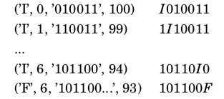
The Instantaneous Description (ID) of a TM
Jove-style
(control state, head-index
That starts at 0, Full tape,
”remaining fuel”)
Mathematical-style
(shows control state + what
the head is looking at).
Suppresses ”remaining fuel”

Slide 75
The Instantaneous Description (ID) of a TM
Jove-style
(control state, head-index
That starts at 0, Full tape,
”remaining fuel”)
Mathematical-style
(shows control state + what
the head is looking at).
Suppresses ”remaining fuel”
The arrow points to
the symbol that the
“TM head” is looking at.
The origin of the arrow
signifies the current
control state
of the TM

Slide 76
The Instantaneous Description (ID) of a TM
Jove-style
(control state, head-index
That starts at 0, Full tape,
”remaining fuel”)
Mathematical-style
(shows control state + what
the head is looking at).
Suppresses ”remaining fuel”
What is the “head”
looking at now?
Answer:

Slide 77
The Instantaneous Description (ID) of a TM
Jove-style
(control state, head-index
That starts at 0, Full tape,
”remaining fuel”)
Mathematical-style
(shows control state + what
the head is looking at).
Suppresses ”remaining fuel”
We shall use
the mathematical
kind when doing
Proofs.
I’ll remind you of the
Jove kind when necessary.

Slide 78
The Language of a TM: Mathematical IDs
The language of a TM (DTM or NDTM) M is the set of strings w such that the ID
q_0 w
evolves into this ID
w’ f w’’

Slide 79
The Language of a TM: Jove IDs
The language of a TM (DTM or NDTM) M is the set of strings w such that
When M is started from Jove-style ID
(q_0, 0, w, Fuel) where q_0 is the starting state
The TM runs for a while, and is found ”stuck” (halted) at some ID of the form
(f, h, w’, Fuel’) for some f in F

