Slide 1

CS 3100, Models of Computation, Spring 2020, Lec 2
Ganesh Gopalakrishnan
School of Computing
University of Utah
Salt Lake City, UT 84112
https://bit.ly/3100S20Syllabus

Slide 2
Lecture 2, Covering Chapter 3 (Please remind me to turn on recording before the lecture begins)

Slide 3
Pattern to expect for all future lectures
Required reading to be done before class
Class is for review + detailed examples + Q/A
Watch posted videos for lecture
This helps you plan your reading + try out things beforehand
Pace will pick up
Also, non-trivial material will appear – will give you sufficient notice
Asg-1 has been posted
Mainly “worked out” problems
Fast-track your learning of basic Python (just 4-5 simple ideas), colab (how to use it) and reading Ch 2-3
Easy, but get started soon, as there will be no deadline extensions in this course
Submit early, Submit Often, ask questions!

Slide 4
Recap: Match these in all possible ways
Symbol : string-of-length-one
String : sequence of Symbols
Alphabet : set of Symbols
Language : set of Strings
Set : an arbitrary set (no restrictions)

Slide 5
Operations on objects (of various types)
Avoid these
type error!
This one is OK

Slide 6
Think of all operations as having types
Language union and intersection have type Lang x Lang -> Lang
Language concatenation has type Lang x Lang -> Lang
Zero of language concatenation:
What that language – call it Zero – such that
Zero L = L Zero = Zero ?
One of language concatenation
What is that language – call it One – such that
One L = L One = L ?

Slide 7






Assessment: Language Concatenation
Is this true ??

Slide 8
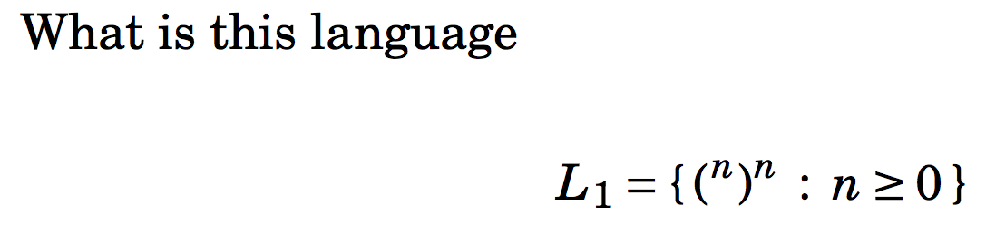
Assessment 1: Find the difference
How is the above language different from the following?
L_balPar = { x : x is a string of “well balanced parentheses” } ?
Is L1 included in L_balPar or vice-versa ??
If so, which way does the inclusion hold?

Slide 9
Assessment 2: Same or different?

Slide 10
If concatenation is like multiplication, then doing concatenation many times is like …. ?

Slide 11

If concatenation is like multiplication, then doing concatenation many times is like …. Exponentiation

Slide 12



Choose the right answer below (write it…)
If we now view
language concatenation
as multiplication, then
Exponentiation is
Repeated multiplication
Which of these two must be true ??

Slide 13

Answer for Language Concatenation Definition
Much like with numbers, 33 raised to 0 is 1
Likewise, a “language raised to Zero is the One language”

Slide 14
Interesting facts : let alphabet Sigma = {0,1}
{‘’} = all strings of length 0
{0,1} = all strings of length 1
{0,1} {0,1} = all strings of length 2
{0,1} {0,1} {0,1} = all strings of length 3
…

Slide 15
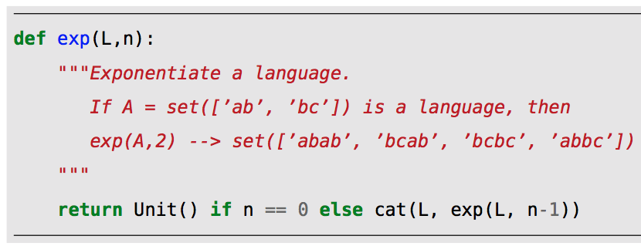

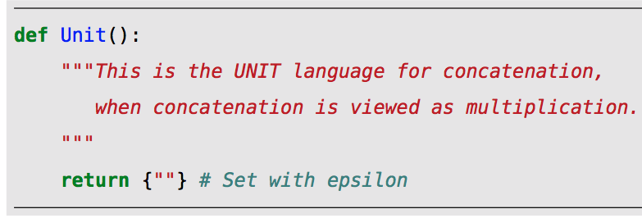
Defining lexp in Python (`language exp’)

Slide 16
Now…. for the ‘star’ of the show !!
i.e. Kleene Star

Slide 17
Purpose of Kleene-Star (or “star”)
Divide-up a language design problem into manageable pieces
Design one language (and its machine) for the BLOCK
Put a WHILE around the BLOCK
ZERO or More Identifiers declared in C
Zero or more files whose names begin with ’a’
”rm a*” → You are using Kleene-star or Star
Remove zero or more files beginning with ‘a’

Slide 18
Suppose you want to say “I want ALL strings of length 0 OR ALL strings of length 1 OR ALL strings of length 2 OR …” Here is a start – finish it !!!
{0,1} {0,1} {0,1}
{0,1} {0,1} {0,1}
{0,1} {0,1} {0,1}
… ?

Slide 19
Suppose you want to say “I want ALL strings of length 0 OR ALL strings of length 1 OR ALL strings of length 2 OR …"
Does this do it ?
{0,1} {0,1} {0,1}
{0,1} {0,1} {0,1}
{0,1} {0,1} {0,1}
… ?

Slide 20
Suppose you want to say “I want ALL strings of length 0 OR ALL strings of length 1 OR ALL strings of length 2 OR …"
NO, Don’t forget the Unit Language for Concatenation !! i.e. the set with Epsilon
{‘’}
{0,1} {0,1} {0,1}
{0,1} {0,1} {0,1}
{0,1} {0,1} {0,1}
… !!

Slide 21
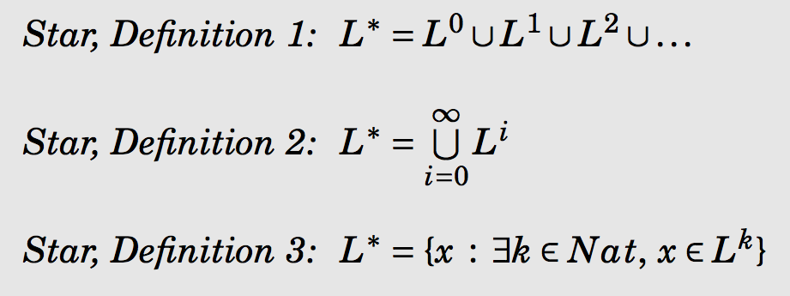
Definition of Star (three equivalent ones)
“Pick your poison…”

Slide 22
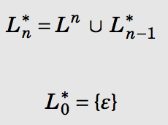
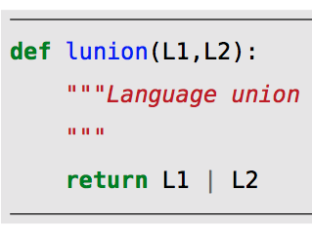
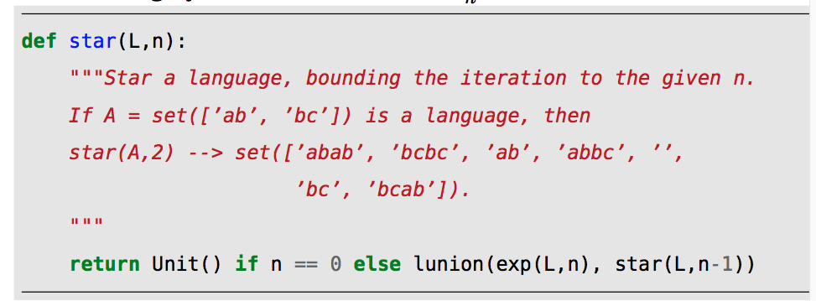
Star as a limit (handy for coding, understanding)

Slide 23


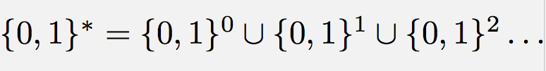

The star of ANY language CONTAINS

Slide 24
CRUCIAL OBSERVATION !!!!!
What is the universal language over an alphabet, say Sigma?
E.g. Sigma = {0,1} ; what is the universal language over it?
Express it in terms of Star!
So now, what does it mean to complement a language L, given a Sigma?
What language are we creating?
Express in terms of Sigma, Star, and set subtraction

Slide 25
CRUCIAL OBSERVATION !!!!!
For a language L and a given alphabet , the complement of L , written is nothing but
In Lecture-1 we had not introduced the star operator; there we called this universal set “U”. WE SHALL NO LONGER USE THAT NOTATION, NOW THAT WE HAVE DEFINED STAR!

Slide 26


The star of ANY language CONTAINS

Slide 27
One minute quiz: Property of Star
There are just two languages L1 and L2 such that
L1* and L2* are finite
L1 = ?
L2 = ?
The Star of any other language is an infinite language

Slide 28
On listing strings in a language
We often need to list strings from a language
To feed the strings to some tool
To show someone what the language contains (by way of example)
How do we ”smartly list” strings from an infinite language

Slide 29
How do you list a language “smartly”?
WRONG WAY:
Choose a method that guarantees that you will NEVER list some string
RIGHT WAY:
Choose a method that guarantees that every string will be EVENTUALLY listed
Such methods of listing are called enumeration

Slide 30
How do you list a language “smartly”?
WRONG WAY:
Choose a method that guarantees that you will NEVER list some string
Called Lexicographic Order of listing
This is NOT an enumeration
RIGHT WAY:
Choose a method that guarantees that every string will be EVENTUALLY listed
Called Numeric Order of enumeration

Slide 31
Example of enumeration and non-enumeration
Numeric order : This is an enumeration (gets to any string eventually, i.e. in a FINITE NUMBER of steps)
Lexicographic order : NOT an enumeration. Does not guarantee to EVER get to some strings (anything containing 1 won’t be listed !!)

Slide 32
See the book for code that enumerates

Slide 33
See the book for code that enumerates
Code to enumerate in numeric order
See book
Code to list in lexicographic order
It is easy to list strings in lexicographic order
But this is useless for most purposes (not an enumeration)

Slide 34
Language Reversal
Reverse each string in the language

Slide 35


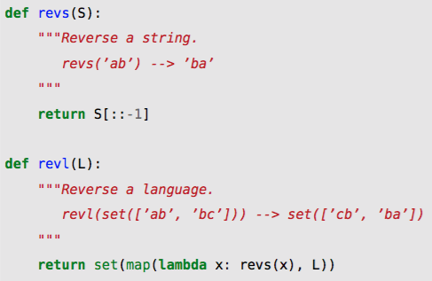
String and Language Reversal

Slide 36
1-min Exercise Set Comprehension for Palindromes
Write below a set comprehension listing all palindromes over {0,1}
Allowed to use notations are
w^R for the reverse of w
w1 w2 for concatenation
Call it Pal

Slide 37
1-min Exercise Set Comprehension for Palindromes
Is star(Pal) = Pal ?
Justify your answer
Is Pal Pal = Pal ?

Slide 38
More exercises
Pal Sigma* = Sigma* Pal ??
Pal U Sigma* = Sigma* U Pal ??

Slide 39
What this course is about: STRUCTURE of information in strings
Is Pal Sigma* = Sigma* Pal ?
Answer:
Is Pal U Sigma* = Sigma* U Pal ?
Answer:

Slide 40
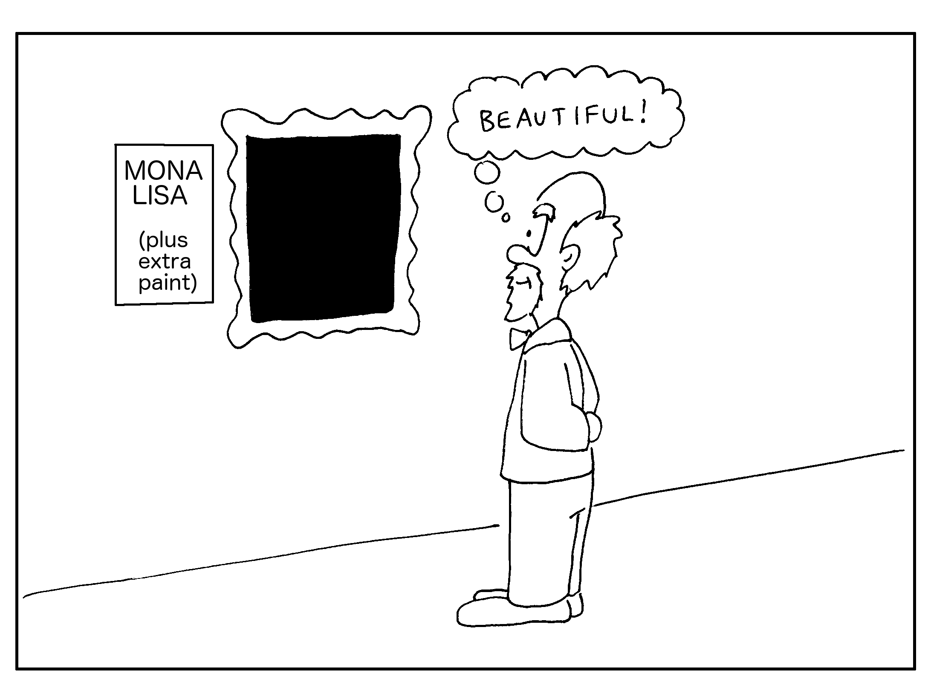
What this course is about: STRUCTURE of information in strings
Pal U Sigma* = Sigma* U Pal
Yes!
Union with Sigma* blends structure
away !!
(destroys information )

Slide 41
Compare sizes |{a,ab}{a,ab}| vs. |{‘’,a}{‘’,a}|
Which is bigger?

Slide 42
Ex: (({a,ab}{a,ab})^R)^*
Here, juxtaposition is concatenation, ^R is reverse, and ^* is Kleene star
If this is an infinite set, then
write 6 elements in numeric order
Write 6 elements in lexicographic order
Space for answer below:

Slide 43
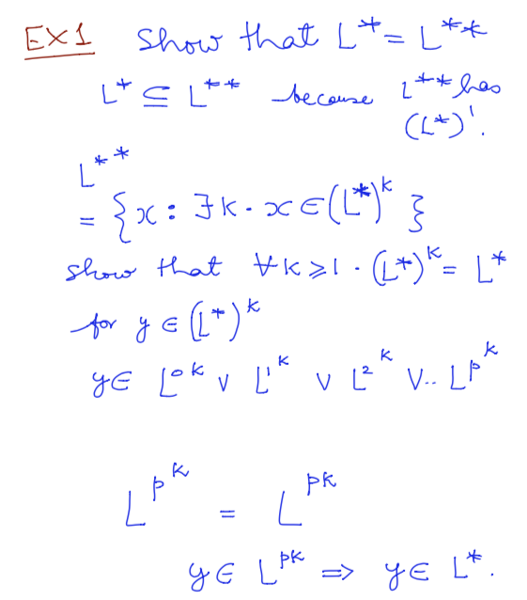
Drill Problems to try soon

Slide 44
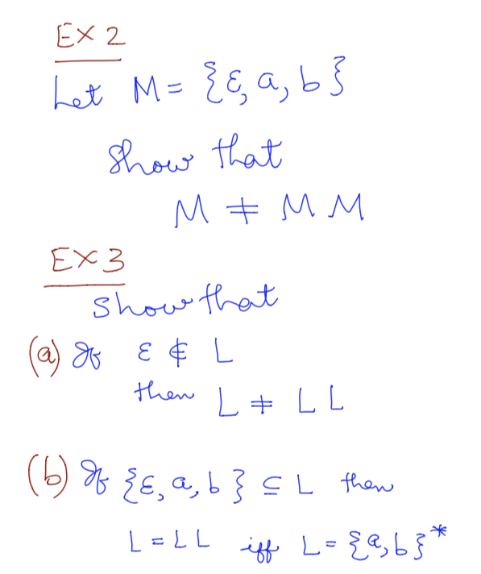
Drill Problems to try soon

Slide 45
Extra Slides

Slide 46
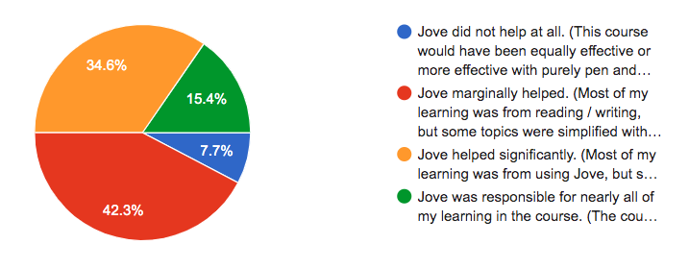
Plans for using Jove which helped during F’19 (feedback from F’19 hopefully will improve things)
Students did face issues wrt the Windows platform
Mac install was smooth
Colab is given to you to help accelerate w/o any installation
We will give you practice during Asg-1 (based on feedback F’19)

