Slide 1

CS 3100, Models of Computation, Spring 20, Lec 20 March 25, 2020
Ganesh Gopalakrishnan
School of Computing
University of Utah
Salt Lake City, UT 84112
URL: https://bit.ly/3100s20Syllabus

Slide 2
Agenda for Wed March 25
Walk through First_Jove_Tutorial/CH13/CH13.ipynb in full detail
Live-code a TM for w#w where w in {0}*
At this point, expect students to read and try out the other examples suggested in these notebooks and successfully code-up a DTM
Also expect them to do Asg-6 Problem-1
START EARLY! This is potentially tricky!
Live-code an NDTM to look for “11” in a string
At this point, assume the students can do Asg-6 Problem-2
Go over PCP once more
At this point, assume the students can do Asg-6 Problem-3
Devote the rest of the lecture to Quiz-7 and Asg-6 Qn 4,5
2-stack simulation of a TM
RE and Recursive Sets
But we will go thru all the basic material quicky, do quizzes etc

Slide 3
Take a look at Asg-6, Question 3
The topic is the Post Correspondence Problem (Chapter 15)
Let us examine its significance
A hugely important problem in CS --- yet, easily explained even to a 7-year old
Can be used as the starting point to show that
CFG Ambiguity is undecidable
First-order Validity is undecidable
Checking the reachability of communicating finite-state machines is undecidable

Slide 4

Elements of a TM, one by one
Turing machines are structures
Has finite-state control (as with a DFA, NFA, or PDA)
Has an input alphabet Sigma
Strings over this input alphabet can be submitted as “input” to the TM
The input w in Sigma*
Has a tape that is doubly infinite
The read/write head faces one cell initially
That cell
Transitions mention what character is being looked at, what it must be changed to, and which way the head must move
Head motions are L,R,S for “move left”, “move right”, “stay at the same place”

Slide 5
General TM conventions
Initialize input on tape
don’t put blanks in the middle of your input
End input with blanks
To present “epsilon”, leave a complete blank tape
Blanks denoted by “.” in our Jove input
“readable blank”
A TM may read an input multiple times
It can move its head back to an already read input
It can modify a tape cell and read that modified value also
A TM halts when it gets “stuck”
It may not have read any of its input
Still, if it gets stuck in the accept state, that input which was laid out on the tape is deemed to have been accepted
All other states are “reject” states – being stuck in a non-accept state is tantamount to rejecting the input
A TM may never get stuck (in an accept or a non-accept state)
It is then said to loop
It may zig-zag away .. Never repeating any looping pattern

Slide 6
“Care and feeding” of a TM
To feed a TM epsilon
Leave its tape fully blank
To feed a TM something else other than Epsilon
Make sure that we don’t put anything outside of its Sigma on the tape
The TM may in fact put things outside of Sigma on its tape
But it can do so as special “markers”
This was allowed even for a PDA, so a TM is also allowed
But when a string from Sigma* is to be presented,
DO NOT insert any blanks in the middle!
A TM “thinks” that a blank in the middle is the end of your string.

Slide 7
Language of a TM
The language of a TM is the set of inputs that lead to the TM eventually being stuck in an accepting state
A TM may halt or loop
”Loop” means “not stuck yet” (I’m still a journey-man)
Halt means found stuck in an “F” state
We will make sure that all useful TMs (from which we want an accept/reject decision)
Go to an ”F” state from which there are no outlets (no moves possible) for announcing “success”
It is like a program that goes to the “success label”
Go to a ”non-F” state to announce rejection (no outlets from there either)
It is like a program that goes to a label “unsuccessful”
Till there is positive evidence (of being stuck in an F state), we can’t say what is in the language of a TM
A TM may never have read the input or only parially read the input or read the input multiple times….
Just the mere act of placing ”w” on the tape and later finding the Turing machine stuck at “F” is enough to declare “w is accepted”

Slide 8
Run this! First_Jove_Tutorial/Start_with_These_Animations.ipynb Study the basics of DTM and NDTM behavior from there

Slide 9
Consult the book for larger TMs
To solve Problems 1 and 2, we need to learn about larger TMs
Chapters 13.1 through 13.6 cover these (take a look)

Slide 10
Run this! First_Jove_Tutorial/CH13/CH13.ipynb See some serious TMs from here, and get ideas for Asg-6 from here

Slide 11
Run this! First_Jove_Tutorial/CH15/CH15.ipynb Get to use a PCP-solver The only one out there that solves hard problems (as far as I know) Authored by Ling Zhao of Univ of Alberta in early 2000’s (posted by some kind person at https://github.com/chrozz/PCPSolver )

Slide 12
Where is all this material going?
We will study the Chomsky Hierarchy
We will understand the full picture of formal language results

Slide 13
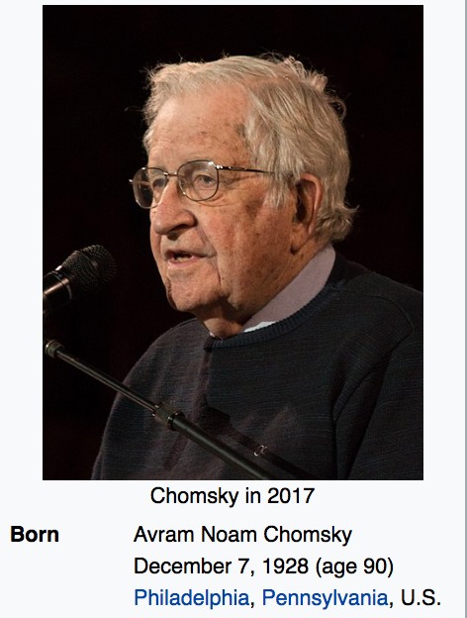
The Chomsky Hierarchy of Machines/Languages
Studying
This
Now

Slide 14
Full picture of Formal Language Results (Ch 14, Fig 14.2)

Slide 15
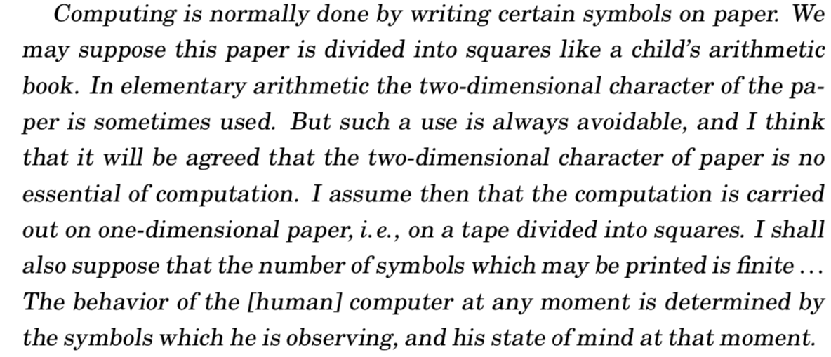

TM in Turing’s Own Words… (Hodge’s biography)

Slide 16
An in-depth study of TMs and Computability
We will now go through the details of TMs
This will be followed by results from Computability
We will need to carefully understand the notions of recursively enumerable and recursive sets (Asg-6, Question-4’s parts)
The goal of Wed’s lecture (3/25) will be to cover these topics

Slide 17
Example TM dtm1
Task for you:
Is this a DTM or NDTM?
What is the language of this TM?
Answer in set-comprehension form.
Can this TM loop? If so, on what input(s)?
How do you feed an ‘’ to any TM? This TM?

Slide 18
Example TM dtm2
Task for you:
Is this a DTM or NDTM?
What is the language of this TM?
Answer in set-comprehension form.
Can this TM loop? If so, on what input(s)?

Slide 19
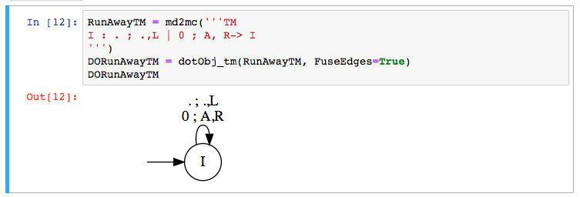
Languages of these TM?

Slide 20
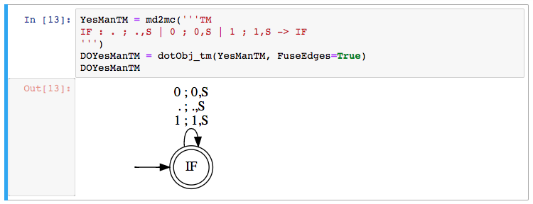
Languages of these TM?

Slide 21
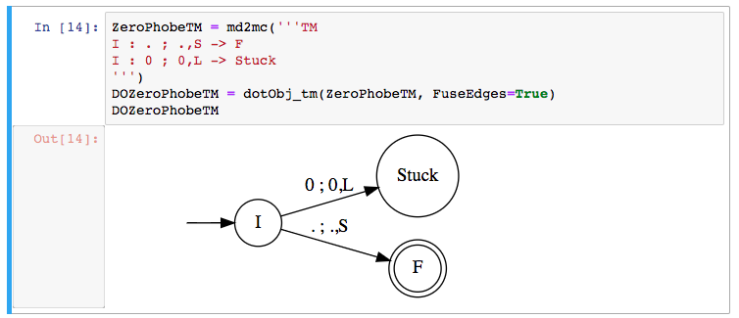
Languages of these TM?

Slide 22
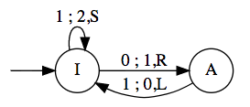
Simulating TMs using “PDA with 2 stacks”
If you can operate on 2 stacks in an extended PDA, you get a TM
Simulate the various moves as follows
Let [ ….) mean the left stack
Let ( …. ] mean the right stack
[….a) means “a” is on top of the left stack
(b….. ] means “b” is on top of the right stack
[…..a) (b….] means that we have L-stack and R-stack
This is how the “TM” tape is modeled:
[…xa) (by….] … i.e. we choose to show what’s under the T.O.S. also!
We are always looking at the top of the right-hand side stack – arrange things to be so!

Slide 23
Simulating TMs using “PDA with 2 stacks”
If you can operate on 2 stacks in an extended PDA, you get a TM
Simulate the move
“If I’m looking at q under my TM head, I want to change q to an x,
and then move right”
I’ll write [ …ab) (qp…] → [ ….abx) (p… ]
i.e.
Pop the right stack
Push x on the left stack
Example: the transition from I to A is 0; 1,R
This will be captured as
[..ab) (0p …] → [..ab1) (p…]

Slide 24
Simulating TMs using “PDA with 2 stacks”
If you can operate on 2 stacks in an extended PDA, you get a TM
Simulate the move
“If I’m looking at q under my TM head, I want to change q to an x,
and then move left”
I’ll write [ …ab) (qp…] → [ ….a) (bxp… ]
i.e.
Capture the top of the left stack (call it b)
Pop it (left stack)
Push x on the left stack and then push b on the right stack
Example: the transition from A to I is 1 ; 0, L
This will be captured as
[..ab) (1p …] → [..a) (b0p…]

Slide 25
Checklist to do Quiz-7
TM
Alphabets, looping, language
NDTM versus DTM (go over more)
Two-stack simulation (TODAY)
RE versus Recursive languages (TODAY)

Slide 26
Procedure versus Algorithm
When a program is known to halt on all inputs, it is said to realize an algorithm
When a program may loop on some of its inputs (we don’t know whether it would halt on all inputs), we say that the program realizes a procedure

Slide 27
Key Features of Algorithms
Algorithms are special cases of procedures (”always halt”)
It is only for algorithms that we meaningfully specify the runtime using the Big-O notation
For a procedure, the Big-O runtime is INFINITY!
REASON ?

Slide 28
Key Features of Algorithms
REASON:
Big-O tracks the worst-case runtime of a program.
If a program can loop, the worst-case is infinity.

Slide 29
Example TM dtm2
Task for you:
Does this TM realize a procedure
or an algorithm?
If an algorithm, what time
complexity (# of steps taken by
the TM as a function of the
input length)

Slide 30
Example DTM dtm3
Task for you:
Is this a DTM or NDTM?
What is the language of this TM?
Answer in set-comprehension form.
Can this TM loop? If so, on what input(s)?

Slide 31
Example DTM dtm4
Task for you:
Is this a DTM or NDTM?
What is the language of this TM?
Answer in set-comprehension form.
Can this TM loop? If so, on what input(s)?

Slide 32
Example DTM dtm5
Task for you:
Is this a DTM or NDTM?
What is the language of this TM?
Answer in set-comprehension form.
Can this TM loop? If so, on what input(s)?

Slide 33
See Rec Enum sets (bottom); Rec sets are a special case

Slide 34
Recursively Enumerable Language L
L is a recursively enumerable (RE) language if there is a TM (call it TM_L) whose language L is
EQUIVALENTLY
L is a recursively enumerable language (RE) if the contents of L can be listed systematically (e.g. in numeric order) by a single TM, say TM_L

Slide 35
Recursive Language L
L is a recursive (Rec) language if there is a TM (call it TM_L) whose language L is, and furthermore given something, say “x” not in L, TM_L can examine “x”, reject it, and halt [DECIDER for L or ALGORITHM TO CHECK MEMBERSHIP IN L)
EQUIVALENTLY
L is a recursive language (Rec) if the contents of L can be listed systematically (e.g. in numeric order) by a single TM, say TM_L, and furthermore there is also a TM, say TM_Lbar, that can enumerate L-bar (complement of L) also

Slide 36
Here are some sets: some RE and some Rec
Set of DFA descriptions whose language is empty
{ < D > : D is a DFA with an empty language }
RE? (if so TM? enum procedure?) Rec? (if so algo? Method to list L-bar?)
Set of DFA descriptions whose language is non-empty
RE? (if so TM? enum procedure?) Rec? (if so algo? Method to list L-bar?)
Set of PDA descriptions whose language is non-empty
RE? (if so TM? enum procedure?) REC? (If so, algo? Method to list L-bar?)

Slide 37
Let us solve the first example: L-emptyD
Set of DFA descriptions whose language is empty
L-emptyD = { < D > : D is a DFA with an empty language }
RE?
YES!
TM?
Build a TM that examines D, runs a DFA emptiness checking algo on D
Method to list L-emptyD ?
Keep listing various candidate D’s on a tape (some “scratch area of the tape”
Check D’s language to be empty
If so, print that D on an output tape

Slide 38
Let us solve the first example: L-emptyD
Set of DFA descriptions whose language is empty
L-emptyD = { < D > : D is a DFA with an empty language }
Rec?
YES!
ALGO?
Accept D and check if its language is empty. Accept if so, else reject
Method to list L-emptyD-Bar?
Keep listing various candidate D’s on a tape (some “scratch area of the tape”)
Check D’s language to be empty
If so, don’t print that D on an output tape, else print it !!

Slide 39
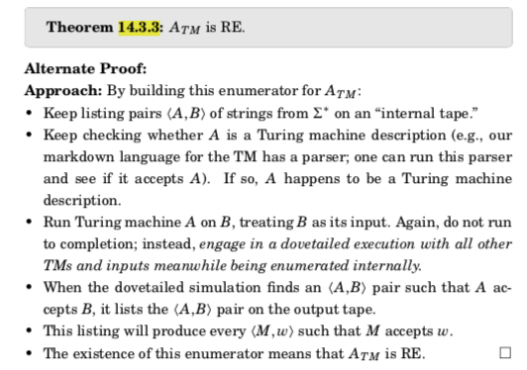
A general proof of a set being RE (14.3.3)

Slide 40
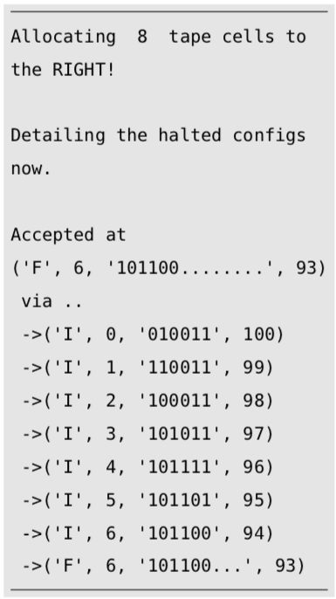
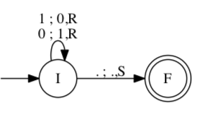
Example-1: Flip bits given on input tape
Initialize input on tape
Fire-up the machine
See how it gets stuck (with input-tape flipped)
How to run it:
explore_tm(TM, input, fuel)
“fuel” = number of allowed
time-steps
Prevents “run-away” looping
(no ^C)
Measures time-complexity
(number of TM-steps executed)
Jove markdown description:
I : 0 ; 1,R -> I
I : 1 ; 0,R -> I
I : . ; .,S -> F

Slide 41
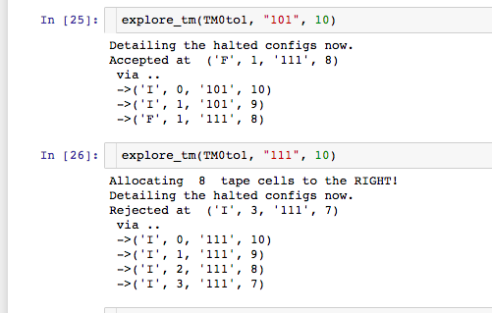
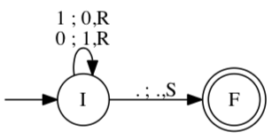
Example-2: Look for 0; turn into a 1; accept

Slide 42
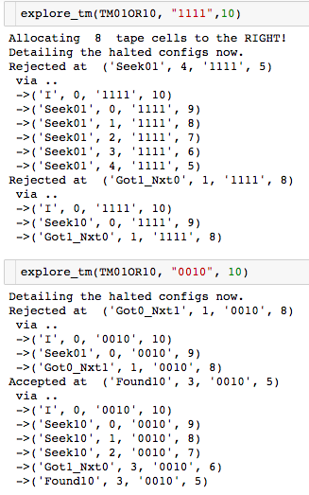
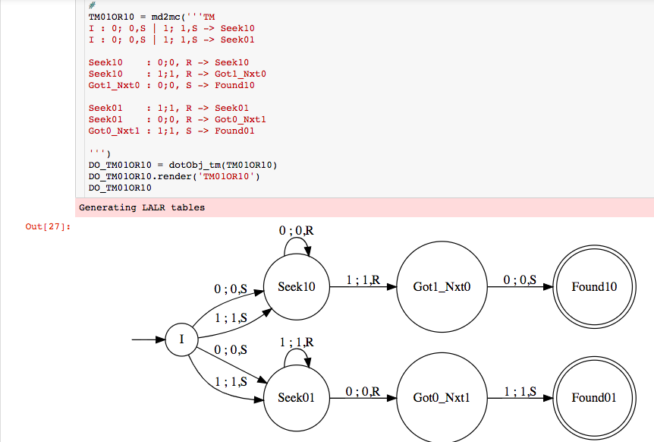
Example-3: Look for 01 or 10 using nondet.

Slide 43
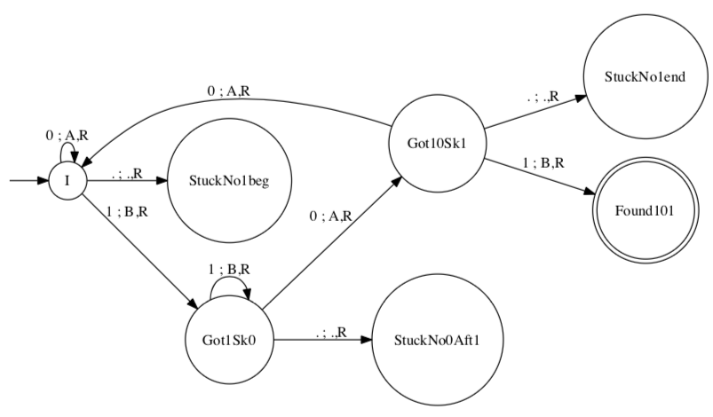

Example-4: DTM to accept inputs with “101” in it
This is what we write against each “arrow” (transition) of a TM :

Slide 44
Example-4: DTM to accept inputs with “101” in it
Task for you:
Language of this TM?
Realizes a procedure or an algorithm?
If an algorithm, what time
complexity (# of steps taken by
the TM as a function of the
input length) ?
This is what we write against each “arrow” (transition) of a TM :

Slide 45

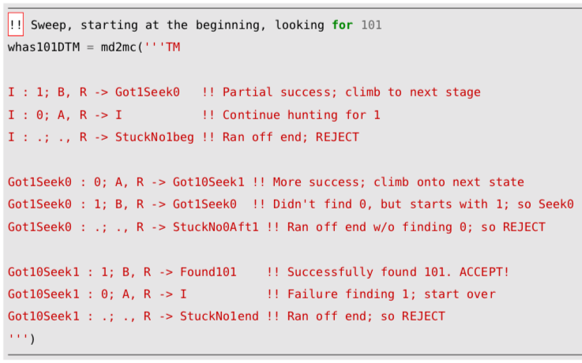
Example-4: DTM to accept inputs with “101” in it
Task for you:
Specify the mapping for
(Got10Sk1, 0) that yields
(Q, Gamma, {L,R,S}
Answer:

Slide 46
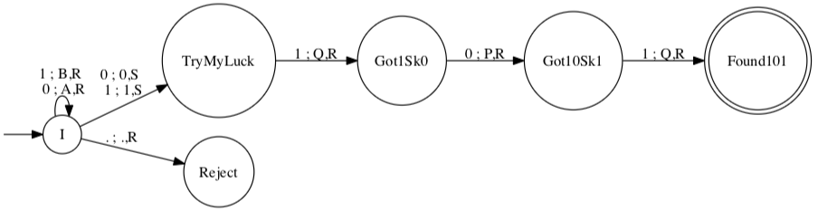

Example-5: NDTM to accept inputs with “101” in it
Task for you:
Locate nondeterminism
in the Delta function above.
Express your answer as a set of
(Q, Gamma, {L,R,S})
Answer:

Slide 47
DTMs and NDTMs are Equivalent in Power
Given any DTM, there is a language-equivalent NDTM
Proof: Direct, because any DTM is also an NDTM
Given any NDTM, there is a language-equivalent DTM
Proof Sketch: One can build a DTM that can simulate each non-deterministic option taken along the computational tree
The simulation may increase the runtime exponentially
But it still ensures halting!

Slide 48
How to “Determinize” this NDTM
Determinizing any NDTM (the way it is usually done):
Show that a “multi-tape TM” is equivalent to a single-tape TM
Keep the ND choices on one tape
Search through them one by one
In this example, this conversion would remember that at “I”, one could have
executed an ND step, and builds a tree of choices to explore

Slide 49
Which Machines have ND “more powerful” ?
This one is known
to be so (ND
more powerful)
This one is open
(no one knows
if NLBA and DLBA
are equivalent)

Slide 50
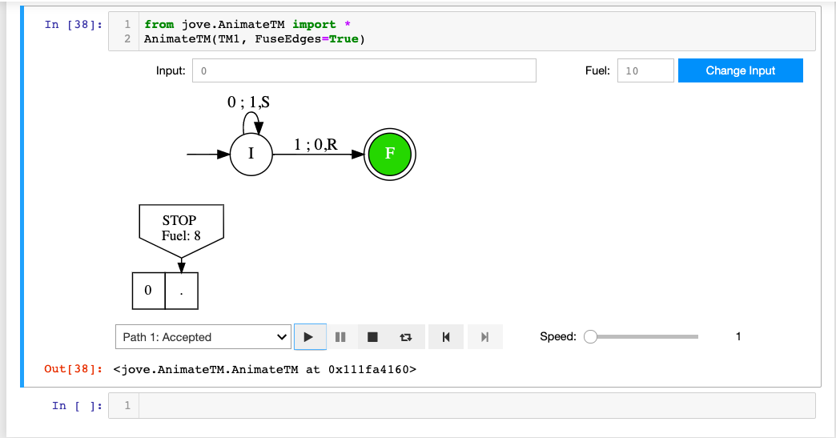
Explain This Halting Configuration

Slide 51
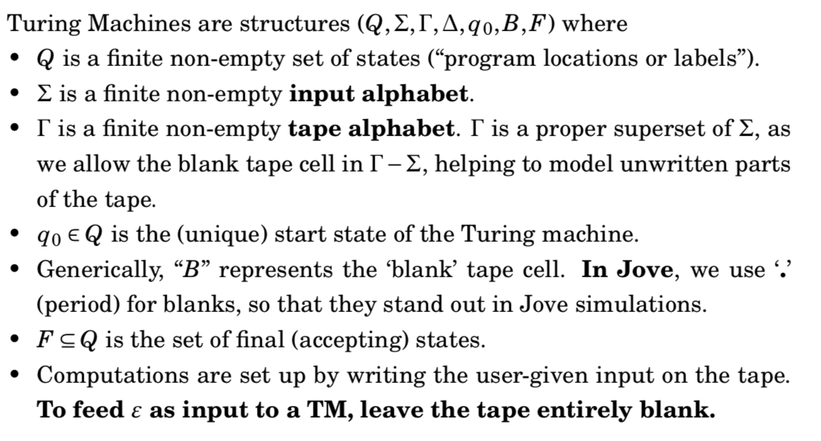
What is a TM (formal version)?

Slide 52
Transition Functions for DTM and NDTM
DTM:
NDTM:

Slide 53
Feeding inputs to a TM, etc.
We always feed a finitary input to a TM
That is, eventually there will be a blank to the RHS
The left-side of the head always has an infinite number of blanks

Slide 54
Key Features of NDTMs
NDTMs can “take a guess”
If one of the guesses succeeds, the TM accepts
This makes the construction of NDTMs often “easier”

Slide 55
Example-5: NDTM to accept inputs with “101” in it
Answer, including a definition of the language of an NDTM:
Task for you: What is the language
of this NDTM ?

Slide 56
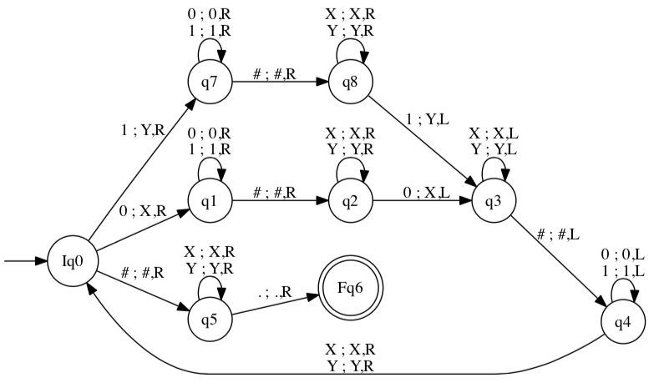
Example-6: DTM to accept w#w
Task for you:
What is the language of this TM?
Answer:
The set of strings that
Make the TM “stuck at Fq6”
Which is
{ … , … , … }
OR in set comprehension:

Slide 57
Example-7: NDTM to accept ww
Task for you: What is the language of this TM?
Answer in set-comprehension form:

Slide 58
Most Important Proof in Chapter 14
There is no algorithm to tell whether a given TM realizes a procedure or an algorithm

Slide 59
Most Important Proof in Chapter 14
There is no algorithm to tell whether a given TM realizes a procedure or an algorithm
There are of course procedures that tell whether a given TM realizes a procedure or an algorithm
But…. It…… May…… Loooooooooooooooooooooo…

Slide 60
Most Important Proof in Chapter 14
There is no algorithm to tell whether a given TM realizes a procedure or an algorithm
In other words, the “halting problem” is undecidable.

Slide 61
IMPORTANT: Recursive Sets
The language of a TM that always halts (i.e. the language of a TM realizing an algorithm) is a RECURSIVE SET
This term is historic in importance

Slide 62
IMPORTANT: Recursive Sets
The language of this TM is a recursive set

Slide 63
IMPORTANT: Recursively Enumerable Sets
The language of a TM that may loop (i.e. the language of a TM realizing a PROCEDURE) is a RECURSIVELY ENUMERABLE set
This term is historic in importance

Slide 64
IMPORTANT: RE sets (not ‘regexp’ but rec. enum)
The language of this TM is an RE set

Slide 65
IMPORTANT: RE sets (not ‘regexp’ but rec. enum)
The language of this TM is an RE set
Question: What is that recursive set?

Slide 66
IMPORTANT: RE sets (not ‘regexp’ but rec. enum)
The language of this TM is an RE set

Slide 67
IMPORTANT: RE sets (not ‘regexp’ but rec. enum)
The language of this TM is an RE set
Question: What is that RE set?

Slide 68
IMPORTANT: RE sets (not ‘regexp’ but rec. enum)
The language of this TM is an RE set
Reason for calling them Recursively Enumerable:
We can enumerate these sets by going by the numeric order over Sigma*
Run the TM on each such string under an increasing amount of fuel
And record in an output set IF and WHEN an input string
causes a TM to halt in the accepting state

Slide 69
IMPORTANT: RE sets (not ‘regexp’ but rec. enum)
The language of this TM is an RE set
Reason for calling them Recursively Enumerable:
If we do it any other way, we may not discover a string in the RE set
Example: if you run this TM on input 0, the TM loooooooops
And you don’t get to run “1”
Hence you cannot discover that ”1” is in the set

Slide 70
IMPORTANT: RE sets (not ‘regexp’ but rec. enum)
The language of this TM is an RE set
Reason for calling them Recursively Enumerable:
If we do it any other way, we may not discover a string in the RE set
Example: if you run this TM on input 0, the TM loooooooops
And you don’t get to run “1”
Hence you cannot discover that ”1” is in the set

Slide 71
Instantaneous Description
The ID (instantaneous description, “snapshot”) of a TM is a
full description of its state
Knowing the ID of a TM, we can predict its next ID (for a DTM)
Knowing the ID of a TM, we can predict the
set of next possible IDs (for an NDTM)

Slide 72
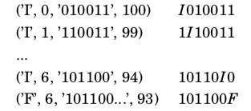
The Instantaneous Description (ID) of a TM
Jove-style
(control state, head-index
That starts at 0, Full tape,
”remaining fuel”)
Mathematical-style
(shows control state + what
the head is looking at).
Suppresses ”remaining fuel”

Slide 73
The Instantaneous Description (ID) of a TM
Jove-style
(control state, head-index
That starts at 0, Full tape,
”remaining fuel”)
Mathematical-style
(shows control state + what
the head is looking at).
Suppresses ”remaining fuel”
The arrow points to
the symbol that the
“TM head” is looking at.
The origin of the arrow
signifies the current
control state
of the TM

Slide 74
The Instantaneous Description (ID) of a TM
Jove-style
(control state, head-index
That starts at 0, Full tape,
”remaining fuel”)
Mathematical-style
(shows control state + what
the head is looking at).
Suppresses ”remaining fuel”
What is the “head”
looking at now?
Answer:

Slide 75
The Instantaneous Description (ID) of a TM
Jove-style
(control state, head-index
That starts at 0, Full tape,
”remaining fuel”)
Mathematical-style
(shows control state + what
the head is looking at).
Suppresses ”remaining fuel”
We shall use
the mathematical
kind when doing
Proofs.
I’ll remind you of the
Jove kind when necessary.

Slide 76
The Language of a TM: Mathematical IDs
The language of a TM (DTM or NDTM) M is the set of strings w such that the ID
q_0 w
evolves into this ID
w’ f w’’

Slide 77
The Language of a TM: Jove IDs
The language of a TM (DTM or NDTM) M is the set of strings w such that
When M is started from Jove-style ID
(q_0, 0, w, Fuel) where q_0 is the starting state
The TM runs for a while, and is found ”stuck” (halted) at some ID of the form
(f, h, w’, Fuel’) for some f in F

