Slide 1

CS 3100, Models of Computation, Spring 20, Lec 20 March 30, 2020
Ganesh Gopalakrishnan
School of Computing
University of Utah
Salt Lake City, UT 84112
URL: https://bit.ly/3100s20Syllabus

Slide 2
Agenda for Wed March 30
Help students answer the assignment questions
Launch into the topics of RE and Recursive sets
Present the Halting problem (start it today; finish April 1st)
Asg drop policy:
Drop a single 200-pt asg OR two 100-pt asgs (lowest 200 pts)
Grade the remaining out of 700

Slide 3
Run this to gain some footing wrt DTM and NDTM First_Jove_Tutorial/Start_with_These_Animations.ipynb Study the basics of DTM and NDTM behavior from there Also helps debug file include issues

Slide 4
Thereafter, run this! First_Jove_Tutorial/CH13/CH13.ipynb See some serious TMs from here, and get ideas for Asg-6 from here Includes w#w DTM runs Includes ww NDTM runs This last one gives you good clues for Asg-6 You can also see how to write binary addition – a large TM you can run!

Slide 5
Your approach to “nail” Asg-6
Build + test your DTM (study examples as much as you want)
NDTM and PCP then
Then the theoretical material (starts today)

Slide 6
We now begin studying TMs with these views
To convince ourself that anything that a “real” computer can do can be done on a TM (takes much longer; but feasible)
See a mechanical TM working here : https://youtu.be/E3keLeMwfHY
We will then model problems using TM’s language
”Solve a problem” turns into “is x a member of this TM’s language?”
We will then use TM-based arguments as a way to “settle” many open questions out there
Which problems can be solved by a computer?
“Solved” means they have full algorithms
Which problems can be “semi-solved”?
“Semi-solved” means a “half algorithm” or “semi-algorithm”
You get answers when a certain language membership is true
Which problems cannot be solved?
Even a “half solution” is unavailable”

Slide 7
We now begin studying TMs with these views
We will then use TM-based arguments as a way to “settle” many open questions out there
Which problems can be solved by a computer?
“Solved” means they have full algorithms
The language in question is RECURSIVE (recursive implies recursively enumerable)
Which problems can be “semi-solved”?
“Semi-solved” means a “half algorithm” or “semi-algorithm”
You get answers when a certain language membership is true
The language in question is NOT RECURSIVE but RECURSIVELY ENUMERABLE
Which problems cannot be solved?
Even a “half solution” is unavailable”
The language in question is NOT EVEN RECURSIVELY ENUMERABLE

Slide 8
Full picture of Formal Language Results (Ch 14, Fig 14.2)

Slide 9
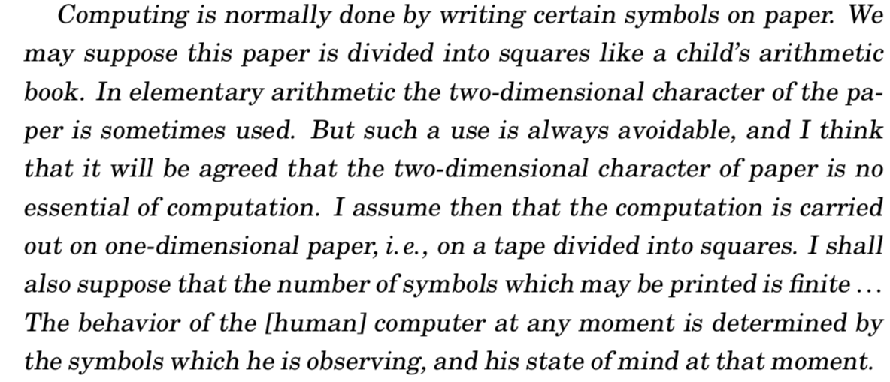
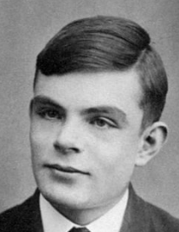
TM in Turing’s Own Words… (Hodge’s biography)

Slide 10
Checklist to do Quiz-7
TM
Alphabets, looping, language
NDTM versus DTM (go over more)
Two-stack simulation (TODAY)
RE versus Recursive languages (TODAY)

Slide 11
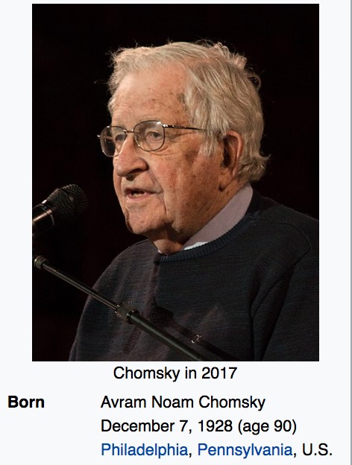
The Chomsky Hierarchy of Machines/Languages
Studying
This
Now

Slide 12
The notion of the Language of a TM

Slide 13
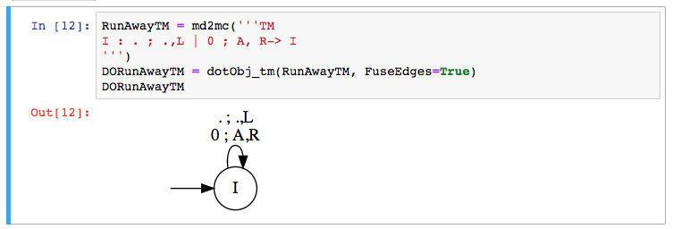
Languages of these TM?

Slide 14
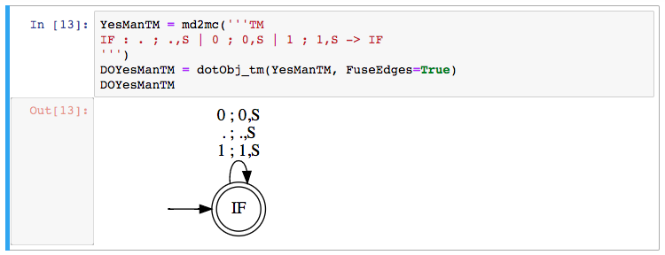
Languages of these TM?

Slide 15
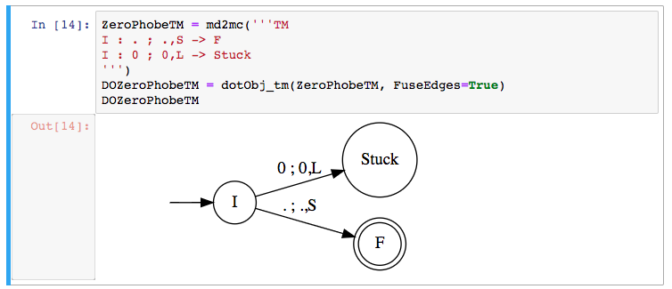
Languages of these TM?

Slide 16
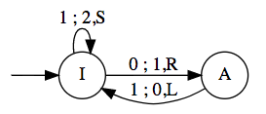
Simulating TMs using “PDA with 2 stacks”
If you can operate on 2 stacks in an extended PDA, you get a TM
Simulate the various moves as follows
Let [ ….) mean the left stack
Let ( …. ] mean the right stack
[….a) means “a” is on top of the left stack
(b….. ] means “b” is on top of the right stack
[…..a) (b….] means that we have L-stack and R-stack
This is how the “TM” tape is modeled:
[…xa) (by….] … i.e. we choose to show what’s under the T.O.S. also!
We are always looking at the top of the right-hand side stack – arrange things to be so!

Slide 17
Simulating TMs using “PDA with 2 stacks”
If you can operate on 2 stacks in an extended PDA, you get a TM
Simulate the move
“If I’m looking at q under my TM head, I want to change q to an x,
and then move right”
I’ll write [ …ab) (qp…] → [ ….abx) (p… ]
i.e.
Pop the right stack
Push x on the left stack
Example: the transition from I to A is 0; 1,R
This will be captured as
[..ab) (0p …] → [..ab1) (p…]

Slide 18
Simulating TMs using “PDA with 2 stacks”
If you can operate on 2 stacks in an extended PDA, you get a TM
Simulate the move
“If I’m looking at q under my TM head, I want to change q to an x,
and then move left”
I’ll write [ …ab) (qp…] → [ ….a) (bxp… ]
i.e.
Capture the top of the left stack (call it b)
Pop it (left stack)
Push x on the left stack and then push b on the right stack
Example: the transition from A to I is 1 ; 0, L
This will be captured as
[..ab) (1p …] → [..a) (b0p…]

Slide 19
For every NDTM, there is an equivalent DTM

Slide 20
DTMs and NDTMs are Equivalent in Power
Given any DTM, there is a language-equivalent NDTM
Proof: Direct, because any DTM is also an NDTM
Given any NDTM, there is a language-equivalent DTM
Proof Sketch: One can build a DTM that can simulate each non-deterministic option taken along the computational tree
The simulation may increase the runtime exponentially
But it still ensures halting!

Slide 21
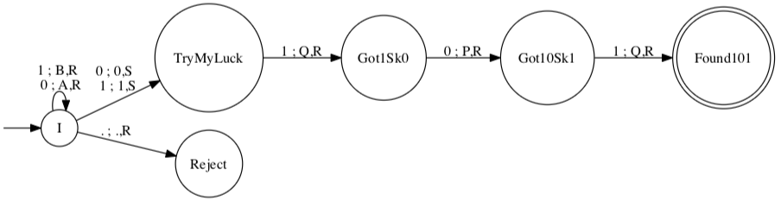
How to “Determinize” this NDTM
Determinizing any NDTM (the way it is usually done):
Show that a “multi-tape TM” is equivalent to a single-tape TM
Keep the ND choices on one tape
Search through them one by one
In this example, this conversion would remember that at “I”, one could have
executed an ND step, and builds a tree of choices to explore

Slide 22
Therefore, we can study procedures/algorithms using DTM

Slide 23
Procedure versus Algorithm
When a program is known to halt on all inputs, it is said to realize an algorithm
“Algorithm” goes with “Recursive Sets”
When a program may loop on some of its inputs (we don’t know whether it would halt on all inputs), we say that the program realizes a procedure
”Procedure” goes with “Recursively Enumerable” sets

Slide 24
Key Features of Algorithms
Algorithms are special cases of procedures (”always halt”)
It is only for algorithms that we meaningfully specify the runtime using the Big-O notation
For a procedure, the Big-O runtime is INFINITY!
REASON ?

Slide 25
Key Features of Algorithms
REASON:
Big-O tracks the worst-case runtime of a program.
If a program can loop, the worst-case is infinity.

Slide 26
Example TM dtm2
Task for you:
Does this TM realize a procedure
or an algorithm?
If an algorithm, what time
complexity (# of steps taken by
the TM as a function of the
input length)

Slide 27
See Rec Enum sets (bottom); Rec sets are a special case

Slide 28
The notion of Recursively Enumerable Sets * Regular Sets (Languages) <-> DFA * Context-Free Sets (Languages) <-> PDA * Recursively Enumerable Sets (Languages) <-> DTM

Slide 29
Recursively Enumerable Language L
L is a recursively enumerable (RE) language if there is a TM (call it TM_L) whose language L is
EQUIVALENTLY
L is a recursively enumerable language (RE) if the contents of L can be listed systematically (e.g. in numeric order) by a single TM, say TM_L

Slide 30
Recursive Language L
L is a recursive (Rec) language if there is a TM (call it TM_L) whose language L is, and furthermore given something, say “x” not in L, TM_L can examine “x”, reject it, and halt [DECIDER for L or ALGORITHM TO CHECK MEMBERSHIP IN L)
EQUIVALENTLY
L is a recursive language (Rec) if the contents of L can be listed systematically (e.g. in numeric order) by a single TM, say TM_L, and furthermore there is also a TM, say TM_Lbar, that can enumerate L-bar (complement of L) also

Slide 31
Examples of RE and Recursive Languages
Boring/uninteresting ones
{} is Recursive (hence also RE)
{1} is Recursive
{1,2,3,44} is Recursive
{“hello”, “there”} is Recursive
{1,2,3,4,…. To infinity} is Recursive (set of Nat)
Primes are Recursive
Sets of all Checkmate positions in Chess boards: Recursive
All { <In,Out> … } where In are arrays to be sorted and Out are sorted arrays
Again Recursive
These are boring / uninteresting because we KNOW that there are algorithms to check membership
Really interesting ones: that study OTHER MACHINE’s BEHAVIORS!!

Slide 32
Examples of RE and Recursive Languages
Really interesting ones: that study OTHER MACHINE’s BEHAVIORS!!
{ <G> : G is a CFG } is Recursive
{ <P> : P is a legal Java Program } is Recursive
{ <D> : Language(DFA D) is empty } is Recursive
{ <G> : Language(CFG G) is empty } is Recursive
We will learn how to argue that the above are true

Slide 33
Examples of RE and Recursive Languages
Really interesting ones: that study OTHER MACHINE’s BEHAVIORS!!
{ <G,IN> : G is a CFG and IN is an input and Parser(G) accepts IN } is Recursive
{ <G,IN> : G is a CFG and IN is an input and Parser(G) doesn’t accept IN } is Recursive
{ <M , w> : M is a legal TM and w is its input and M accepts w } : RE not Rec!
{ <M, w> : M is a legal TM and w is an input and M does not accept w } : not even RE !!
{ <P, in> : P is a legal Java Program and in is any input submitted to P and P when run on in halts } is Recursively Enumerable but not Recursive !!
Same behavior as <M,w> because Java programs and TMs are similar !!
We will learn how to argue that the above are true

Slide 34
Example of how to show “Recursive”
Set of DFA descriptions whose language is empty
L = { < D > : D is a DFA with an empty language }
Is this an RE language?
If so which TM shows it?
What enum procedure? Shows it?
Is this a Recursive language?
If so which algo would you propose for membership?
Can you now tell me how to enumerate L-bar, the complement of L ?

Slide 35
Example of how to show “Recursive”
We just studied this in the previous slide:
Set of DFA descriptions whose language is empty
{ < D > : D is a DFA with an empty language }
RE? (if so TM? enum procedure?) Rec? (if so algo? Method to list L-bar?)
Now study the same situations on the following languages
Set of DFA descriptions whose language is non-empty
RE? (if so TM? enum procedure?) Rec? (if so algo? Method to list L-bar?)
Set of PDA descriptions whose language is non-empty
RE? (if so TM? enum procedure?) REC? (If so, algo? Method to list L-bar?)

Slide 36
Two centrally important languages
A_TM = { <M,w> : M is a TM with input alphabet Sigma,
and w is a string in Sigma* and M accepts w }
H_TM = { <M,w> : M is a TM with input alphabet Sigma,
and w is a string in Sigma* and M halts on w }
We will study these closely related languages mainly to understand the various concepts we need to deeply understand

Slide 37
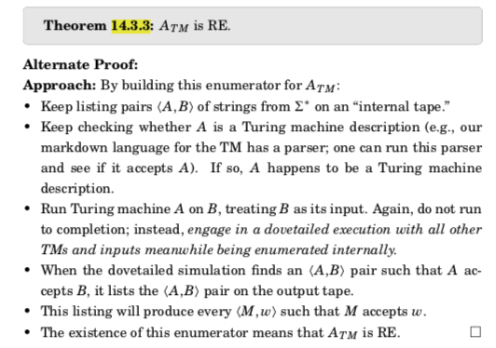
A general proof of a set being RE (14.3.3)

Slide 38
How to argue that A_TM is RE
A_TM = { <M,w> : M is a TM with input alphabet Sigma,
and w is a string in Sigma* and M accepts w }

Slide 39
Now, study Asg-6’s remaining problems
Go through Problem 4, except for Part (e)

Slide 40
How to argue that A_TM is not recursive
Also can be stated as “A_TM is undecidable”
Undecidable means the same as “not recursive”
Decidable means “Recursive”
Decidable problems are desirable also !!

Slide 41
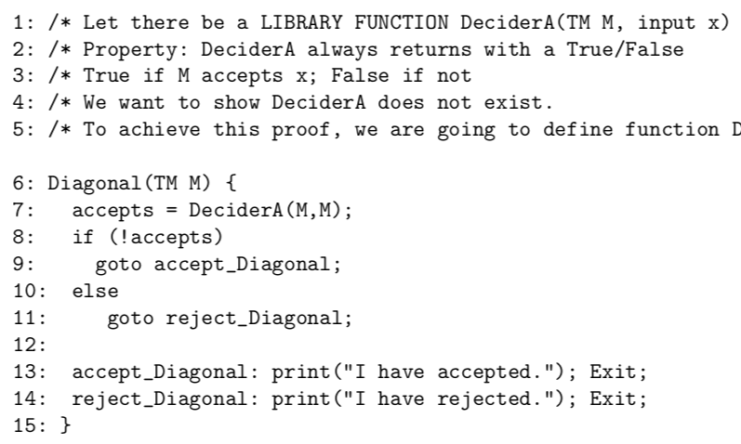
How to argue that A_TM is not recursive

Slide 42
How to argue that H_TM is not recursive
Your Asg-6

