Slide 1

CS 3100, Models of Computation, Spring 20, Lec 22 April 1, 2020
Ganesh Gopalakrishnan
School of Computing
University of Utah
Salt Lake City, UT 84112
URL: https://bit.ly/3100s20Syllabus

Slide 2
Agenda for Wed Apr 1
Review basic definitions
Make sure everyone can do Asg-6
Introduce Diagonalization and the A_TM problem

Slide 3
Full picture of Formal Language Results (Ch 14, Fig 14.2)

Slide 4
The notion of Recursively Enumerable Sets * Regular Sets (Languages) <-> DFA or NFA * Context-Free Sets (Languages) <-> PDA (not just DPDA) * Context-Sensitive Sets (Languages) <-> LBA (open issue: NLBA versus DLBA) * Recursively Enumerable Sets (Languages) <-> DTM or NDTM - Special case: Recursive Sets

Slide 5
We can study procedures/algorithms using DTM

Slide 6
Procedure versus Algorithm
When a program is known to halt on all inputs, it is said to realize an algorithm
“Algorithm” goes with “Recursive Sets”
When a program may loop on some of its inputs (we don’t know whether it would halt on all inputs), we say that the program realizes a procedure
”Procedure” goes with “Recursively Enumerable” sets

Slide 7
Key Features of Algorithms
Algorithms are special cases of procedures (”always halt”)
It is only for algorithms that we meaningfully specify the runtime using the Big-O notation
For a procedure, the Big-O runtime is INFINITY!
REASON ?

Slide 8
Key Features of Algorithms
REASON:
Big-O tracks the worst-case runtime of a program.
If a program can loop, the worst-case is infinity.

Slide 9
Example TM dtm2
Task for you:
Does this TM realize a procedure
or an algorithm?
If an algorithm, what time
complexity (# of steps taken by
the TM as a function of the
input length)

Slide 10
Recursively Enumerable Language L
L is a recursively enumerable (RE) language if there is a TM (call it TM_L) whose language L is
EQUIVALENTLY
L is a recursively enumerable language (RE) if the contents of L can be listed systematically (e.g. in numeric order) by a single TM, say TM_L

Slide 11
Recursive Language L
L is a recursive (Rec) language if there is a TM (call it TM_L) whose language L is, and furthermore given something, say “x” not in L, TM_L can examine “x”, reject it, and halt [DECIDER for L or ALGORITHM TO CHECK MEMBERSHIP IN L)
EQUIVALENTLY
L is a recursive language (Rec) if the contents of L can be listed systematically (e.g. in numeric order) by a single TM, say TM_L, and furthermore there is also a TM, say TM_Lbar, that can enumerate L-bar (complement of L) also

Slide 12
Examples of RE and Recursive Languages
Boring/uninteresting ones
{} is Recursive (hence also RE)
{1} is Recursive
{1,2,3,44} is Recursive
{“hello”, “there”} is Recursive
{1,2,3,4,…. To infinity} is Recursive (set of Nat)
Primes are Recursive
Sets of all Checkmate positions in Chess boards: Recursive
All { <In,Out> … } where In are arrays to be sorted and Out are sorted arrays
Again Recursive
These are boring / uninteresting because we KNOW that there are algorithms to check membership
Really interesting ones: that study OTHER MACHINE’s BEHAVIORS!!

Slide 13
Examples of RE and Recursive Languages
Really interesting ones: that study OTHER MACHINE’s BEHAVIORS!!
{ <G> : G is a CFG } is Recursive
{ <P> : P is a legal Java Program } is Recursive
{ <D> : Language(DFA D) is empty } is Recursive
{ <G> : Language(CFG G) is empty } is Recursive
We will learn how to argue that the above are true

Slide 14
Examples of RE and Recursive Languages
Really interesting ones: that study OTHER MACHINE’s BEHAVIORS!!
{ <G,IN> : G is a CFG and IN is an input and Parser(G) accepts IN } is Recursive
{ <G,IN> : G is a CFG and IN is an input and Parser(G) doesn’t accept IN } is Recursive
{ <M , w> : M is a legal TM and w is its input and M accepts w } : RE not Rec!
{ <M, w> : M is a legal TM and w is an input and M does not accept w } : not even RE !!
{ <P, in> : P is a legal Java Program and in is any input submitted to P and P when run on in halts } is Recursively Enumerable but not Recursive !!
Same behavior as <M,w> because Java programs and TMs are similar !!
We will learn how to argue that the above are true

Slide 15
Example of how to show “Recursive”
Set of DFA descriptions whose language is empty
L = { < D > : D is a DFA with an empty language }
Is this an RE language?
If so which TM shows it?
What enum procedure? Shows it?
Is this a Recursive language?
If so which algo would you propose for membership?
Can you now tell me how to enumerate L-bar, the complement of L ?

Slide 16
Example of how to show “Recursive”
We just studied this in the previous slide:
Set of DFA descriptions whose language is empty
{ < D > : D is a DFA with an empty language }
RE? (if so TM? enum procedure?) Rec? (if so algo? Method to list L-bar?)
Now study the same situations on the following languages
Set of DFA descriptions whose language is non-empty
RE? (if so TM? enum procedure?) Rec? (if so algo? Method to list L-bar?)
Set of PDA descriptions whose language is non-empty
RE? (if so TM? enum procedure?) REC? (If so, algo? Method to list L-bar?)

Slide 17
Two centrally important languages
A_TM = { <M,w> : M is a TM with input alphabet Sigma,
and w is a string in Sigma* and M accepts w }
H_TM = { <M,w> : M is a TM with input alphabet Sigma,
and w is a string in Sigma* and M halts on w }
We will study these closely related languages mainly to understand the various concepts we need to deeply understand

Slide 18
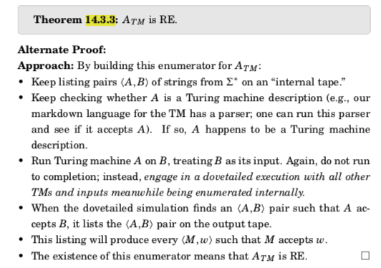
A general proof of a set being RE (14.3.3)

Slide 19
How to argue that A_TM is RE
A_TM = { <M,w> : M is a TM with input alphabet Sigma,
and w is a string in Sigma* and M accepts w }

Slide 20
Now, study Asg-6’s remaining problems
Go through Problem 4

Slide 21
This is where we will study the “Halting Problem”
This is colloquially stated as
We cannot tell if a program will halt on an input
There are many connotations to this question
There is no way one can know whether a given problem is “solvable”
E.g. check the Ambiguity of a given CFG algorithmically!
E.g. Does this given PCP puzzle have a solution (or not)?
This also includes everyday problems
E.g. why is this program not executing this “print” statement?
Can I even show that this “print” will never get executed?

Slide 22
The Halting Problem is FOUNDATIONAL
VIRTUALLY EVERYTHING we study in CS finally leads to the question of “what are the fundamental limits of computing”?
We formulate and prove the undecidability of the Halting Problem using a proof that A_TM is undecidable
The A_TM problem really shows “acceptance is undecidable”
In Asg6, you will prove that H_TM is undecidable (“halting is undecidable”)
Recall: ”Is undecidable” means “is not recursive”

Slide 23
How to argue that A_TM is not recursive
Also can be stated as “A_TM is undecidable”
Undecidable means the same as “not recursive”
Decidable means “Recursive”
Decidable problems are desirable also !!

Slide 24
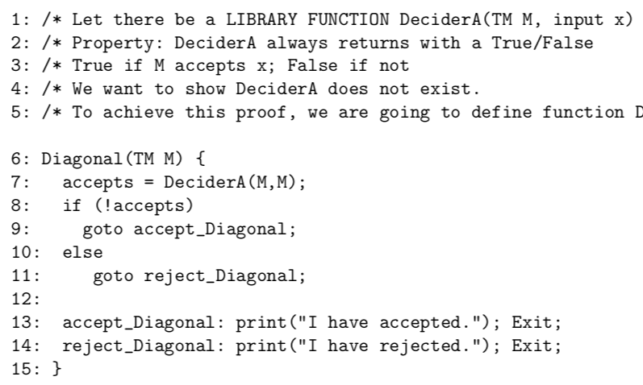
How to argue that A_TM is not recursive

Slide 25
How to argue that H_TM is not recursive
Your Asg-6

Slide 26
Why “diagonalization?” (See Appendix C, book)
Arose from Cantor’s proof method called “diagonalization”
Basics
Nat is an infinite set
Real is an infinite set
There are “more Reals than Nat”
There are Aleph_0 Nats (first infinite cardinality)
“Countably Infinite”
There are Aleph_1 Reals (second infinite cardinality)
“Uncountably Infinite”

Slide 27
Why “diagonalization?” (See Appendix C, book)
Arose from Cantor’s proof method called “diagonalization”
Quick illustration: There are more languages than RE languages
Each RE language goes with a TM
There are an Aleph_0 number of TMs
How to show? Use the Schroder-Bernstein Theorem (SBT)
Also known as “mirror in front of a mirror” Theorem (I call it that, anyhow)
Will present the SBT soon

Slide 28
Why “diagonalization?” (See Appendix C, book)
Arose from Cantor’s proof method called “diagonalization”
Quick illustration: There are more languages than RE languages
‘’ 0 1 00 01 10 11 000 001
L0 0 1 0 0 1 1 0 … → language {0,01,10}
L1 0 0 0 …. -> Language { }
L2 1 1 1 1 -> Language Sigma*
L3 1 0 1 0 1 0 … -> -> Alternate strings in num order
Diag language : Complement the diagonal (red bits) → is a language not in the listing!
L0 L1 L2 L3 … all go with TMs (Aleph_0). The diagonal language can’t be the language of a TM

Slide 29
In our proof of A_TM, we have diagonalization going on…
These are Machines
------------------------→
|
|
| D
|
V
Being run on these machines
Machine “D” is on the diagonal, and D is being run on D
And that causes a contradiction! Hence “like diagonalization”

Slide 30
Why “diagonalization?” Two illustrations
Arose from Cantor’s proof method called “diagonalization”
Cantor showed that no set and its powerset can have a bijective map
No 1-1 and onto map
For finite or infinite set
Example: Nat and Powerset of Nat don’t have a bijective map
Powerset of Nat and Reals have a bijective map
Thus Nat and Real don’t have a Bijective map
Schroder-Bernstein Theorem
If A and B are two sets and there is a 1-1 map from A to B and vice-versa, then there is a bijective map between A and B

Slide 31
Illustration of the SBT
There are are many C programs as Nat
SBT requires two injections (1-1 maps)
One from Nat to C and the other from C to Nat
Nat to C : 0 -> main(){} , 1 -> main(){;}, 2 -> main(){ ;; }, etc
All these trivial C programs are legal; they do compile and run!
C to Nat : just take the ascii string and read it as a Nat ☺

Slide 32
Zoom quizzes

Slide 33
Concepts Covered
1. This is how I feed "equal a's and b's to a TM" - for example the string "aabb" ( Multiple Choice)
Answer 1: By putting it as "aabb" and no other restriction
Answer 2: Put it as "aabb" with the TM head pointing to the left end
Answer 3: Put it as "aa.bb" on the tape (allow blanks in the input)

Slide 34
DTM versus NDTM
Here are facts that apply to a DTM and an NDTM ( Multiple Choice)
Answer 1: An NDTM can move without processing the current character under its tape head
Answer 2: An NDTM and DTM are one and the same syntactically
Answer 3: You would not even know whether the nondeterminism you coded in a TM will ever get exercised!
Answer 4: You can deliberately plan to be coding an NDTM (then choose the guess/check approach)
Answer 5: A DTM or an NDTM can leave the current character and tape-head position the same (it still REWRITES the character and executes the S move)

Slide 35
NDTM versus DTM
It is possible to algorithmically determine whether the nondeterminism one coded in a TM will ever get exercised ( Single Choice)
Answer 1: Yes
Answer 2: No

Slide 36
TM's alphabet, its makeup and size
A TM's tape alphabet is ( Multiple Choice)
Answer 1: Always larger than the "input alphabet" by exactly one
Answer 2: Could be larger than the input alphabet by at least one but any finite amount after that
Answer 3: Could be infinite

Slide 37
Turing machine and when it accepts its input
A TM accepts its input under these conditions (Multiple Choice)
Answer 1: It has fully read its input exactly once (nothing more)
Answer 2: It has read its input more than once (nothing more)
Answer 3: It may read its input any number of times or even partially and be stuck in a state
Answer 4: It may read its input any number of times or even partially and be stuck in a FINAL state
Answer 5: It has to exactly read its input left-to-right and be stuck in a final state

Slide 38
The language of a TM
The language of a TM is ( Multiple Choice)
Answer 1: All the strings that lead it to get stuck in a final state
Answer 2: All the strings that lead it to get stuck in some state
Answer 3: For a given TM, its language can be regular
Answer 4: In general, the language of a TM is recursively enumerable (higher in the Chomsky Hierarchy which we will study)

Slide 39
The Venn Diagram of languages (Fig 14.2)
Answer 1: It shows closure and containment of formal languages
Answer 2: It shows how you can fall outside of a class under some operations
Answer 3: It shows that there are languages not even model-able by a TM (non-RE)

Slide 40
Can this TM (dtm1) loop? on what inputs? ( Multiple Choice)
Answer 1: It can loop
Answer 2: It can't loop
Answer 3: It can loop on THIS input (type in chat)

Slide 41
Can this TM (dtm2) loop? on what inputs? ( Multiple Choice)
Answer 1: It can loop
Answer 2: It can't loop
Answer 3: It can loop on THIS input (type in chat)

Slide 42
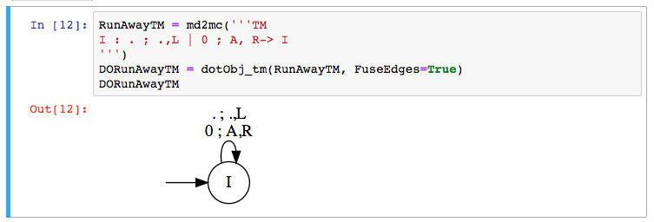
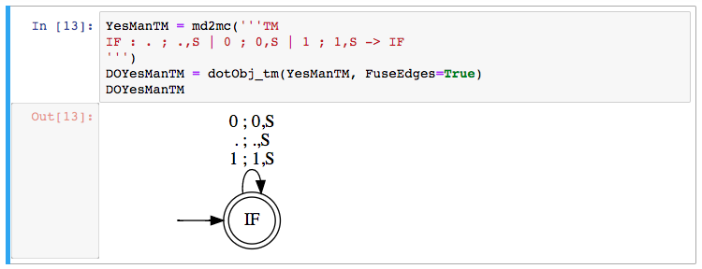
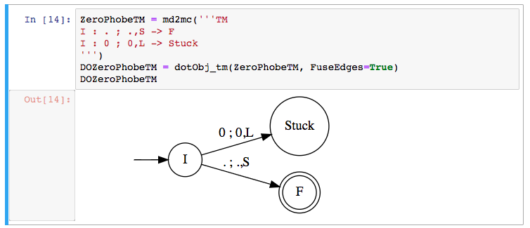
The three TMs
Answer 1: first TM empty
Answer 2: second TM empty
Answer 3: second TM sigma*
Answer 4: second TM unit language
Answer 5: Third TM - no zero

Slide 43
What is an RE Language?
A recursively enumerable language L ( Multiple Choice)
Answer 1: Is associated with one specific TM
Answer 2: Is associated with any one of an infinity of TMs that have language L
Answer 3: The language of a TM that must always halt regardless of whether it is run on a string in L or outside of L
Answer 4: The language of a TM that must halt on inputs in L (may loop on inputs outside of L)

Slide 44
Recursive Language?
A recursive language L is ( Multiple Choice)
Answer 1: The language of a single TM M
Answer 2: The language of any one of an infinity of TMs whose language is L
Answer 3: The language of a TM that halts on inputs inside and outside of L
Answer 4: A language L such that both L and L-bar (complement) are RE
Answer 5: Also known as a Decidable Language

Slide 45
RE Languages
If a language L is finite then ( Multiple Choice)
Answer 1: L is RE
Answer 2: L-bar (complement of L) is RE
Answer 3: L is recursive
Answer 4: It is possible that L is RE but not Recursive
Answer 5: It is possible that L is Recursive but not RE

Slide 46
Wof defining an RE language
. An RE language L can be defined in many ways ( Multiple Choice). Also many associated facts
Answer 1: There is a TM that enumerates L
Answer 2: There is a TM that recognizes L
Answer 3: There is a TM that enumerates L; then one can realize a TM that recognizes L also
Answer 4: There is a TM that recognizes L; then one can realize a TM that enumerates L also.

