Slide 1

CS 3100, Models of Computation, Spring 20, Lec 23 April 6, 2020
Ganesh Gopalakrishnan
School of Computing
University of Utah
Salt Lake City, UT 84112
URL: https://bit.ly/3100s20Syllabus

Slide 2
Agenda for Wed Apr 6
Review of Functions
Review of basic concepts such as Domain, CoDomain, Range, 1-1, Onto
Cantor-Schroder-Bernstein Theorem (CSB Theorem)
Counting sets using the SBT
Show that there are as many TMs as Nat
Showing that there exist non-RE languages (Appendix C)
Show that a Correspondence between TMs and Languages FAILS
Hence non-RE sets exist
Mapping Reductions: Two Approaches
Solver for New Problem helping solve an Already Impossible Problem
As a transformation from an Old Impossible problem to a New Problem

Slide 3
Review of Functions

Slide 4
Review of Functions
Functions map Domains to their CoDomains
Where the mapped points fall is called the Range of a function
Functions can be 1-1 (injections) or Many-to-one
Functions can be Onto (covers the range) or Into (does not)
Which of these are 1-1 and which are many-to-one ?
Rot13: {A,B,C, …, Z} ➔ {A,B,C,…,Z} where rot13 maps each character to the 13th next character; for instance
A <-> N, B <-> O, …., L <-> Y, M <-> Z
Mod3 : Nat ➔ Nat where
0 -> 0, 1 -> 1, 2 -> 2, 3 -> 0, 4 -> 1, …

Slide 5
Review of Functions
Is Rot13 Onto, where Rot13: {A,B,C, …, Z} ➔ {A,B,C,…,Z} ?
Mod3 : Nat -> Nat Onto?
Suppose we define Mod3 : Nat ➔ {0,1,2} then is Mod3 Onto?
Functions that are 1-1 and Onto are important
They are called Bijections
Establishes a 1-1 Correspondence between the sets
E.g. a “barter”

Slide 6
Fun Exercise using Functions: the CSB Theorem
We can “count” infinite sets via a Correspondence
I.e. we place the sets into a 1-1, Onto arrangement (Correspondence)
Example : Nat ➔ Int
Recall Nat = {0,1,2,3…}
And Int = {0, 1, -1, 2, -2, 3, -3, …}
Suppose we specify this function: h : Nat ➔ Int
0 -> 0, 1 -> 1, 2 -> -1, 3 -> 2, 4 -> -2, 5 -> 3, 6 -> -3
Odd n -> (n+1)/2 Even n -> - n/2
This is a Correspondence between Nat and Int
There are as many Nat as Int -- even though Nat is a proper subset of Int !!

Slide 7
Fun Exercise using Functions: the CSB Theorem
This is a 1-1 Correspondence between Nat and Int
There are as many Nat as Int -- even though Nat is a proper subset of Int !!
The cardinality of Nat is Aleph_0
Hence the cardinality of Int is also Aleph_0
Because there is a 1-1 correspondence between Nat and Int

Slide 8
Fun Exercise using Functions: the CSB Theorem
Finding a 1-1 correspondence between Nat and Int was easy
Odd n -> (n+1)/2 Even n -> - n/2
But often it is not that easy
E.g. how do we find a 1-1 correspondence between
Nat and C programs ?
Nat and TMs ?
The Cantor-Schroder-Bernstein Theorem helps find a 1-1 correspondence by merely asking you to find 1-1 maps going both ways!

Slide 9
The Cantor-Schroder-Bernstein Theorem

Slide 10
The Cantor-Schroder-Bernstein Theorem
For sets A and B
If there is a 1-1 map f : A -> B
And there is a 1-1 map g : B -> A
Then there is a 1-1 Correspondence h : A -> B
i.e. we will now have a function “h” that is a 1-1 and Onto map from A and B
And by virtue of that, the inverse of h must exist also !!

Slide 11
Illustration of the CSB Theorem
Show that there are Aleph_0 C programs (same cardinality as Nat)
SBT requires two 1-1 maps
One from Nat to C and the other from C to Nat
Nat to C : 0 -> main(){} , 1 -> main(){;}, 2 -> main(){ ;; }, etc
All these trivial C programs are legal; they do compile and run!
We don’t need to hit all C programs! Just finding ANY 1-1 map is sufficient
C to Nat : just take the ASCII string and read it as a Nat ☺
Hence proved! We just proved that there are as many C programs as Nat
The same argument can be applied to TMs
Take 0 -> First-Trivial-TM , 1 -> First-Trivial-TM-with-One-NoOp-move
Take 2 -> First-Trivial-TM-with-Two-NoOp-moves, etc.

Slide 12
There exist non-RE Languages
There are as many RE languages as Turing Machines
Because each TM goes with an RE language
Thus there are Aleph_0 RE languages
We will now show that there are Aleph_1 languages
The cardinality of Languages is Aleph_1
Aleph_1 is the cardinality of Reals
Thus there are more languages than RE languages
Or some language is non-RE !!

Slide 13
Now to show there are ”more languages”
Suppose there is a 1-1 Correspondence between TMs and languages
‘’ 0 1 00 01 10 11 000 001…. (all possible strings)
TM0 0 1 0 0 1 1 0 … → language {0,01,10}
TM1 0 0 0 …. -> Language { }
TM2 1 1 1 1 -> Language Sigma*
TM3 1 0 1 0 1 0 … -> -> Alternate strings in num order
The above listing shows all candidate strings on the top row
And uses a “bit vector” to pull out languages
Here we portray as if TM0’s language is {0, 01, 10
TM1’s language is portrayed as { }
TM2’s language is portrayed as Sigma*
TM3’s language is portrayed as {‘’, 1, 01, …. (alternate strings of the numeric order) }

Slide 14
Now to show there are ”more languages”
Then in this listing, consider the COMPLEMENT of the diagonal
‘’ 0 1 00 01 10 11 000 001…. (all possible strings)
TM0 0 1 0 0 1 1 0 … → language {0,01,10}
TM1 0 0 0 …. -> Language { }
TM2 1 1 1 1 -> Language Sigma*
TM3 1 0 1 0 1 0 … -> -> Alternate strings in num order
Then the DIAGONAL LANGUAGE – the language obtained by complementing the diagonal CANNOT be in the listing because it differs from each listed language at least at one place
But since there are Aleph_0 TMs, there must be Aleph_1 languages
( there is no cardinality between Aleph_0 and Aleph_1 )
And in fact we can read out each “bit vector” for a language as a Real Number also !!

Slide 15
Mapping Reductions

Slide 16
Basics of Mapping Reductions
Mapping Reductions help “bridge” from an OLD and HARD problem to a potentially HARDER problem
This way if the HARDER problem can be solved, then the OLD and HARD problem can be solved
This is how we show that TMs ”can’t solve certain problems”
This is how we show that some problems are NP-complete

Slide 17
Mapping Reductions: Definition

Slide 18
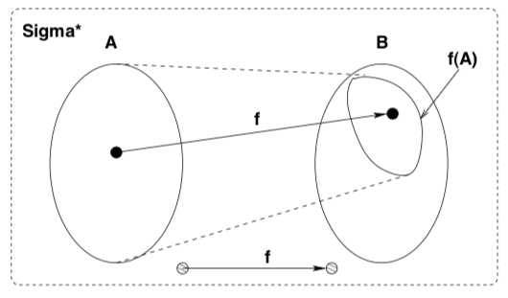
Mapping Reduction : Definition w.r.t. Language Mapping
A language A is mapping-reduced to a language B via function f
Written A <=m B
If the following holds
We find a Turing-computable function “Translate” (“f” below) such that
For any x in Sigma*
x in A iff Translate(x) in B

Slide 19
Mapping Reduction : Definition w.r.t. Problem-Solving
Problem A is mapping-reduced to Problem B via function f
Written A <=m B
If the following holds
We find a Turing-computable function “Translate” (“f” below) such that
For any x in Sigma*
We produce f(x) also falling into Sigma*
But we focus on what x does to points in A
Those points must fall INTO B
Points x outside of A must fall OUTSIDE B

Slide 20
Mapping Reduction : Definition w.r.t. Problems
Problem A is mapping-reduced to Problem B via function f
The ENTIRETY of A is mapped into a subspace of B via f
A are “all the Old and Hard” problem instances
B are the “New and Potentially Harder” problem instances
Thus, if there is an algorithm for B
We must have an algorithm for the
f(A) region which is contained in B
But we now have an algorithm for A also!
Given an instance x in A, map it via “f” into B
Then solve the mapped problem via B’s algorithm!
Let us illustrate these specifically on an example

Slide 21
Mapping Reductions: Examples

Slide 22
Regular_TM is not decidable (has no algorithm)
Regular_TM is a language
Regular_TM = { <M> : The language of M is regular }
Suppose Regular_TM is decidable
Then we can build a decider for A_TM
But we have already shown that A_TM does not have an algorithm
Thus, we cannot have an algorithm for Regular_TM (Reg_TM)
We will show A_TM <=m Reg_TM by presenting the “f” function

Slide 23
The Mapping Reduction Picture now
Let “A” be A_TM
Let “B” be Reg_TM
We want a function “f”
f must be a computable function
Thus, f is a program-function that
translates an <M,w> within A_TM into an M’ that falls into Reg_TM
We will define such a translator called “Translate” (next slide)

Slide 24
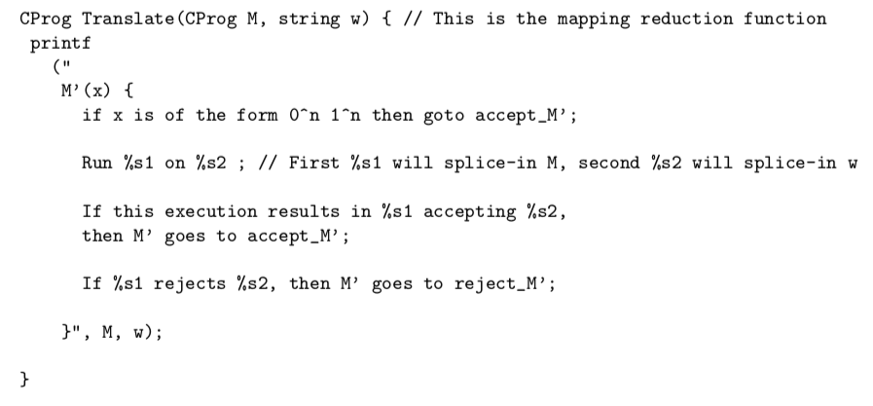
Proof that Regular_TM is not recursive: define function “Translate” as follows

Slide 25
What does Translate yield?
Translate yields the description of a TM M’
That is what the “print” produces
Now suppose FullDeciderRegTM exists (algorithm for Reg_TM)
How can we build FullDeciderATM ? (algorithm for A_TM)

Slide 26
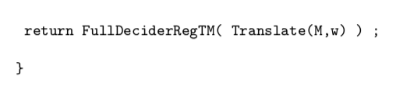
FullDeciderATM is built as follows
What are the strings that fall into the language of M’ ??
First they are strings “x” of the form 0^n and 1^n
Then there are additional strings (all other strings in fact), provided M accepts w
What is the language of M’ if M accepts w?
What is the language of M’ if M does not accept w?
When is it that the language of M’ is regualr ??

Slide 27
Does Reg_TM have an algorithm?
There are only two possibilities:
Either M’ has a regular language or not
We see that M’ includes strings of the form 0^n 1^n always
But if M accepts w, then M’ also includes strings that are NOT of the form 0^n 1^n
Thus if M accepts w, the language of M’ is regular
If M does not accept w, the language of M’ is not regular
Thus we have shown A_TM <=m Reg_TM
Asg-6 asks you to modify this proof for CFL_TM

Slide 28
Asg-6 also asks you to show Amb has no algo.
Let “A” be PCP
Let “B” be AMB
Function f is given to you
f takes a collection of tiles (PCP inst.)
and produces a CFG
Such that the CFG will be unambiguous IF and ONLY IF the PCP system has no solution.
Thus if we bring along an algorithm for Amb, we will have an algorithm for PCP
Thus we have shown PCP <=m Amb

Slide 29
Ways of pictorically presenting <=m

Slide 30
Boxes inside boxes view of A_TM to Reg_TM
If you have a Reg_TM decider, you can build up an A_TM decider which is “known impossible”
Accept
i.e.
M accepts w
M
M
Translate
Function
M’
Reg_TM
decider
Reject
i.e.
M does not
accept w
w
w

