Slide 1

CS 3100, Models of Computation, Fall 2019 Lec 25, Chapter 14 and beginning Chapter 16 Plus Asg-6 Discussion bit.ly/3100s20Slides
Ganesh Gopalakrishnan
School of Computing
University of Utah
Salt Lake City, UT 84112

Slide 2
Definitions of RE and Recursive
An RE language L is the language of a TM M
i.e. for any member x of L, M is guaranteed to accept x (take x, halt in “accept”)
For x not in L, M may loop
A recursive language is the language of a TM that halts on all inputs
Take in x, halt in “accept/reject” ; never loop
If a language L and its complement are RE, then L is recursive
This is because we have M1 for L and M2 for L-bar
One of them has to halt on any x. Then we have a decider (yes/no without looping)

Slide 3
Alternate definitions of RE
An RE language L is one that a TM M can enumerate in such a way that if x is in L, then M will emit “x” on an output tape in a finite amount of time
Multi-tape TMs are possible, and are equivalent to a single-tape TM… we won’t prove this but we depend on this standard result
It (M) will never postpone the generation of some particular x infinitely

Slide 4
RE Language: Example, How to argue
L_G1neqG2 = { <G1,G2> : G1 and G2 are strings that represent context-free grammars, and L(G1) != L(G2)
Q: How to formally argue that L_G1neqG2 is RE?
A1: Provide the enumeration argument
We can build a TM that enumerates the contents of L_G1neqG2 without any external help!
This TM only has an OUTPUT TAPE
It keeps enumerating the contents of this language such that ANY member of this language WILL appear on the output tape IN A FINITE AMOUNT of time
I.e. this TM will not “keep postponing some particular output”
I.e. This TM enumerates similar to a numeric order – not similar to a lexicographic order

Slide 5
(Continued from the previous slide…)
L_G1neG2 = { <G1,G2> : G1 and G2 are strings that represent context-free grammars, and L(G1) != L(G2)
Q: How to formally argue that L_G1neG2 is RE?
A1: Provide the enumeration argument
We can build a TM Menum that enumerates the contents of L_G1neqG2 without any external help!
Design of the enumerator TM for L_G1neqG2
In its internal tape, this TM keeps generating pairs of strings from Sigma* according to the numeric order – generate all (str1,str2) of total length < N, then move on to generate all (str1,str2) of total length < N+1, and so on
Also keep generating strings from {0,1}* on a separate tape in numeric order: w1, w2, …
Whenever (str1,str2) represents a pair of CFGs, start parsing each string wi generated so far using str1 and str2. Now call str1 “g1” and str2 “g2” (because they are grammars)
If and when we find that g1 parses wi but g2 does not parse wi, then output (g1,g2) on the output tape

Slide 6
RE Language: Example, How to argue
L_G1neqG2 = { <G1,G2> : G1 and G2 are strings that represent context-free grammars, and L(G1) != L(G2)
Q: How to formally argue that L_G1neqG2 is RE?
A2: Provide the “there exists a TM argument”

Slide 7
RE Language: Example, How to argue
L_G1neqG2 = { <G1,G2> : G1 and G2 are strings that represent context-free grammars, and L(G1) != L(G2)
Q: How to formally argue that L_G1neqG2 is RE?
A2: Provide the “there exists a TM argument”
The TM for L_G1neqG2 , call it “Mgneq” , is built as follows
It takes in “x” on the input tape
It starts a copy of Menum inside it
When it finds that Menum emits ”x”, then Mgneq jumps to its accept state
But if “x” is not a member of L_G1neqG2, then Mgneq may never halt.

Slide 8
Important language: acceptance TM (A_TM)
Language A_TM = { <M,w> : M is a TM and w is a word in
the tape alphabet of M, and M accepts w }
The language A_TM is what we will use to prove that the acceptance problem of TMs is “unsolvable” – non-recursive.
But first, two proofs for A_TM being RE
Enumeration argument
Language acceptance argument
Then the proof we have been waiting for: that A_TM is not recursive!

Slide 9
Proof of A_TM being RE : Enumerator view
…fill this in class…
…enumerate M’s and w’s… and run M and w for increasing quanta of time (fuel increased).
…whenever one of the M’s accepts one of the w’s, then output <M,w>

Slide 10
Proof of A_TM being RE : Semi-decider view
…fill this in class…
…Design Matm as follows…
Matm takes <M,w> on its tape
It checks that M is a proper TM encoding
If so, it runs M on w
When that run accepts, Matm accepts

Slide 11
Proof of A_TM being RE : Semi-decider view
Pseudo-code for Matm
Matm(TM M, string w) {
check_is_a_TM(M); // if not, go to Reject_Matm
status = run(M, w); // This may never come back!
//Phew, came back!
if (stopped_accept(status)) goto Accept_Matm;
else goto Reject_Matm;
}

Slide 12
Proof that A_TM is NOT recursive.
Suppose not. That is A_TM is indeed recursive.
Then there exists a decider TM
Its “C prototype” will look like
Bool DeciderA(TM M, input x);
DeciderA exists in some library (nobody will show it to us, but the library designer claims it exists)
Then we can do this to derive a contradiction

Slide 13
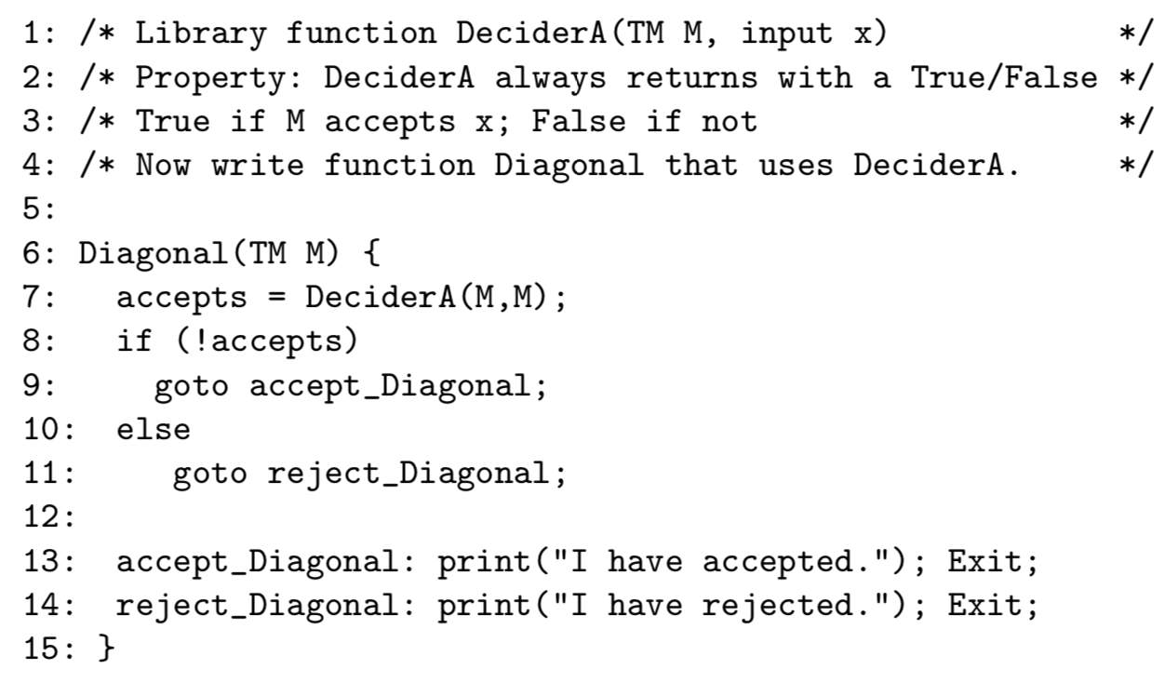
Proof that A_TM is NOT recursive.

Slide 14
Now does Diagonal(Diagonal) accept or reject?
Diagonal(Diagonal) accepts → DeciderA(Diagonal,Diagonal) does not accept → … ? (fill)
Diagonal(Diagonal) rejects → DeciderA(Diagonal,Diagonal) accepts → … ? (fill)

Slide 15
Now look at Asg-6
It asks you to write a similar proof for “halt”
Then it asks you to write a proof for CFL_TM
We will now study the “regular TM” part covered in Asg-6

Slide 16
Regular_TM is not decidable
Regular_TM is a language
Regular_TM = { <M> : The language of M is regular }
Suppose Regular_TM is decidable
Then we can build a decider for A_TM
What does this mean, in the light of the proof we just now did?
Here is how we will build a decider for A_TM

Slide 17
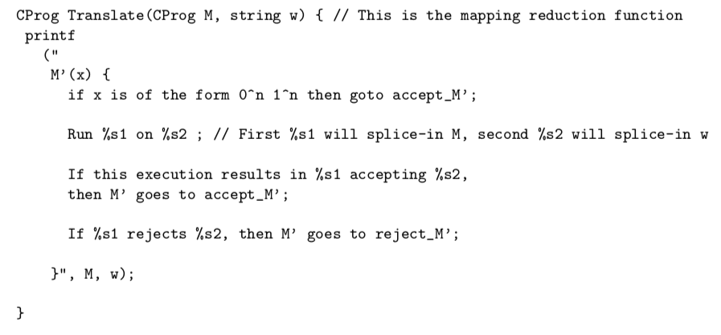
Proof that Regular_TM is not recursive: define function “Translate” as follows

Slide 18
What does Translate yield?
Translate yields the description of a TM M’
That is what the “print” produces
Now suppose FullDeciderRegTM exists
How can we build FullDeciderATM ?

Slide 19
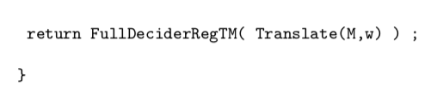
FullDeciderATM is built as follows
Draw this as a “boxes within boxes” drawing below
Then ask “When is the language of M’ regular ?? “
What are the strings that fall into the language of M’ ??
First they are strings “x” of the form 0^n and 1^n
Then there are additional strings (all other strings in fact), provided M accepts w
What is the language of M’ if M accepts w?
What is the language of M’ if M does not accept w?
When is it that the language of M’ is regualr ??

Slide 20
Asg-6 asks you to prove that CFL_TM is not regular
Submit a boxes within boxes drawing
Define “translate” and other things
Review this and ask questions by Thu

Slide 21
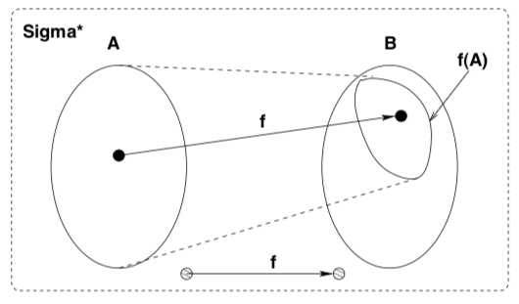
This process of building “Translate” is called Mapping Reduction
A language A is mapping-reduced to a language B
Written A <=m B
If the following holds
We find a Turing-computable function “Translate” (“f” below) such that
For any x in Sigma*
x in A iff Translate(x) in B

Slide 22
Theory of NP-completeness uses “p” not “m” below!!
A language A is P-time mapping-reduced to a language B
Written A <=p B
If the following holds
We find a Turing-computable P-time function “Translate” (“f” below) such that
For any x in Sigma*
x in A iff Translate(x) in B

Slide 23
To learn the theory of NP-completeness, we need these
Good knowledge of Binary Decision Diagrams
First_Jove_Tutorial/Ch16.ipynb
Good knowledge of SAT-checking
CryptoMiniSat
Page 265 of our book
Click on a link to get CryptoMiniSat in your browser
Rest of this class: illustrations of these concepts

Slide 24
Basics of 3-CNF
Boolean formulae are built out of /\ (and), \/ (or) and ! (not)
Sometimes we use . For and, + for or, and ~ for not
Examples
(a + b ) . (!a + c)
(a \/ b) /\ (~a \/ c)

Slide 25
Basics of 3-CNF
a , !a , ~a are all literals
Literals are the true or complement form of Boolean variables
A clause is a disjunction (“or”) of literals
(a + !b + c) is a clause
“a” itself is a clause
True and False are clauses or products of clauses
True → (a + !a) for a fresh variable a
False → (a) . (!a) for a fresh variable a
Sometimes we write 0 for False and 1 for True

Slide 26
Basics of 3-CNF
A 3-cnf clause is a clause which has exactly 3 literals
A 3-cnf formula is a conjunction of 3-cnf clauses
Theorem: The satisfiability of 3-cnf formulae is NP-complete
Examples follow

Slide 27
How the theory of NPC will be presented
A quick proof overview of why 3-cnf SAT is NP-complete
Then for new problems, we will need to show mapping reductions
The only problem we will study is that of Cliques in graphs
The K-clique problem is NP-complete

Slide 28
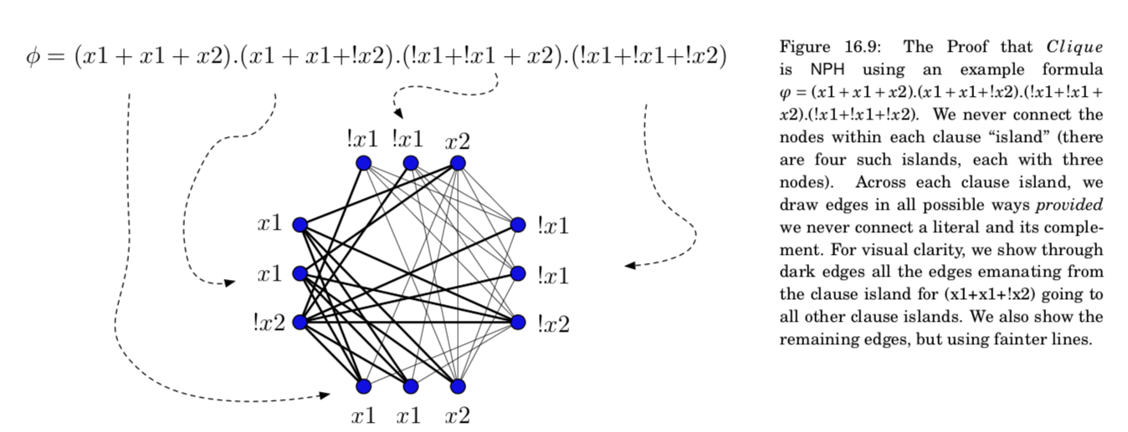
How the mapping reduction for K-clique will go (Ch 16)

