Slide 1

CS 3100, Models of Computation, Spring 20, L24
Ganesh Gopalakrishnan
School of Computing
University of Utah
Salt Lake City, UT 84112
URL: bit.ly/3100s20Syllabus

Slide 2
Computability Review to do Asg-7
You can do Questions 1 and 2 rightaway!
In this lecture, we will introduce the idea of mapping reductions through short examples
After seeing enough of these, you will know what is being attempted (once you get this, you can begin constructing your own MRs)
In the following, TMs will be presented in familiar C-style syntax, using function names M, M’, M1, etc
All TMs will be presented as if they take a single input argument “x” . Sometimes, we will denote inputs by “w”. You’ll see how the usage goes. Most often, “w” is the input provided for the mapping-reduction process.
We will show their accept/reject states via “labels” of the form Accept_M and Reject_M. Sometimes, these label(s) may be omitted – but assume they exist always.
We shall introduce functions Translate, Translate’, Translate1, etc. that produce TMs in terms of other TMs
Note: I’ve placed “final batteries”. They help review for MT-3 also.

Slide 3
What is the language of this TM?
M ( x ) {
Goto Accept_M;
Accept_M: // stuck
}

Slide 4
What is the language of this TM?
M ( x ) {
Goto Accept_M;
Accept_M: // stuck
}
Ans: Sigma*

Slide 5
What is the language of this TM?
M ( x ) {
Goto Reject_M;
Reject_M: // stuck
}

Slide 6
What is the language of this TM?
M ( x ) {
Goto Reject_M;
Reject_M: // stuck
}
Ans: { }

Slide 7
What is the language of this TM?
M ( x ) {
Loop; // infinite loops are denoted by the “Loop” command
Accept_M: // stuck
}

Slide 8
What is the language of this TM?
M ( x ) {
Loop; // infinite loops are denoted by the “Loop” command
Accept_M: // stuck
}
Ans: { }

Slide 9
What is the language of this TM?
M ( x ) {
If x = 101 goto Accept_M;
Loop;
Accept_M: // stuck
}

Slide 10
What is the language of this TM?
M ( x ) {
If x = 101 goto Accept_M;
Loop;
Accept_M: // stuck
}
Ans: { 101 }

Slide 11
What is the language of this TM?
M ( x ) {
If x = 101 goto Accept_M;
Accept_M: // stuck
Else
Accept1_M: // stuck
}

Slide 12
What is the language of this TM?
M ( x ) {
If x = 101 goto Accept_M;
Accept_M: // stuck
Else
Accept1_M: // stuck
}
Ans: {101} Union { all others} i.e. Sigma*

Slide 13
What is the language of TM M’ ?
TM M = …a given TM … // think of this as a global constant
Input w = …a given w… // think of this as a global constant
// Now define a new machine M’ in terms of M and w
M’ ( x ) {
If x = “101” goto Accept_M;
Run M on w;
// Phew, got here!
Accept_M’: // stuck
}
Ans:
M’ has language {101} if M does not halt on w
M’ has language Sigma* if M halts on w

Slide 14
What is the language of TM M’ ?
TM M = …a given TM … // think of this as a global constant
Input w = …a given w… // think of this as a global constant
// Now define a new machine M’ in terms of M and w
M’ ( x ) {
If x = “101” goto Accept_M;
Run M on w;
// Phew, got here!
Accept_M’: // stuck
}
Ans:
M’ has language {101} if M does not halt on w
M’ has language Sigma* if M halts on w

Slide 15
What is the language of TM M’ ?
TM M = …a given TM … // think of this as a global constant
Input w = …a given w… // think of this as a global constant
// Now define a new machine M’ in terms of M and w
M’ ( x ) {
Run M on w;
// Phew, got here!
If x = “101” goto Reject_M’;
Accept_M’: // stuck
Reject_M’: // stuck
}
Ans:
M’ has language { } if M does not halt on w
M’ has language Sigma* - {101} otherwise

Slide 16
What is the language of TM M’ ?
TM M = …a given TM … // think of this as a global constant
Input w = …a given w… // think of this as a global constant
// Now define a new machine M’ in terms of M and w
M’ ( x ) {
Run M on w;
// Phew, got here!
If x = “101” goto Reject_M’;
Accept_M’: // stuck
Reject_M’: // stuck
}
Ans:
M’ has language { } if M does not halt on w
M’ has language Sigma* - {101} otherwise

Slide 17
What is the language of the TM M’ produced ?
Translate(M, w) {
Print(
“M’ ( x ) {
Run %s1 on %s2;
// Phew, got here!
If x = “101” goto Reject_M’;
Accept_M’: // stuck
Reject_M’: // stuck
}”, M, w);
}
Ans:
M’ has language { } if M does not halt on w
M’ has language Sigma* - {101} otherwise

Slide 18
What is the language of the TM M’ produced ?
Translate(M, w) {
Print(
“M’ ( x ) {
Run %s1 on %s2;
// Phew, got here!
If x = “101” goto Reject_M’;
Accept_M’: // stuck
Reject_M’: // stuck
}”, M, w);
}
Ans:
M’ has language { } if M does not halt on w
M’ has language Sigma* - {101} otherwise

Slide 19
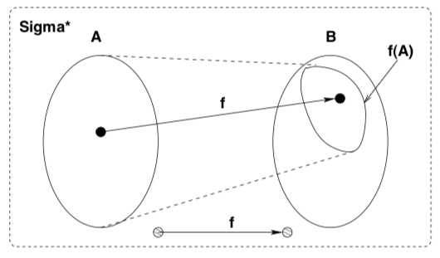
Why even introduce the “Translate” function?
Function “Translate” is our Mapping Reduction function desired!
The MR is from language A to language B
It must ensure that x in A if and only if f(x) in B; that is
x in A => f(x) in B
x not in A => f(x) not in B

Slide 20
Why do we build such a Translate function?
We take “A” to be an ”already shown-impossible” problem
”Shown-impossible” here means “shown to be undecidable”
We are given a new problem “B”
We want to (somehow) show that B is also impossible
I.e. show that B is also undecidable
We try our best to build Translate such that
x in A => Translate(x) in B
x not in A => Translate(x) not in B
If we succeed, then we have this going on:
Suppose someone claims to have a decider for B
We can then “invite” someone to give an “x” that falls into A
Then send Translate(x) to B’s decider, and take its decision as a decision for x in A
This violates the premis that A has a decider
Hence a decider for B cannot exist!

Slide 21
What all can the set “B” be?
In general, set “B” is ANY INTERESTING QUESTION WE CAN ASK OF A TM !!
The real result (known as Rice’s Theorem) says “no nontrivial property of a TM M’s language can be decided based on the syntactic description of M”
For us, candidate “B” sets are
Given a TM M, does it have 101 in its language?
Given a TM M, does it have a regular language?
Let’s build the Translate function for these two examples!

Slide 22
Specific example of “Translate” (or the ‘f’ fn.)
Function “Translate” is our Mapping Reduction function desired!
The MR is from language A_TM to language Reg_TM
It must ensure that x in A if and only if f(x) in B; that is
x in A => f(x) in B
x not in A => f(x) not in B

Slide 23
Translate function for “TM has 101 in its lang.”
Translate(M, w) {
Print(
);
}
Ans:
M’ has language { } if M does not halt on w
M’ has language Sigma* - {101} otherwise

Slide 24
Translate function for “TM has 101 in its lang.”
Translate(M, w) {
Print(
“M’ ( x ) {
Run %s1 on %s2;
If %s1 does not accept %s2, then loop;
// Got here because %s1 accepts %s2
Accept_M’: // stuck
}”, M, w);
}
If M does not accept w, M’s language does not have 101 -- in fact it is empty
If M does accept w, then M’s language does have 101 – in fact, it has EVERYTHING
Thus, testing M’ having 101 or not leaks information on whether M accepts w. This provides a decider for A_TM

Slide 25
Translate function for “TM has 101 in its lang.”
Translate(M, w) {
Print(
“M’ ( x ) {
Run %s1 on %s2;
If %s1 does not accept %s2, then loop;
// Got here because %s1 accepts %s2
Accept_M’: // stuck
}”, M, w);
}
If M does not accept w, M’s language does not have 101 -- in fact it is empty
If M does accept w, then M’s language does have 101 – in fact, it has EVERYTHING
Thus, testing M’ having 101 or not leaks information on whether M accepts w. This provides a decider for A_TM

Slide 26
Translate function for “TM has a regular lang.”
Translate(M, w) {
Print(
);
}
Strategy:
Force M’ to have a regular language exactly when M accepts (or does not accept) w.

Slide 27
Translate function for “TM has a regular lang.”
Translate(M, w) {
Print(“
M’(x) {
Run %s1 on %s2 ; // this is a different construction than taught last class! Many constructions work !!
// Phew reached here; so %s1 did not loop on %s2
If %s1 accepted %s2 then if x is of the form 0^n 1^n then goto Accept_M1’ ;
goto Reject_M1’;
}”, M, w
);
}
If M accepts w, M’ has a CFL i.e. { }
If M does not accept w, M’ has a regular language i.e. { }

Slide 28
NP-Completeness

Slide 29
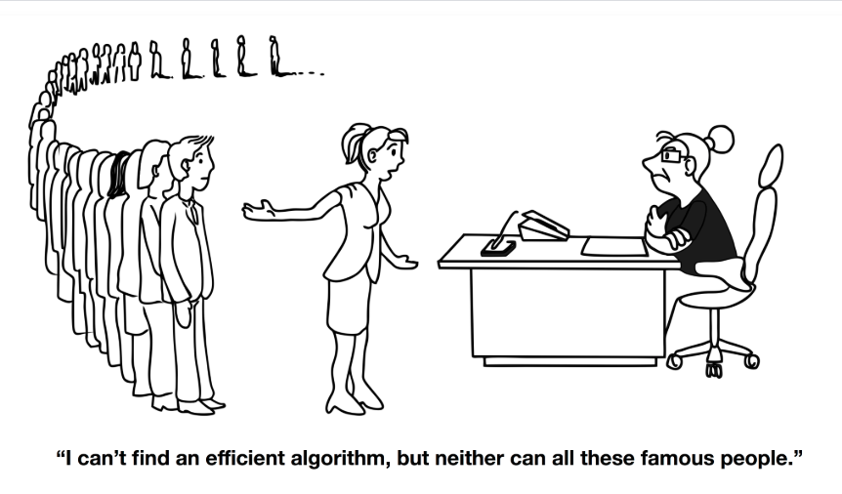
Why NPC matters (from book by Garey/Johnson)

Slide 30
Agenda: Chapters 16 and 17
Before Chapter 16, we studied only Computability
Can a problem be solved algorithmically at all?
We never asked “how long does such an algorithm take?”
Complexity – Theory of NP-Completeness – will now be studied
Motivation: Can we solve it in Polynomial-time?
If the answer is not known, can we “link up all those important problems in some way such that solving any one of them using a P-time algorithm allows you to solve ALL of them using a P-time algorithm”

Slide 31
Chapters 16 and 17: Motivations for NPC
Many problems of importance appear to have only exponential algorithms
There is no proof (yet) that they do not have polynomial algorithms
But in many cases they have Nondeterministic Polynomial-time algorithms (an NDTM can consume a poly amount of “fuel” and stop with a solution)
Thus scientists grouped together problems into a class called NPC -- “NP-Complete”
NPC are the hardest of NP problems
Any NP problem <=p an NPC problem
Thus by solving a single NPC problem using a P-time algorithm allows them to solve ALL of NP problems using a P-time algorithm

Slide 32
Agenda: Chapters 16 and 17
The first NP-Complete Problem studied was 3-SAT
3-CNF Boolean Satisfiability
Thus we will review Boolean Logic first (and then study NPC)

Slide 33
Review of Boolean Logic

Slide 34
Boolean variable
Boolean variables are syntactically denoted by variable names such as
x, y, z, etc.

Slide 35
Boolean literals
Literals are syntactically denoted by
x, !x, y, !z, etc.
Literals are variables or their negations

Slide 36
A clause
Clauses are syntactically written as
(x + !y + z)
They are disjunctions of literals
A 3-CNF clause is one that has 3 literals
3-CNF clauses are important in our discourse

Slide 37
A CNF formula
CNF formulae are syntactically conjunctions of clauses, written
(x + !y + z) . (!x + y + p) . (q + r + s) (the “dot” could be replaced by & or /\ )
or
(x + !y + z) (!x + y + p) (q + r + s) (the conjunctions could also be left out )
They are in Conjunctive Normal Form (CNF)
That means, a product (“and”) of clauses

Slide 38
A product term, and a DNF formula
In contrast, a DNF formula is a sum of products
A DNF formula is of the form
a . !b . c + !a . d . !e
DNF formulae won’t have much of a role in the study of NPC, as they do not encode the hardness of NPC problems
( Of course one can convert DNF formulae to CNF
But that can blow-up the formula to an exponential size )

Slide 39
Satisfiability
CNF formulae are satisfied by satisfying every clause
(x + !y + z) . (!x + y + p) . (q + r + s)

Slide 40
Satisfiability
DNF formulae are satisfied by satisfying any product term
x . !y . z + !x . x . W + p . !x . z

Slide 41

Overall, 3CNF SAT is THE central problem
Have clauses, each containing 3 literals in a CNF formula
(a + b + !b) . (!a + a + d) . (a + e + !f)
Some 3CNF formulae are UNSAT (unsatisfiable). This one is:
(a + b + c) . (a + b + !c) . (a + !b + c) . (a + !b + !c) .
(!a + b + c) . (!a + b + !c) . (!a + !b + c) . (!a + !b + !c)
Such formulae behave like a whack-a-mole
Whichever assignment you try, some clauses
acts as a “blocking clause” ( a “spoiler” )

Slide 42
3SAT or 3CNF-SAT as a language
3SAT = { fmla : fmla is a 3CNF formula that is satisfiable }

Slide 43
Where we are going with this: We will present a mapping reduction from 3-SAT to Clique This helps us review the basics … and drive home NP-Completeness ideas

Slide 44
The language K-Clique
Given an undirected graph, is there a set of K nodes such that they are all pairwise connected?
They form a K-Clique?
K-Clique – { < G > : G is a graph that has a K-Clique in it }

Slide 45
We are about to show 3-SAT <=p K-Clique
<=p is a mapping reduction but with a polynomial bound on runtime
That is, we can translate a 3-SAT instance to a K-Clique instance in polynomial time
This means that if K-Clique has a Polynomial Algorithm, then
3-SAT will also have a Polynomial Algorithm

Slide 46
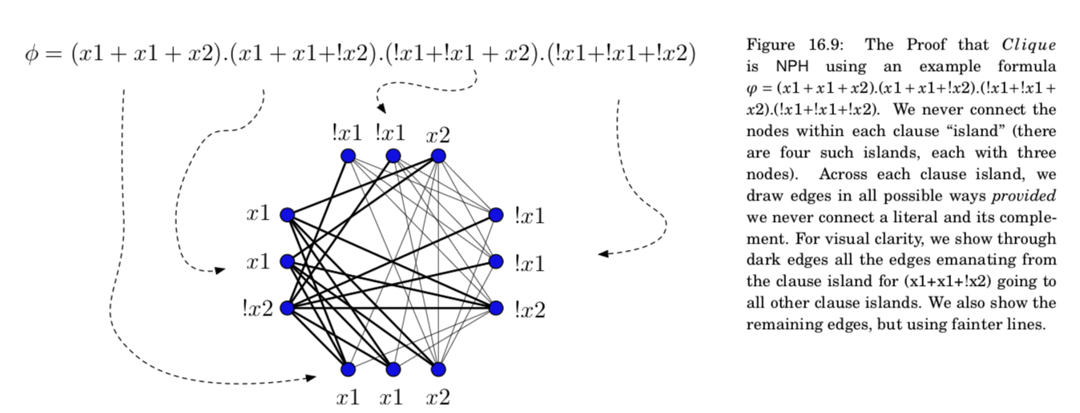
3SAT <=p K-Clique (the “Translate” fn.)

Slide 47
Exercises to help learn 3-SAT <=p K-Clique

Slide 48
Practice Problems: Sat? Sat Instance? Clique?

Slide 49
Practice Problems: Sat? Sat instance? Clique?

Slide 50
Sat? Sat instance? Clique?

Slide 51
Sat? Sat instance? Clique?

Slide 52
Your Asg-7’s problems
They help you practice these notions using the Binary Decision Diagram tool (BDD tool)
Part of Jove
Binary Decision Diagrams will be explained now
They also are minimal DFA “ in disguise “
We will then study the theory of NPC armed with this knowledge

Slide 53
Binary Decision Diagrams

Slide 54
BDDs
They are a data structure for representing Boolean Functions
Included in Jove (see First_Jove_Tutorial/CH17/CH17.ipynb)
All the details of BDDs is not that important
But practice with our BDD tool will fix ideas in your mind better (seeing Boolean formulae as graphs is often edifying)

Slide 55
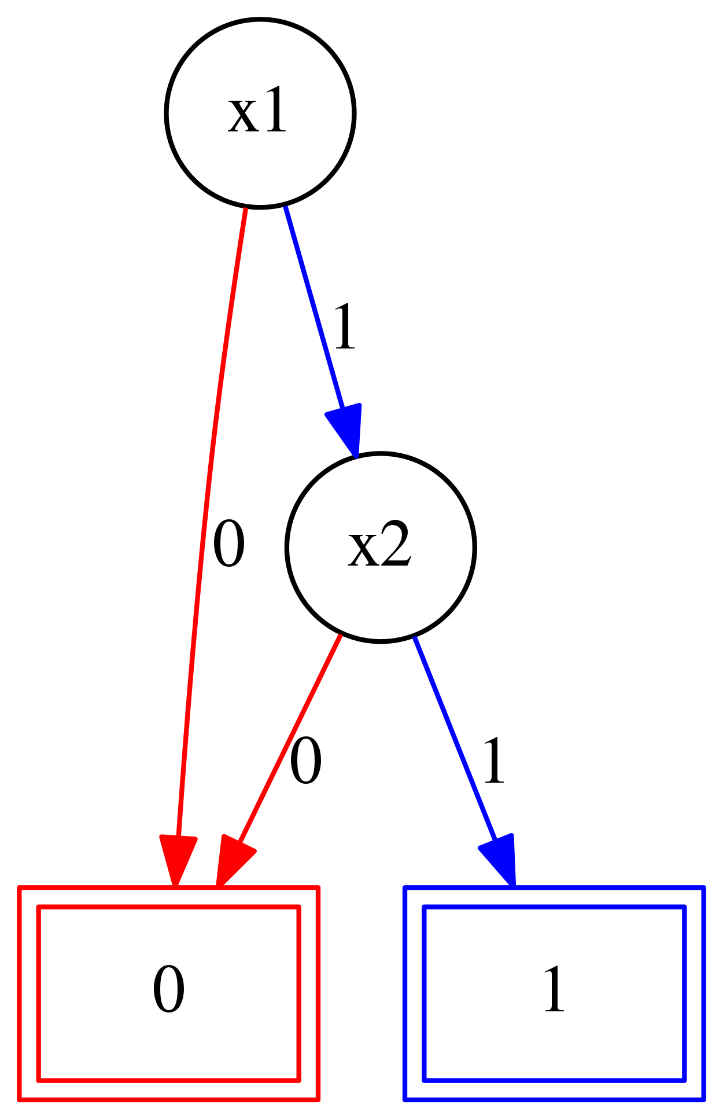
Use of BDD tool
# http://formal.cs.utah.edu:8080/pbl/BDD.php
# Very simple example to show-off syntax
#First declare the variables and specify variable orderings
Var_Order : x1 x2 x3
#Then define formula
fmla = (x1 | x2) & (x1 | !x2) & (!x1 | x2)
Main_Exp : fmla
# Type “build BDD”
# Right-click and save PNG
# SAT, UNSAT, Valid – from shape of BDD
# SAT : paths exist to “1”
# UNSAT: [0] BDD
# Valid: [1] BDD

Slide 56
Things to observe about BDDs
They are DAGs with one “layer” per variable
They “decode” the formula in a top-to-bottom order
The order of decoding determines the BDD size
There are often good heuristics to select this order

Slide 57
Practice Problems: Sat? BDD for var order x1,x2,x3 ?

Slide 58
Sat? Sat instance with BDD var order x1,x2,x3?

Slide 59
TMs help precisely model time complexity
Here, we need to consider TMs solving problems involving Boolean expressions

Slide 60
Show relative hardness of problems via <=p
People observed that many real-world problems are expensive to solve in the worst case
E.g. Is there a clique in a large graph
The internet is a huge graph
Update of internet node software, reliable direct
links between cities, … are all hard problems
They are all formally connected via <=p
(poly-time mapping reductions)

Slide 61
NPC problems are easy to check; difficult to solve
Both for 3SAT
(a + b + !b) . (!a + a + d) . (a + e + !f)
And clique

Slide 62
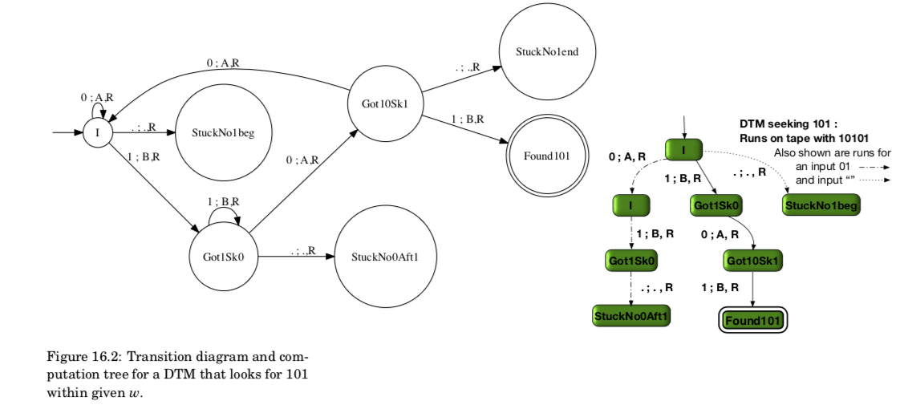
Definition of P-time and NP-time (from book)
P-time: An algo is P-time if its computational tree is bounded in height by a polynomial function of the length of its input for every input in the language that the DTM decides. For this simple “101” DTM, here is that DTM’s code and here is a computational tree – with paths shown. The paths are two for rejecting runs and one for an accepting run.

Slide 63
Definition of NP-time (from book)
NP-time: An algo is NP-time if an NDTM can be obtained where it can guess a solution nondeterministically but be able to CHECK that solution in P-time. So the depth of the worst-case (deepest) path in that NDTM must be P-bounded for any input. Some problems may not even qualify for the “check phase” being P-bounded… but many useful problems have !! That makes the theory of NPC interesting and relevant in practice!

Slide 64
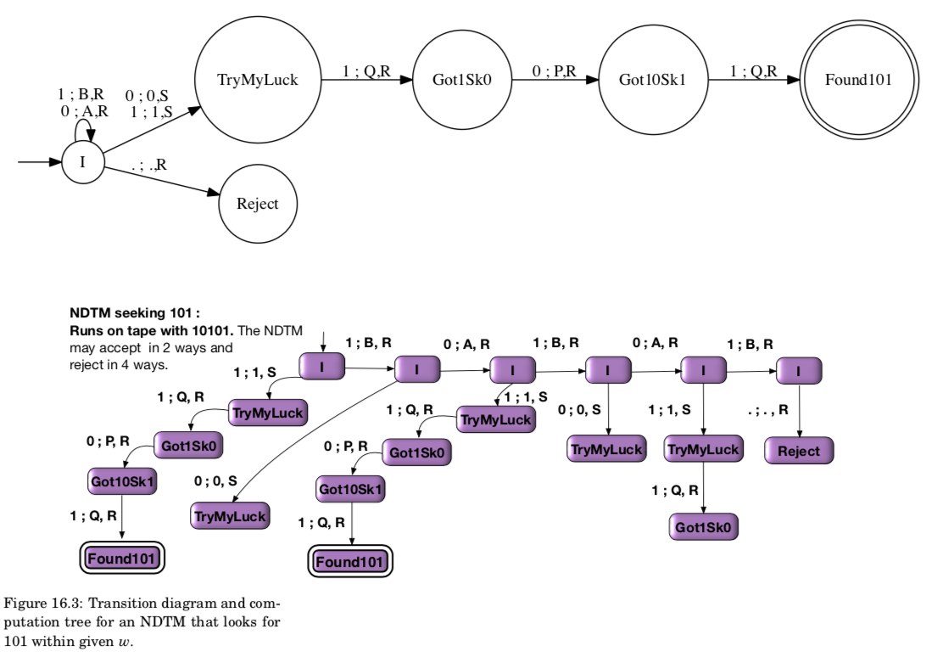
Illustration of NP-time (from book)
Look for the deepest
path which accepts.
That corresponds to
The NP-time.
In Jove, the Fuel
Models this depth
Faithfully even for
NDTMs…
(modulo
bug-fixes if any…)

Slide 65
Definition of P-time and NP-time (from book)
P-time: Illustrated wrt 3SAT
Obtain computation tree of DTM for the language 3SAT (all members in it)
Can we claim anything about the depth of the computational tree for all inputs?
As far as we know, any DTM working on 3SAT appears to incur an exp depth for at least some of the instances
NP-time: there is an NDTM that can guess the solution for a 3SAT problem (in P-time) – and also check this guess in P-time
Question: will we ever get a DTM that does this in P-time??
This is what the question of P =?= NP really means

Slide 66
Smart idea
Define the idea of the hardest problems in NP
Call it NPC
I.e. A language L is NPC if
L is in NP --- has a NP-time algo (guess check on NDTP is P-time)
For every problem L’ in NP, we have L’ <=p L
That is, L is harder than anything there is in NP
Any problem such as L is “NP-hard” i.e. harder than anything in NP
So, NPC = NP-hard + in NP
Finding such an NPC language was the open question that Cook and Levin solved

Slide 67
First NPC problem
3SAT was shown NPC as follows
First show that 3SAT has an NP algorithm (easy; build an NDTM)
Then show that EVERY NP problem has a P-time M.R. to 3-SAT
This was achieved by imagining the solution of any NP problem as a collection of “tape histories”
Then encoding these histories using 3CNF formulae!

Slide 68
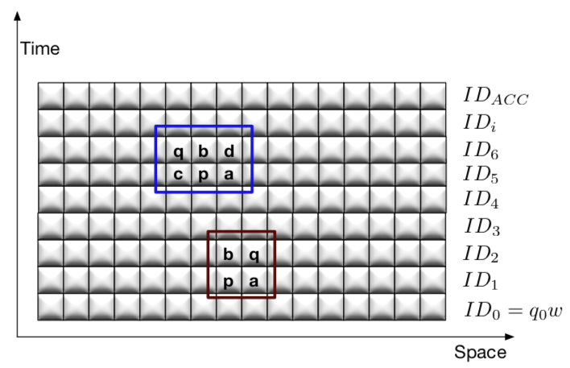
How 3SAT was shown NP-hard (from book)
This is the history of how a TM chugs along. Fortunately, each move from ID_k (full tape)
to ID_k+1 (full tape) can be modeled as changes that occur within a 2x2 or 2x3 window.
These changes can be captured using a 3CNF formula. …. The rest is history! (see the book for more)

Slide 69
Mapping reductions are key to “connect-up”
NPC
A language L is NPC
If L is in NP
It has a P-time NDTM
EVERY language in NP has a P-time mapping-reduction to L
In order to show that a NEW language L is NPC
We will end up producing a mapping reduction from one of the problems in NPC to L
Then we have a mapping reduction from EVERY language in NP to L
Study this “funnel diagram” (Ch-16) to be convinced

Slide 70
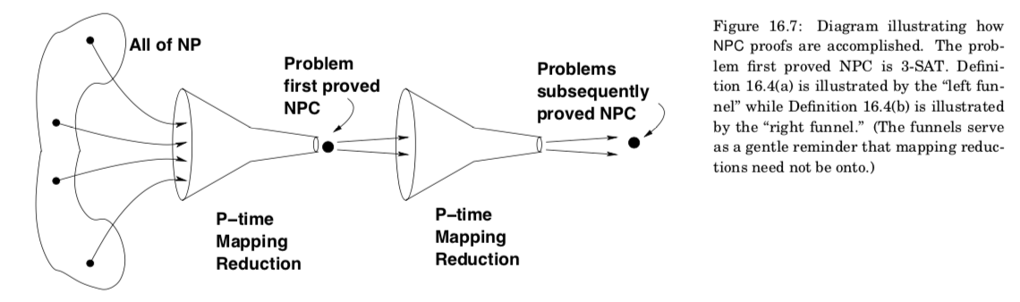
The “funnel diagram”

Slide 71
The “funnel diagram”
Easier than HPC

Slide 72
The “funnel diagram”
Hardest
NPC
Problems
Easier than HPC
Example
(a + b + !b) . (!a + a + d) . (a + e + !f)

Slide 73
The “funnel diagram”
Also becomes
NPC
Because
Mapping-reductions
Compose!
Hardest
NPC
Problems
Easier than HPC
Example
Clique
Example
(a + b + !b) . (!a + a + d) . (a + e + !f)

Slide 74
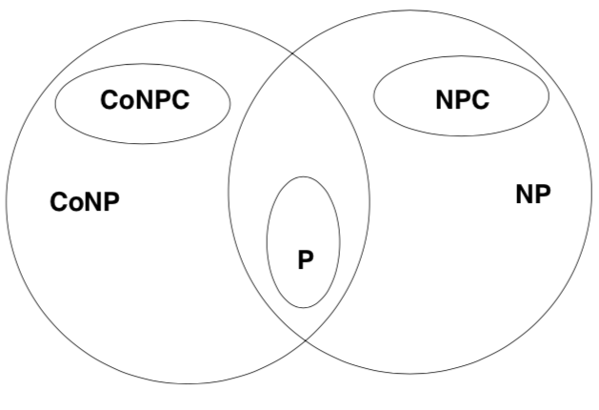
Language hierarchy in NP-land (ignore “Co” for now)

Slide 75
Boolean Satisfiability: First NPC problem
From any NDTM, we can compile a 3-SAT formula
If the NDTM is NP-time, then we can decide the truth of the generated 3-SAT formula in NP-Time
If 3-SAT is deterministic P-time, then we can decide any NDTM in P-time (not in NP-time)
Details given in the book

Slide 76
Mapping reduction based proof of K-clique being NPC
Show K-clique is in NPC
Given a description of which nodes are in the clique, we can CHECK that these nodes indeed form a K-clique
Show a mapping reduction from 3-SAT of K clauses into a K-clique instance

Slide 77
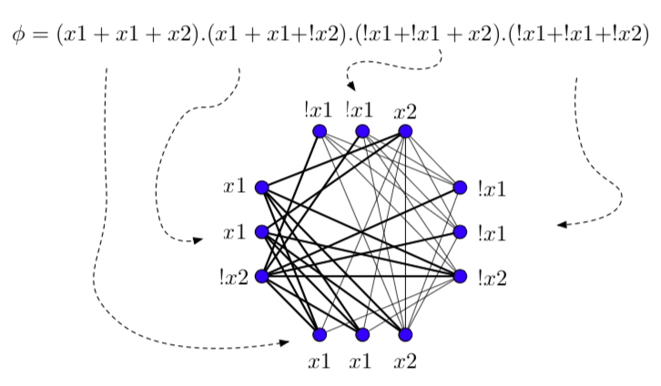
3-SAT to K-clique Mapping Reduction

Slide 78
3-SAT to K-clique Mapping Reduction
Depict each clause as an “island” of 3 nodes each
For a K-clause formula, there are K islands
Between any two islands, draw an edge from one node
of an island to another node of another island
Do the above in ALL possible ways
The edge must connect any two COMPATIBLE nodes
Nodes x and y are compatible if (x and y) is satisfiable
The given K-clause 3-CNF formula is SAT iff there is a K-clique in the mapped graph
This is a classical mapping reduction!
Thus, if there is a P-time algorithm for K-clique, then there is a P-time algorithm for 3-SAT
(and ergo for all of NP)

Slide 79
Aside: DNF does not capture the complexity of NPC properly!
Given this or any other CNF with N variables, an NDTM can be built such that
* its first N moves are to write out a variable assignment on the tape
* then check that under that assignment, the formula is true
But hey, DNF is linear-time SAT-checkable. Multiply the above out to get a DNF
x1 + x1.!x2 + x1.!x3 + x2.x1 + x2.!x2 + x2.!x3 + x3.x1 + x3.!x2 + x3.!x3
→ then simplify
SAT if ANY product-term is ….. ?(what)
This is a linear check
But expansion to DNF turns the formula EXP LONG !!! So no real advantage.
In a sense, DNF is spelling out every possible solution and we have to check one by one !!!

