Slide 1

CS 3100, Models of Computation, Spring 20, L24
Ganesh Gopalakrishnan
School of Computing
University of Utah
Salt Lake City, UT 84112
cp Lec25.pptx ../Lec25
URL: bit.ly/3100s20Syllabus

Slide 2
Undecidability proofs

Slide 3
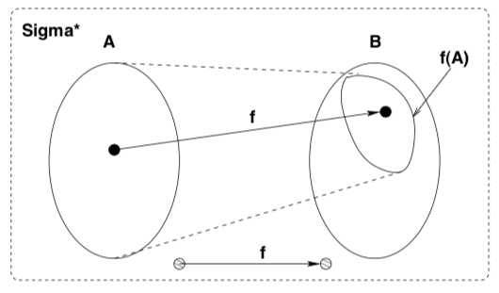
The basic idea of Mapping Reduction in Undec.
A way to take advantage of an already proven hard-fought theorem (“A” below) in establishing the truth of new conjectures (“B” below)
We do a proof via diagonalization that A_TM (H_TM) is undecidable (the “A” mentioned)
We can then handle 1000s of other (often more relevant) questions easily (the “B”s)
Prove that ”A” <= “B” i
i.e. A mapping-reduces-to B via a computable function f (i.e. you can code-up f in any of your favorite prog. languages in a way that f NEVER loops on any A-input). This is almost always easy. Our “Translate” function was a “print” command. No need to loop in there !!)
i.e. Given a solver (or decider) for B, we can take ANY
A-instance, map it via “f” into a B-instance
and feed it to the claimed B-solver (or B-decider)
Given that an MR means
“x in A iff f(x) in B”, i.e.
x in A => f(x) in B
x not in A => f(x) not in B
We can conclude that
“solving B means Solving A → blooper!”

Slide 4
NP-Completeness proofs

Slide 5
Important things about NPC-studies
NPC problems never loop!
It is always about P-time runnability
What was “bad” (looping) is now “exp-time decider behavior (i.e. solvability in P-time is NOT KNOWN)
NPC is a reflection of honest human ignorance
The only way science advances is by confessing ignorance and being brutally honest. There is ABSOLUTELY NO ROOM for saying things for the sake of situational convenience … unless facts allow things to be well-grounded
Ever noble human endeavor must allow for retractions
To be perfect is to never try!

Slide 6
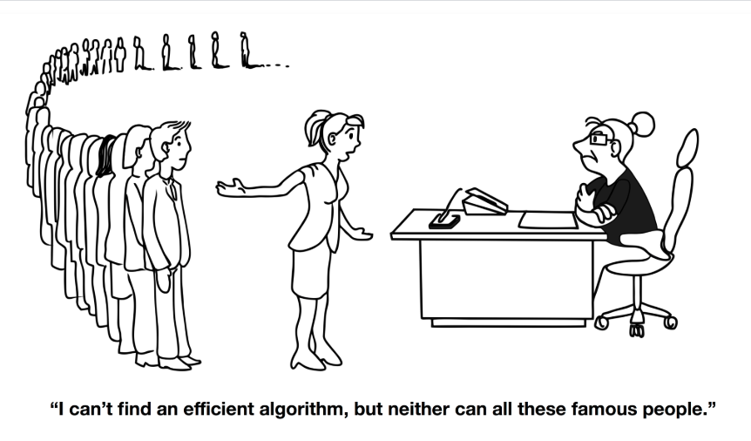
Why NPC matters (from book by Garey/Johnson)

Slide 7
The basic idea of Mapping Reduction NPC proofs
A way to take advantage of an already proven hard-fought theorem (“A” below) in establishing the truth of new conjectures (“B” below)
We do a proof via diagonalization that 3-SAT is NP-Complete (the “A” mentioned)
We can then handle 1000s of other (often more relevant) questions easily (the “B”s)
Prove that ”A” <= “B” i
i.e. A mapping-reduces-to B via a Polynomial-time computable function f (i.e. you can code-up f in any of your favorite prog. languages in a way that f NEVER loops on any A-input and runs in P-time. Easy to do – you map Boolean formulae to Graphs, etc as we will see!)
i.e. Given a P-time solver for B, we can take ANY
A-instance, map it via “f” into a B-instance
and feed it to the claimed P-time B-solver
(P-time decider)
Given that an MR means
“x in A iff f(x) in B”, i.e.
x in A => f(x) in B
x not in A => f(x) not in B
We can conclude that
“solving B in P-time means Solving A in P-time --> A Turing Award or Clay Prize !! (not a blooper)

Slide 8
The language K-Clique
Given an undirected graph, is there a set of K nodes such that they are all pairwise connected?
They form a K-Clique?
K-Clique – { < G > : G is a graph that has a K-Clique in it }

Slide 9
We are about to show 3-SAT <=p K-Clique
<=p is a mapping reduction but with a polynomial bound on runtime
That is, we can translate a 3-SAT instance to a K-Clique instance in polynomial time
This means that if K-Clique has a Polynomial Algorithm, then
3-SAT will also have a Polynomial Algorithm

Slide 10
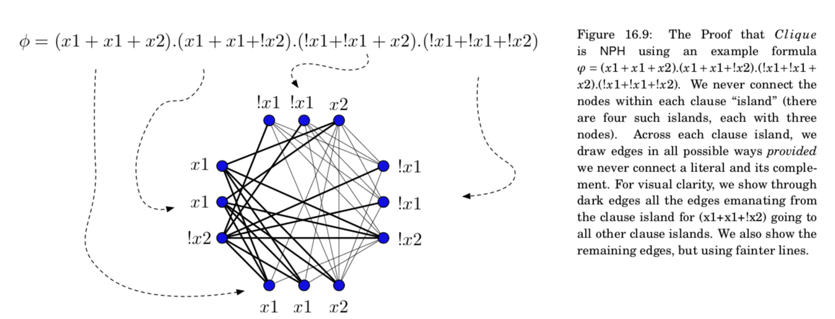
3SAT <=p K-Clique (the “Translate” fn.)

Slide 11
Exercises to help learn 3-SAT <=p K-Clique

Slide 12
Practice Problems: Sat? Sat Instance? Clique?

Slide 13
Practice Problems: Sat? Sat instance? Clique?

Slide 14
Sat? Sat instance? Clique?

Slide 15
Sat? Sat instance? Clique?

Slide 16
Your Asg-7’s problems
They help you practice these notions using the Binary Decision Diagram tool (BDD tool)
Part of Jove
Binary Decision Diagrams will be explained now
They also are minimal DFA “ in disguise “
We will then study the theory of NPC armed with this knowledge

Slide 17
Binary Decision Diagrams

Slide 18
BDDs
They are a data structure for representing Boolean Functions
Included in Jove (see First_Jove_Tutorial/CH17/CH17.ipynb)
All the details of BDDs is not that important
But practice with our BDD tool will fix ideas in your mind better (seeing Boolean formulae as graphs is often edifying)

Slide 19
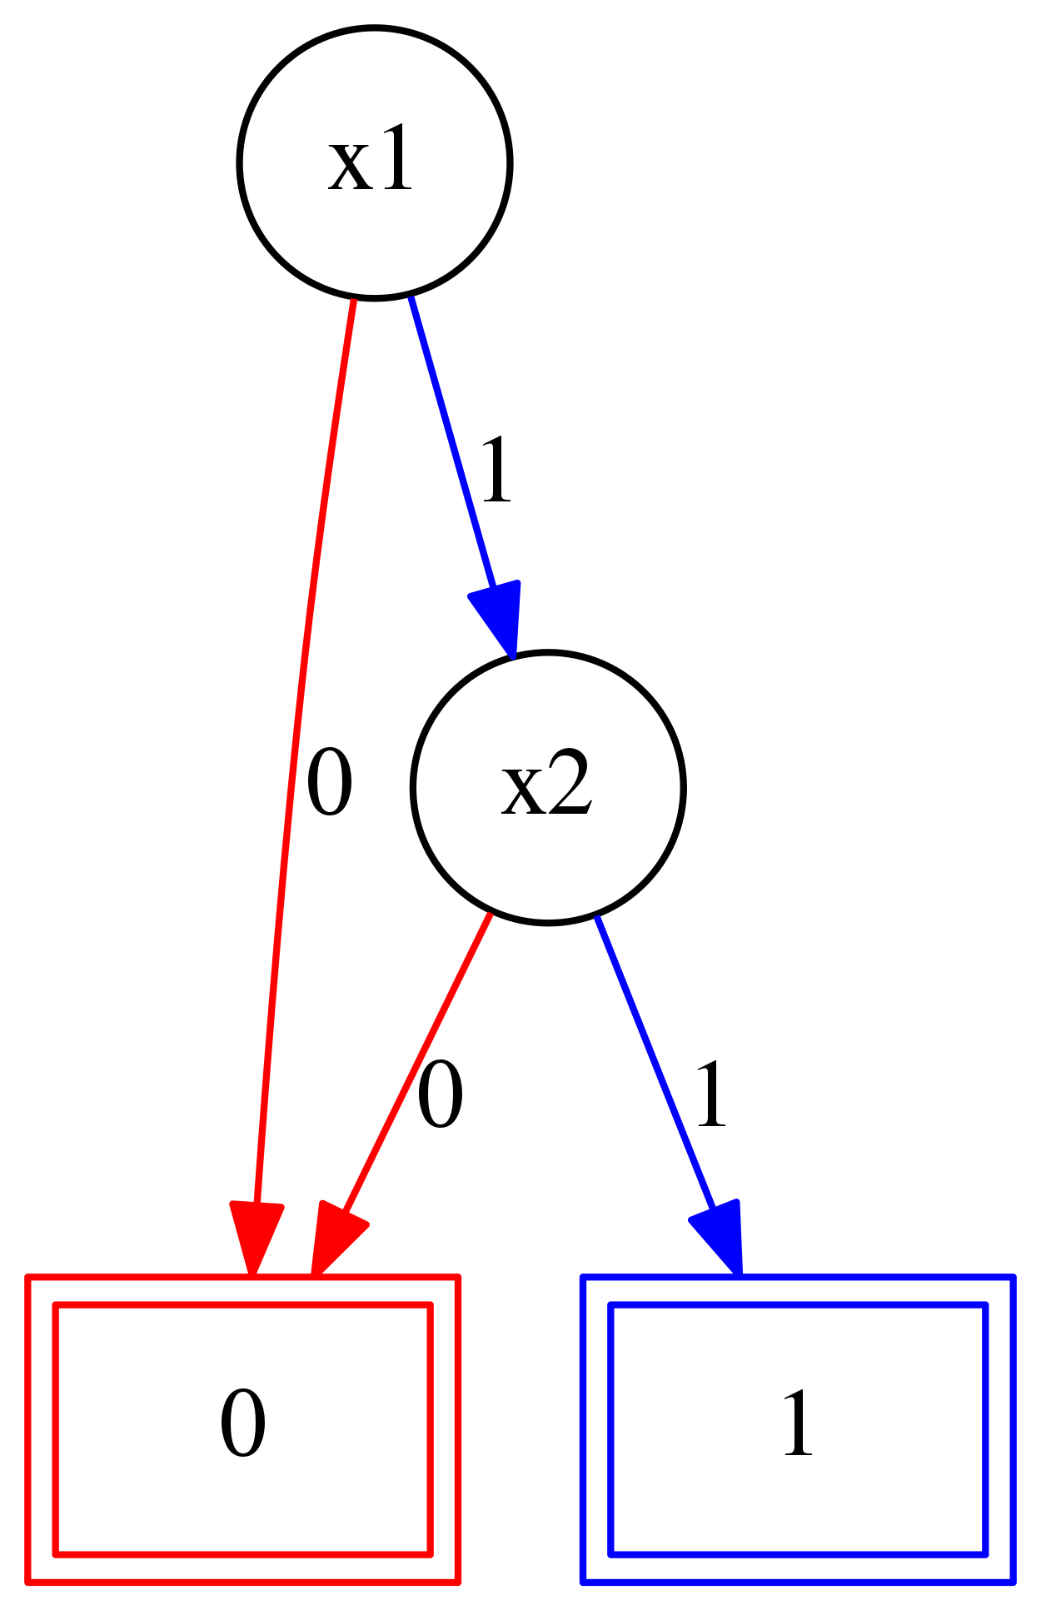
Use of BDD tool
# http://formal.cs.utah.edu:8080/pbl/BDD.php
# Very simple example to show-off syntax
#First declare the variables and specify variable orderings
Var_Order : x1 x2 x3
#Then define formula
fmla = (x1 | x2) & (x1 | !x2) & (!x1 | x2)
Main_Exp : fmla
# Type “build BDD”
# Right-click and save PNG
# SAT, UNSAT, Valid – from shape of BDD
# SAT : paths exist to “1”
# UNSAT: [0] BDD
# Valid: [1] BDD

Slide 20
Things to observe about BDDs
They are DAGs with one “layer” per variable
They “decode” the formula in a top-to-bottom order
The order of decoding determines the BDD size
There are often good heuristics to select this order

Slide 21
Practice Problems: Sat? BDD for var order x1,x2,x3 ?

Slide 22
Sat? Sat instance with BDD var order x1,x2,x3?

Slide 23
TMs help precisely model time complexity
Here, we need to consider TMs solving problems involving Boolean expressions

Slide 24

Show relative hardness of problems via <=p
People observed that many real-world problems are expensive to solve in the worst case
E.g. Is there a clique in a large graph
The internet is a huge graph
Update of internet node software, reliable direct
links between cities, … are all hard problems
They are all formally connected via <=p
(poly-time mapping reductions)

Slide 25
NPC problems are easy to check; difficult to solve
Both for 3SAT
(a + b + !b) . (!a + a + d) . (a + e + !f)
And clique

Slide 26
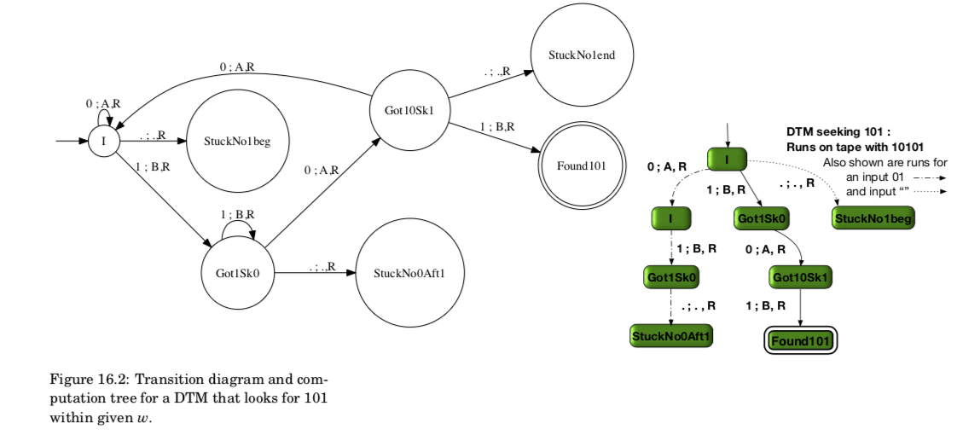
Definition of P-time and NP-time (from book)
P-time: An algo is P-time if its computational tree is bounded in height by a polynomial function of the length of its input for every input in the language that the DTM decides. For this simple “101” DTM, here is that DTM’s code and here is a computational tree – with paths shown. The paths are two for rejecting runs and one for an accepting run.

Slide 27
Definition of NP-time (from book)
NP-time: An algo is NP-time if an NDTM can be obtained where it can guess a solution nondeterministically but be able to CHECK that solution in P-time. So the depth of the worst-case (deepest) path in that NDTM must be P-bounded for any input. Some problems may not even qualify for the “check phase” being P-bounded… but many useful problems have !! That makes the theory of NPC interesting and relevant in practice!

Slide 28
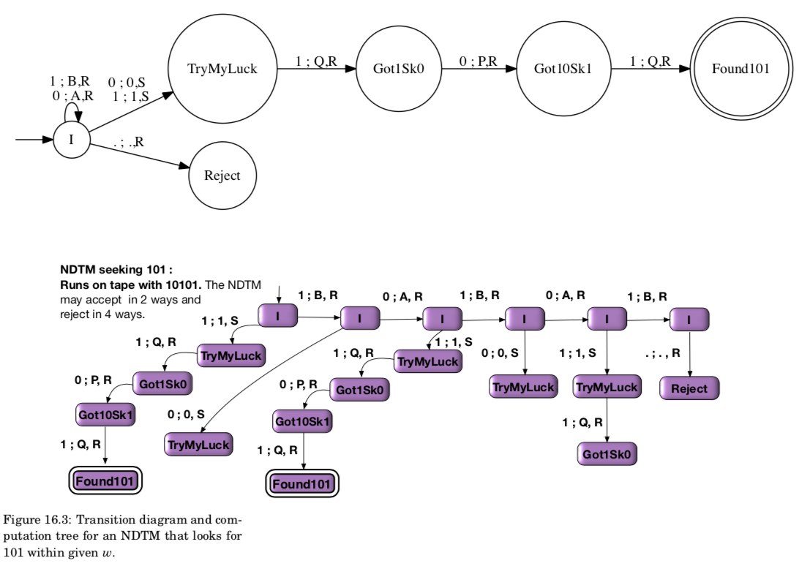
Illustration of NP-time (from book)
Look for the deepest
path which accepts.
That corresponds to
The NP-time.
In Jove, the Fuel
Models this depth
Faithfully even for
NDTMs…
(modulo
bug-fixes if any…)

Slide 29
Definition of P-time and NP-time (from book)
P-time: Illustrated wrt 3SAT
Obtain computation tree of DTM for the language 3SAT (all members in it)
Can we claim anything about the depth of the computational tree for all inputs?
As far as we know, any DTM working on 3SAT appears to incur an exp depth for at least some of the instances
NP-time: there is an NDTM that can guess the solution for a 3SAT problem (in P-time) – and also check this guess in P-time
Question: will we ever get a DTM that does this in P-time??
This is what the question of P =?= NP really means

Slide 30
Smart idea
Define the idea of the hardest problems in NP
Call it NPC
I.e. A language L is NPC if
L is in NP --- has a NP-time algo (guess check on NDTP is P-time)
For every problem L’ in NP, we have L’ <=p L
That is, L is harder than anything there is in NP
Any problem such as L is “NP-hard” i.e. harder than anything in NP
So, NPC = NP-hard + in NP
Finding such an NPC language was the open question that Cook and Levin solved

Slide 31
First NPC problem
3SAT was shown NPC as follows
First show that 3SAT has an NP algorithm (easy; build an NDTM)
Then show that EVERY NP problem has a P-time M.R. to 3-SAT
This was achieved by imagining the solution of any NP problem as a collection of “tape histories”
Then encoding these histories using 3CNF formulae!

Slide 32
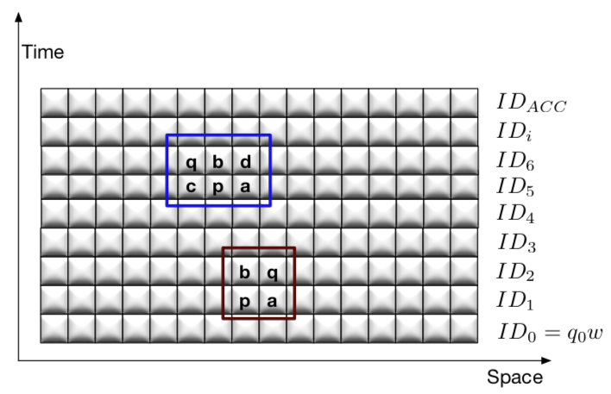
How 3SAT was shown NP-hard (from book)
This is the history of how a TM chugs along. Fortunately, each move from ID_k (full tape)
to ID_k+1 (full tape) can be modeled as changes that occur within a 2x2 or 2x3 window.
These changes can be captured using a 3CNF formula. …. The rest is history! (see the book for more)

Slide 33
Mapping reductions are key to “connect-up”
NPC
A language L is NPC
If L is in NP
It has a P-time NDTM
EVERY language in NP has a P-time mapping-reduction to L
In order to show that a NEW language L is NPC
We will end up producing a mapping reduction from one of the problems in NPC to L
Then we have a mapping reduction from EVERY language in NP to L
Study this “funnel diagram” (Ch-16) to be convinced

Slide 34
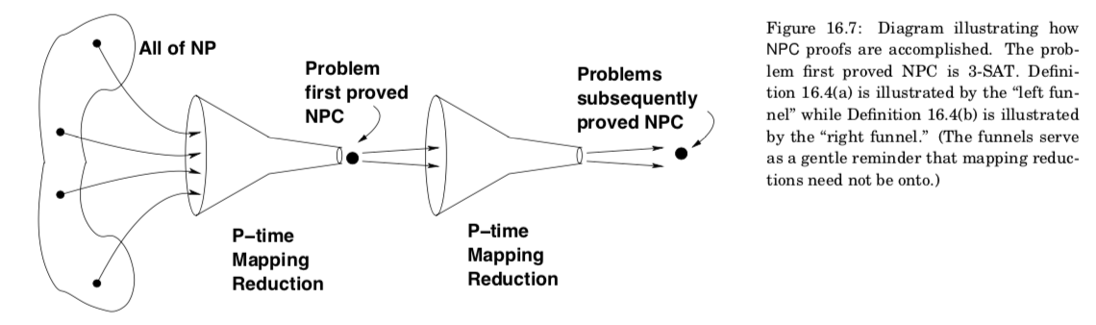
The “funnel diagram”

Slide 35
The “funnel diagram”
Easier than HPC

Slide 36
The “funnel diagram”
Hardest
NPC
Problems
Easier than HPC
Example
(a + b + !b) . (!a + a + d) . (a + e + !f)

Slide 37
The “funnel diagram”
Also becomes
NPC
Because
Mapping-reductions
Compose!
Hardest
NPC
Problems
Easier than HPC
Example
Clique
Example
(a + b + !b) . (!a + a + d) . (a + e + !f)

Slide 38
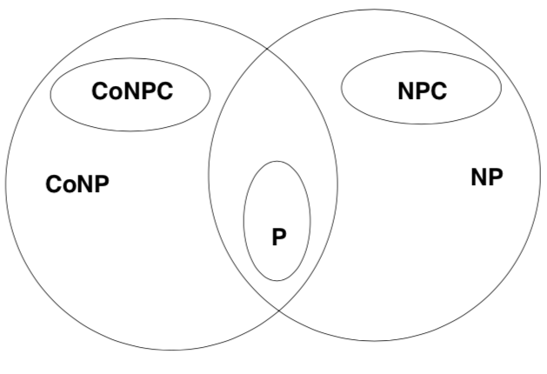
Language hierarchy in NP-land (ignore “Co” for now)

Slide 39
Boolean Satisfiability: First NPC problem
From any NDTM, we can compile a 3-SAT formula
If the NDTM is NP-time, then we can decide the truth of the generated 3-SAT formula in NP-Time
If 3-SAT is deterministic P-time, then we can decide any NDTM in P-time (not in NP-time)
Details given in the book

Slide 40
Mapping reduction based proof of K-clique being NPC
Show K-clique is in NPC
Given a description of which nodes are in the clique, we can CHECK that these nodes indeed form a K-clique
Show a mapping reduction from 3-SAT of K clauses into a K-clique instance

Slide 41
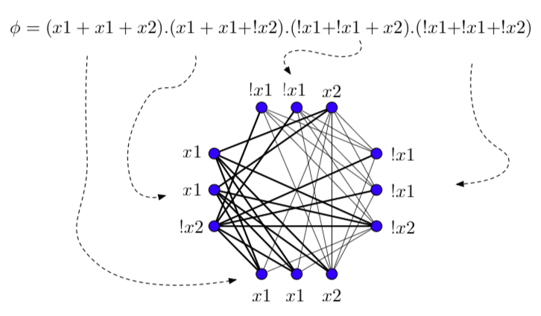
3-SAT to K-clique Mapping Reduction

Slide 42
3-SAT to K-clique Mapping Reduction
Depict each clause as an “island” of 3 nodes each
For a K-clause formula, there are K islands
Between any two islands, draw an edge from one node
of an island to another node of another island
Do the above in ALL possible ways
The edge must connect any two COMPATIBLE nodes
Nodes x and y are compatible if (x and y) is satisfiable
The given K-clause 3-CNF formula is SAT iff there is a K-clique in the mapped graph
This is a classical mapping reduction!
Thus, if there is a P-time algorithm for K-clique, then there is a P-time algorithm for 3-SAT
(and ergo for all of NP)

Slide 43
Aside: DNF does not capture the complexity of NPC properly!
Given this or any other CNF with N variables, an NDTM can be built such that
* its first N moves are to write out a variable assignment on the tape
* then check that under that assignment, the formula is true
But hey, DNF is linear-time SAT-checkable. Multiply the above out to get a DNF
x1 + x1.!x2 + x1.!x3 + x2.x1 + x2.!x2 + x2.!x3 + x3.x1 + x3.!x2 + x3.!x3
→ then simplify
SAT if ANY product-term is ….. ?(what)
This is a linear check
But expansion to DNF turns the formula EXP LONG !!! So no real advantage.
In a sense, DNF is spelling out every possible solution and we have to check one by one !!!

