Slide 1

CS 3100, Models of Computation, Spring 2020, Lec 3
Ganesh Gopalakrishnan
School of Computing
University of Utah
Salt Lake City, UT 84112
bit.ly/3100s20Syllabus

Slide 2
Lecture 3, covering up to Chapter 4.6

Slide 3
Introducing DFA
Machines with a finite set of states : “Q”
Is defined for an alphabet Sigma (usually {0,1})
Has a single initial state
Has some number of final states “F”
Could be none
Could be all of Q
Has moves defined
for every state q in Q
for every member of Sigma
Helps define a language!
Any string that takes the DFA from I to one of the states in “F” is in the DFA’s language
The DFA accepts such a string
All the strings that go from I to F are in the language recognized by the DFA

Slide 4

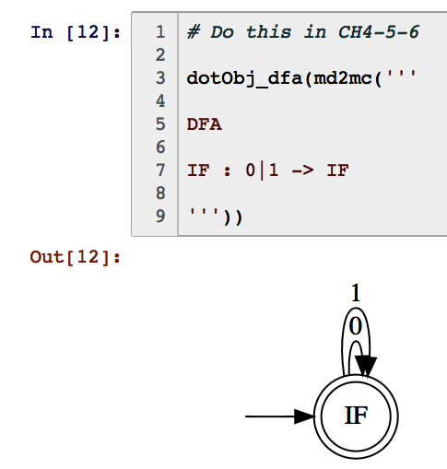
Is this a DFA? Which strings are accepted by it? What language is recognized by it?

Slide 5

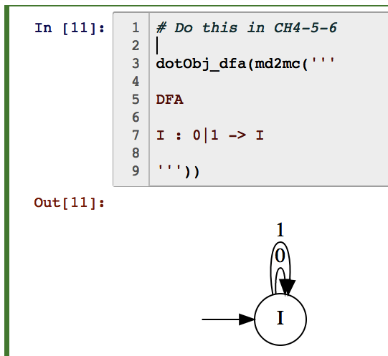
Is this a DFA? Which strings are accepted by it? What language is recognized by it?

Slide 6
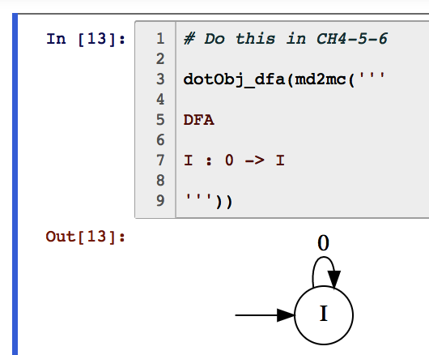
Is this even a DFA over {0,1} ?? Why or why not?

Slide 7
Is this a DFA over {0} ?

Slide 8
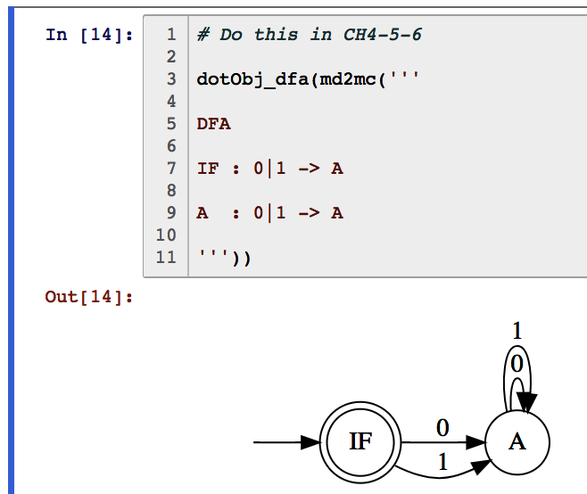
Is this a DFA? Which strings are accepted by it? What language is recognized by it?

Slide 9
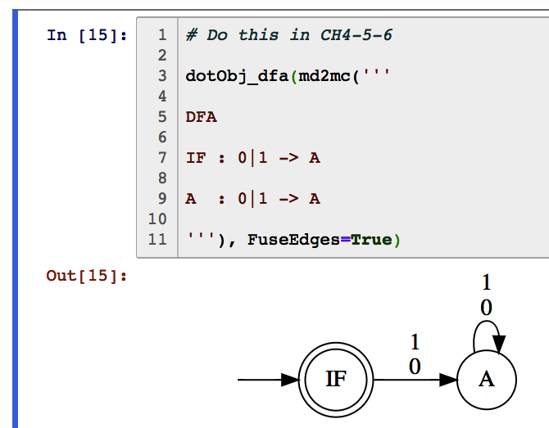
Is this a DFA? Which strings are accepted by it? What language is recognized by it?

Slide 10
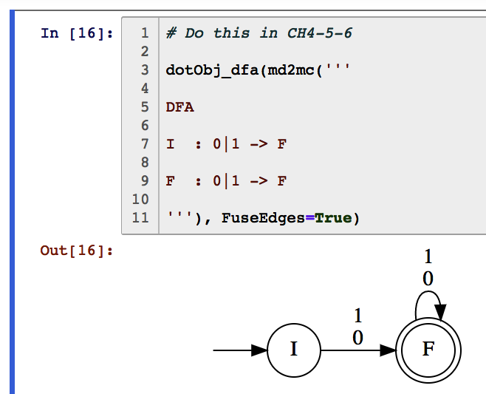
Is this a DFA? Which strings are accepted by it? What language is recognized by it?

Slide 11
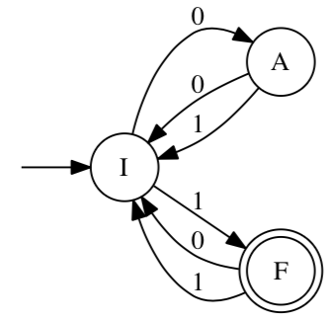
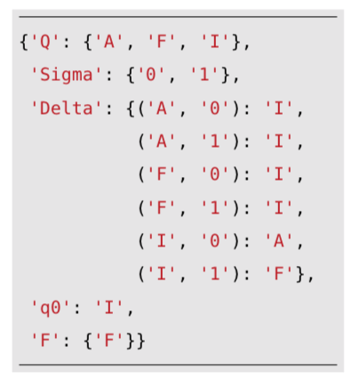
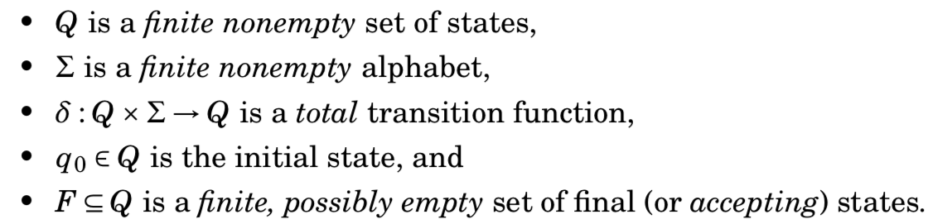
Formal structure of a DFA, and an example
The language of a DFA is
“ the strings that take the DFA from the initial state to one of the final states ”
(if the initial state is also a final state, then the language also contains epsilon)
List five strings in this DFA’s language (in numeric order)

Slide 12
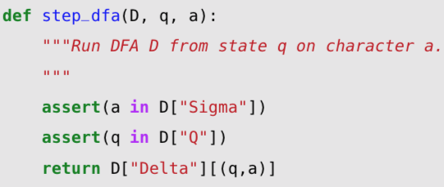
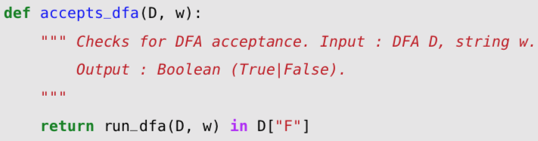
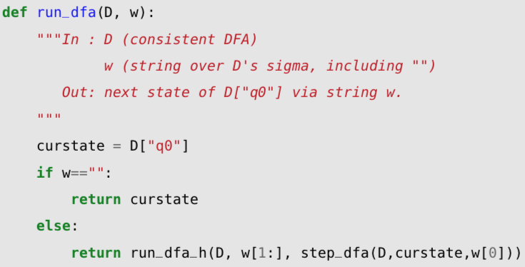
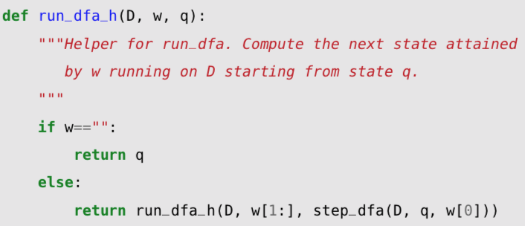
step_dfa, run_dfa, accepts_dfa in code

Slide 13



step_dfa, run_dfa, accepts_dfa in math
“step_dfa”
“run_dfa”
“accepts_dfa”

Slide 14
step_dfa, run_dfa, accepts_dfa in both!

Slide 15
Design a DFA for “ends with 0101”
Express mathematically as a language
Design in Jove syntax, keeping the relevant piece of the input in the state name
i.e. S010 means “seen 010 so far”

Slide 16
Design a DFA for “contains 0101”
Express mathematically as a language
Design in Jove syntax, keeping the relevant piece of the input in the state name
i.e. S010 means “seen 010 so far”
Some prefer to draw the DFA out also. But still, name states consistently.

Slide 17
Design a DFA for {0,1} where every block of length 3 contains exactly two 1’s

Slide 18
Design a DFA for strings over {0,1} whose numeric value is a multiple of 3

