Slide 1

CS 3100, Models of Computation, Spring 20, Lec 7
Ganesh Gopalakrishnan
School of Computing
University of Utah
Salt Lake City, UT 84112
bit.ly/3100fs20Syllabus

Slide 2


Lecture 3, covering Ch 5 and 6

Slide 3
Today: Algorithms around DFA
Algorithms that help build more complex DFA out of simpler DFA
Algorithms that minimize DFA into a unique minimal form
We will be running this notebook alongside, and study the code
First_Jove_Tutorial/CH4-5-6/L7-f19-exercises.ipynb
Quiz3 is very similar and Asg-2 also helps you build-up your understanding
Remember, if you can code something, you truly understand it!
* coding is teaching… er, teaching a computer!
* if you teach the most unforgiving beast (a computer), you have
spelled out things to the last detail

Slide 4
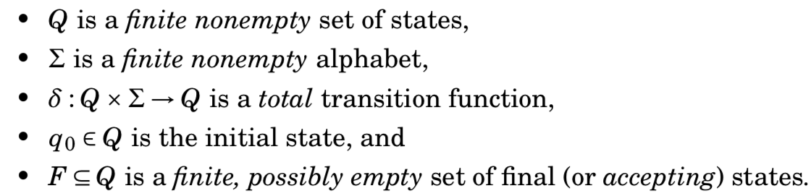
Recap: Formal structure of a DFA
The language of a DFA is the set of strings that lead the DFA from one of the I states to an F state
Example: Language of strings over Sigma={0,1} that “Begin with a 0”
List five strings in numeric order
Draw a DFA
Express it as (Q,Sigma,delta,q0,F)
Now design “End with a 1”

Slide 5
Intersect “Begin with 0” and “End with 1”
Intersection has these kinds of strings (express in English): ” …. “
List five strings in numeric order
It is as if we have the DFA side by side, and fed them the same input string
When both DFA enter a final state, accept the string seen so far!
Algorithm: March them in tandem (lock-step) – i.e. tie the DFA together and let them march together!
Q = Q1 x Q2
q0 = (q01, q02)
F = { (f1, f2) : }
delta( (q1, q2), a ) = ( …dfa1’s next state… , …dfa2’s next state… )

Slide 6
Union “Begin with 0” and “End with 1”
Q = Q1 x Q2
q0 = (q01, q02)
F = { (f1, f2) : }
delta( (q1, q2), a ) = ( …dfa1’s next state… , …dfa2’s next state… )

Slide 7
Complement “Begin with 0”
Complementation : a string is in the complement IFF it is not in the original DFA
Which of these change, and which ones stay the same? Then draw the true and complement side by side
Q =
q0 =
F =
delta (q, a) =

Slide 8
Language equivalence and isomorphism
Two DFA are language equivalent if they accept the same set of strings
They are isomorphic if they are language equivalent and have the same number of states
Then we can place one DFA on top of another, and their states and transitions will match
Print them, place one on top, “hold them to light”
Express language equivalence of L1 and L2 in terms of two intersection-complement checks!
Solution:
Start from: L1 = L2 iff L1 contained in L2 and vice-versa
Read L1 contained in L2 as “L1 fully inside L2”
Now read it as “L1 NOT OUTSIDE L2”
Break each containment into an intersection-complement check

Slide 9
DFA minimization
Let’s experiment with two minimization problems.
First approach: “Eyeball algorithm”

Slide 10
DFA minimization: Fig 6.7 of book
Full list of states : IS1, FS2, FS3, S4, S5, FS6
Row : IS1, FS2, FS3, S4, S5 (left to right)
Col : FS2, FS3, S4, S5, FS6 (top to bottom)
Purpose: to make ”N choose 2” state combos easily in a tabular display!
Then iterate in any order (recommend: left col, top to bottom, then second col,…)
6 choose 2 is 15
Two states S1 and S2 are k-distinguishable if
(k=0) : S1 is a final and S2 is a non-final (or vice-versa)
(k>1) : S1 and S2 go to states S1’ and S2’ on some a in Sigma and S1’ and S2’ are k-1 distinguishable

Slide 11
DFA minimization: Fig 6.7 of book
Final equivalence classes of size 2
{FS3, FS2}, {S5, S4}
These classes have no overlap
They don’t merge

Slide 12
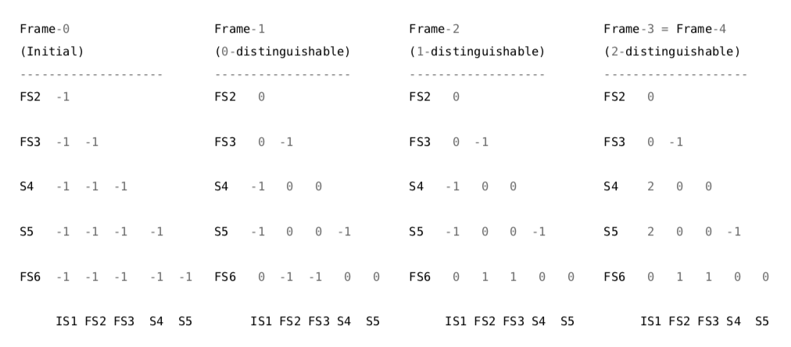
DFA minimization: Fig 6.7 of book

Slide 13
DFA minimization: Fig 6.7 of book
Full list of states : I, FI, FF, FB
Row : I, FI, FF (left to right)
Col : FI, FF, FB (top to bottom)
Purpose: to make ”N choose 2” state combos easily in a tabular display!
Then iterate in any order (recommend: left col, top to bottom, then second col,…)

Slide 14
DFA minimization: Fig 6.7 of book
Final equivalence classes of size 2 :
{FF, FI}, {FB, FI}, {FB, FF}
They have overlaps
Merge them into a super-equivalence class {FF, FI, FB}

