Slide 1

CS 3100, Models of Computation, Fall 2019, Lec 8
Ganesh Gopalakrishnan
School of Computing
University of Utah
Salt Lake City, UT 84112
bit.ly/3100f19Syllabus

Slide 2
Designing a DFA (General)
DFA are simplified C / Java programs with finite states
state = I or IF
While(True) {
switch state {
case ‘IF’ : switch input {
case ‘0’ : state = …update it…
case ‘1’ : state = …update it…
}
case ‘A’ : …
}
}
More realistic programs are modeled by PDA and all programs are modeled by TM

Slide 3
Why NFA? Many answers!
Invented to overcome the limitations of a DFA
For some regular languages (that have a DFA), the DFA are exponentially big
In many of those cases, an NFA will be linear / polynomial in size
Therefore reduces tedium (for humans) to specify
This use of NFA also turns into a syntactic approach called Regular Expressions
Nondeterminism is a fundamental idea in CS
Allows us to classify algorithms into “easy” (P) and “hard” (NP)

Slide 4
Features of an NFA
Finite states
Multiple initial states
Can begin in any initial state
Transitions on Sigma
Transitions also on Epsilon
Recall that Epsilon is not in Sigma
Transitions lead to sets of next states
Has final states (like before)
Acceptance:
Begin at any initial state
A journey described by a string (laden perhaps with Epsilon)
Ends in a final state

Slide 5
Two NFA designs for “third last is a 1”

Slide 6
NFA have equivalent DFA - Subset Construction (function nfa2dfa)
Bascially for each NFA that is in a set of states {S1,S2,S3}
For example we assume a set of 3 states an NFA is in.
First E-close {S1,S2,S3}
Let S1 go to S11, S12 on ‘’
Let S2 go to S21 on ‘’
Let S3 go on S31, S32, S33 on ‘’
E-closure ( {S1,S2,S3} ) = {S11,S12,S21,S31,S32,S33}
Fire a symbol, say a in Sigma from each of S11, S12,…S33
Let the resulting SET OF STATES be
S11’, S12’, …. , S33’ (these are SETS of states)
Take a set union of S11’, S12’, …, S33’
E-close that state.
This is what {S1,S2,S3} transitions to, upon an “a” in Sigma
Do this for Book77 NFA
Do this for “third last is a 1” NFA

Slide 7
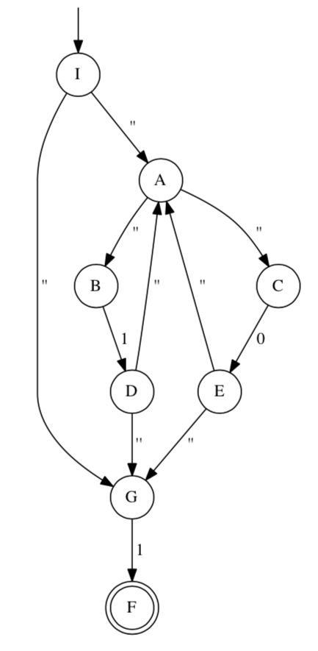
Book’s Figure 7.7 NFA : Write in Jove’s markdown in 2 ways, then convert to DFA via Subset Construction

