Slide 1

CS 3100, Models of Computation, Spring 20, Lec 9
Ganesh Gopalakrishnan
School of Computing
University of Utah
Salt Lake City, UT 84112
bit.ly/3100s20Syllabus

Slide 2


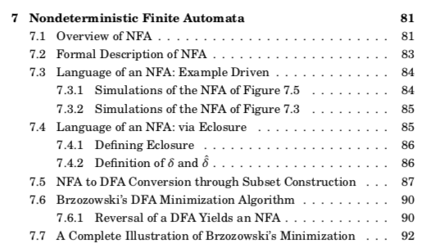
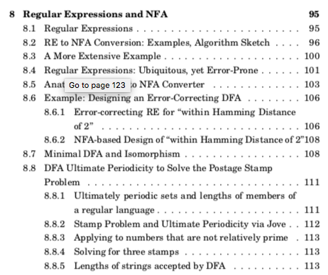
Lecture 9, covering Ch 7,8
Practice using
CH7/CH7.ipynb and then CH8-9/CH8-9.ipynb

Slide 3
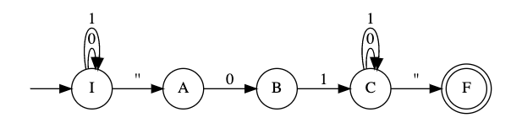
Concepts around NFA, DFA, RE, and Applications
NFA allow regular languages to be specified succinctly
E.g. NFA for “strings that contain 01” (one of many designs)

Slide 4
Concepts around NFA, DFA, RE, and Applications
NFA allow regular languages to be specified succinctly
E.g. NFA for “strings that contain 0101”

Slide 5
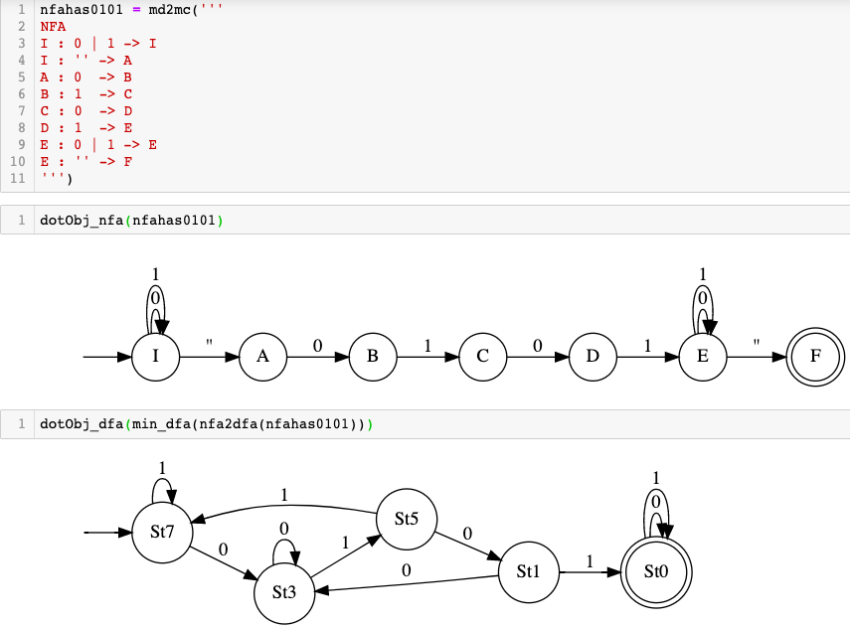
One NFA for “contains 0101”

Slide 6
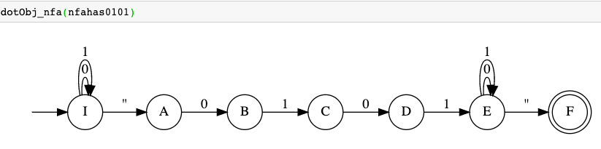
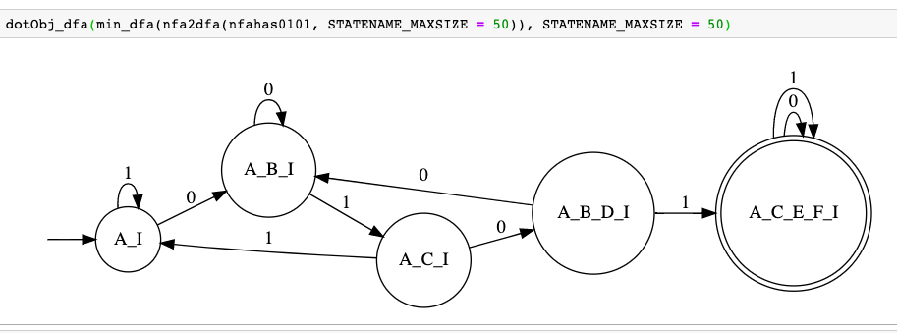
One NFA for “contains 0101” and its equivalent DFA

Slide 7
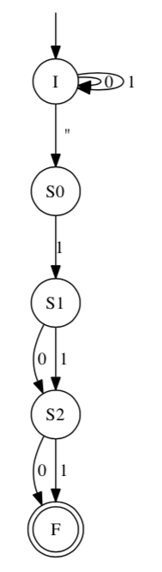
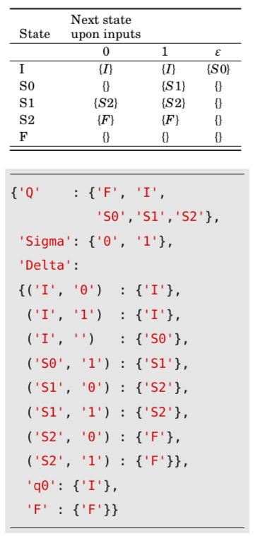
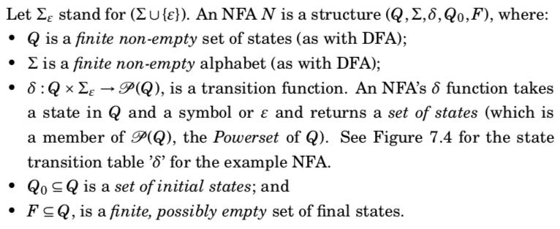
What is an NFA formally?

Slide 8
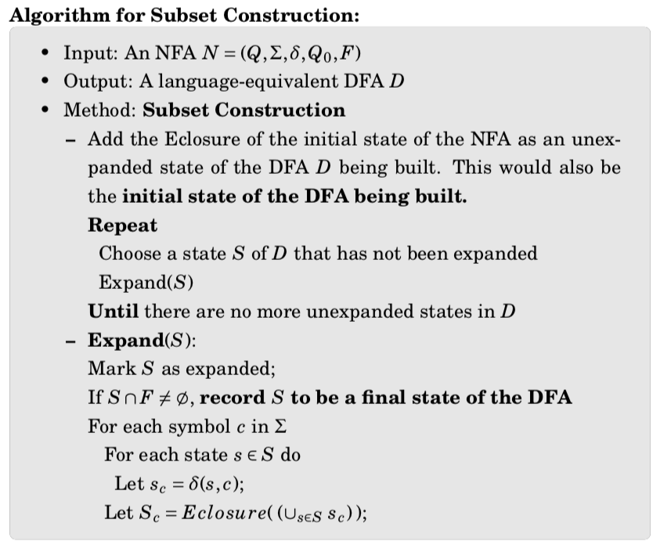
NFA to DFA Conversion

Slide 9
Subset construction illustrated

Slide 10
Review of concepts so far
NFA allow regular languages to be specified succinctly
No direct NFA minimization!
But they are often quite succinct
NFA can never be larger than DFA
DFA are essentially NFA
No epsilon moves
Next SET of states is to a singleton set
NFA can be converted to a DFA with a potential exp blowup
Exp blowup is apparent when we convert the “Nth-last is a 1” NFA to a DFA
Algorithm is called subset construction

Slide 11
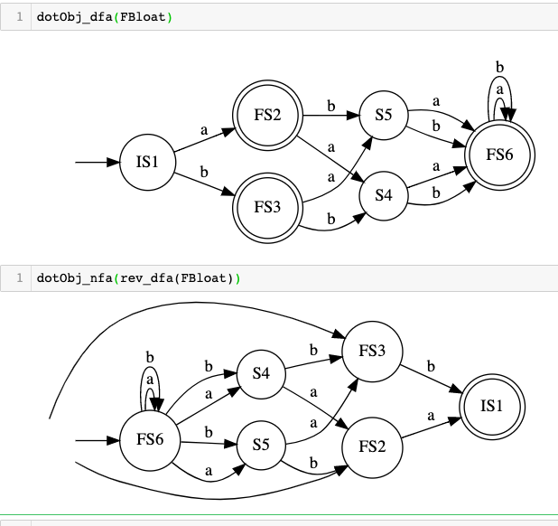
Reversal of DFA produce NFA

Slide 12
What’s the language of FBloat and its reverse?
Language of FBloat via language operations
Language of rev_dfa(Fbloat)

Slide 13
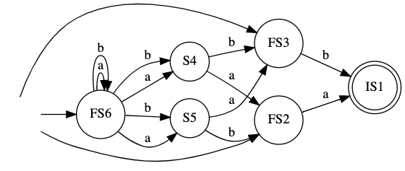
Reversal followed by nfa2dfa i.e. R ; D so far Do subset constrn.

Slide 14
Reversal followed by nfa2dfa i.e. R ; D so far Do subset constrn.
dotObj_dfa(nfa2dfa(rev_dfa(FBloat), STATENAME_MAXSIZE=50), STATENAME_MAXSIZE=50).render('/private/tmp/rdbloat')

Slide 15
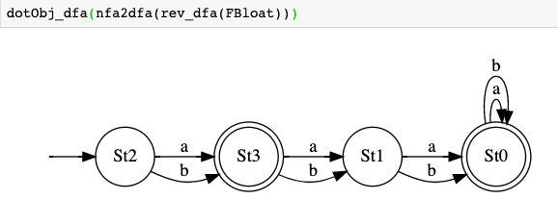
Reversal followed by nfa2dfa i.e. R ; D so far Do subset constrn.

Slide 16
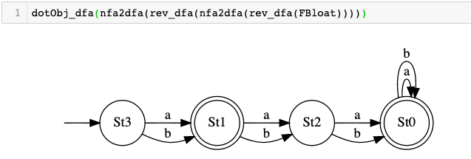
R ; D ; R ; D is Brzozowski’s minimization!

Slide 17
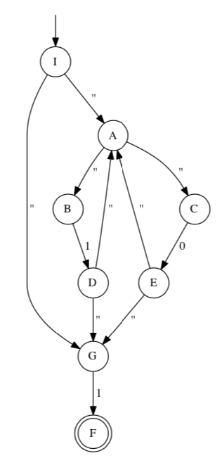
NFA2DFA for NFA with epsilons

Slide 18
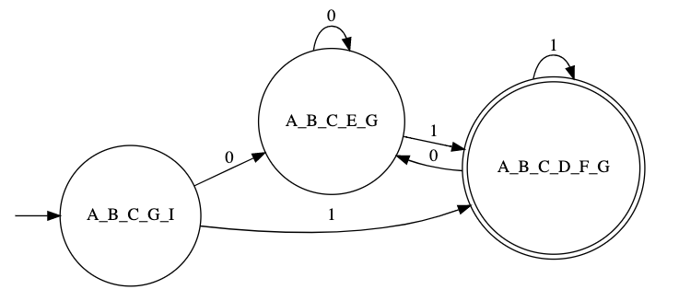
NFA2DFA for NFA with epsilons

Slide 19
Summary
DFA minimization can be done via Rev;Det;Rev;Det
This is Brzozowski’s algorithm

Slide 20
Regular Expressions
RE are textual short-hands for regular languages
Languages put together using Union, Concat, Star, and basic languages
In general, we won’t ask you to design complicated NFA
We will ask you to write REs instead

Slide 21
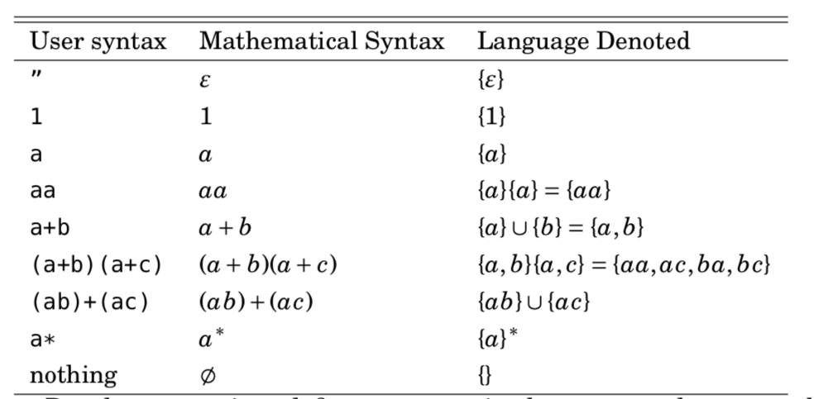
Regular Expressions: Examples
RE are textual short-hands for regular languages
Languages put together using Union, Concat, Star, and basic languages

Slide 22
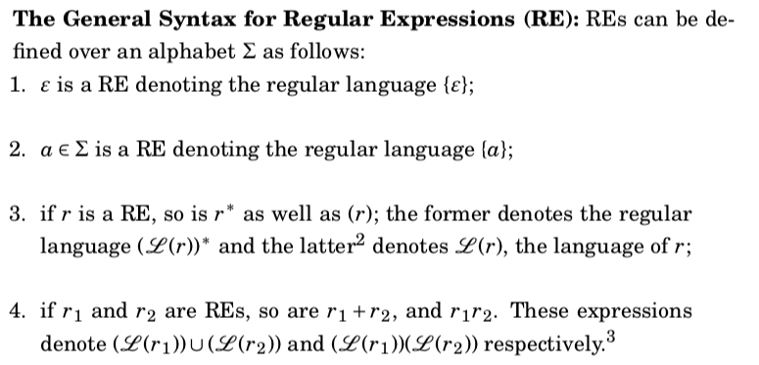
Regular Expressions: General rules

Slide 23
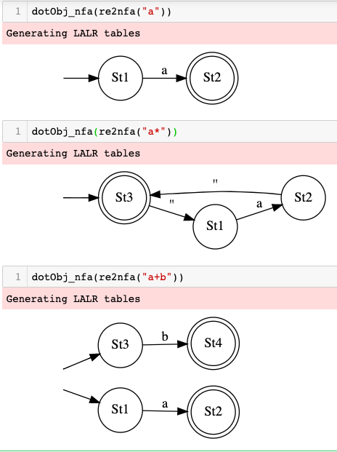
re2nfa

Slide 24
Example: All words with 0101 with a 1-bit error
….0101….
Here either the 0 or the 1 or the 0 or the 1 could be flipped
We must still accept

Slide 25
Idioms for REs
… is (0+1)*
One-bit errors can be captured by a (0+1) pattern
That is,
0101
Versus
(0+1)101
Build the whole RE
Experiment in Jove

Slide 26
…0101… with a 1-bit error (Hamming dist).
dotObj_dfa(min_dfa(nfa2dfa(re2nfa( "(0+1)* ((0+1)101 + 0 (0+1) 01 + 01 (0+1) 1 + 010 (0+1) ) (0+1)*" )))).
render('/private/tmp/0101-one-bit-error')

Slide 27
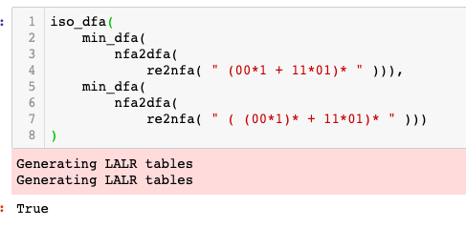
Find the strings in the language of these RE
(00*1 + 11*01)*
( (00*1)* + 11*01)*
( 00*1 + (11*01)*)*
Find out by developing a min DFA
Use iso_dfa

Slide 28
Compare these RE pairwise
( 00*1 )*
( 0 (0+1)* 1 )*

Slide 29
Compare these RE pairwise
(00*1 + 11*01)*
(0 (0+1)* 1 + 11*01)*

