Slide 1

CS 3100, Models of Computation, Fall 20, Lec 5
Ganesh Gopalakrishnan
School of Computing
University of Utah
Salt Lake City, UT 84112

Slide 2
This course is tightly integrated with Jove
Jove provides us the “practice” or “work-book”
Hence all updates will be in the Github that serves you Jove
So please note – WHEN IS MIDTERM-1 NOW?
Go to the Jove landing page (in the syllabus)
bit.ly/cs3100fall2020
You’ll see it there!
Keep looking at this page (as required in the syllabus)
All updates and study plans and readings are there too

Slide 3
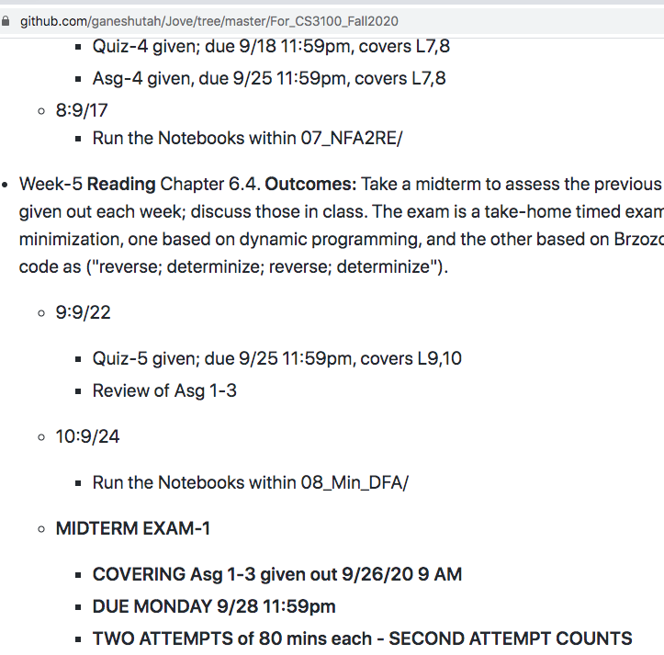
Here is a screenshot of MIDTERM-1 update!

Slide 4
The 30,000 feet view till Midterm-1
Big Picture
DFA: Get its design well-understood
Large DFA:
We will be converting regular expressions (RE) to NFA then to DFA
Sometimes we will design a DFA in parts and assemble (union, intersection, etc.)
NFA
We will study its Delta function through simulation
How to think of non-determinism (if you were to build a non-deterministic device!)
Basic tool in complexity theory (non-deterministic Turing Machines build off this)
Main things with an NFA:
NFA to DFA algorithm
Follows the simulation mindset closely, but the end result is a single DFA that acts like an NFA
Some things are hard (directly to do) with a DFA, some with an NFA
DFA: which are hard: Union? Intersection? Complement? Concatenation? Star?
NFA: which are hard: Union? Intersection? Complement? Concatenation? Star?
RE (Regular Expressions): Just how you TYPE IN certain well-structured NFA !!! No more, no less!!!
Will learn to convert RE to NFA to DFA to NFA to RE to NFA to DFA … (as many times) … and minimize a DFA whenever!
Brzozowski’s minimization
The most powerful one-line Python program you’ll write in this course!
Other textbooks teach the dyn prog algo which we will also study!
Learned at the feet of Prof. Brzozowski: His minimization is often faster !!
Brzozowski’s Derivatives
The “d/dx” of Automata !!!
Helps you handle complementation of RE

Slide 5
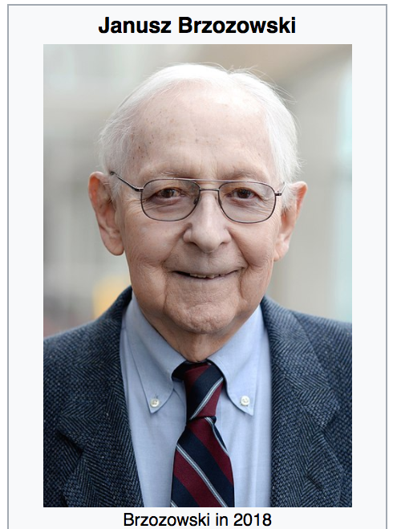
Honoring Prof. Janusz Brzozowski (lucky me!)
https://en.wikipedia.org/wiki/Janusz_Brzozowski_(computer_scientist)

Slide 6
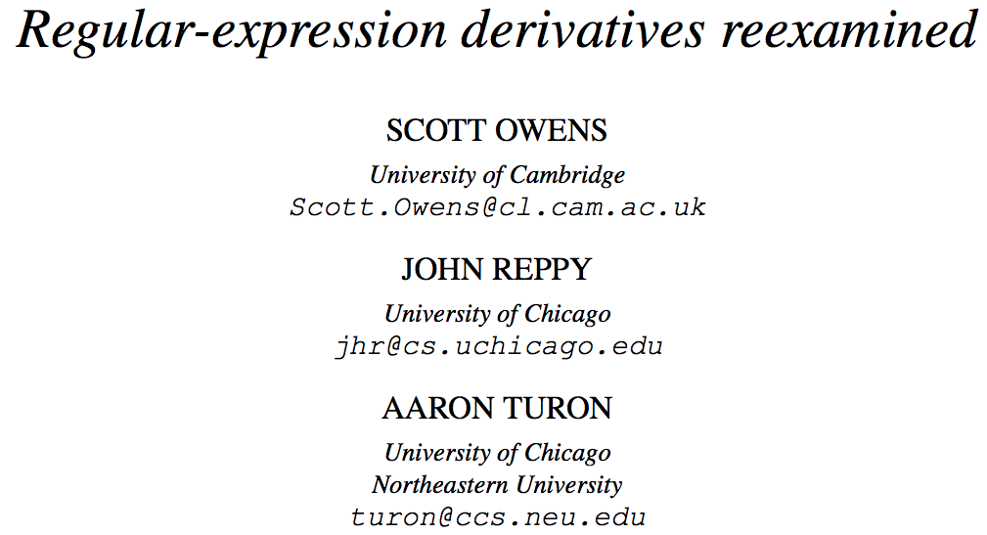
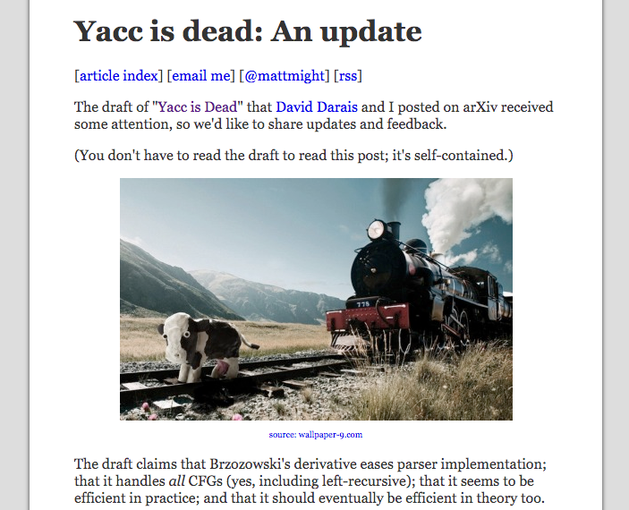
Where all have derivatives gone?

Slide 7
AMA
In response to surveys
Immensely helps stay connected in an online class
Will administer one next week
Let’s design a few DFA
Notebook in 02-DFA/AMA_9_10_20.ipynb

Slide 8
Overview of Lec-5
Finish up DFA operations (from Lec-4)
Union and Complement
Value of having Intersection, Union, Complement
Very brief of Isomorphism and Language Equivalence
You’ll be using these facilities in Asg-2
Details of the minimization algorithm coming later
Today’s main topic - NFA

Slide 9
Recap (solve the Union construction for DFA)
Given two DFA D1 = (Q1, Sigma, delta1, q01, F1) and
D2 = (Q2, Sigma, delta2, q02, F2)
Define a new DFA D such that L(D) = L(D1) Union L(D2)
Let D = (Q, Sigma, delta, q0, F)
What are these items:
Q = ?
q0 = ?
F = ?
For x in Sigma, what is delta( (q1, q2), x ) = ?
(PAUSE)

Slide 10
Union of two DFA
Given two DFA D1 = (Q1, Sigma, delta1, q01, F1) and
D2 = (Q2, Sigma, delta2, q02, F2)
Define a new DFA D such that L(D) = L(D1) Union L(D2)
Let D = (Q, Sigma, delta, q0, F)
What are these items:
Q = ?
q0 = ?
F = ?
For x in Sigma, what is delta( (q1, q2), x ) = ?
( would you like hints?? )

Slide 11
Union of two DFA
Given two DFA D1 = (Q1, Sigma, delta1, q01, F1) and
D2 = (Q2, Sigma, delta2, q02, F2)
Define a new DFA D such that L(D) = L(D1) Union L(D2)
Let D = (Q, Sigma, delta, q0, F)
What are these items:
Q = Q1 x Q2
q0 = (q01, q02)
F = (F1 x Q2) U (Q1 x F2)
For x in Sigma, what is delta( (q1, q2), x ) = ( delta1(q1, x), delta2(q2,x) )
(confirm!)

Slide 12
Complement of a DFA
Given a DFA D = (Q, Sigma, delta, q0, F)
What is the complement of D ?
What are these items:
Q =
q0 =
F =
For x in Sigma, what is delta( q, x ) = ?
(pause / confirm)

Slide 13
Uses of DFA ”Boolean Ops” (U, intersection, compl)
DFA Design for many languages can be simplified
Example: Define a DFA that accept strings that
DON’T’s begin with 010 AND DON’T’s end with 101
Can use Demorgan’s laws
Design for Begins with 010
Design for End with 101
OR them
Complement them
Compare with a direct design of the given problem!
This will be worked out in class interactively, by hand and by Jove

Slide 14
Checking one’s work
Since DFA designs are “tricky”, it is good to try and design it using two different approaches
Then one can check one’s work thanks to one property:
“ If DFA D1 and D2 have the same language, then min(D1) and min(D2)
are isomorphic”
This is the Myhill-Nerode Theorem

Slide 15
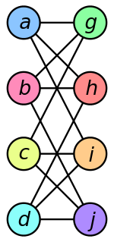
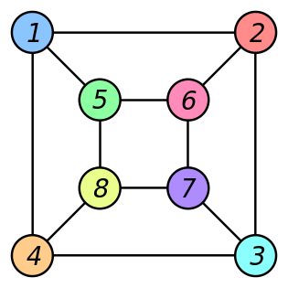
Review: Graph Isomorphism
Two graphs G1 and G2 are isomorphic if
(Informal) If one can print G1 and G2, place them one on top of the other and match up states and transitions
may have to ”pull” one graph and reshape it…
(Formal) If there is a 1-1 and onto function that maps states to states and transitions to transitions
(Example from Wikipedia)

Slide 16
Review: Graph Isomorphism
These graphs are isomorphic because of this 1-1 and onto map
f ( a ) = 1
f ( b ) = 6
f ( c ) = 8
f ( d ) = ?
f ( g ) = ?
f ( h ) = ?
f ( i ) = ?
f ( j ) = ?

Slide 17
Review: Graph Isomorphism
These graphs are isomorphic because of this 1-1 and onto map
f ( a ) = 1
f ( b ) = 6
f ( c ) = 8
f ( d ) = 3
f ( g ) = 5
f ( h ) = 2
f ( i ) = 4
f ( j ) = 7

Slide 18
Complexity
General graph isomorphism is hard - known to be in NP
Exact status beyond that is open
In our case, for two DFA, we can solve it in polynomial time
At-most we will generate only Q1 x Q2 states
We can match starting from the initial state pairs
We can then (recursively) match as per the symbols from the alphabet

Slide 19
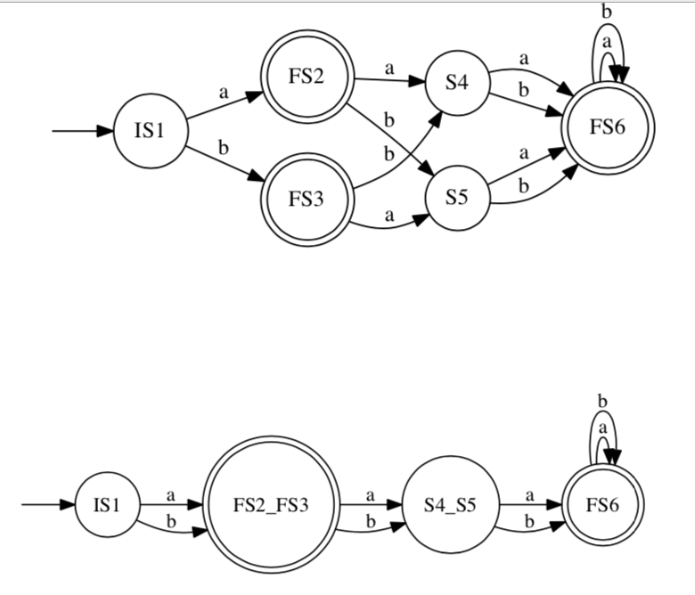
Language equivalence and isomorphism
Two DFA are language equivalent if they accept the same set of strings
They are isomorphic if they are language equivalent and have the same number of states
Question: Are these DFA
Language Equivalent ?
Isomorphic ?

Slide 20
DFA minimization (for Asg-2)
Two DFA states s1 and s2
can be merged
if for all strings s from Sigma*
s1 upon s goes to state s1prime
s2 upon s goes to state s2prime
AND
s1prime and s2prime are either
Both accepting or Both non-accepting
You’ll practice this while doing
Assignment-2

Slide 21
Main use in Automata Theory
Design a DFA using two different approaches
Obtain D1 and D2
If min(D1) is isomorphic to min(D2) then the two DFA are language-equivalent
Else we can find mistakes in our design
One of the designs is wrong (relative to the other)

Slide 22
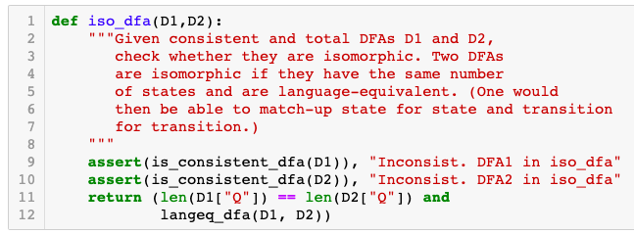
Code for Isomorphism: Check that the given DFA D1 and D2 1) have the same number of states AND 2) are language-equivalent

Slide 23
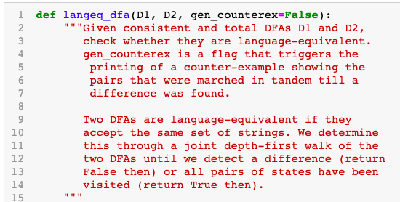
Code Comments for Language Equivalence Basically does a Depth-First traversal on the graphs of the DFA to check that they are recursively language equivalent, after each transition

Slide 24
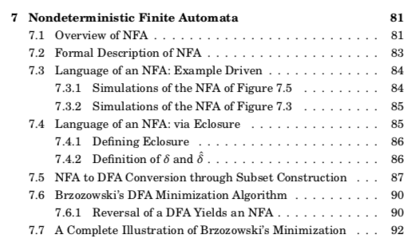
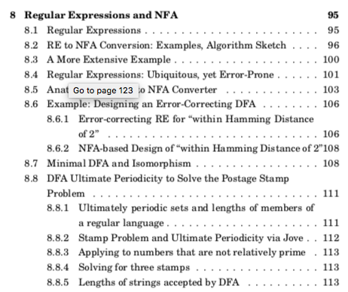
Now, onto NFA, covering Ch 7,8

Slide 25
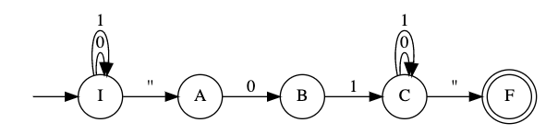
Why NFA?
NFA allow regular languages to be specified succinctly
E.g. NFA for “strings that contain 01” (one of many designs)

Slide 26
NFA sizes versus DFA sizes
NFA for “Second bit is 1” versus “Second-last is 1”
DFA for “Second bit is 1” versus “Second-last is 1”
Which do you think is larger and why (intuition)?

Slide 27
Importance of “nondeterminism” in CS
Assume that “parallelism is free”
Allow the machine to explore many moves in parallel
”NP”: With this assumption, we still take polynomial time

Slide 28
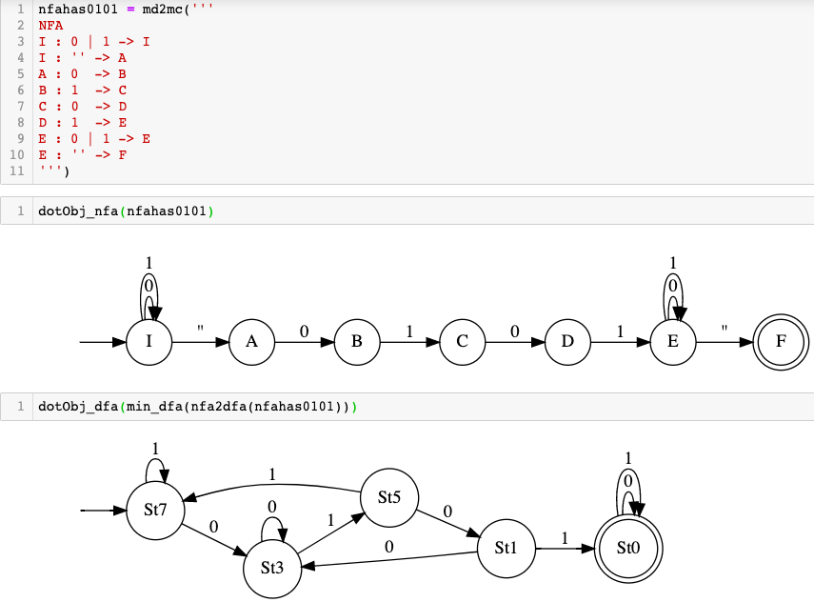
One NFA for “contains 0101” (it has an underlying DFA)

Slide 29
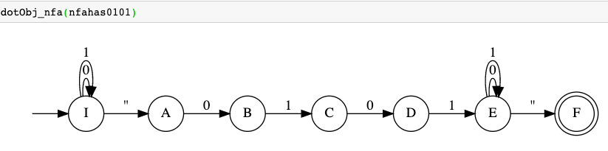
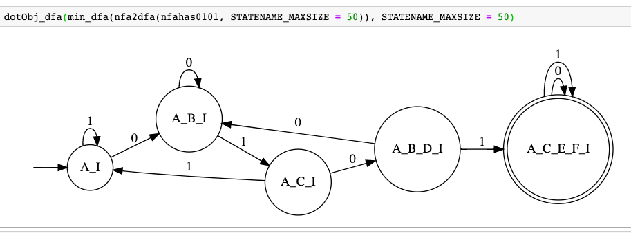
One NFA for “contains 0101” and its equivalent DFA
Revealing how nfa2dfa works in Jove by setting STATENAME_MAXSIZE

Slide 30
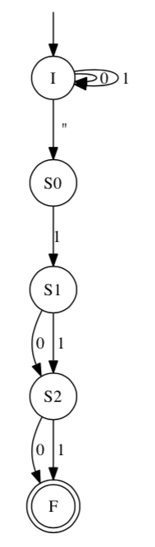
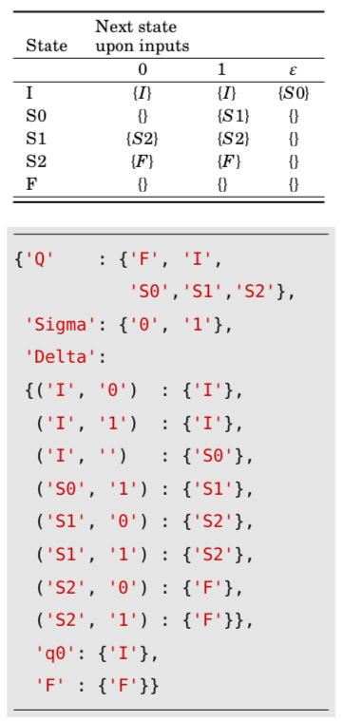
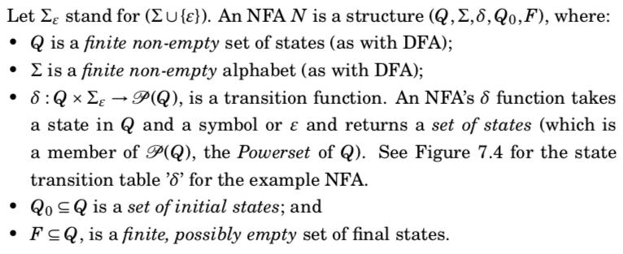
What is an NFA formally?
An NFA accepts a string x
if there is a string starting
from some initial state to
one of the final states
(x may have epsilons inserted into it)

Slide 31
NFA details
Number of initial states?
Number of final states?
What can label the transitions?
What is the nature of its delta?

Slide 32
NFA operations
Take these NFA as examples:
NFA1 = md2mc(
‘’’NFA I : a -> F1
I : b -> F2
| : a -> S ’’’)
NFA2 = md2mc(
‘’’NFA I : b -> F1
I : c -> F2’’’)
How to perform these NFA operations:
Union, intersection, Concatenation, Complement

Slide 33
NFA operations
Take these NFA as examples:
NFA1 = md2mc(
‘’’NFA I : a -> F1
I : b -> F2
| : a -> S ’’’)
NFA2 = md2mc(
‘’’NFA I : b -> F1
I : c -> F2’’’)
How to perform these NFA operations:
Union, intersection, Concatenation, Complement

Slide 34
NFA operations
Take these NFA as examples:
NFA1 = md2mc(
‘’’NFA I : a -> F1
I : b -> F2
| : a -> S ’’’)
NFA2 = md2mc(
‘’’NFA I : b -> F1
I : c -> F2’’’)
How to perform these NFA operations:
Union, intersection, Concatenation, Complement

Slide 35
NFA operations
Take these NFA as examples:
NFA1 = md2mc(
‘’’NFA I : a -> F1
I : b -> F2
| : a -> S ’’’)
NFA2 = md2mc(
‘’’NFA I : b -> F1
I : c -> F2’’’)
How to perform these NFA operations:
Union, intersection, Concatenation, Complement

Slide 36
NFA operations
Take these NFA as examples:
NFA1 = md2mc(
‘’’NFA I : a -> F1
I : b -> F2
| : a -> S ’’’)
NFA2 = md2mc(
‘’’NFA I : b -> F1
I : c -> F2’’’)
How to perform these NFA operations:
Union, intersection, Concatenation, Complement

Slide 37
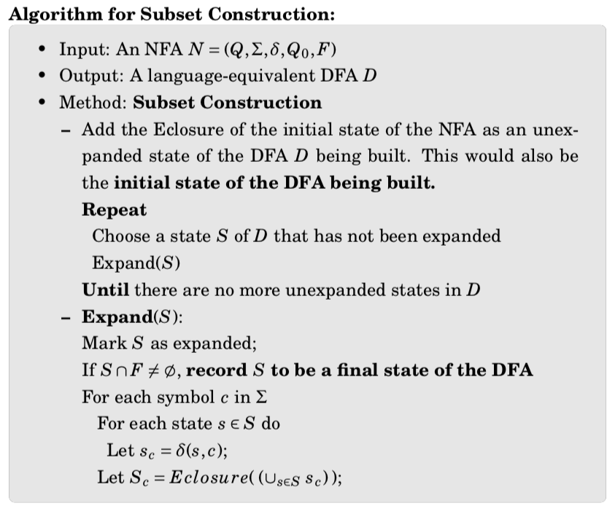

NFA to DFA Conversion [[ Obtains the DFA underying an NFA 1) Describe using an NFA 2) Obtain a DFA 3) Put DFA in code 4) “ship it” ]]

Slide 38

Exercise 1: Convert this NFA to a DFA

Slide 39
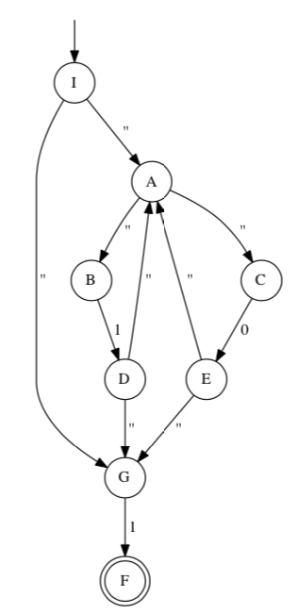
Exercise-2: Convert this NFA to a DFA

Slide 40
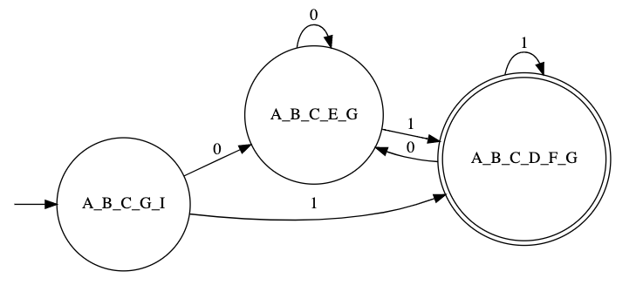
NFA2DFA for NFA with epsilons

Slide 41
NFA to DFA conversion complexity
For an N-state NFA, how many DFA states can we expect (worst-case)?

