Slide 1

CS 3100, Models of Computation, Spring 20, Lec 9
Ganesh Gopalakrishnan
School of Computing
University of Utah
Salt Lake City, UT 84112
bit.ly/3100s20Syllabus

Slide 2


Overview
Walk the Kleene-Pipeline
The Postage-Stamp Problem

Slide 3
Today’s Item 1: Walk the Kleene-Pipeline
Review
Once
More
Practice
Once
More
Study
Again
RE
NFA
DFA
minDFA
Brand New
Trivial, but a Useful
Stepping-Stone
(this way we don’t
need to implement
a separate DFA to RE
procedure)

Slide 4
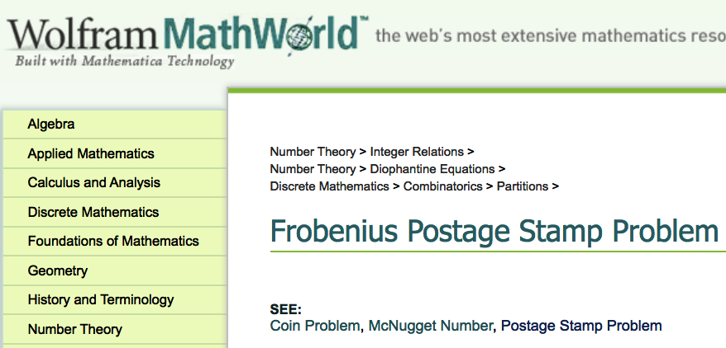
Today’s Item 2: Solve the Postage-Stamp Problem

Slide 5
What are RE?
Epsilon
a in Sigma
If R1 and R2 are RE, then R1 + R2 is an RE
If R1 and R2 are RE, then R1 R2 is an RE
If R is an RE, then ( R ) is an RE
If R is an RE, then R* is an RE
Nothing else is an RE

Slide 6
Cover RE → NFA for each case
Epsilon
a in Sigma
If R1 and R2 are RE, then R1 + R2 is an RE
If R1 and R2 are RE, then R1 R2 is an RE
If R is an RE, then ( R ) is an RE
If R is an RE, then R* is an RE
Nothing else is an RE

Slide 7
Cover RE → NFA for each case
Epsilon
a in Sigma
If R1 and R2 are RE, then R1 + R2 is an RE
If R1 and R2 are RE, then R1 R2 is an RE
If R is an RE, then ( R ) is an RE
If R is an RE, then R* is an RE
Nothing else is an RE

Slide 8
Cover RE → NFA for each case
Epsilon
a in Sigma
If R1 and R2 are RE, then R1 + R2 is an RE
If R1 and R2 are RE, then R1 R2 is an RE
If R is an RE, then ( R ) is an RE
If R is an RE, then R* is an RE
Nothing else is an RE

Slide 9
Cover RE → NFA for each case
Epsilon
a in Sigma
If R1 and R2 are RE, then R1 + R2 is an RE
If R1 and R2 are RE, then R1 R2 is an RE
If R is an RE, then ( R ) is an RE
If R is an RE, then R* is an RE
Nothing else is an RE

Slide 10
Cover RE → NFA for each case
Epsilon
a in Sigma
If R1 and R2 are RE, then R1 + R2 is an RE
If R1 and R2 are RE, then R1 R2 is an RE
If R is an RE, then ( R ) is an RE
If R is an RE, then R* is an RE
Nothing else is an RE

Slide 11
Cover RE → NFA for each case
Epsilon
a in Sigma
If R1 and R2 are RE, then R1 + R2 is an RE
If R1 and R2 are RE, then R1 R2 is an RE
If R is an RE, then ( R ) is an RE
If R is an RE, then R* is an RE
Nothing else is an RE

Slide 12
Regular Expressions
RE are textual short-hands for regular languages
Languages put together using Union, Concat, Star, and basic languages
In general, we won’t ask you to design complicated NFA
We will ask you to write REs instead

Slide 13
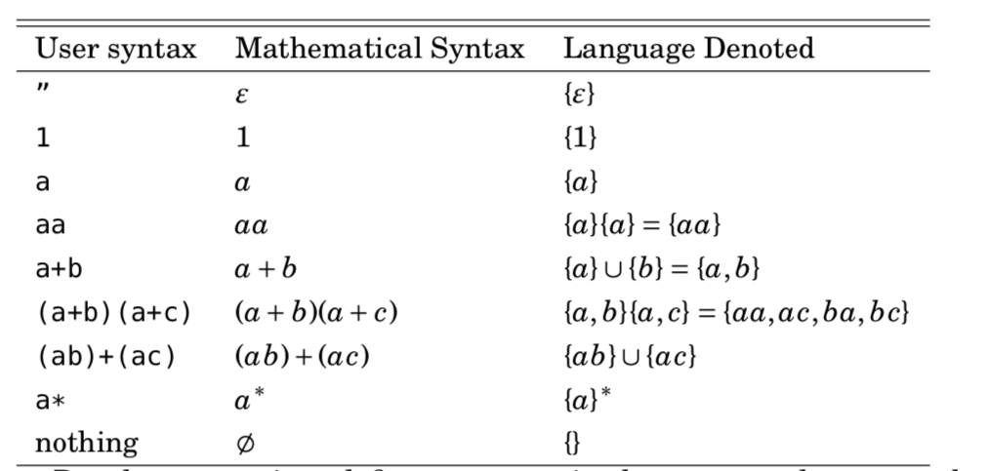
Regular Expressions: Examples
RE are textual short-hands for regular languages
Languages put together using Union, Concat, Star, and basic languages

Slide 14
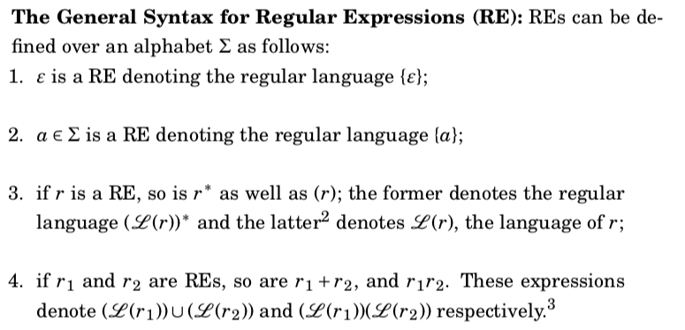
Regular Expressions: General rules

Slide 15
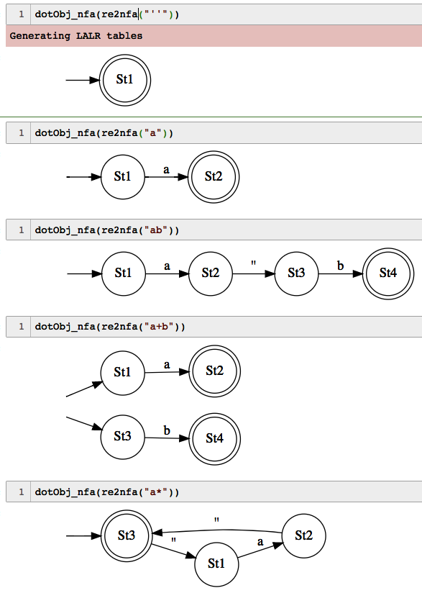
RE → NFA examples

Slide 16
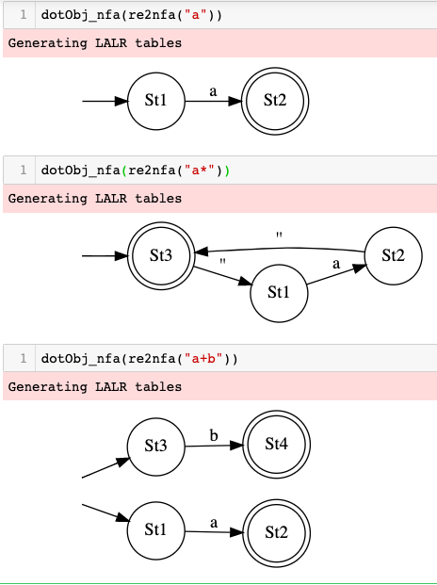
re2nfa

Slide 17
Example: All words with 0101 with a 1-bit error
….0101….
Here either the 0 or the 1 or the 0 or the 1 could be flipped
We must still accept

Slide 18
Idioms for REs
… is (0+1)*
One-bit errors can be captured by a (0+1) pattern
That is,
0101
Versus
(0+1)101
Build the whole RE
Experiment in Jove

Slide 19
…0101… with a 1-bit error (Hamming dist).
dotObj_dfa(min_dfa(nfa2dfa(re2nfa( "(0+1)* ((0+1)101 + 0 (0+1) 01 + 01 (0+1) 1 + 010 (0+1) ) (0+1)*" )))).
render('/private/tmp/0101-one-bit-error')

Slide 20
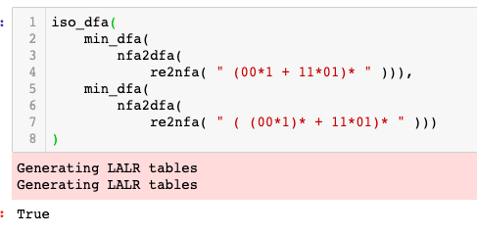
Find the strings in the language of these RE
(00*1 + 11*01)*
( (00*1)* + 11*01)*
( 00*1 + (11*01)*)*
Find out by developing a min DFA
Use iso_dfa

Slide 21
Challenge Problems

Slide 22
Problem-1: Compare these RE pairwise
( 00*1 )*
( 0 (0+1)* 1 )*
Equivalent?
Differences?

Slide 23
Problem-2: Compare these RE pairwise
(00*1 + 11*01)*
(0 (0+1)* 1 + 11*01)*
Equivalent?
Differences?

Slide 24
Postage-stamp problems
For relatively prime numbers a,b what is the largest integer not expressible as a linear combination of a, b ?
Let a = 2, b = 3
(for larger numbers, let’s use a tool)
How about for more pairwise relatively prime numbers a,b,c
How about non relatively-prime numbers?
These relate to the ”stamps” problems

Slide 25
Postage-stamp problems
Stamp problems
How do we express all stamps that can be formed using 3 and 5 cents as an RE?
How do we find out the largest value that CANNOT be made using 3 and 5 cents?

Slide 26
Postage-stamp problems
Idea:
A 3-cent is like “111”
A 5-cent is like “11111”
A 3 and a 5 cent is like
111 followed by 11111 (or the other way)
Many 3 and 5 cents (zero or more) is ?

Slide 27
Postage-stamp problems
Many 3 and 5 cents (zero or more) is
(111 + 11111)*
This is an RE!
Its minimal DFA has a specific shape -- what is it?

Slide 28
Postage-stamp problems
Its minimal DFA has a specific shape -- what is it?
It is a ”lasso”
Cannot branch (only one symbol in the alphabet)
It goes forward a while
Then it curls back onto the last state!
This is guaranteed for relatively prime numbers like 3 and 5
For 2 and 4 cents, the lasso is different
It curls back to a previous state including a loop of size > 1

Slide 29
Postage-stamp problems
It goes forward a while
Then it curls back onto the last state!
This is guaranteed for relatively prime numbers like 3 and 5
For 2 and 4 cents, the lasso is different
It curls back to a previous state including a loop of size > 1
Find out by typing
min_dfa(nfa2dfa(re2nfa(RE1))) or RE2 where
RE1 = (111+11111)*
RE2 = (11+1111)*

Slide 30
Postage-stamp problems
For relatively prime numbers, we can find out
The # of states in the DFA
The number of hops to reach the final state
Answer = one less than the last hop
Which is 2 less than the final state
ANSWER: min_dfa(nfa2dfa(re2nfa(RE1))) [“Q”] – 2
Work thru the notebook to see why!

