Slide 1

CS 3100, Models of Computation, Spring 20, Lec 10
Ganesh Gopalakrishnan
School of Computing
University of Utah
Salt Lake City, UT 84112
bit.ly/3100s20Syllabus

Slide 2
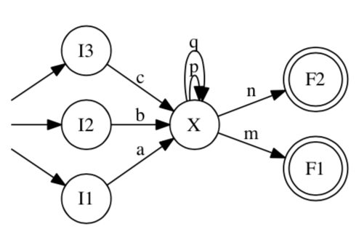
NFA to RE conversion
What is the language of this NFA?
Let’s convert this to an RE and check our work against this RE

Slide 3
NFA to RE conversion
(space for work)

Slide 4
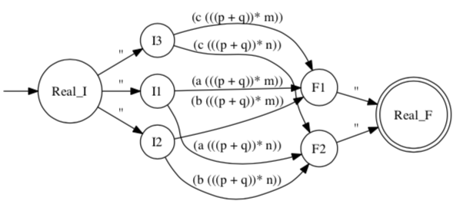
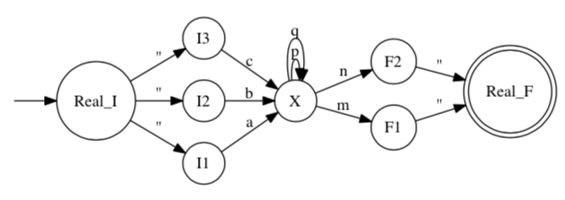
NFA to RE conversion: Results

Slide 5
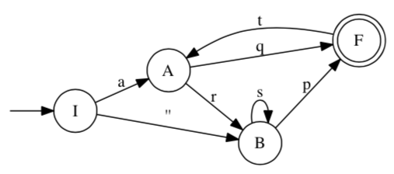
Another example of NFA to RE
(space for work)

Slide 6

One more example of RE -> NFA -> DFA
ac* + acd*, simplified as a(c*+cd*)

Slide 7
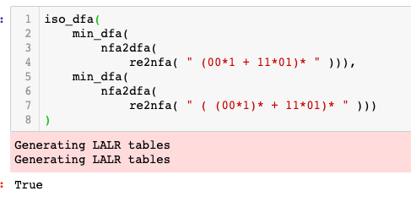
One way to compare two REs using tools
(00*1 + 11*01)*
( (00*1)* + 11*01)*
( 00*1 + (11*01)*)*
Find out by developing a min DFA
Use iso_dfa

Slide 8
Compare these RE pairwise (by hand)
( 00*1 )*
( 0 (0+1)* 1 )*

Slide 9
Compare these RE pairwise (by hand)
(00*1 + 11*01)*
(0 (0+1)* 1 + 11*01)*

