Slide 1

CS 3100, Models of Computation, Fall 20, Lec 9
Ganesh Gopalakrishnan
School of Computing
University of Utah
Salt Lake City, UT 84112

Slide 2
Lecture 9, 9/22/20
Notebooks are in 08_Min_DFA
Today: will work out
Postage Stamps
RE
Minimization
Thu
Will send you into breakout rooms of size 6 (or so) with a problem-set
You can tell us when we all visit what help you need
Problems will be VERY SHORT but examine all concepts + ideas taught
E.g. intersect-dfa : Ask you to do ONE STEP!
Will give RE problems too

Slide 3
POSTAGE STAMPS – good illustration of RE

Slide 4
Postage Stamp Problems
AKA “coin problem” (see Wikipedia)
Sylvester’s formula for two relatively-prime numbers
e.g. a=2 and b=3
Largest one cannot make is ab - a – b (called the Frobenius number)
For a=2, b=3, it is 2.3 – 2 – 3 = 1
a=3,b=4 --> 12 – 7 = 5
a=3,b=7 → ?
Wikipedia also gives the number of stamps that cannot be made below the Frobenius number
Wikipedia says “for 3 or more stamps, there are hard algos”
I happened to discover them via minimal RE! (have not seen it elsewhere)

Slide 5
Postage Stamp Problems
Excellent illustration of RE and minimal DFA
For a=3 and b=5, the minimal DFA for
(ppp+ppppp)* gives the solution
“p” is just a position – can be anything!
(000+00000)* is OK
(111+11111)* is OK
Only the LENGTH of strings matter!
If you have a,b,c where two of them are relatively prime, those two can fill “all gaps”
E.g. 3,4,6

Slide 6
Postage Stamp Problems
If the numbers are not relatively prime, a “GCD-sized loop” develops!
E.g. a=6,b=9
Then infinitely many values don’t exist!

Slide 7
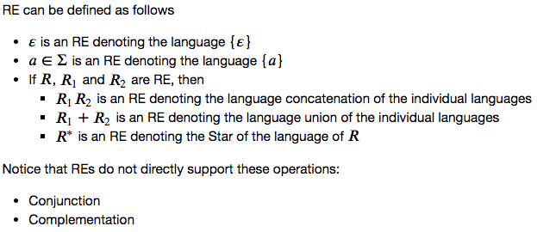
Basics of RE

Slide 8
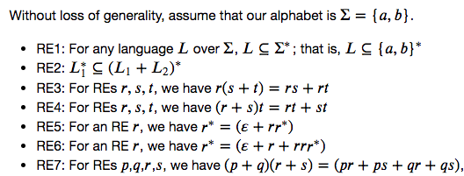
Simplifying RE and comparing them: some RE equations

Slide 9
Compare these RE pairwise (hand / diff_RE)
R1 = ( 00*1 )*
R2 = ( 0 (0+1)* 1 )*
Is R1 contained in R2?
If not, find something in R1 not in R2
Is R2 contained in R1?
If not, find something in R2 not in R1

Slide 10
Compare these RE pairwise (hand / diff_RE )
R1 = ( 00*1 )*
R2 = ( 0 (0+1)* 1 )*
Is R1 contained in R2?
YES, as (0+1)* of R2 generalizes 0* of R1
Is R2 contained in R1?
NO; use diff_RE to find out!

Slide 11
Showing RE equal (or not): reading skill practice
If you find one string in R1 not in R2
and another string in R2 not in R1
Then they are not the same
Else spend time proving equality
Example: (0+1)* =?= (0* 1*)* =?= (1* 0*)*

Slide 12
Use these to prove the fact that (0+1)* = (0* 1*)*

Slide 13
Showing RE equal (or not): reading skill practice
If you find one string in R1 not in R2
and another string in R2 not in R1
Then they are not the same
Else spend time proving equality
Example:
0 (0* + 11*0)* versus (01*)*0

Slide 14
Compare these RE pairwise (by hand/diff_RE)
R3 = ’’+ 0 (0* + 11*0)* + 1 (1* + 00*1)*
R4 = (01*)*0 + (10*)*1
Is R1 contained in R2?
If not, find something in R1 not in R2
Is R2 contained in R1?
If not, find something in R2 not in R1

Slide 15
Compare these RE pairwise (by and by tool)
R3 = ’’+ 0 (0* + 11*0)* + 1 (1* + 00*1)*
R4 = (01*)*0 + (10*)*1
Is R1 contained in R2?
If not, find something in R1 not in R2
Is R2 contained in R1?
If not, find something in R2 not in R1

Slide 16
RE for “does not contain 001” (negation is hard)! But negation is NOT NEEDED to express ALL OF REGULAR LANGUAGES
No001 = …

Slide 17
DFA Minimization via Dynamic Programming

Slide 18
FULL EXAMPLE
bigEqChange
IF : 0 -> F0
IF : 1 -> F1
F0 : 0 -> F0
F0 : 1 -> A
A : 1 -> A
A : 0 -> F2
F2 : 0 -> F0
F2 : 1 -> A
F1 : 1 -> F1
F1 : 0 -> B
B : 0 -> B
B : 1 -> F1

Slide 19
FULL EXAMPLE
bigEqChange
IF : 0 -> F0
IF : 1 -> F1
F0 : 0 -> F0
F0 : 1 -> A
A : 1 -> A
A : 0 -> F2
F2 : 0 -> F0
F2 : 1 -> A
F1 : 1 -> F1
F1 : 0 -> B
B : 0 -> B
B : 1 -> F1
Write out table so that all nC2 entries can be considered
State order: IF F0 F1 A B F2 (pick any!)
X axis : “most from left to right” (leave out only last one)
Y axis : “rest from top to bottom” (begin with second)
E.g.
X axis : IF F0 F1 A B -→
Y axis: F0 F1 A B F2 (top to bottom)

Slide 20
Automated Printout!
dotObj_dfa(min_dfa(bigEqChange, chatty=True, state_name_mode='verbose'), STATENAME_MAXSIZE=60)
Produces full detail of hand algo!!

