Slide 1
Minimalist
Server Side Development Project
T00198005 Yit How Wong
Lecturer : Anne O Brien

Slide 2
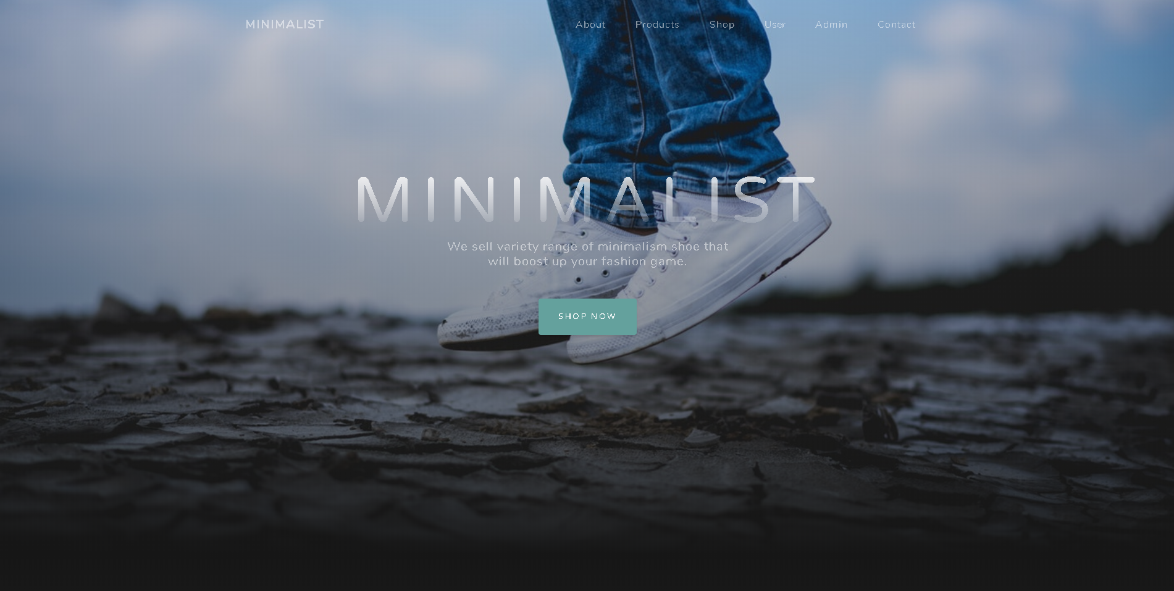
What is Minimalist?

Slide 3
What can minimalist do?
An ecommerce website which only sells premium white shoes with premium price tag.
A customer must be registered within the system before purchasing a shoe.
A registered customer can log in to system again;
An admin can perform various administrative task on this website.

Slide 4
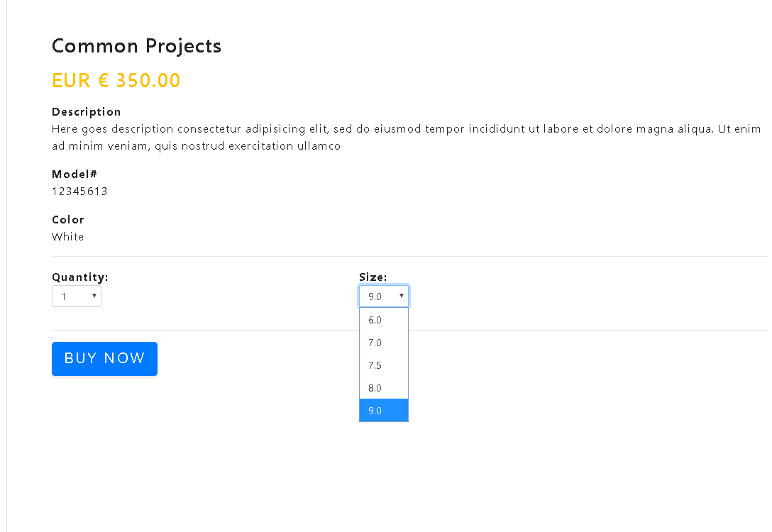
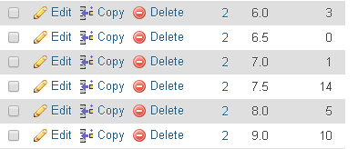
Main point/issues in my project
In this project, I wish to build to build a database driven website using PHP.
Example, retrieve all available size on particular shoe .

Slide 5
Why am I doing this?
Expand the range of the selling products without hard-coding everything.
Keeping everything in consistent such as design, calculation and process
Reducing the amount of code to be changed during next modification

Slide 6
Something special?
Use of session to store customer id , and item cart
Some sort of bootstrap and javascript

Slide 7
What I didn’t finish up/ couldn’t do
Some code are done by hard-coding
Design is not 100% consistent
Passing input value as array (everything display on one page)
Not doing clean-coding
Shopping cart
Deleting data that might bring up some referential integrity issue
Feedback after purchasing product

Slide 8
What should I do?
Starting the project earlier
Listing out the task beforehand

Slide 9
What can I improve on this project?
Better navigation
Reducing use of hard-coding
Better using experience
Better database design

