Slide 1
HTTP5112: Database
Week 1: Introduction to Databases
Fall 2023
Tues/Wed 11:40AM, Online

Slide 2
Instructor: Jemi Choi
Contact: jemi.choi@humber.ca

Slide 3
Welcome to the class
In this course, we will learn:
What is a database
Different tools for interacting with a database
Different techniques for interacting with a database
How to design and optimize a database

Slide 4
Modules
(tentative)
Week | Topic
1 | Introduction
2 | Accessing Data I
3 | Accessing Data II
4 | Join Operations
5 | Built-in Functions
6 | Database Design Part I
7 | Database Design Part II
8 | Database Design Part III
9 | Views & Triggers
10 | Custom Functions
11 | Procedures
12 | User Management
13 | Project presentations

Slide 5
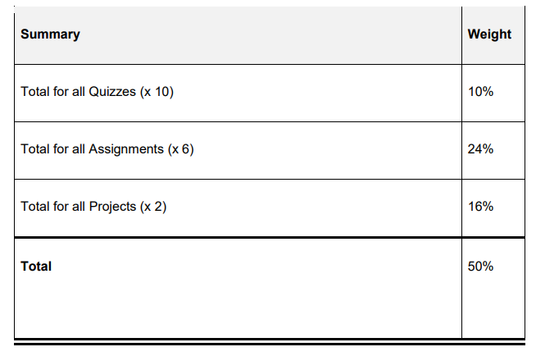
Summary of Course Components
* (tentative)

Slide 6
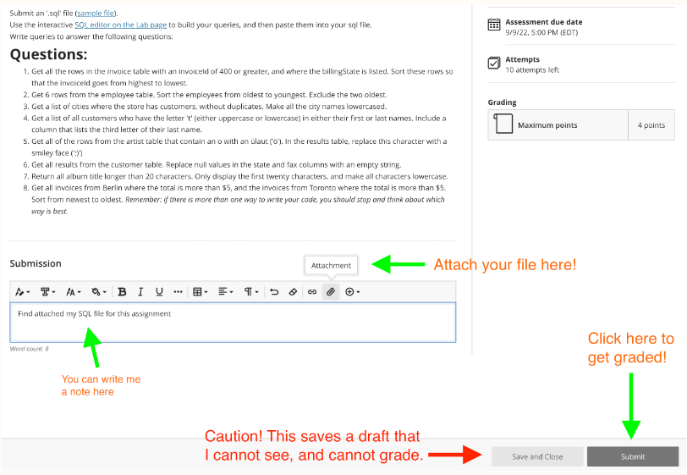
Submitting your assignments
Add your name and student number in the file name
Julie_Lee_HTTP5112_Week2Lab.sql
Submit your assignments and labs in BlackBoard

Slide 7




Why learn Structured Query Language (SQL)?
SQL powers the databases of the internet
3rd most popular programming language (source: StackOverflow)
SQL is used by large companies such as Google, Amazon, Airbnb, Wordpress etc.
SQL jobs skills are in high demand
Robust and easier to use

Slide 8
Job prospects
Web developer
SQL developer / Database developer
Data Scientist
Data Analyst
Business Analyst
Data warehouse architect
Database administrator
Data modeler
ETL developer (Extract, transform, load)

Slide 9
Today’s class:
Introduction
Overview
What is a database?
What does a database do?
Terms and definitions
Install MAMP

Slide 10

What is a database?
Database is the memory of a website

Slide 11
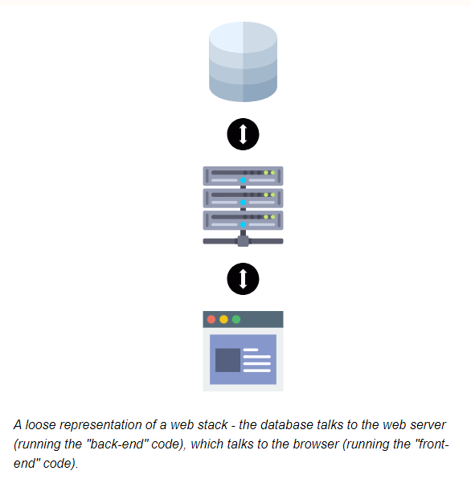
Database
Database stores information that can be later recalled
Common uses :
String the content of your website – especially if the information is updated
Remembering users
Remembering things from one page to the next (for example, items in a shopping cart)
SQL
Servers
Website

Slide 12

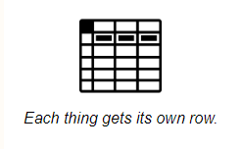
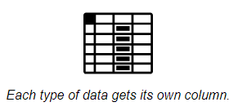
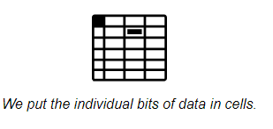
Database: Relational
The most common type of database used today
Made up of tables that connect together, hence “relational”
Table
Row
Column
Data

Slide 13
Example: Creating a Database for a school
If we were creating a database for a school, we'd want a database table for students.
Each type of information a school needs about students would be in a separate column (i.e. student number, first name, last name, email address, etc.)
Each student would be in their own row, and
each different piece of data about each student would be in the cell where the data type's column intersects with that student's row.

Slide 14
If your database is well-designed, the columns will be broken down into narrow categories of data, as it is easier to tell a computer how to put things together (i.e. "Patrick" + " " + "Stewart") than it is to tell a computer how to split things apart (i.e. trying to explain to a computer how to find the last name of "Sir Patrick James Stewart III, Ph.D").
When designing a database, you'll want to split things into their smallest useful pieces.

Slide 15
What makes a database "relational" is that there are relationships between the tables.
Each row (each "thing") gets a unique ID. When there is a relationship between two different types of thing (for example, students and classes), we can map the unique IDs together across tables.
This means we don't have to re-record all the information about every class a student takes - we can just create a reference to the class ID.

Slide 16
We look up data in a database (either in single tables, or many at once) by using a language called Structured Query Language (SQL)
Learning SQL will be most of the content of this course.
SQL can also do everything else we need to do in order to interact with a database server - from creating the database and the rows and tables within, to updating the data within those tables, to deleting data.

Slide 17
SQL is a (relatively) old, and very reliable language, and integrates easily with many other languages that you'll learn in this program (javaScript, PHP, .NET, etc.). It's such a nicely designed language that those languages haven't tried to replace SQL, because it's easier just to write SQL in your PHP.

Slide 18
WHAT A DATABASE DOES
Where does a database sits in relation to other technologies?

Slide 19
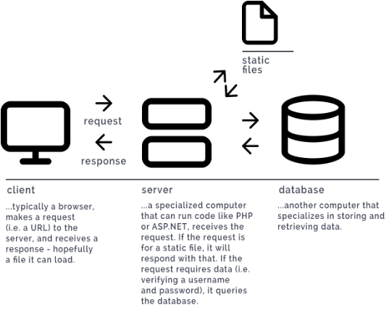

Slide 20
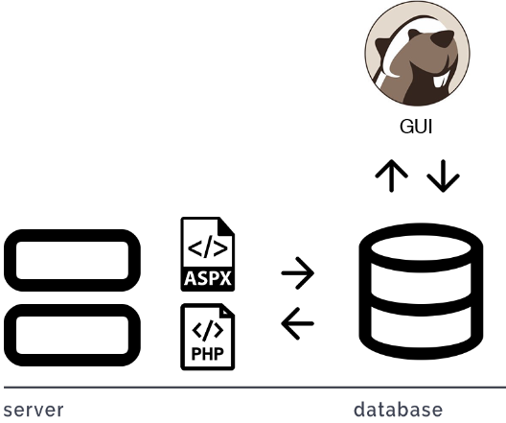

Slide 21
Terminology

Slide 22
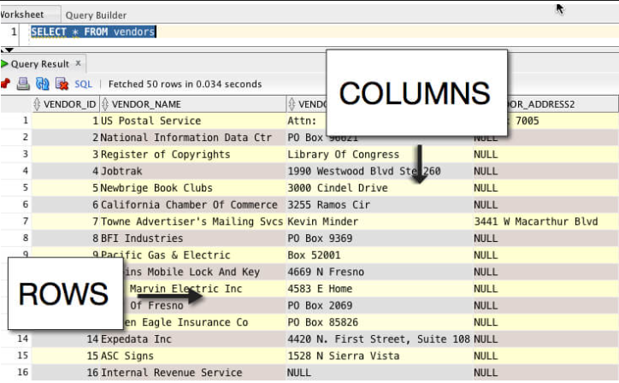
ROWS, COLUMNS & CELLS
rows are horizontal sets of data, and columns are vertical categories of data.

Slide 23
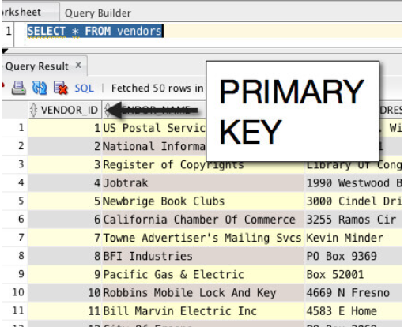
Primary Key
Another important element that every table should have is a primary key. The only job of a primary key is to be unique.
Primary keys are something you define when you create a table. They must be unique for each row! No two rows can have the same primary key.

Slide 24
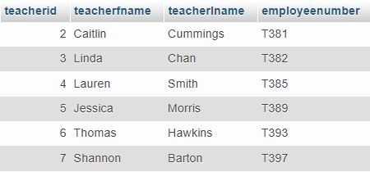
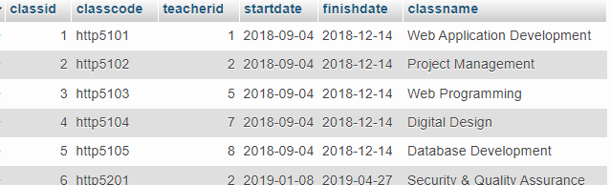
Database: Teachers

Slide 25
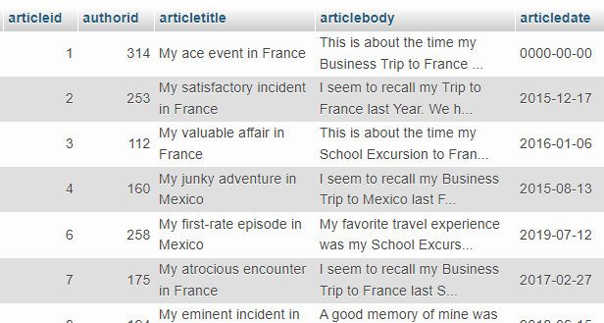
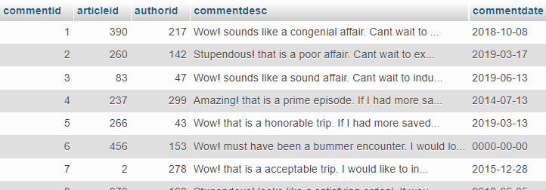
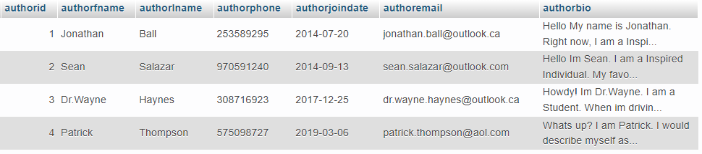
Database: Blog
Article
Comments
Author

Slide 26
We now have a rough idea of what a database does, and how it operates:
It is a store of data that a website can access through server-side languages.
It gives our websites a "memory".
If it's a relational database, it gives different types of thing their own table, and then lets you connect these tables together.
Tables have columns to store different categories of information.
Tables have rows to store information about different things.

Slide 27
Now we can look at Structured Query Language (SQL) that lets us interact with the data in our databases.
The most basic part of SQL is the "query" (which is a fancy way of saying "question").
A query is when we ask the database a question, and it returns an answer.
Who? What? Where? When? Why? How?
Who is the author?
What articles did they write?
Which article had the most comments?
When did they publish the articles?

Slide 28
MAMP

Slide 29
Setting up MAMP
Apache, MySQL and PHPMyAdmin

Slide 30
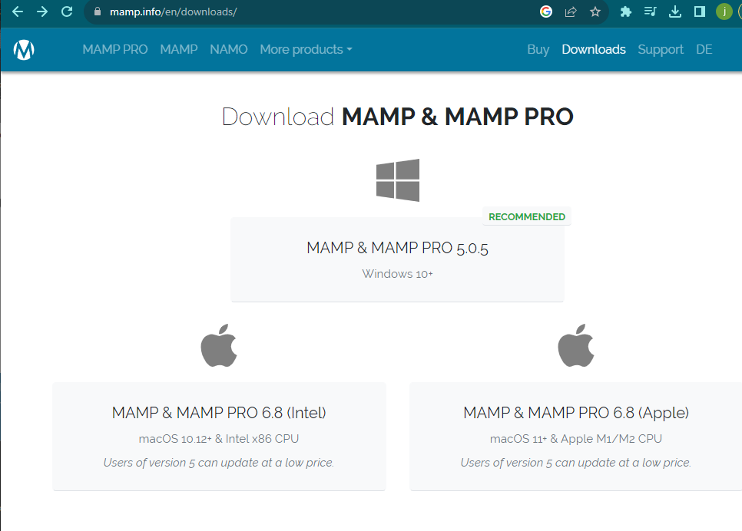
Download :
https://www.mamp.info/en/downloads/

Slide 31
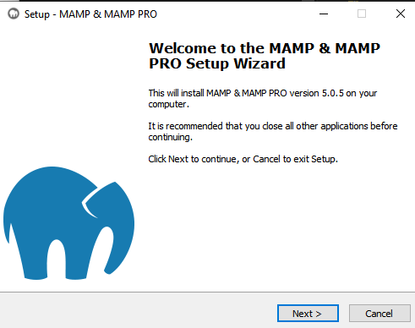

Slide 32
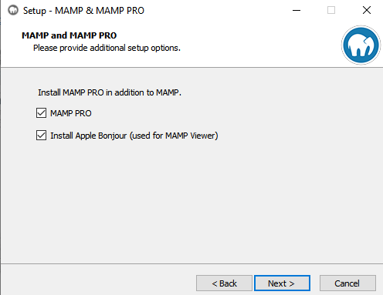

Slide 33
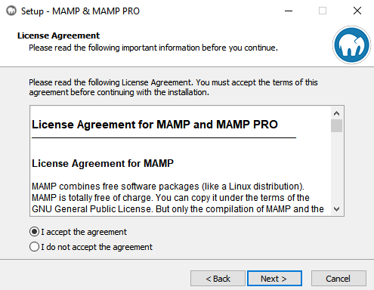

Slide 34
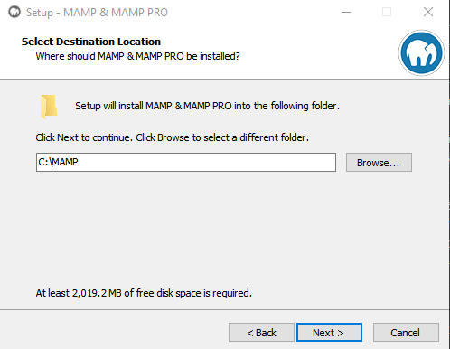

Slide 35
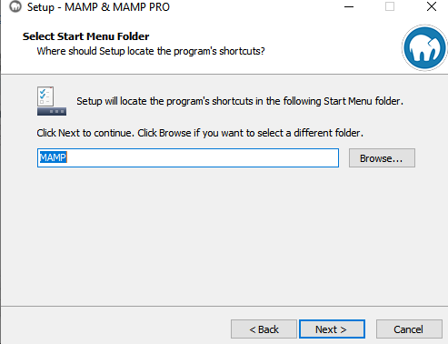

Slide 36
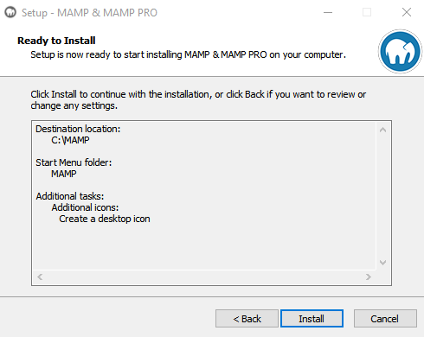

Slide 37
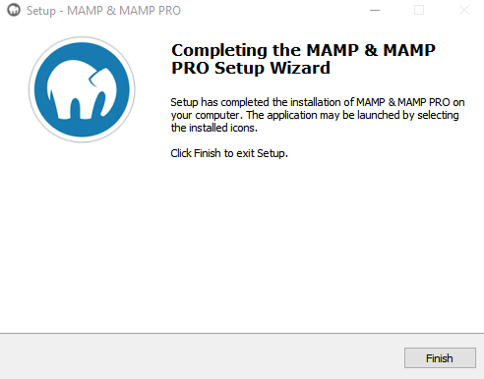

Slide 38
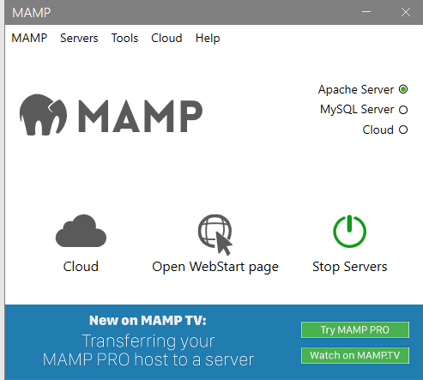





Slide 39
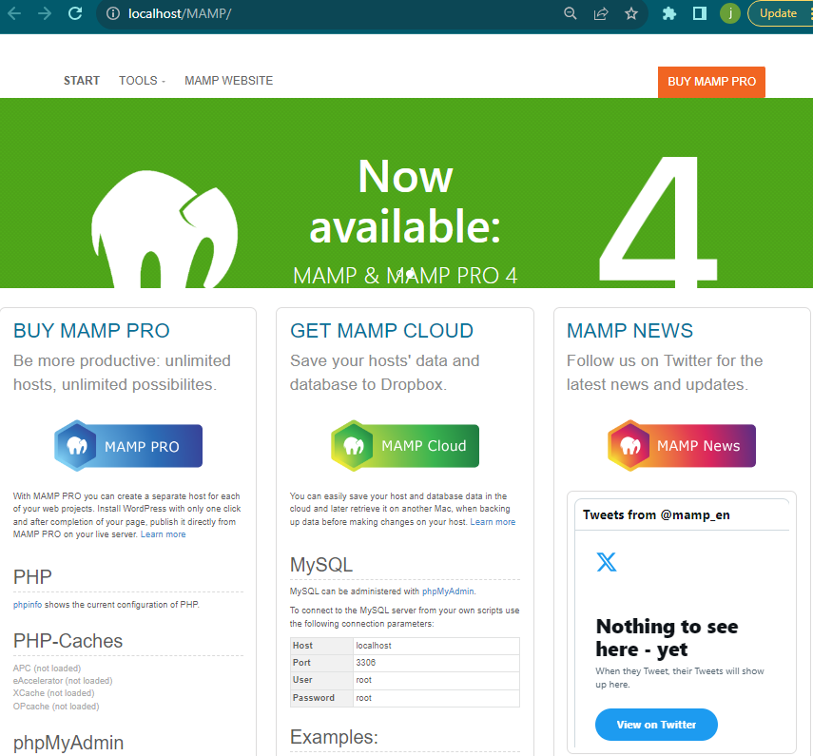


Slide 40
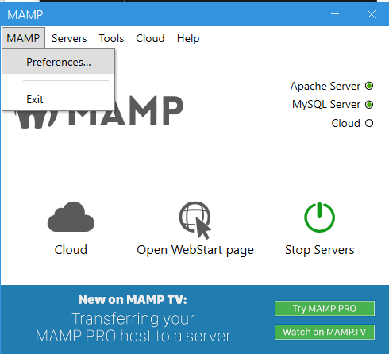

Slide 41
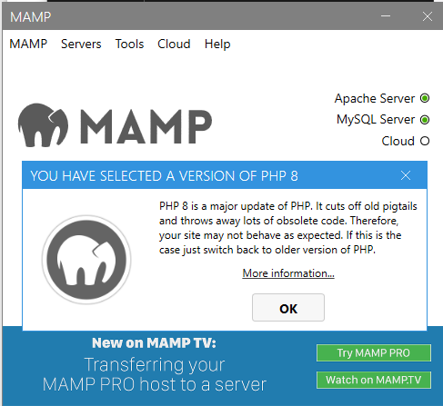

Slide 42
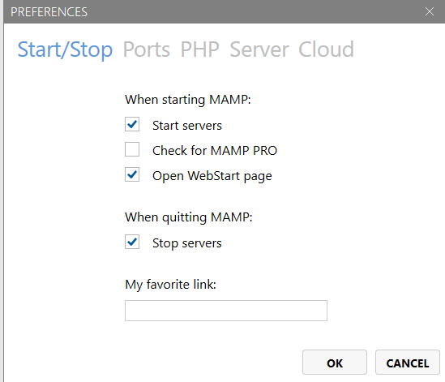

Slide 43
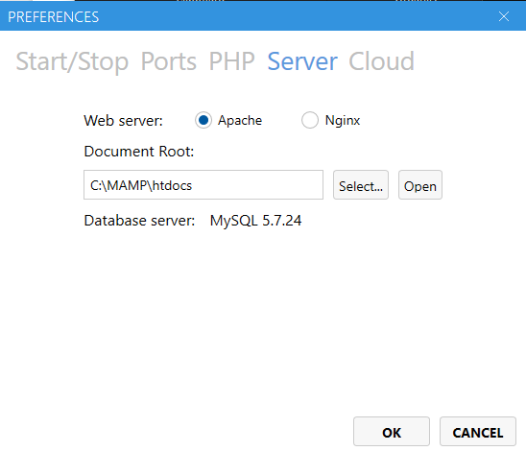
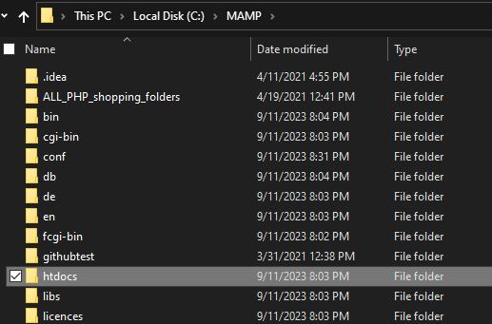

Where to find your databases

Slide 44
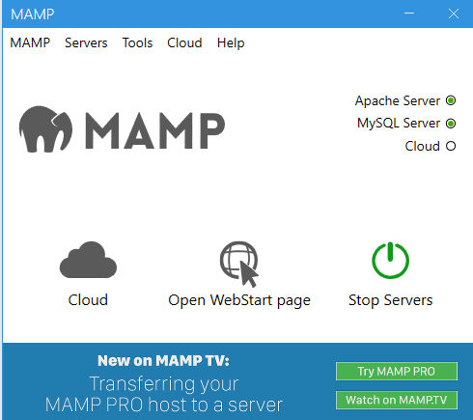

Stop Servers

Slide 45
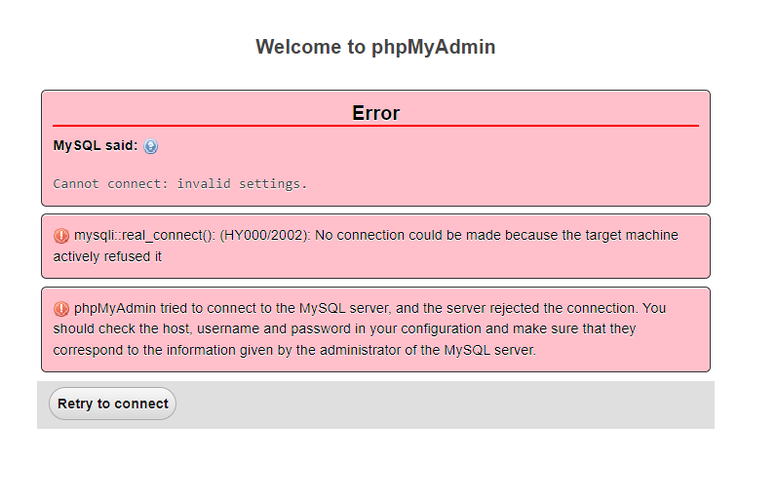
Restart your application

Slide 46
Assignment 1 – Data Design

